Slide 1


Sustainability as a New Driver of Science and Technology
James C. Liao
Academia Sinica, Taiwan

Slide 2


Slide 3
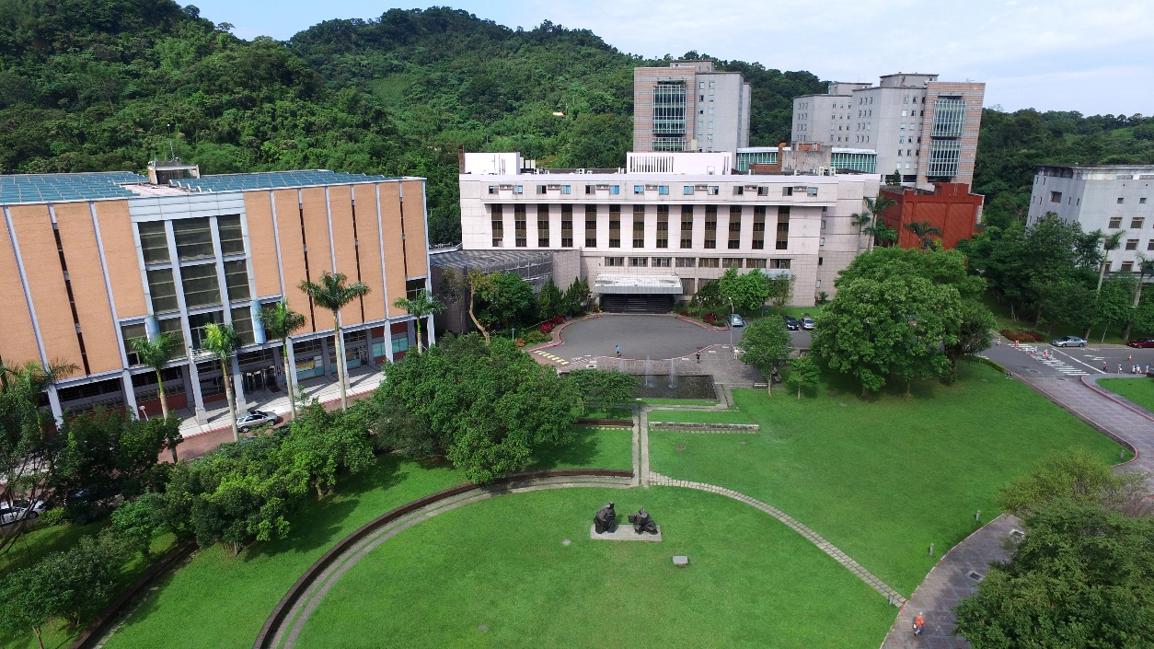

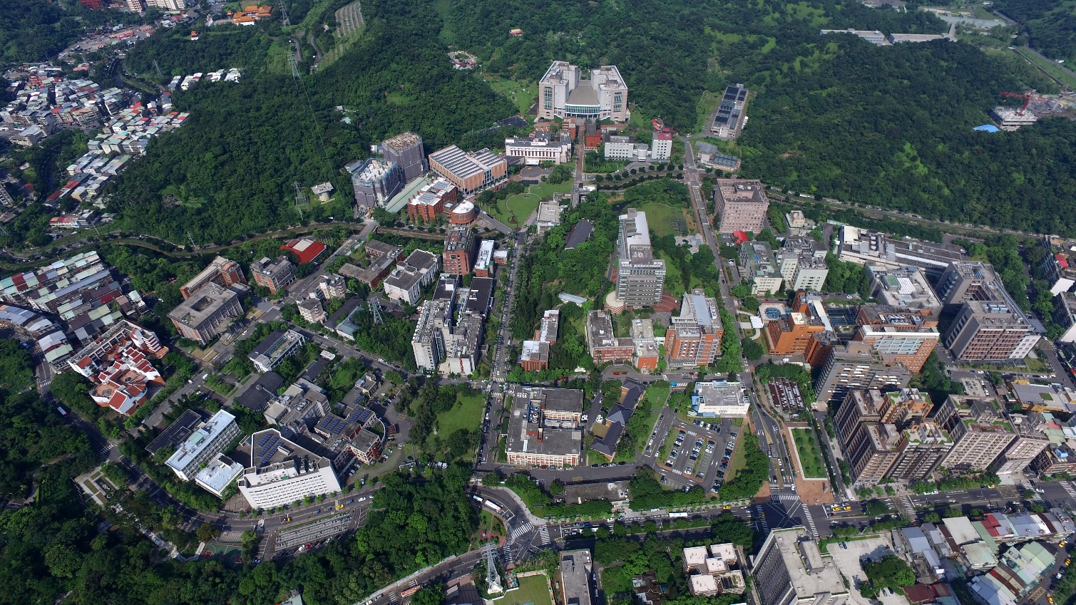

Slide 4
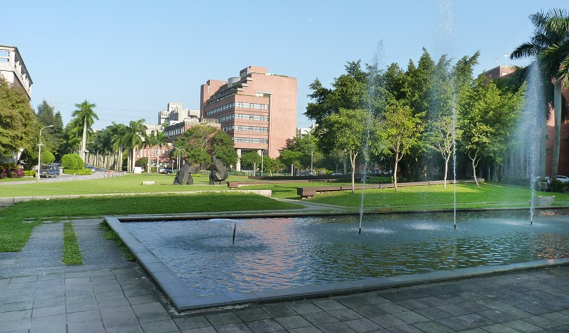

Slide 5



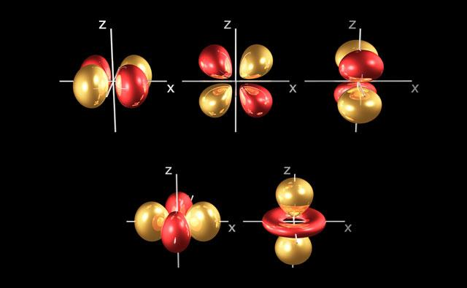
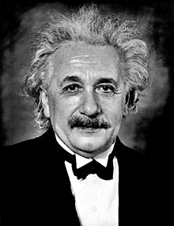



Science: Pushing the limit
Small
Large
Fast

Slide 6

Sustainable Development
Development that meets the current need of the society but does not compromise the need of the future.
Gro Harlem Brundtland

Slide 7
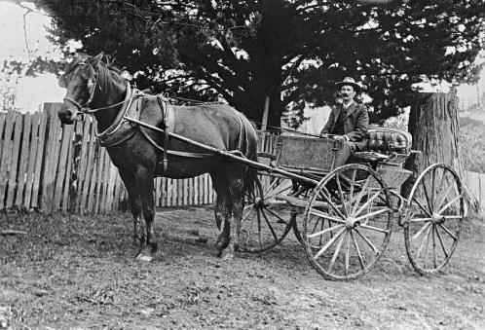
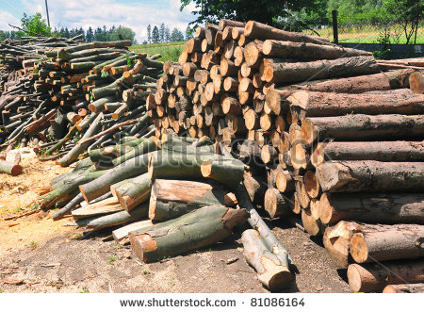
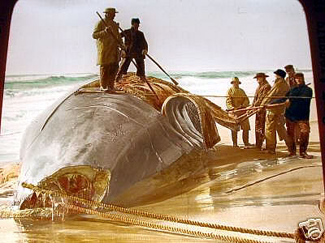
Energy Sources
Before Industrial Revolution
Animal
Biomass
Whaling
Before 1700
1800

Slide 8
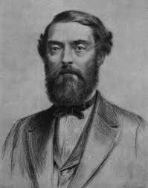
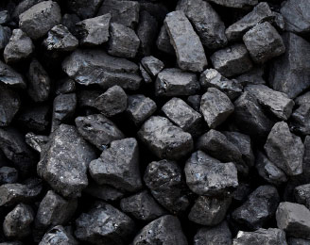
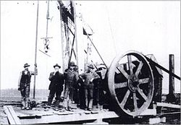
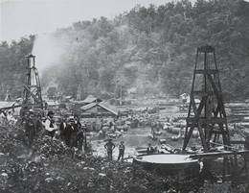
Energy Sources after industrial revolution
Coal
Edwin L. Drake
1800
1820
1850
Natural gas well
Oil Well
Titusville, Pennsylvania

Slide 9
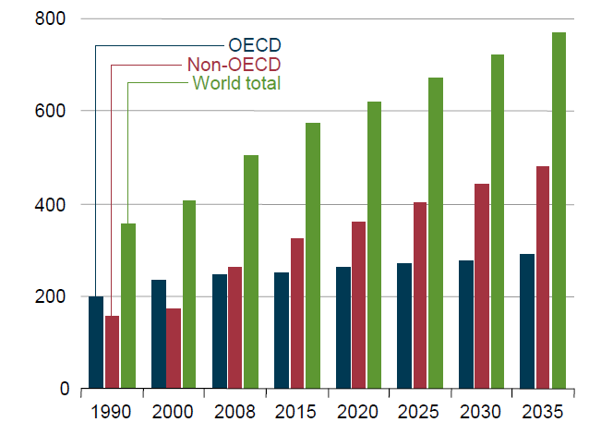
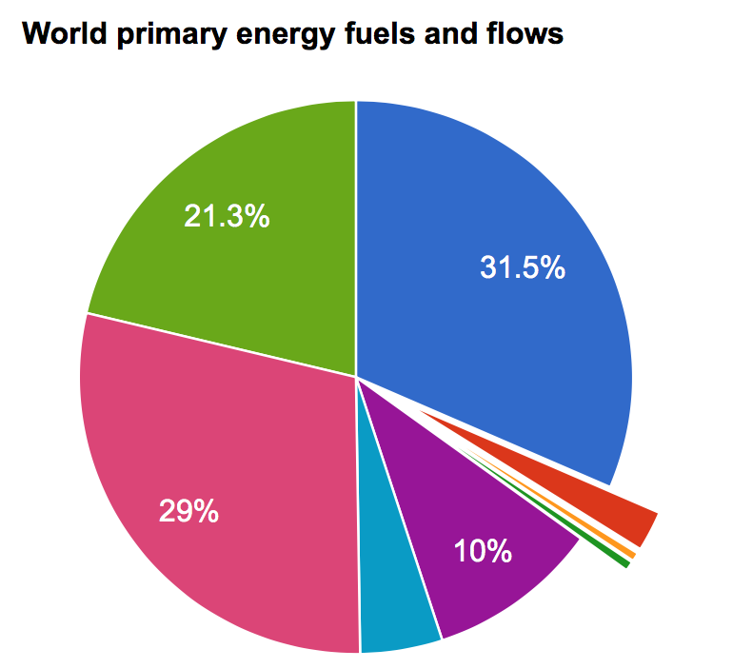
World Energy Consumption
TW
1 TW =10¹² W
26.6
20
18 TW (2015)
13 TW (2000)
13.3
Natural gas
Oil
6.6
Bio/
waste
Coal
Hydro
Solar/wind/Geo
~ $7.5 Trillion/yr @ $0.05/KWH
US expenditure: $3.7 Trillion/yr 2012
Nuclear
Data from IEA (2014), "World energy balances"

Slide 10
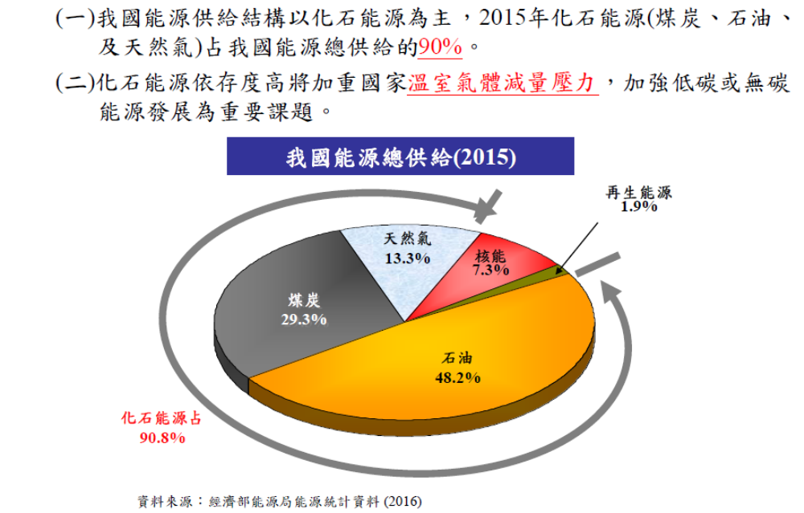

Slide 11
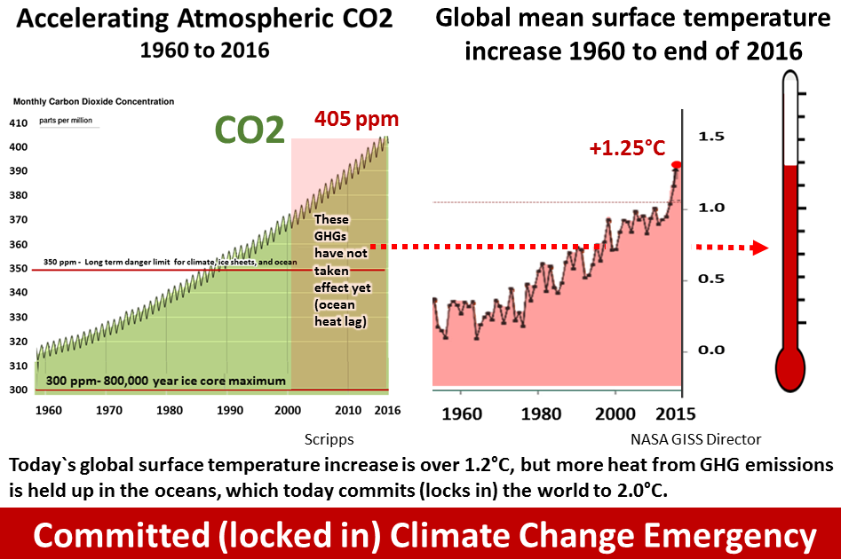
CO₂ accumulation becomes a major concern

Slide 12


Receding Glaciers
Kyetrak Glacier in Tibet
1921
2009

Slide 13
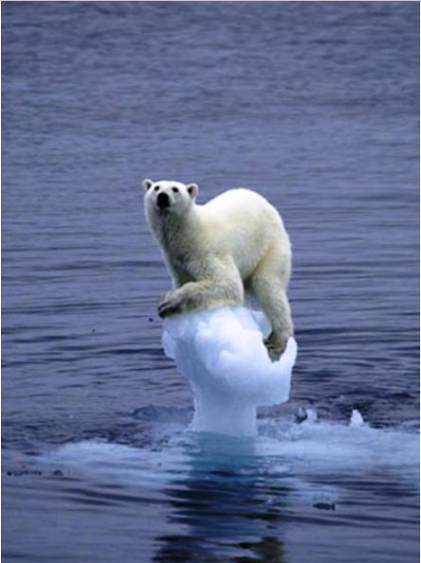
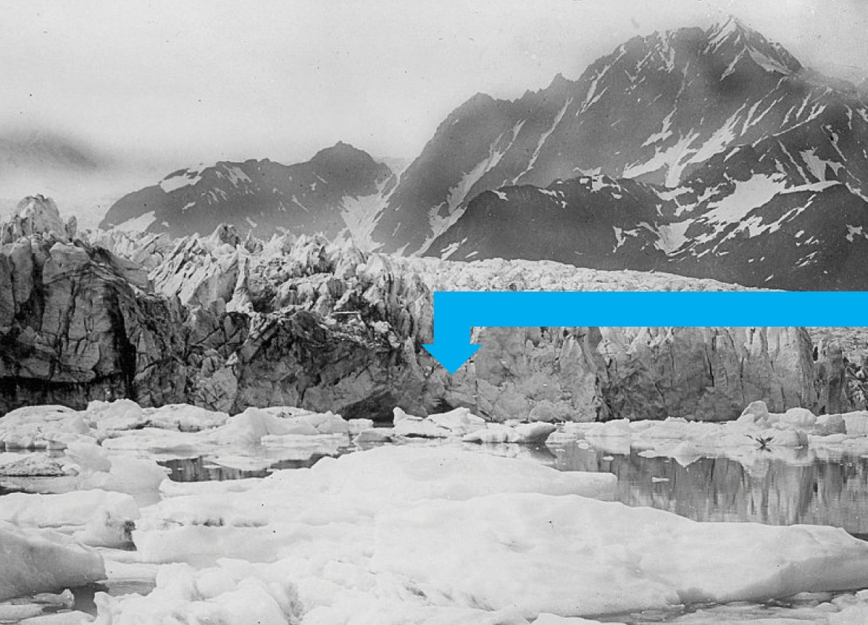
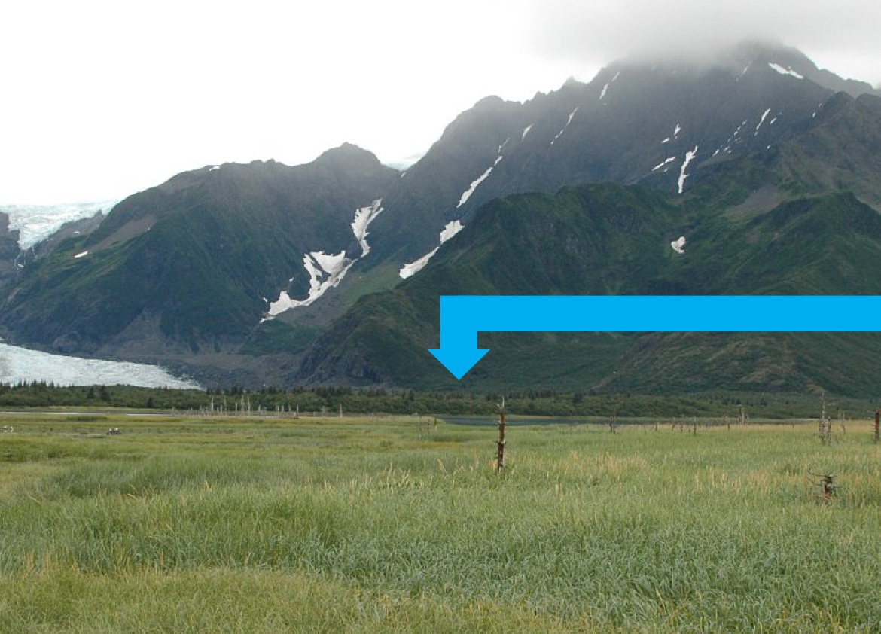
Receding Glaciers
PEDERSEN GLACIER, AK 1920
PEDERSEN GLACIER, AK 2005
13

Slide 14
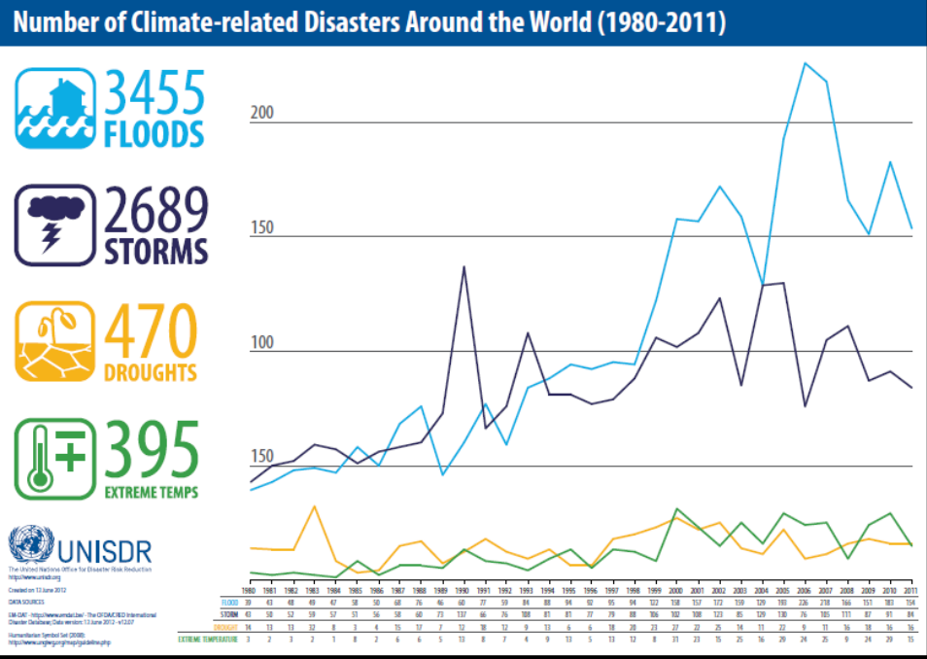
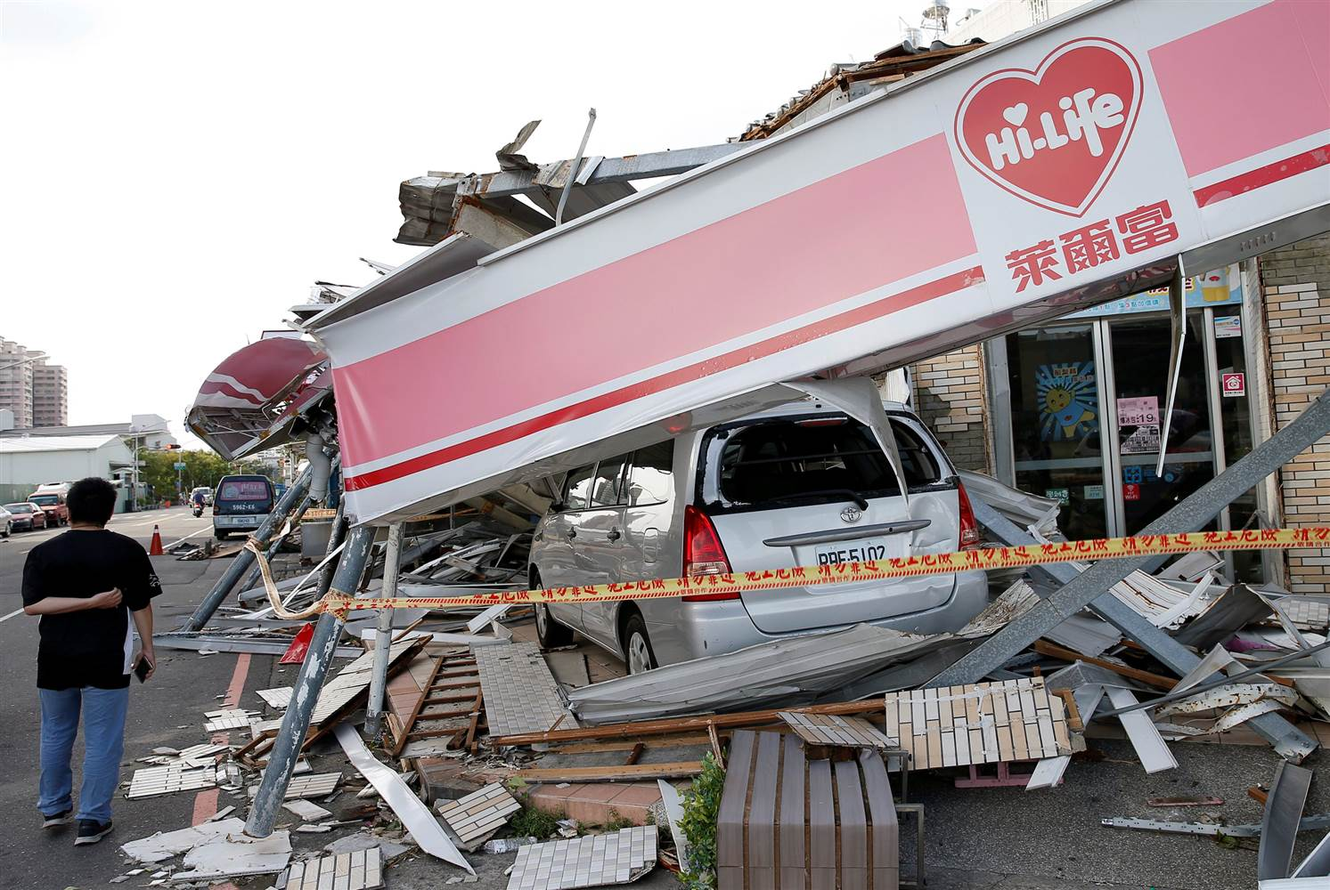
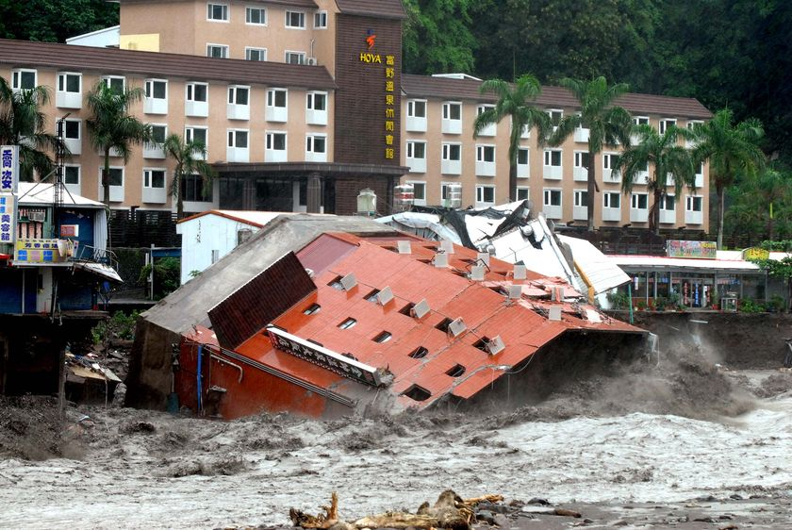
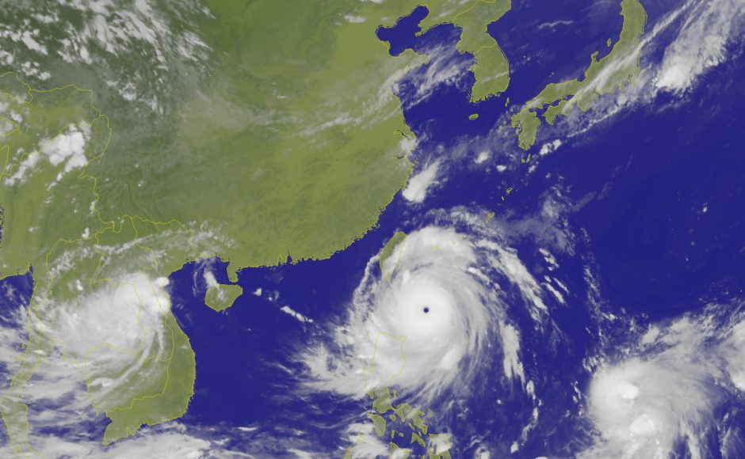
Extreme Weather Becomes More Common
PEDERSEN GLACIER
PEDERSEN GLACIER

Slide 15
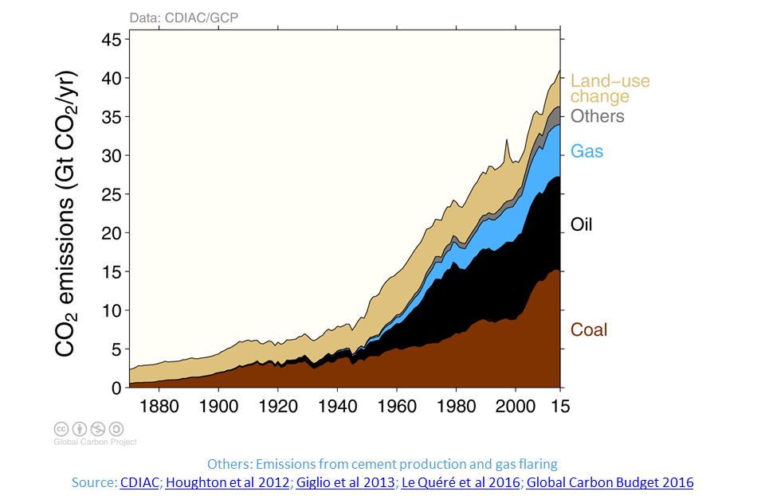
Fossil fuels are the major source of CO₂ emission

Slide 16
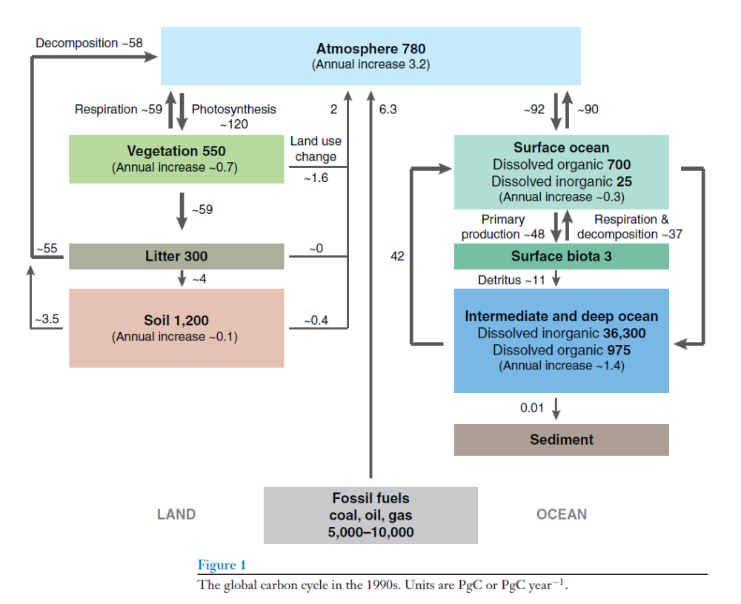
The global carbon cycle
Units are GtC or GtC year⁻¹.
Atmosphere 780 GtC
(Annual increase 3.2 GtC)
7
Fossil fuels
Oil, coal, gas
Land
Modified from Houghton Annu. Rev. Earth Planet. Sci. 2007
Ocean

Slide 17
The global carbon cycle
Units are GtC or GtC year⁻¹.
Atmosphere 780
(Annual increase 3.2)
7
3.5
Renewable
Electricity
Fossil fuels
Oil, coal, gas
5,000-10,000
Land
Modified from Houghton Annu. Rev. Earth Planet. Sci. 2007
Ocean

Slide 18
The global carbon cycle in the 1990s.
Units are GtC or GtC year⁻¹.
Atmosphere 780
(Annual increase 3.2)
2
8
6
Biofuel
Chemicals
Materials
Fossil fuels
Oil, coal, gas
5,000-10,000
Land
Modified from Houghton Annu. Rev. Earth Planet. Sci. 2007
Ocean

Slide 19
The global carbon cycle in the 1990s.
Units are GtC or GtC year⁻¹.
Atmosphere 780
(Annual increase 3.2)
8
CH₄
Biofuel
Chemicals
Materials
Fossil fuels
Oil, coal, gas
5,000-10,000
Land
Modified from Houghton Annu. Rev. Earth Planet. Sci. 2007
Ocean

Slide 21
各國二氧化碳排放量列表
國家或地區 | 年二氧化碳排放量 (千噸) 2015^{[7]} | 占全球總數的百分比(%) | 人均排放量(噸) 2015^{[8]}
世界 | 36,061,710 | 100%
中國 | 10,641,789 | 29.51% | 7.7
美國 | 5,172,338 | 14.34% | 16.1
歐盟 | 3,469,671 | 9.62% | 6.9
印度 | 2,454,968 | 6.81% | 1.9
俄羅斯 | 1,760,895 | 4.88% | 12.3
日本 | 1,252,890 | 3.47% | 9.9
德國 | 777,905 | 2.16% | 9.6
全球船運 | 642,024 | 1.78% | —
伊朗 | 633,750 | 1.76% | 8.0
韓國 | 617,285 | 1.71% | 12.3
加拿大 | 555,401 | 1.54% | 15.5
沙烏地阿拉伯 | 505,565 | 1.40% | 16.0
印尼 | 502,961 | 1.39% | 2.0
全球空運 | 502,936 | 1.39% | —
巴西 | 486,229 | 1.35% | 2.3
墨西哥 | 472,018 | 1.31% | 3.7
澳大利亞 | 446,348 | 1.24% | 18.6
南非 | 417,161 | 1.16% | 7.7
英國 | 398,524 | 1.11% | 6.2
土耳其 | 357,157 | 0.99% | 4.5
義大利 | 352,886 | 0.98% | 5.9
法國 | 327,787 | 0.91% | 5.1
波蘭 | 294,879 | 0.82% | 7.6
泰國 | 279,253 | 0.77% | 4.1
臺灣 | 279,174 | 0.77% | 11.9
哈薩克 | 267,978 | 0.74% | 15.2
西班牙 | 262,683 | 0.73% | 5.7
馬來西亞 | 245,371 | 0.68% | 8.1
23

Slide 22
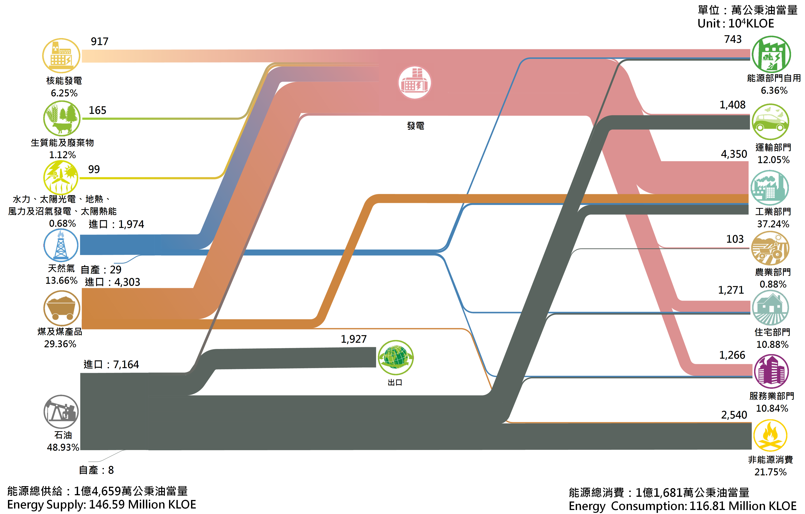
經濟部能源局

Slide 23
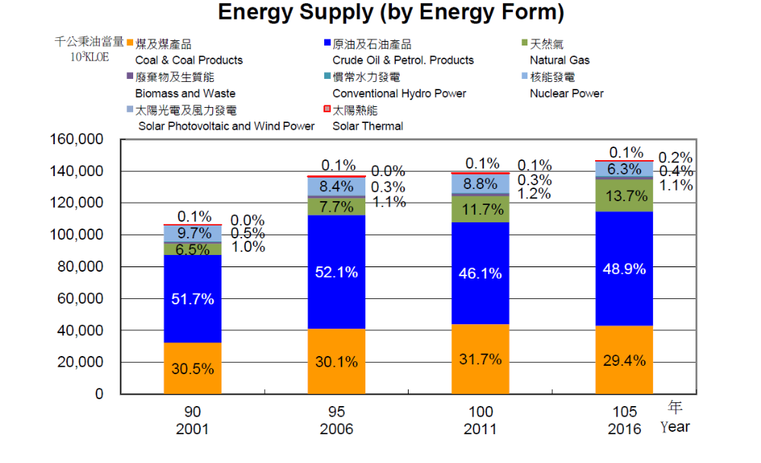
核能
天然氣
石油
煤
經濟部能源局

Slide 24
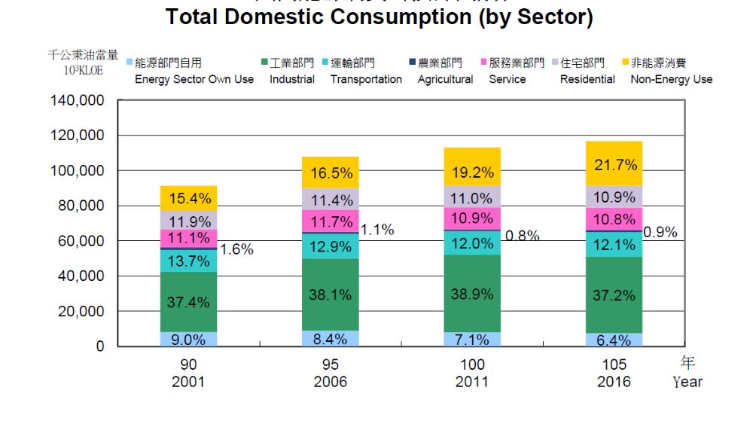
非能源消費
住宅
服務業
運輸
工業
能源部門自用
經濟部能源局

Slide 25
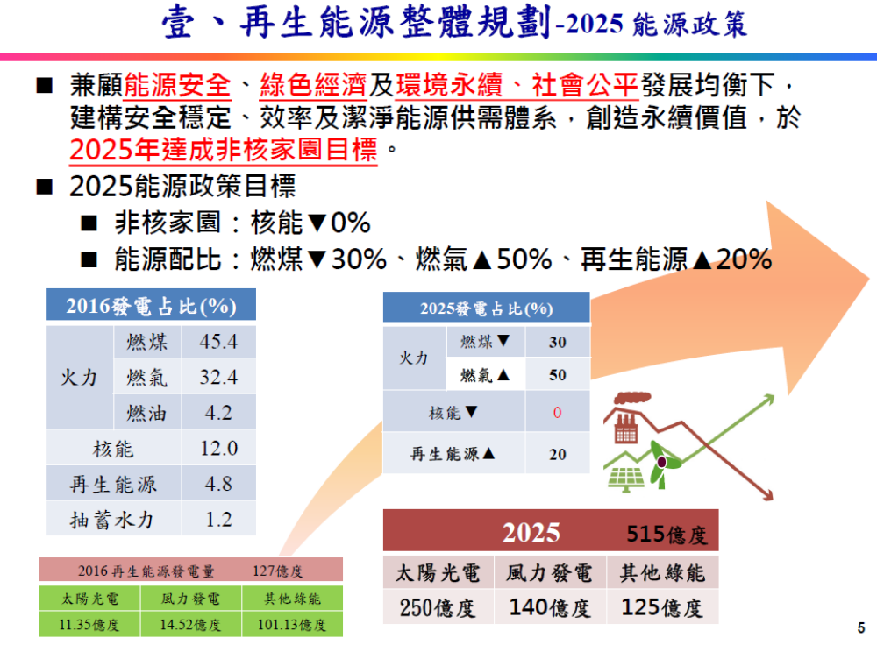

Slide 26
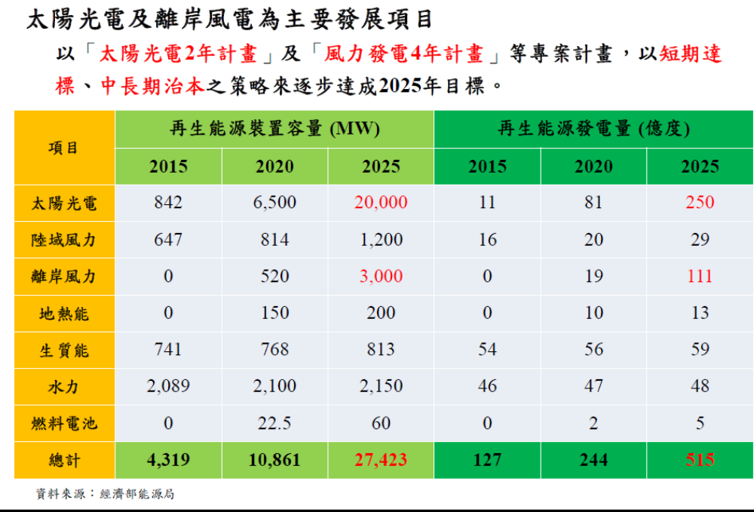

Slide 27
Solar

Slide 28
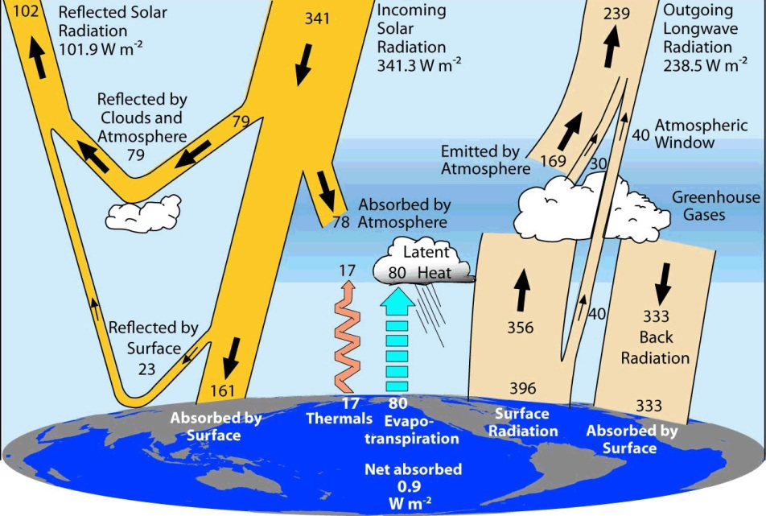
Solar energy is far more than current human usage
The total solar power absorbed by Earth's atmosphere, oceans and land masses is approximately 122,180 TW.
Solar power provides electricity exactly when we need it most-in the daytime.
1 TW = (10¹²) watts
Solar power and human consumption (TW)
Solar | 122,180
Wind | 71.4
Biomass potential | ~6.3
Current primary energy use (year 2015) | 18
Electricity (year 2010) | ~2.1
Kevin Trenberth
National Centre for Atmospheric Research
https://en.wikipedia.org/wiki/Solar_energy

Slide 29
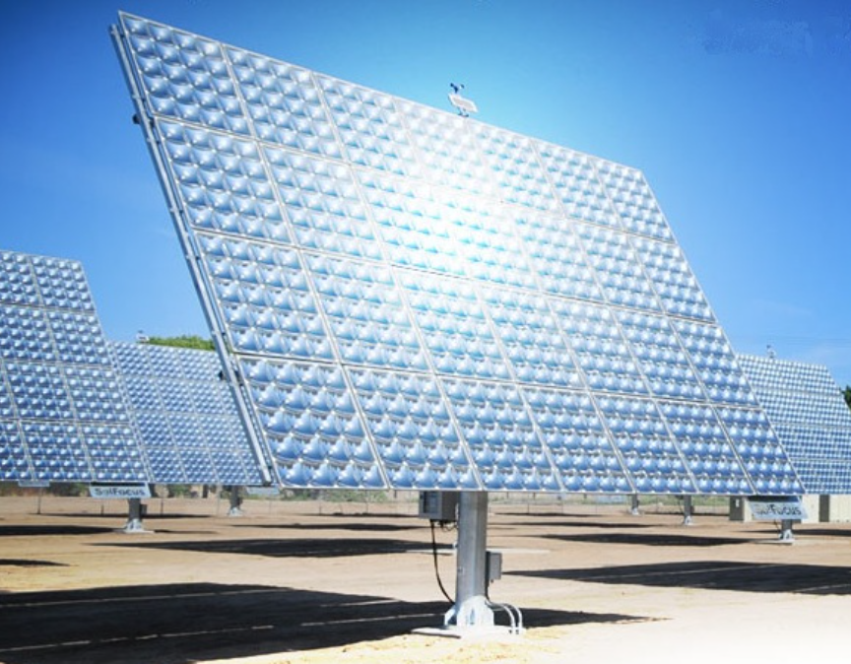
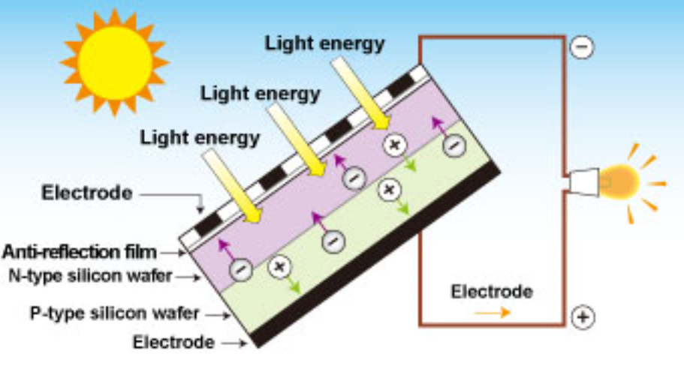
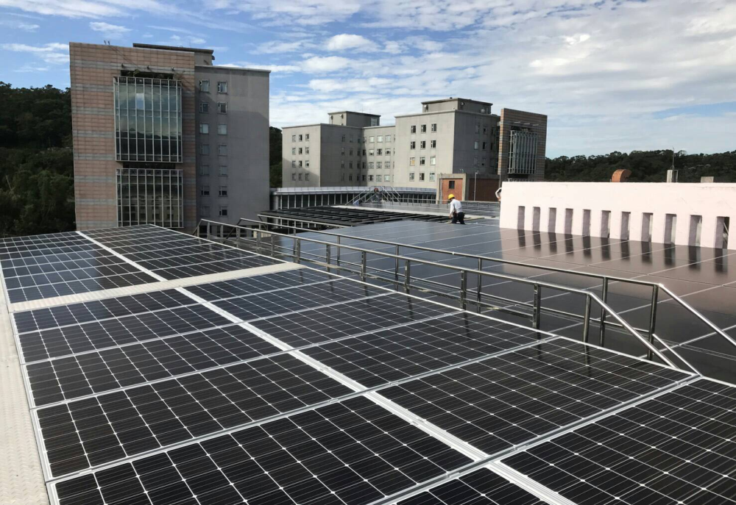
Converting solar power to electricity: Photovoltaic Panels
Concentrated Photovoltaic Panels
Solar Farm in Academia Sinica
Pros: Easy installation
Cons: Low efficiency

Slide 30
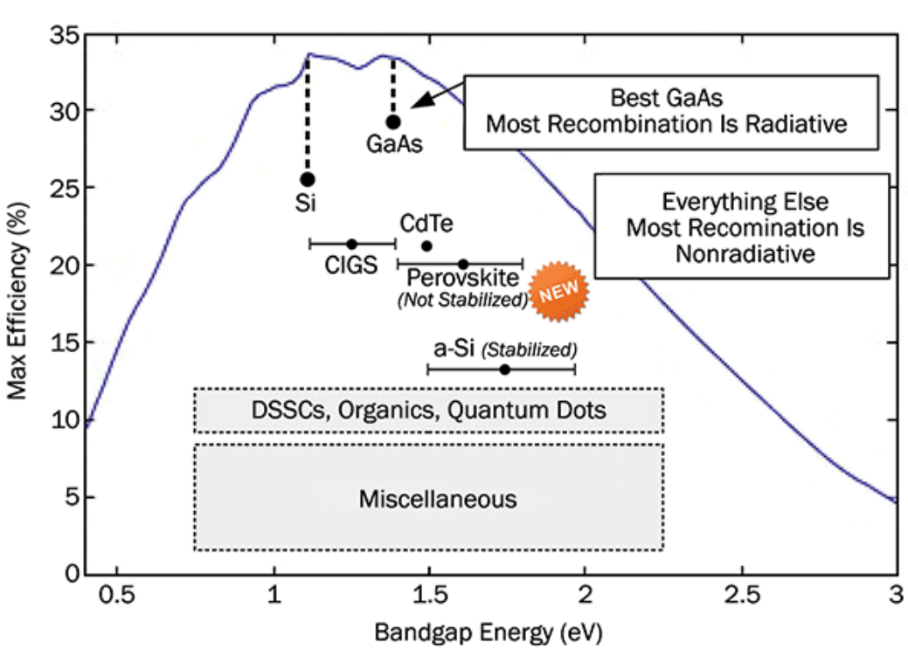
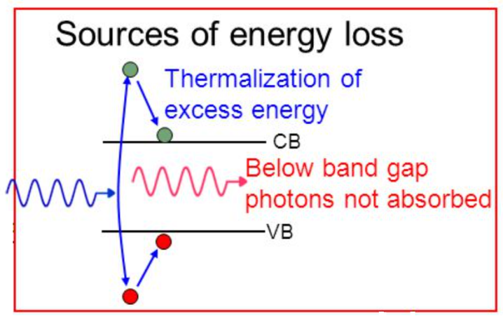
The Shockley-Queisser efficiency limit
The Shockley-Queisser limit defines the maximum theoretical efficiency of a solar cell with a single p-n junction, according to the bandgap of the material.
Image courtesy: S. Byrnes, Harvard University.

Slide 31
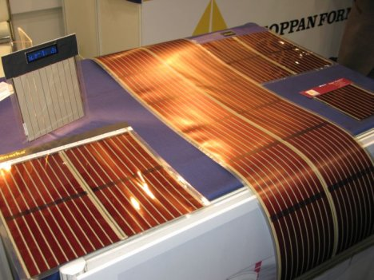
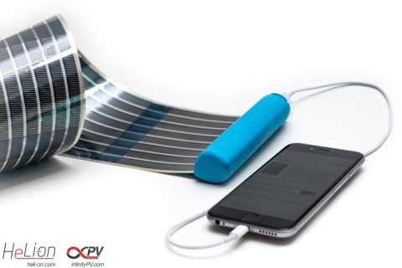

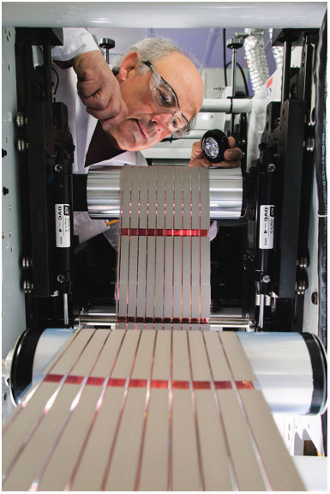
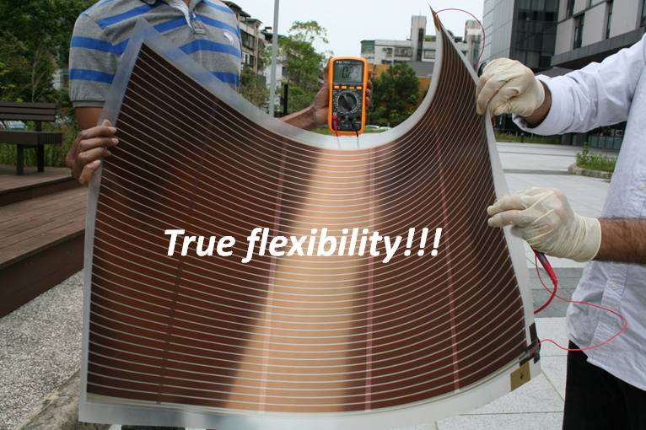
Current trends for “good” photovoltaic solar cells
High efficiency
Earth abundant materials
Inexpensive and low-contamination fabrication
  Solution-based processing
  Low-temperature processing
  Roll-to-roll manufacturing
Easy installation and removal
  Flexibility
  Light weight
Nature Photonics 2, 287 (2008)

Slide 32
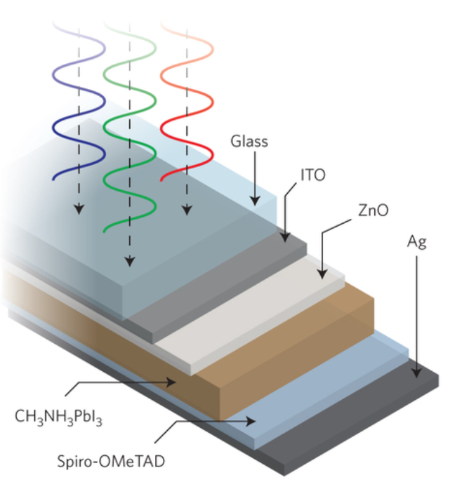
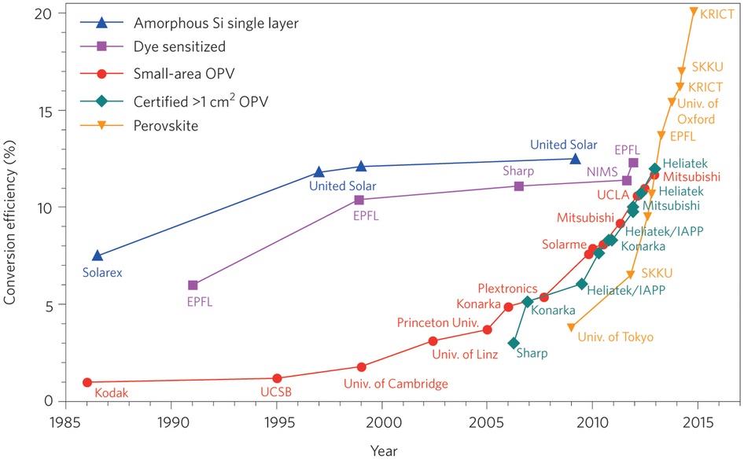
Perovskite solar cells
Why perovskites?
Perovskite solar cell
Efficiency jumps from 3.8 % (2009) to 20.1 % (2015) in photovoltaics research.
Perovskite solar cells are expected to have short EPBT and lower CO₂ emission factor compared to other emerging solar cell technologies.
Pros:
High efficiency
Tunable bandgap
High absorbance
Easy fabrication
Cons:
Toxic materials
Environmental instability
S. Brittman et al., MRS Communications 5, 7 (2015)
D. Y. Liu et al., Nature Photonics 8, 133 (2014).

Slide 33
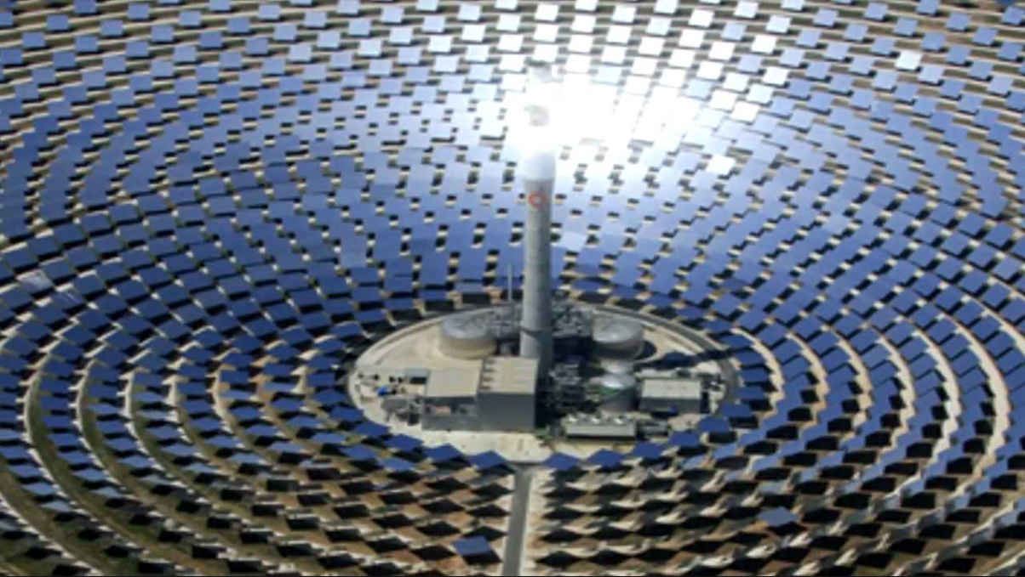
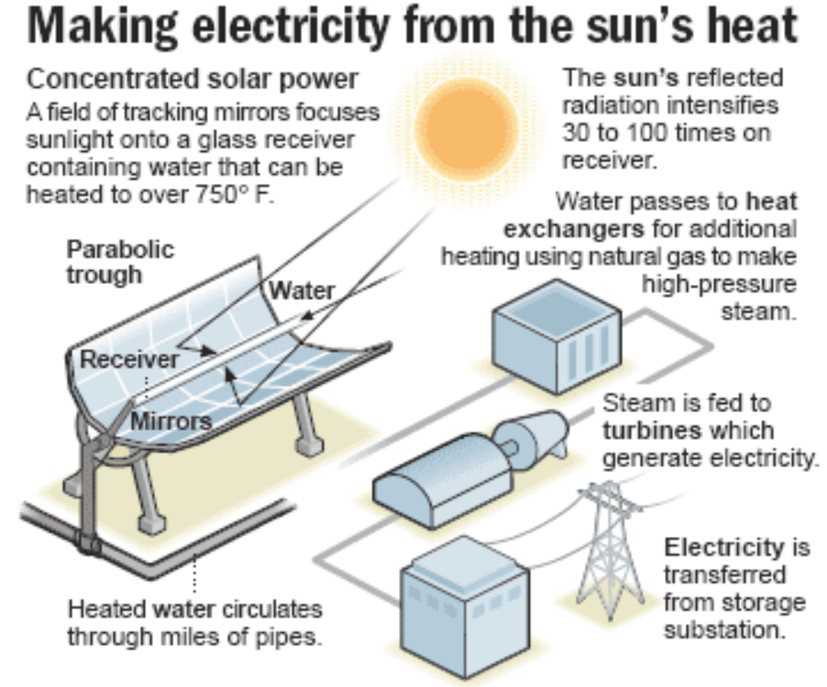
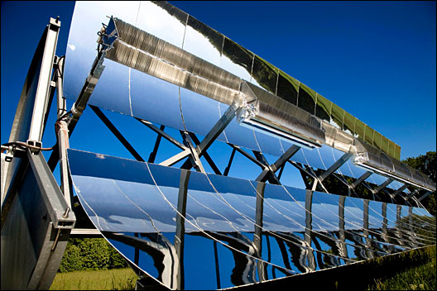
Converting solar power to electricity: Solar thermal
http://www.estelasolar.org/
Pros: High efficiency (>70% )
Cons: High cost and large area occupation
https://dexarch.wordpress.com/

Slide 34
Wind

Slide 35
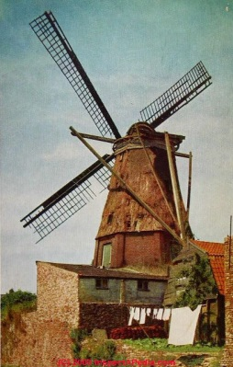
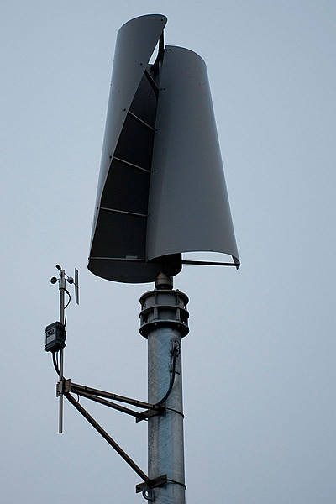
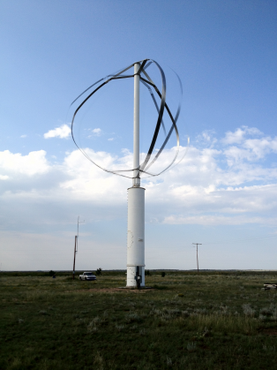
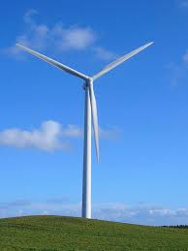
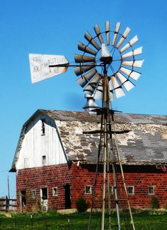

Wind Power: Using wind turbines to convert mechanical power of the wind into electric power
Dutch windmill | Barn anemometer | Cup anemometer | Savonius wind turbine 1922 | Darrieus wind turbine 1931 | Modern horizontal-axis wind turbine
15% | ~ | ~ | 15% | 30-35% | 40-45%
Drag driven |  |  |  | Lift driven
Efficiency
Modern high-efficiency wind turbines are driven by aerodynamic lift force, generated by the airfoil-shaped blades cutting through the wind field.

Slide 36

Betz’s limit of the power efficiency of wind turbines
Wind power harvesting:
Proportional to the sweeping area of wind-turbine blades
(size of the wind turbine)
Proportional to cubic power of wind speed
(location of the wind farm)
Enveloping streamline
Inflow mass, momentum, and power
Base on mass, momentum, and energy conservation laws
Outflow mass,
Momentum, and power
Ideal wind turbine
Force exerted by
the wind turbine
Maximum harvesting power ratio (Betz’s limit): 16/27 ≈ 59.3%
Energy consv.
zone 1
Energy consv.
zone 2
Mass and momentum conservation zone

Slide 37


Modern economic-scale wind turbines
Current wind turbines: 4 MW, about 800-1000 American houses’ usage when fully loaded
Since 2017, wind turbines are scaling up to 7 MW or 8 MW.
10 MW wind turbines are on the way.
Important parameters of wind turbines:
Tip Speed Ratio (TSR)
Power Curve
Thrust Coefficient
Power curves of various wind turbines
Wind turbines with economic potentials
Comparison between Siemens 4 MW and 7 MW wind turbines

Slide 38



Wind turbines go offshore: large area + uniform and faster wind profile + low turbulent intensity
Fastest growing industry. About 3 GW of new offshore wind power was connected in 2015 in Europe, a 108.3% increase over 2014. (In comparison: The 3rd Nuclear Power Plant in Taiwan: 1.7 GW; Tai-Chung Thermal Power Plant: 8 GW)
Denmark constructed the first offshore windfarm (Vindeby, 4.95 MW) in 1991. That capacity can now be achieved by a single modern wind turbine.
(Below) Gemeni wind farm, the Netherlands (starting to operate in 2017), is the world’s largest off-shore wind farm. Its capacity is 0.6 GW, about 1% of the average power consumption in Taiwan.

Slide 39



Taiwan Strait is one of the best wind energy sites:
Winter monsoon season + Topographic effect
Mountains provides a
wind-tunnel rectifier effect
Statistics in Oct. 2016
(Above) Real time wind speed map, Wind Atlas, accessed on 2017/01/12. Light green indicates wind speed about 8-9 m/sec.
(Left) 1988-1994 Wind energy density map of Taiwan Strait, National Renewable Energy Laboratory Report
Notes:
A business model …financial performance of the wind farm operation
全域的風場模擬,來補足氣象塔在空間與時間解析度的不足
However, it is hardly to represent the local wind information through the met mast data because it is only one point showed on the domain.
Implies more momentum are extracted from the atmosphere .

Slide 40


Construction and operation of wind farms in
Taiwan Strait are challenging
Loose thick muddy-silt seabed + high risk of foundation liquefaction + extreme climate condition (typhoons) + sub-tropical high erosive environment
Pile foundations are still the most important structure for wind-turbine installations. Other mounting technologies are emerging.
Wind-turbine foundation has to sustain enormous lateral loading (H) and torque (M).
Notes:
A business model …financial performance of the wind farm operation
全域的風場模擬,來補足氣象塔在空間與時間解析度的不足
However, it is hardly to represent the local wind information through the met mast data because it is only one point showed on the domain.
Implies more momentum are extracted from the atmosphere .

Slide 42


Slide 43
Energy Storage

Slide 44


Status of current energy storage technologies
Technology Roadmap Energy storage

Slide 45




Some of the developing energy storage technologies
Flywheel
Underground compressed air energy storage (CAES)
Vanadium redox flow battery
NaS cell and battery
Electrical Energy Storage Project Team
White Paper, 2017

Slide 46






Renewable H₂ as an energy storage: multiple challenges
e⁻
e⁻
Fuel Cell
H₂ Storage

Slide 47
Bioconversion

Slide 48

Oil-derived fuel is a major source of CO₂
World’s total oil consumption of 97 Mbbl/d (2016)
Global CO₂ release 10 (GtC/yr) →36.7 Gt CO2/yr
20 miles/gallon 1 pound CO₂/mile
(10 km/liter 0.25 kg CO₂ /km)
Light-duty vehicles
~10% of GHG emissions
2004: 750 million light-duty vehicles
2050: 2 billioin

Slide 49
Emissions from Vehicles
Eff ~20%
Conventional Vehicles
Fossil fuel
Engine
Transmission
Wheel
CO₂
Electric Vehicles
Eff ~ 30%
Battery raw materials
Eff > 90%
CO₂
Fossil fuel
Electricity
Battery
Motor
Wheel
CO₂
Hydrogen Vehicles
Natural Gas
H₂
Storage
Fuel Cell
Motor
Wheel
CO₂

Slide 50

Why bioconversion?
Precise chemistry
Able to make different types of fuels
Environmentally friendly
Low temperature
Potentially inexpensive
Liao et al (2016) Nat Rev Microbiol 14,288

Slide 51

Plants as a bio-factory transforming solar energy to chemical energy
Fuels, chemicals
Plant biomass

Slide 52







Biomass to Ethanol
CO₂
Recalcitrance
Ethanol
Sugar

Slide 53




Microalgae to Diesel
CO₂
Bio-Factory
Bio-Factory
Biodiesel
Microalgae
Lipid

Slide 54



Pathways to Life
Cytoplasm
NADPH
hν
hν
Fd_{ox}
Fd_{red}
PQ
Cytochrome
b₆f complex
PQH₂
ATP
e⁻
Photosystem II
Pc-Cu⁺
Photosystem I
H₂O
O₂
Pc-Cu²⁺
Lumen
Calvin cycle (CBB pathway)
Light reactions
Cellulose
Glucose (C6)
Glycolysis (EMP pathway)
ATP
e⁻
TCA Cycle
CO₂
Acetyl-CoA (C2)
Pyruvate (C3)
CO₂
Fatty acid
Amino acids
Alcohol
Alcohol
Acids
Lipid
Acids
Isoprenoids

Slide 55
What fuels to make?
Carbon Feedstock
Isobutanol
1-Butanol
1-Propanol
2-Methyl-1-butanol
3-Methyl-1-butanol
Isoprenoid pathway
DMAPP
3-methyl-1-butanol
1-Isopropyl-4
-methylcyclohexane
Pinene dimer
Farnesane
Bisabolane
G3P
CO₂
MEP
1-Pentanol
1-Hexanol
1-Heptanol
1-Octanol
3-Methyl- 1-pentanol
4-Methyl- 1-pentanol
4-Methyl- 1-hexanol
5-Methyl- 1-heptanol
Native 2-ketoacids
Pyruvate
IPP
Extended 2-ketoacids
CO₂
CO₂
Mevalonate
Ethanol
Acetyl-CoA
Ketoacid pathway
Acetyl-CoA
Acetoacyl-CoA
Acetyl-CoA
Malonyl-CoA
Isopropanol
1-Butanol
1-Hextanol
1-Octanol
Fatty acid
biosynthesis
CO₂
FFA
Fatty alcohols
FAMEs
FAEEs
Fatty acyl-ACP
CoA-dependent pathways
CO₂
Alkanes
Alkenes
Fatty aldehyde
Fatty acid synthesis

Slide 56


Direct photosynthetic production of biofuels
Ethanol
Isobutanol
n-Butanol
3-HP
2MB
...
Intermediates

Slide 57



Efficiency of solar energy to fuel
Photovoltaic
Average
200W
Shockley–Queisser
limit = 33.7%
1 m²
10-20% practical
Charge Separation: e⁻
4.6%
6%
Theoretical
<1 %
Practical
CO₂ fixation
Biomass
Biofuel

Slide 58


e⁻
e⁻
Cytoplasm
CO₂
hν
NADPH
hν
Fd_{ox}
Fd_{red}
PQ
Cytochrome
b₆f complex
PQH₂
Pc-Cu⁺
Photosystem II
Pc-Cu²⁺
Photosystem I
H₂O
O₂
Lumen

Slide 59





Methane as a Greenhouse Gas
Various Greenhouse Gases
CH₄
Manure

Slide 60



Converting methane to chemicals
Methane
CH₄
Methanol
CH₃OH
Catalyst
Enzyme
(pMMO, sMMO)
Other chemicals
Methanotroph
Image by J.C. Lara, University of Washington

Slide 61


Extreme climate: Drought/Heat
Drought-tolerant rice
Adopted from http://irri.org/our-work/research/better-rice-varieties/

Slide 62


Extreme climate: Flooding
Submergence-tolerant rice
Adopted from http://irri.org/our-work/research/better-rice-varieties/

Slide 63




Adopted from Centers for Disease Control and Prevention
Notes:
Climate change impacts a wide-range of health outcomes. This slide illustrates the most significant climate change impacts (rising temperatures, more extreme weather, rising sea levels, and increasing carbon dioxide levels), their effect on exposures, and the subsequent health outcomes that can result from these changes in exposures.

Slide 64
Summary
New science discoveries and technology developments are needed to solve the CO₂ accumulation problem.
Future scientific and engineering developments should consider long-term global impacts.
Sustainability is a major challenge and opportunity for future scientists.

