Slide 1
A 37-Year Experiment 20th Wu Chien Shiung Science Camp 2017, Lukang

Slide 2
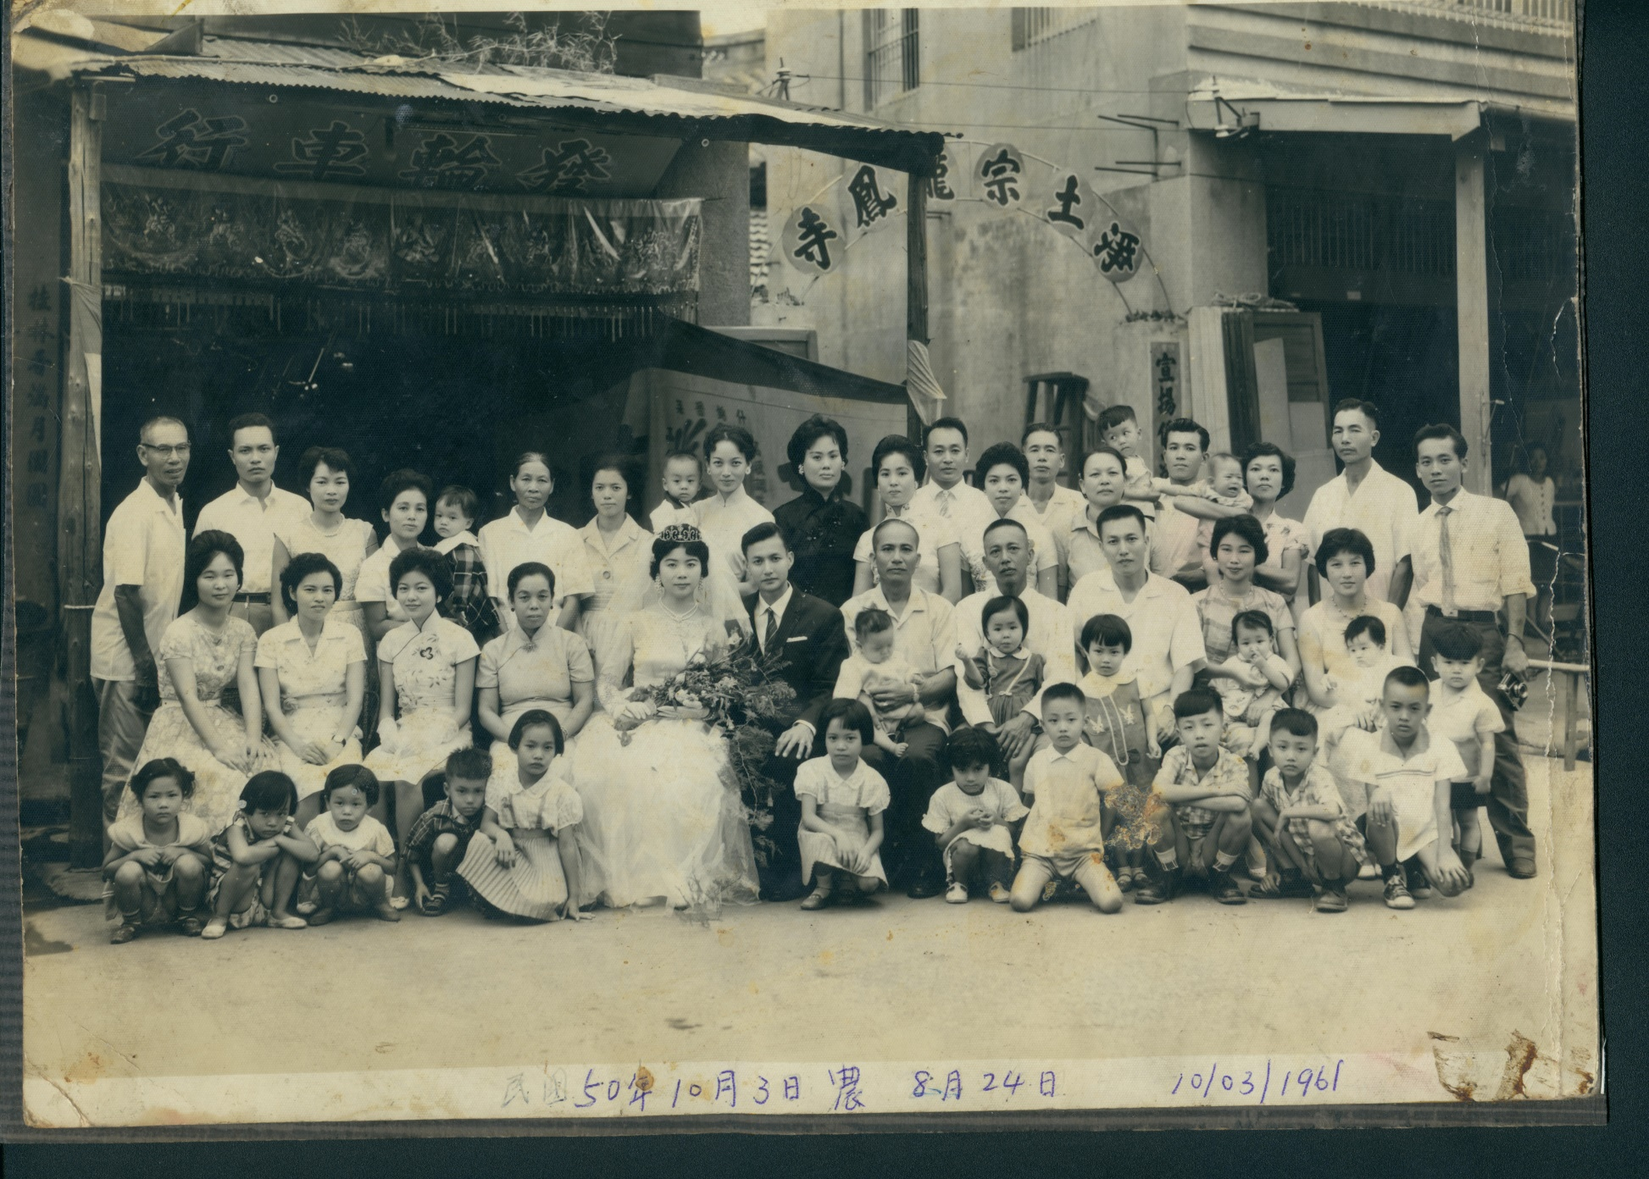
1961 in Changhua

Slide 3
Quiz
When a horse gallops, is there an instant of time that all its four legs are off the ground?
Yes No

Slide 4
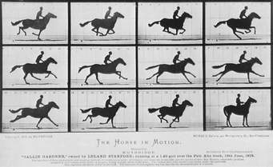
Why time resolved experiments?
Eadweard Muybridge, 1878, Stanford ‘s Palo Alto Stock Farm

Slide 5
Why time resolved experiments?

Slide 6
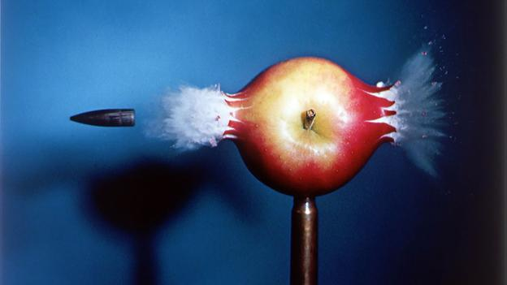
Stopping Time: flash photography
Harold Edgerton, 1964, 10⁻⁶ s flash

Slide 7
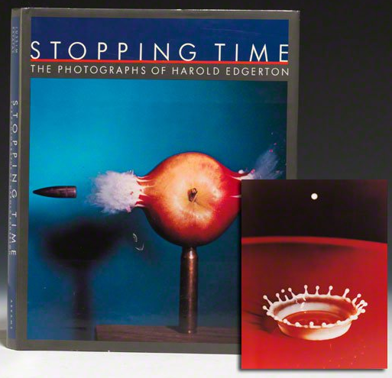
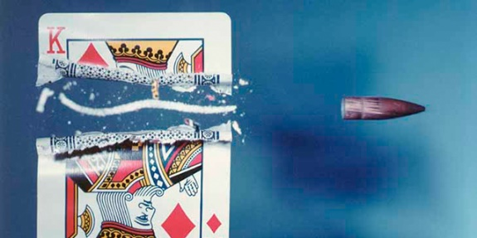
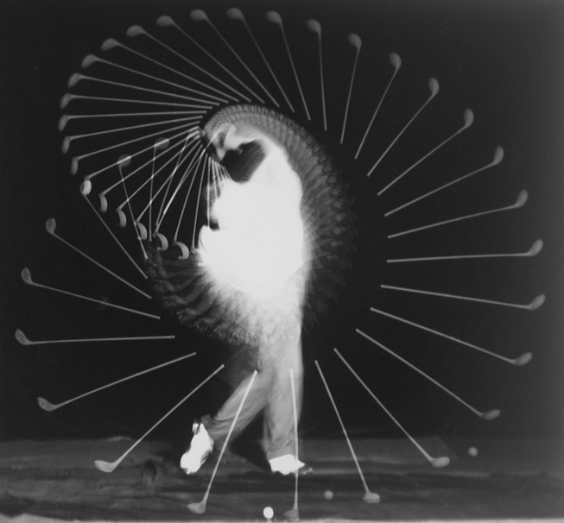
Stopping Time: flash photography

Slide 8
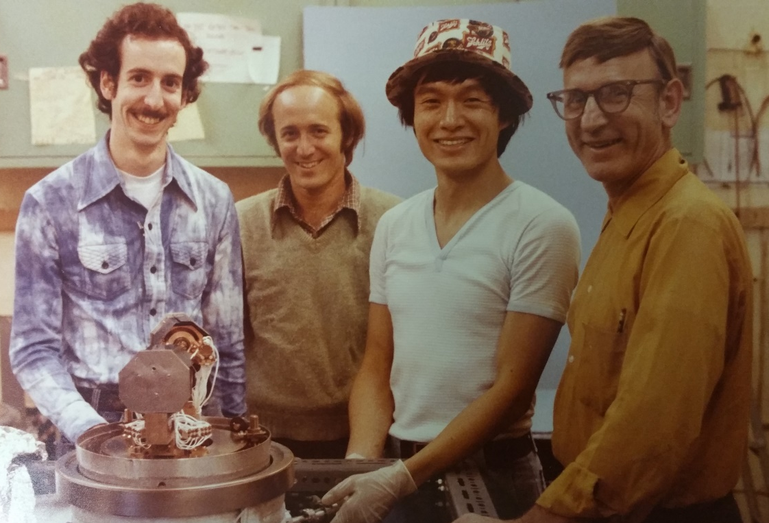
1-Detector EELS Spectrometer @Upenn 1978

Slide 9
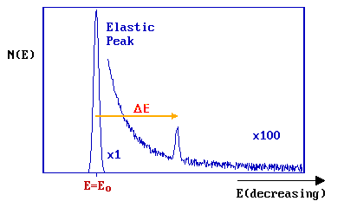
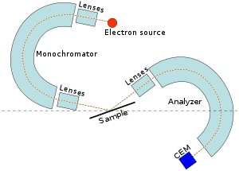
Electron Energy Loss Spectroscopy: vibrations of 10¹² molecules/cm²

Slide 10
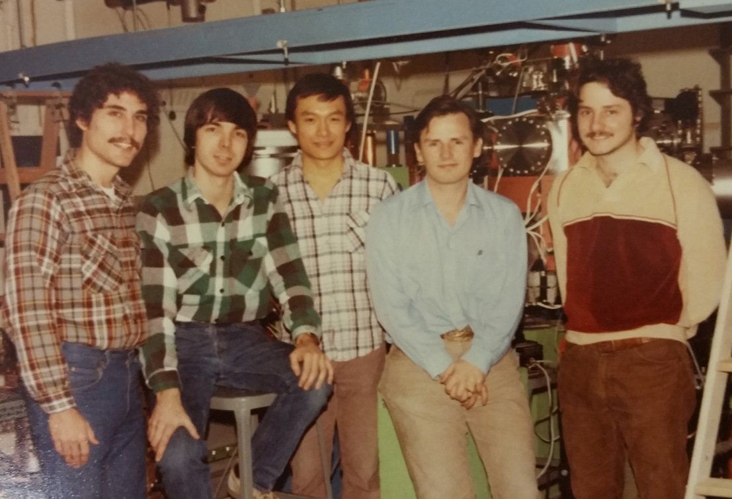
First 4 Graduate Students @ Cornell 1982

Slide 11
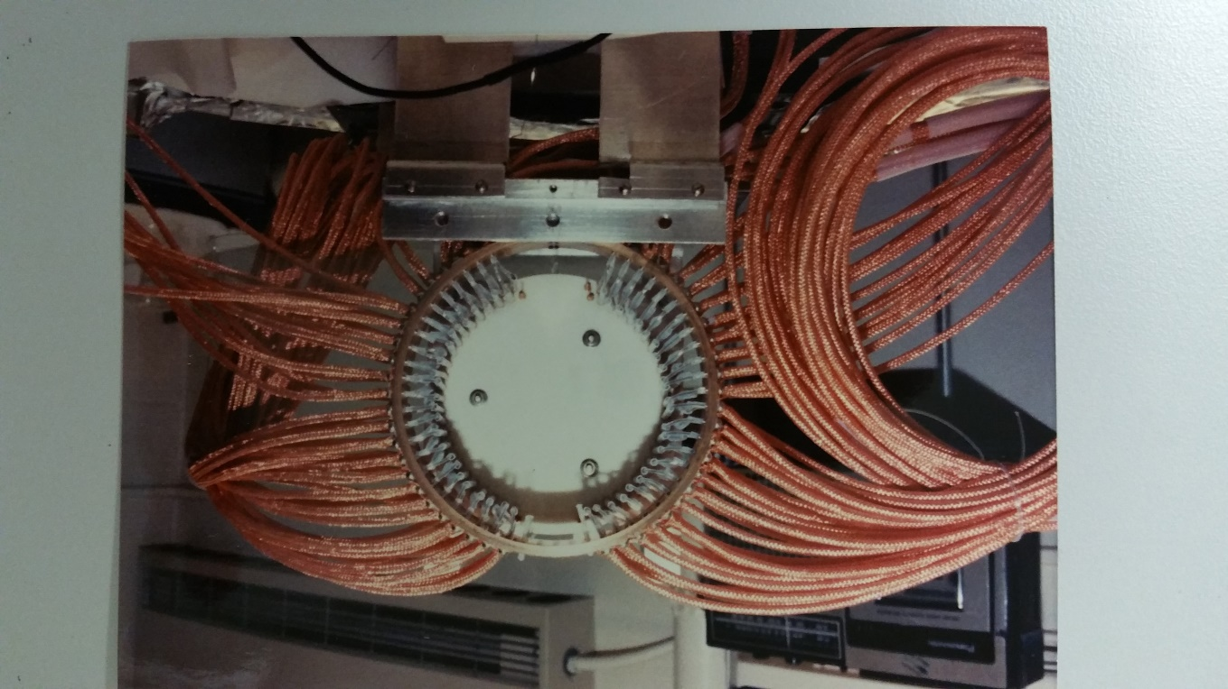
96-Detector Spectrometer

Slide 12
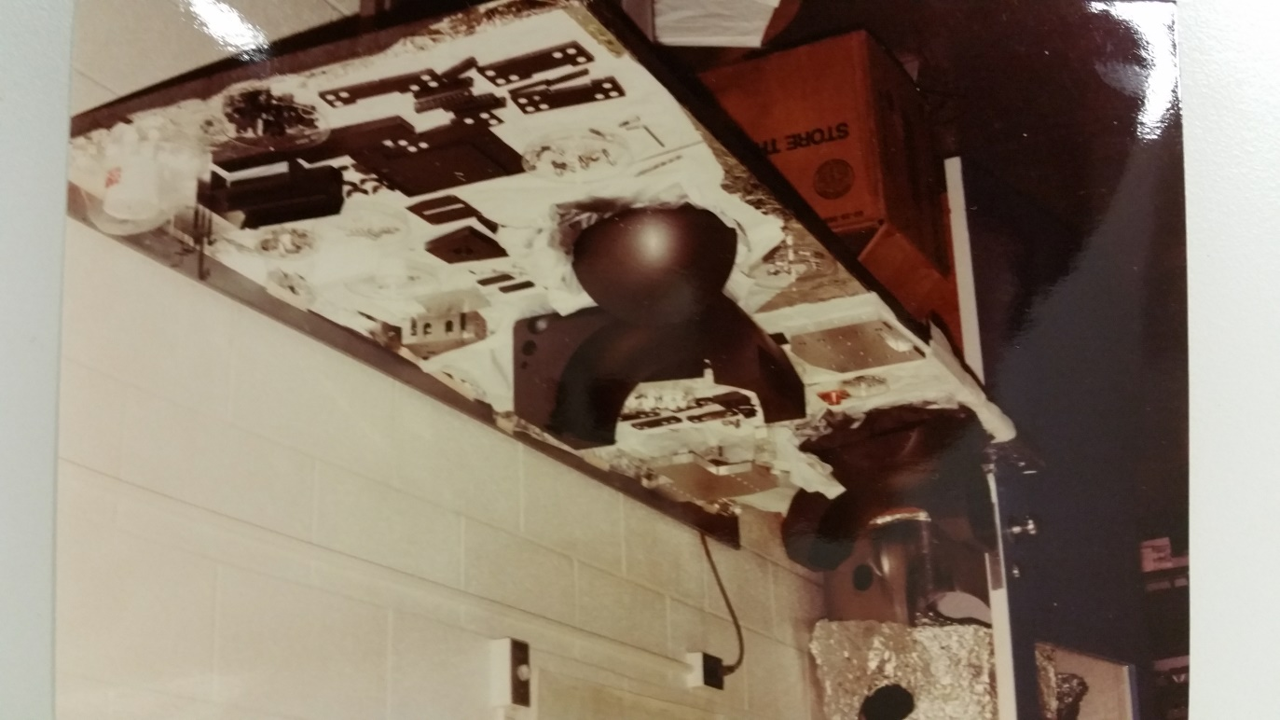
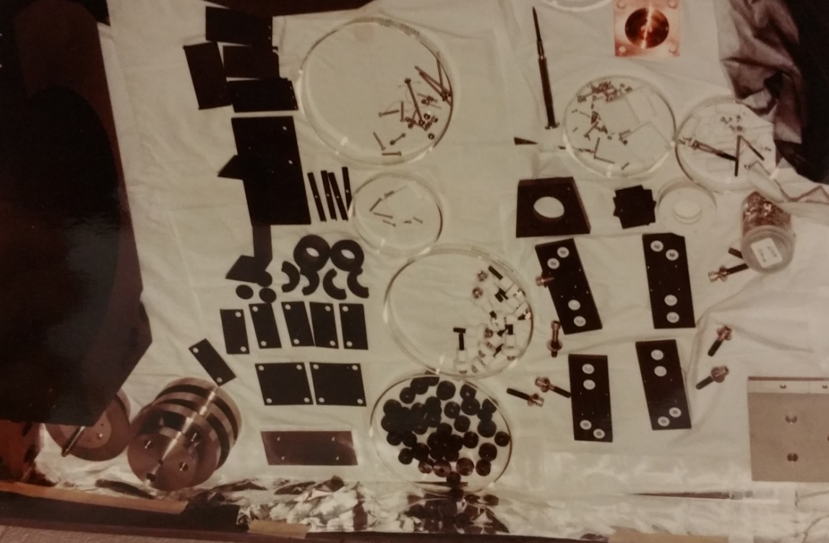
96-Detector Spectrometer

Slide 13
96-Detector Spectrometer Assembled

Slide 14
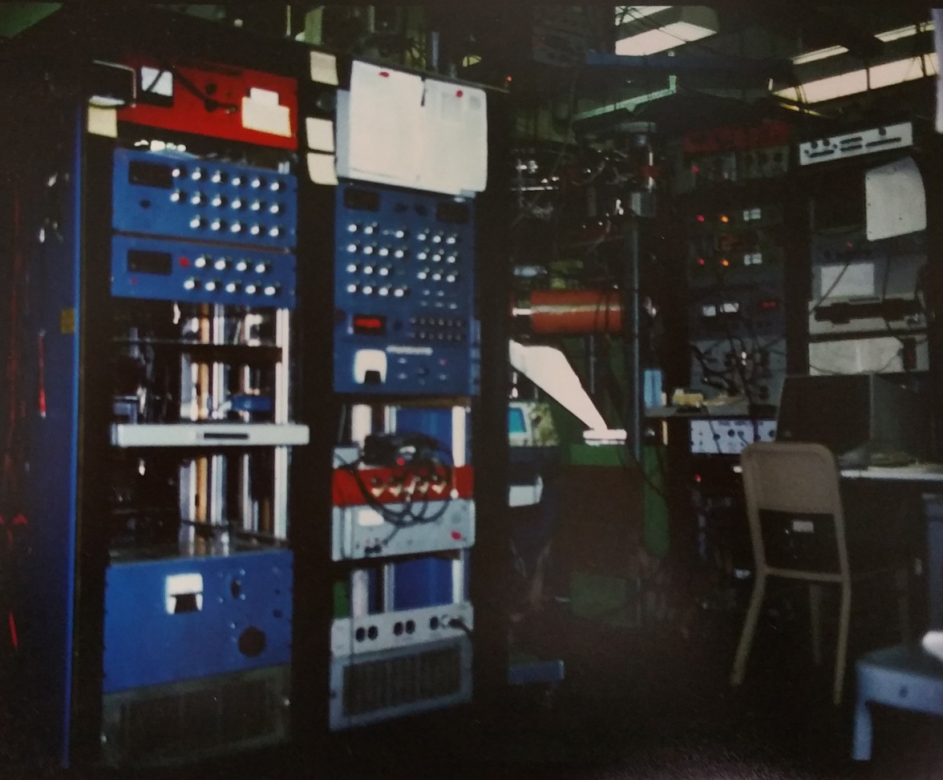
96-Detector Apparatus & Electronics Control

Slide 15
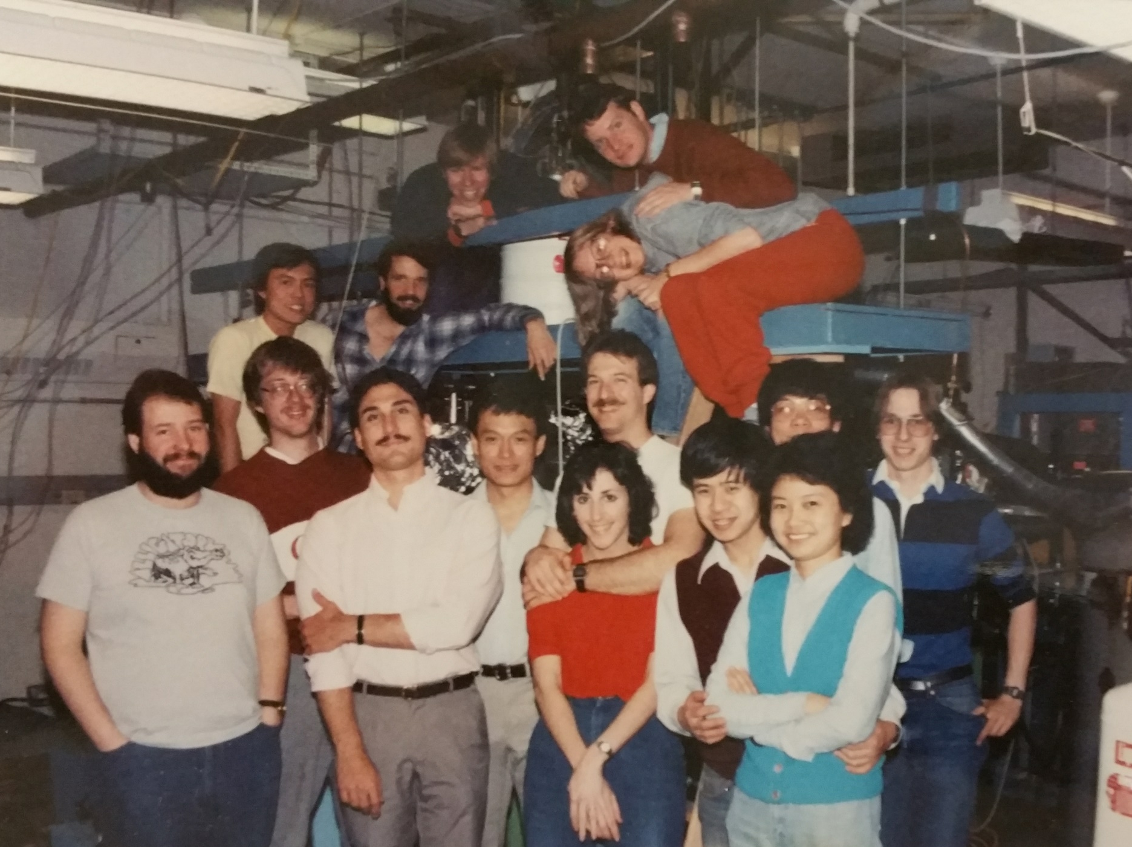
Research Group – Cornell 1986

Slide 16
1st Ph.D. Graduate Cornell, 1985

Slide 17
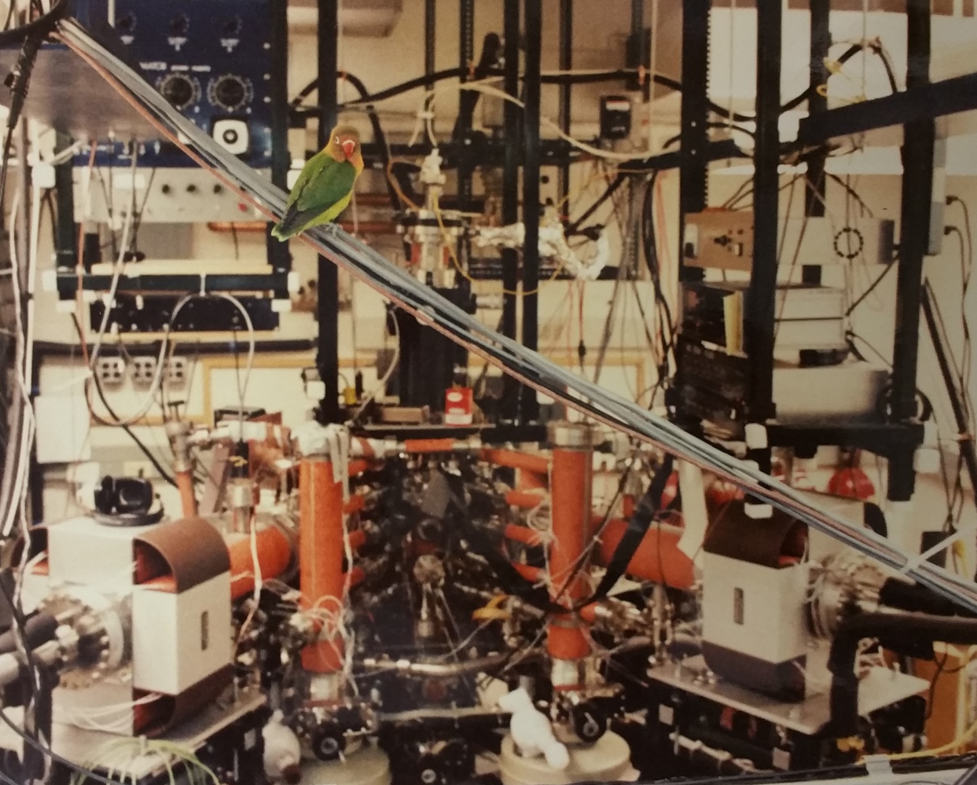
256-Detector Apparatus & Electronics Control

Slide 18
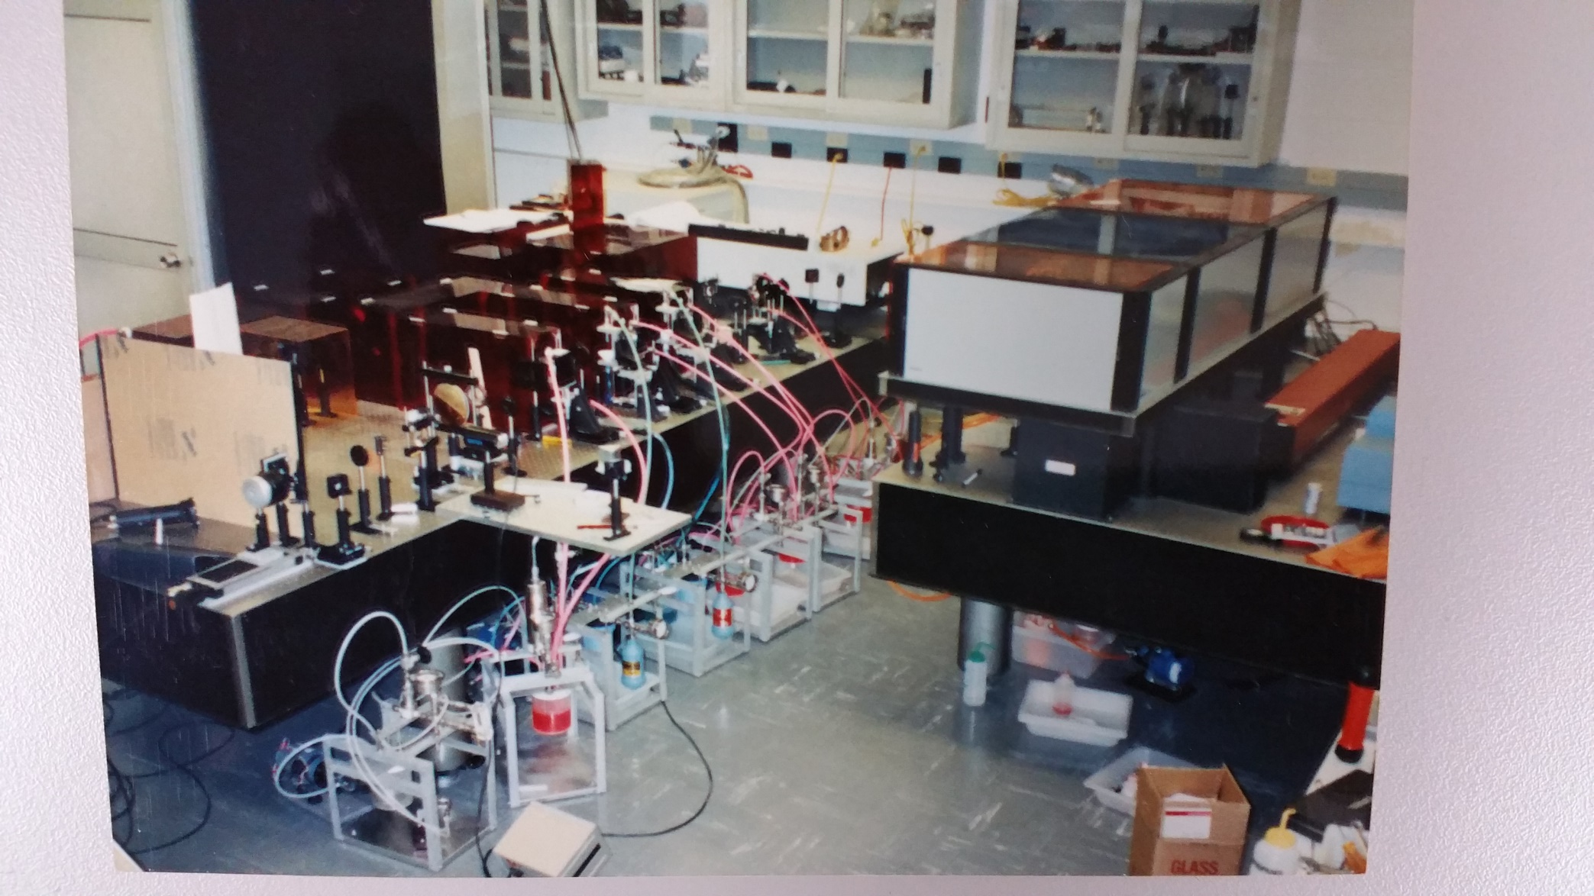
Homebuilt Femtosecond Laser

Slide 19
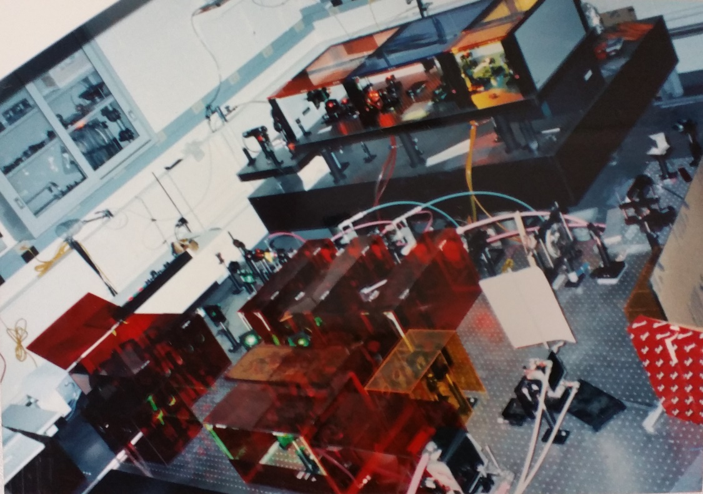
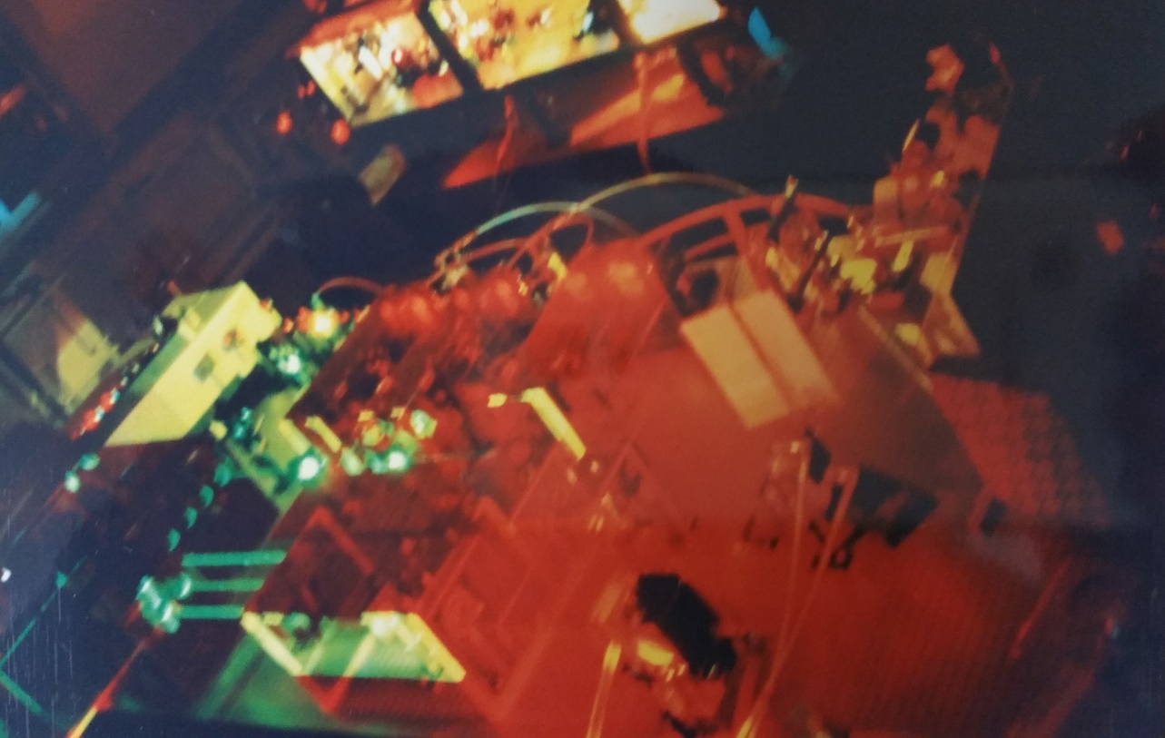
Homebuilt Femtosecond Laser System @Cornell 1990’s

Slide 20
Scanning Tunneling Microscope (STM)

Slide 21
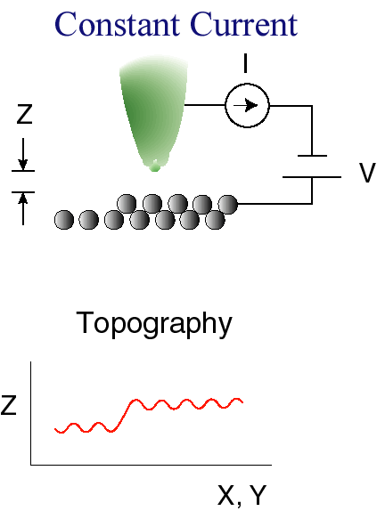
Scanning Tunneling Microscope (STM)

Slide 22
STM Tip

Slide 23
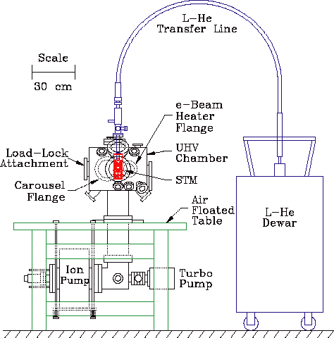
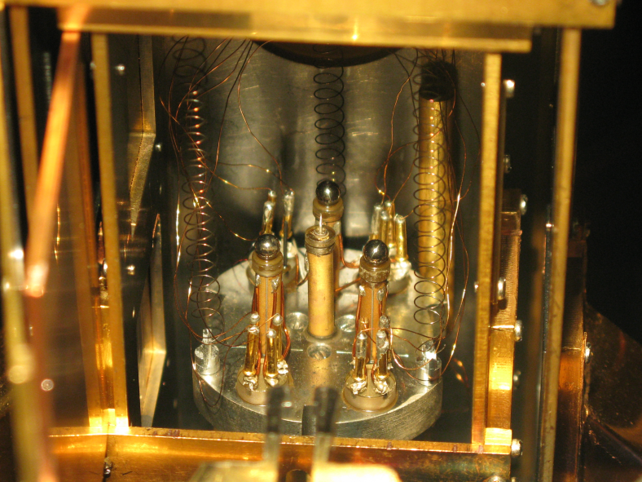
STM Apparatus
Low temperature (10 K)
ultrahigh vacuum STM

Slide 24
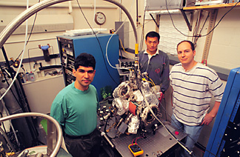
Our 1st STM – Ho, Rezaei, Stipe @ Cornell 1998

Slide 25
Seeing Single Molecules

Slide 26
Molecular Shuttle

Slide 27
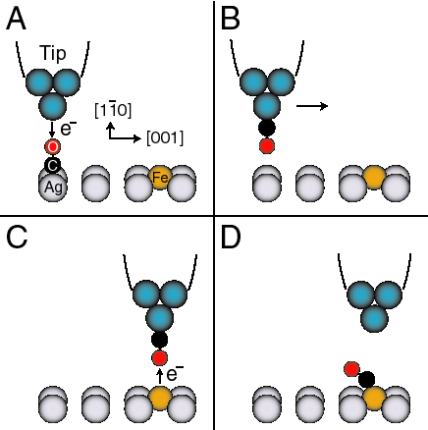
Making a Molecule

Slide 28
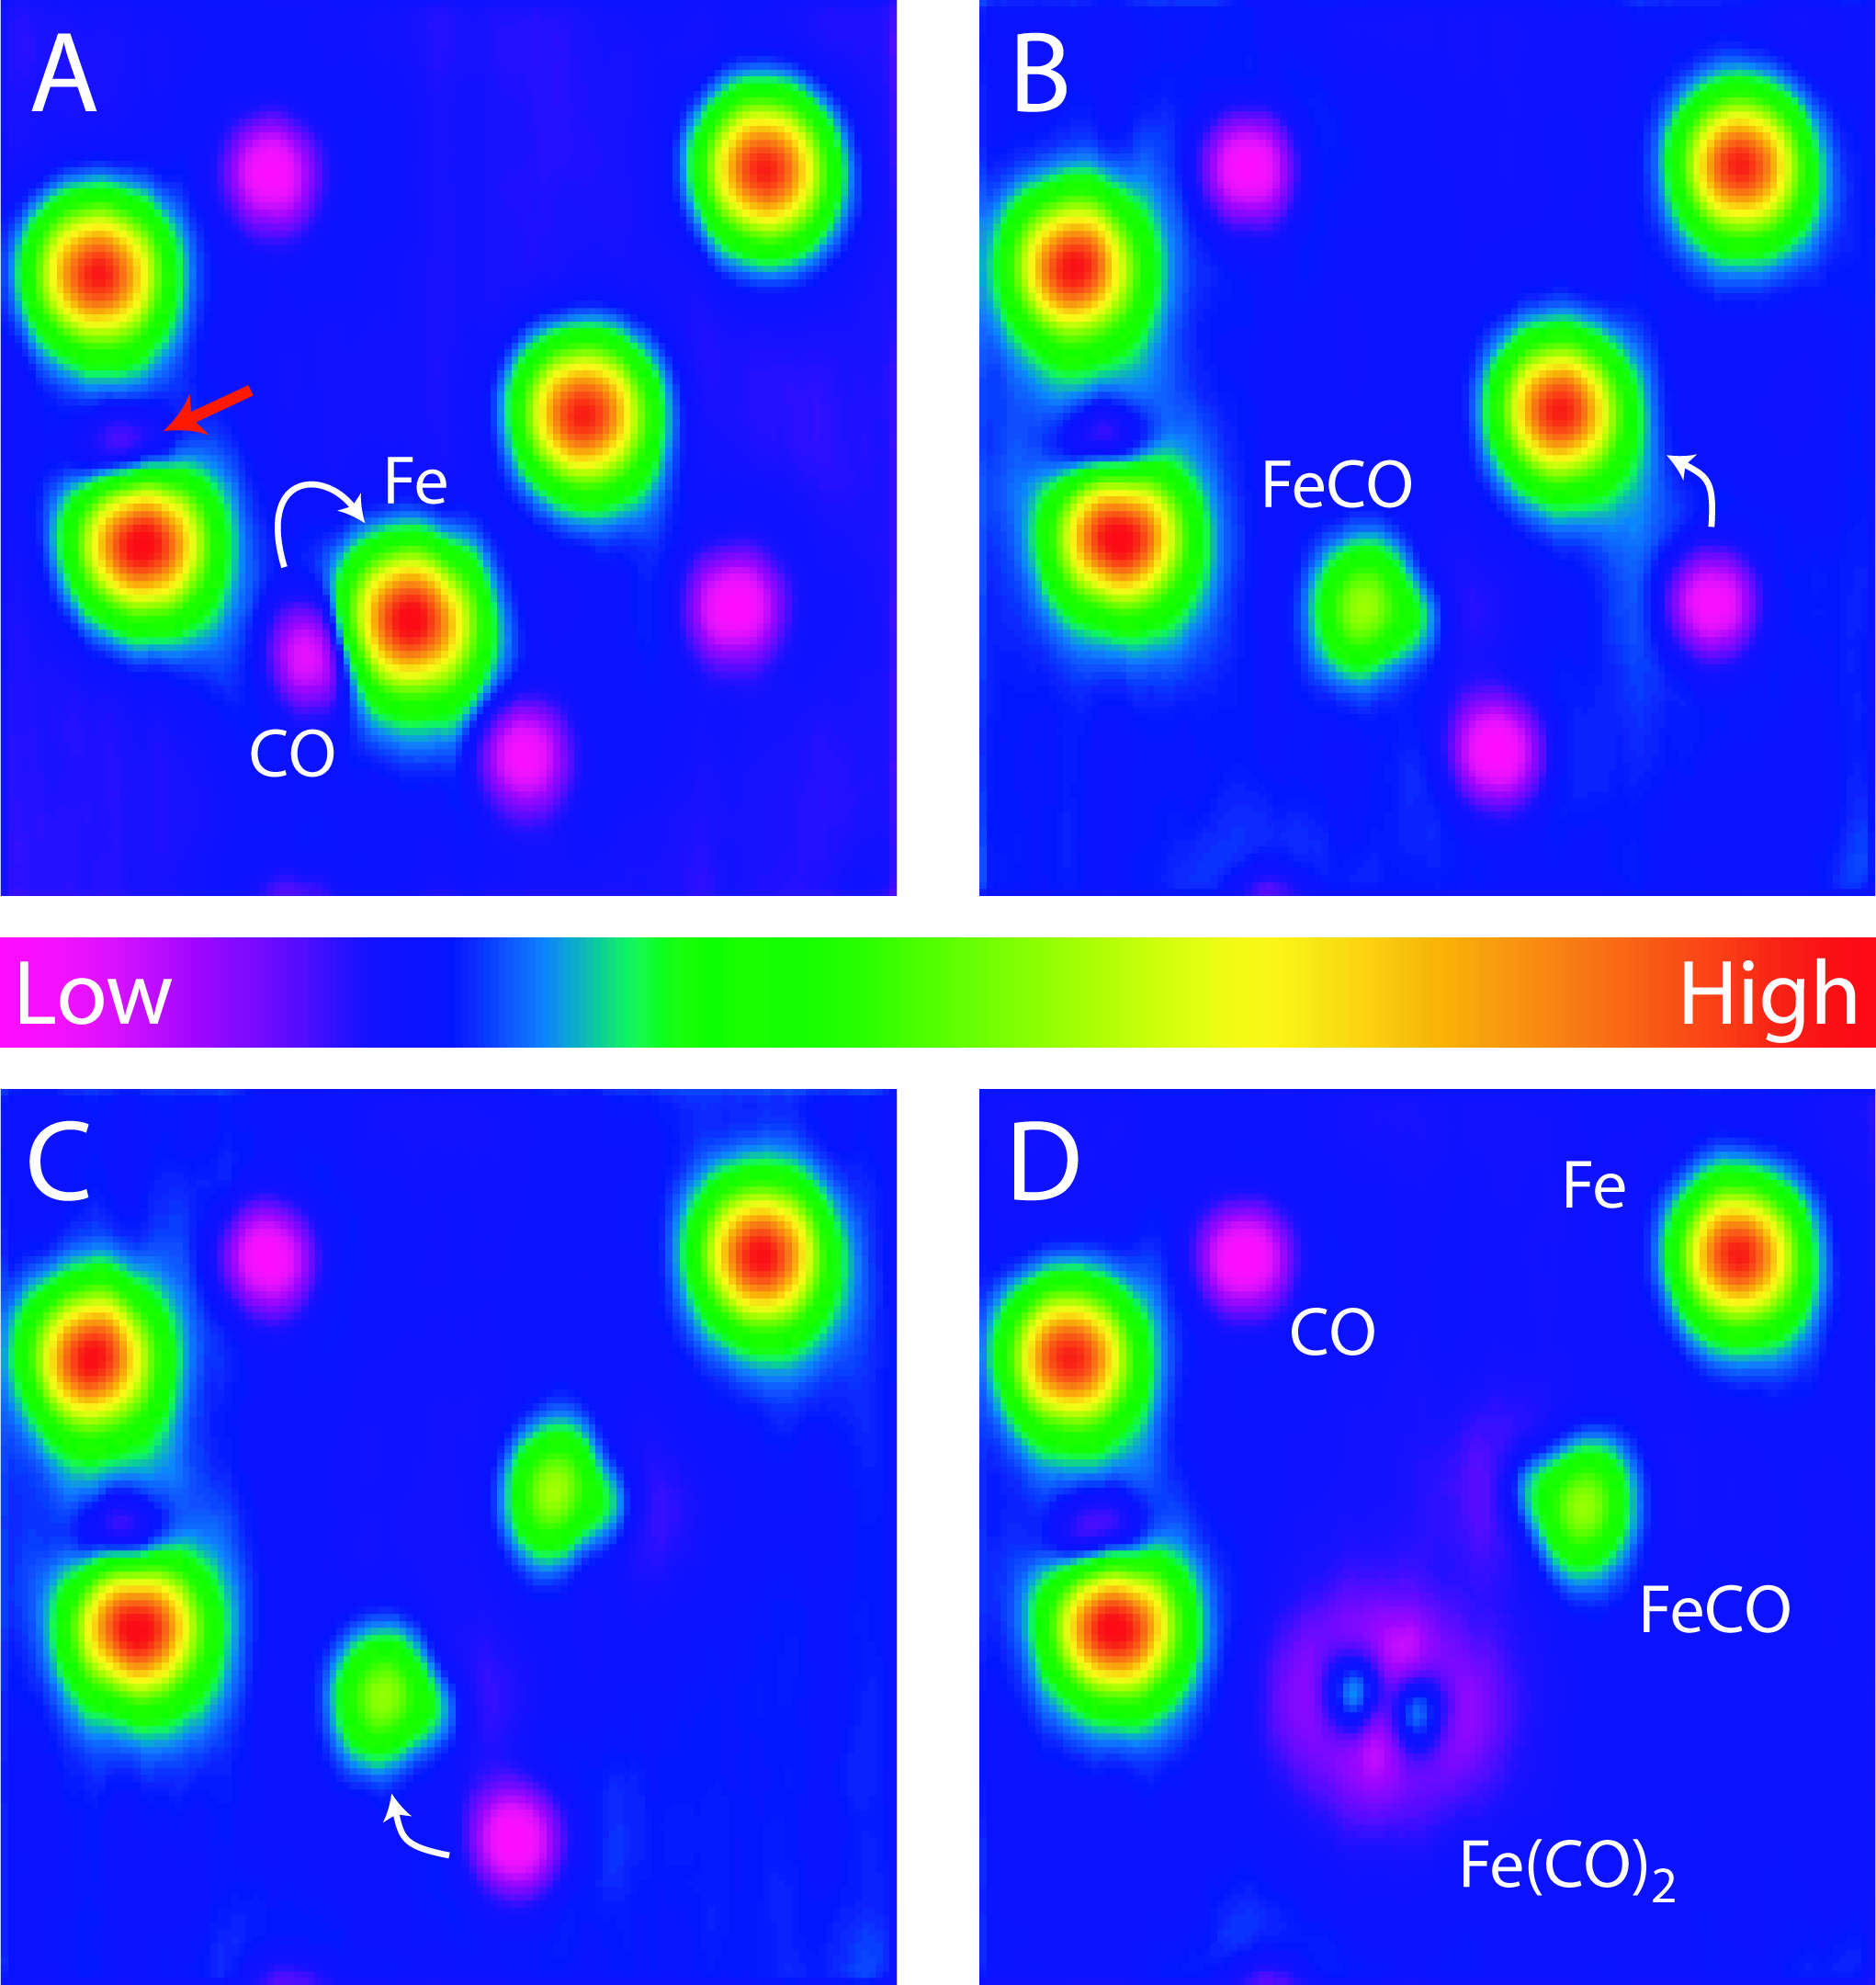
Single Molecule Chemistry

Slide 29
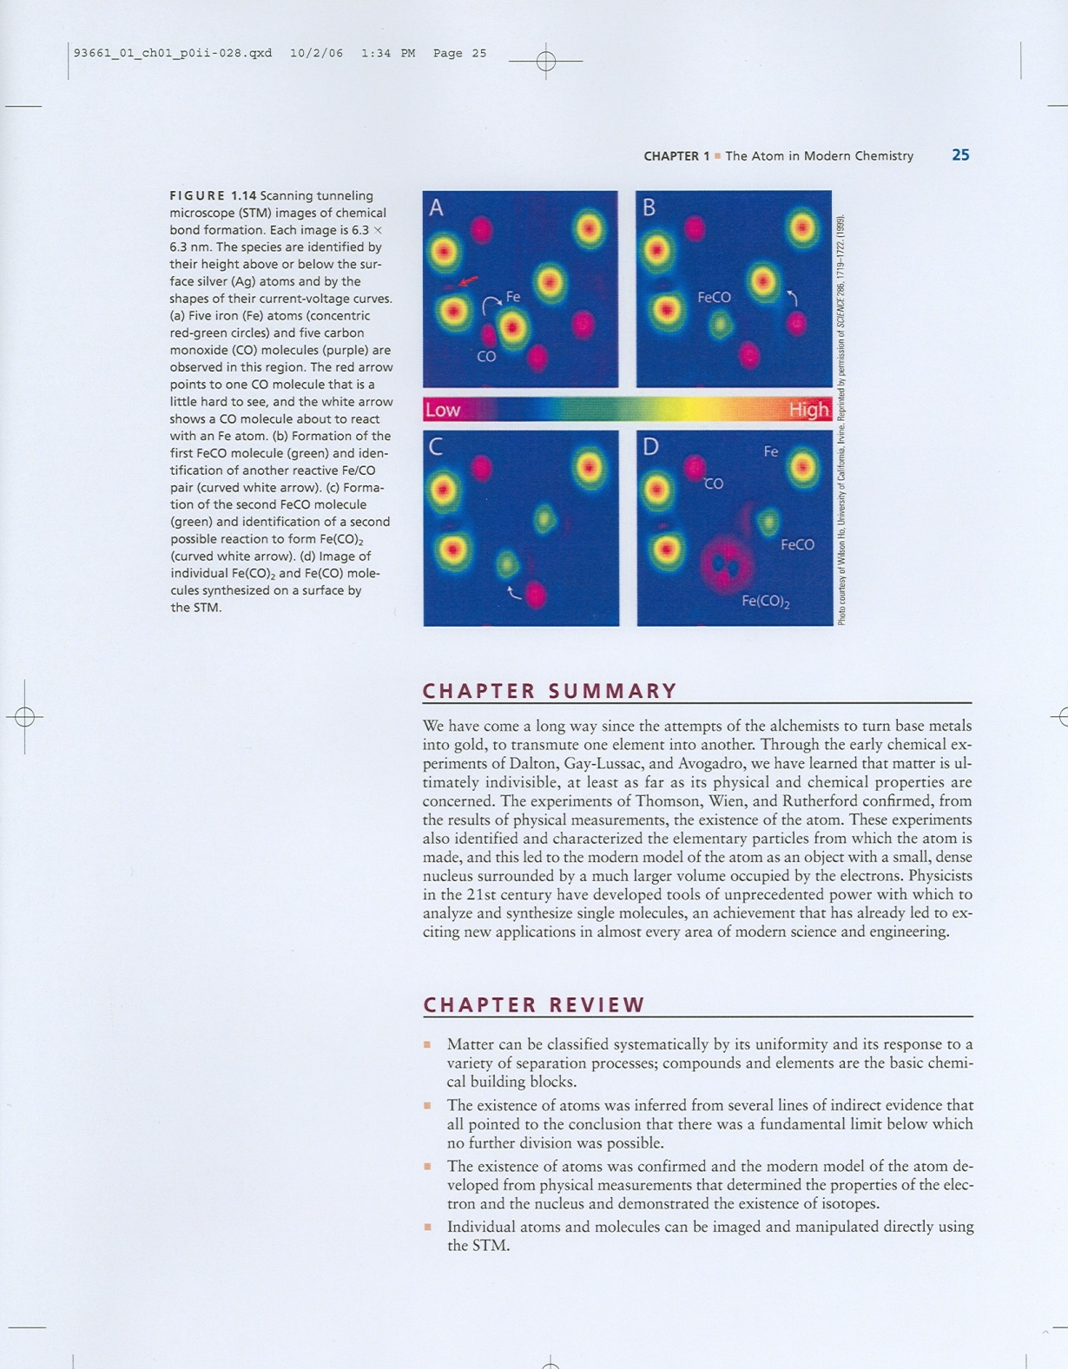
College Textbook:
Principles of
Modern Chemistry,
6th edition,
Oxtoby, Gillis, Campion
(Thomson Brooks/Cole,
2007).

Slide 30
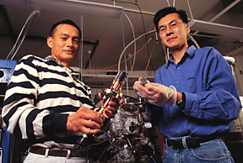
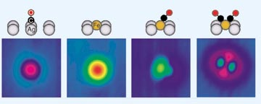
Hyojune Lee & Ho, @Cornell, 1999
Making Molecules One at a Time

