Slide 1
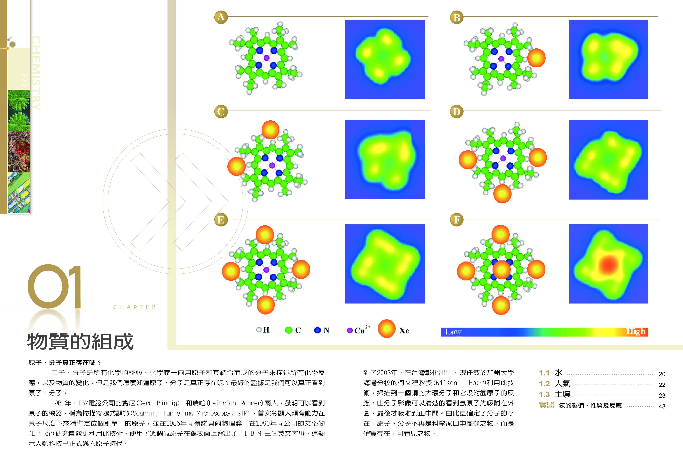
High School Chemistry Textbook by I-Jy Chang, Taiwan
Xe + porphyrin

Slide 2
Imaging Atoms on Solid Surfaces
Silicon(111)
Ag(110)

Slide 3
Elementary Textbook:
Houghton-Mufflin Science,
California Edition (2007).

Slide 4
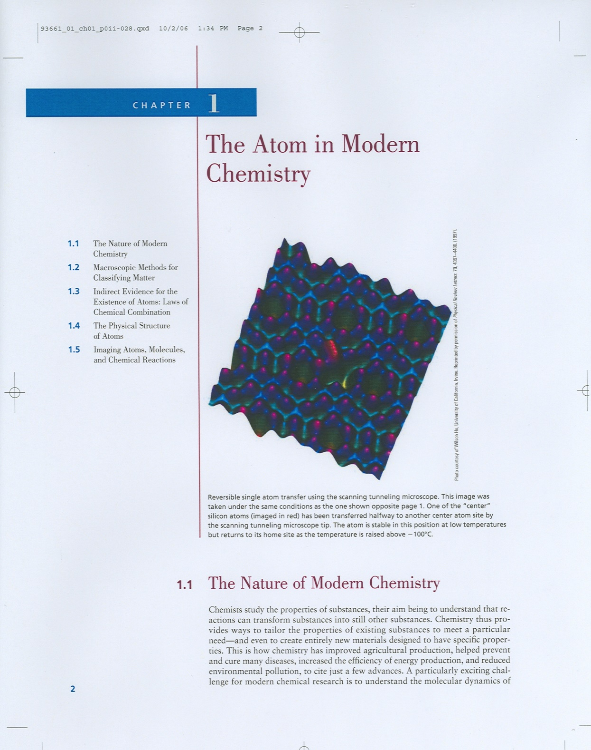
College Textbook:
Principles of
Modern Chemistry,
6th edition,
Oxtoby, Gillis, Campion
(Thomson Brooks/Cole,
2007).

Slide 5
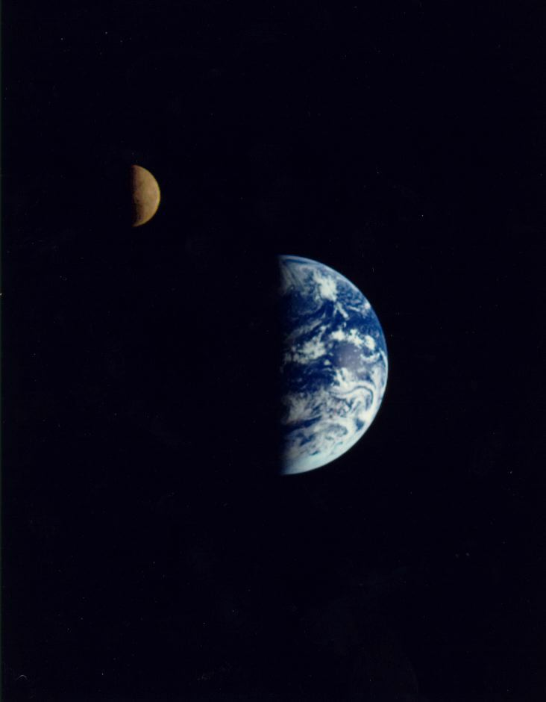
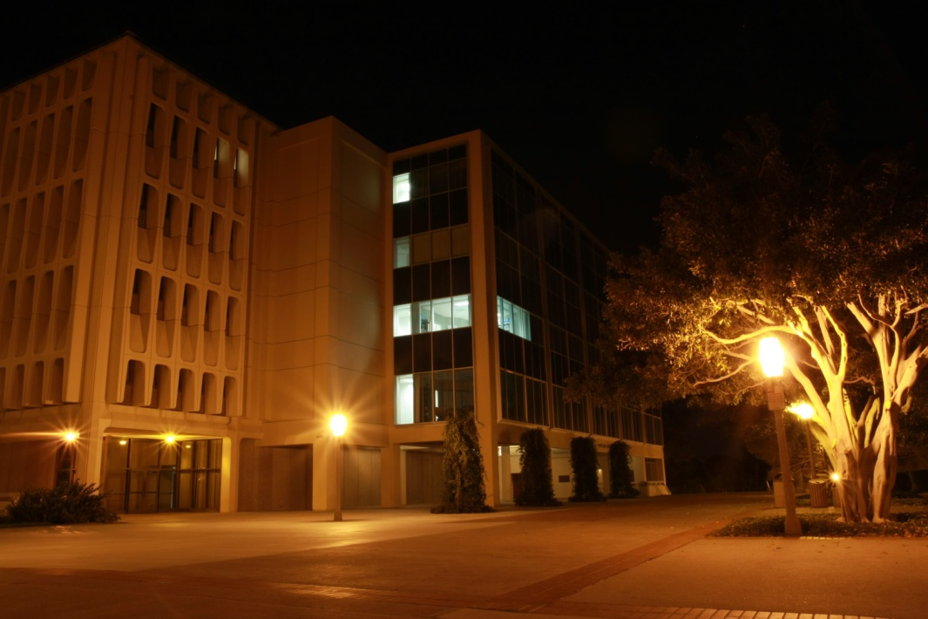
50,000,000× Magnification
Galileo, 1922
3,900,000 Miles
Rowland Hall
UC Irvine

Slide 6
Seeing Single Molecules

Slide 7
Inelastic
Electron
Tunneling
Spectroscopy
(IETS)

Slide 8
Chemical Identification: Single Acetylene Molecules on Cu(100)
B.C. Stipe, M.A. Rezaei, W. Ho, Science 280, 1732 (1998).

Slide 9
Single H Atom
L.J. Lauhon, W. Ho, PRL 85, 4566 (1999).

Slide 10
Particle in a Box: A Textbook Example
College Textbook:
Principles of
Modern Chemistry,
6th edition,
Oxtoby, Gillis, Campion
(Thomson Brooks/Cole,
2007).

Slide 11
20 Years in Ithaca, NY
Millisecond (10⁻³ s) experiment on 10¹² molecules with 96-detector or 256-detector
100 femtosecond ( 100x10⁻¹⁵ s)
experiment on 10¹² molecules with
femtosecond Laser
• Sub-Ångström (<10⁻¹⁰ m) spatial
resolution on 1 molecule with the
scanning tunneling microscope
• Not yet (10 fs + 0.1 Å) experiment

Slide 12
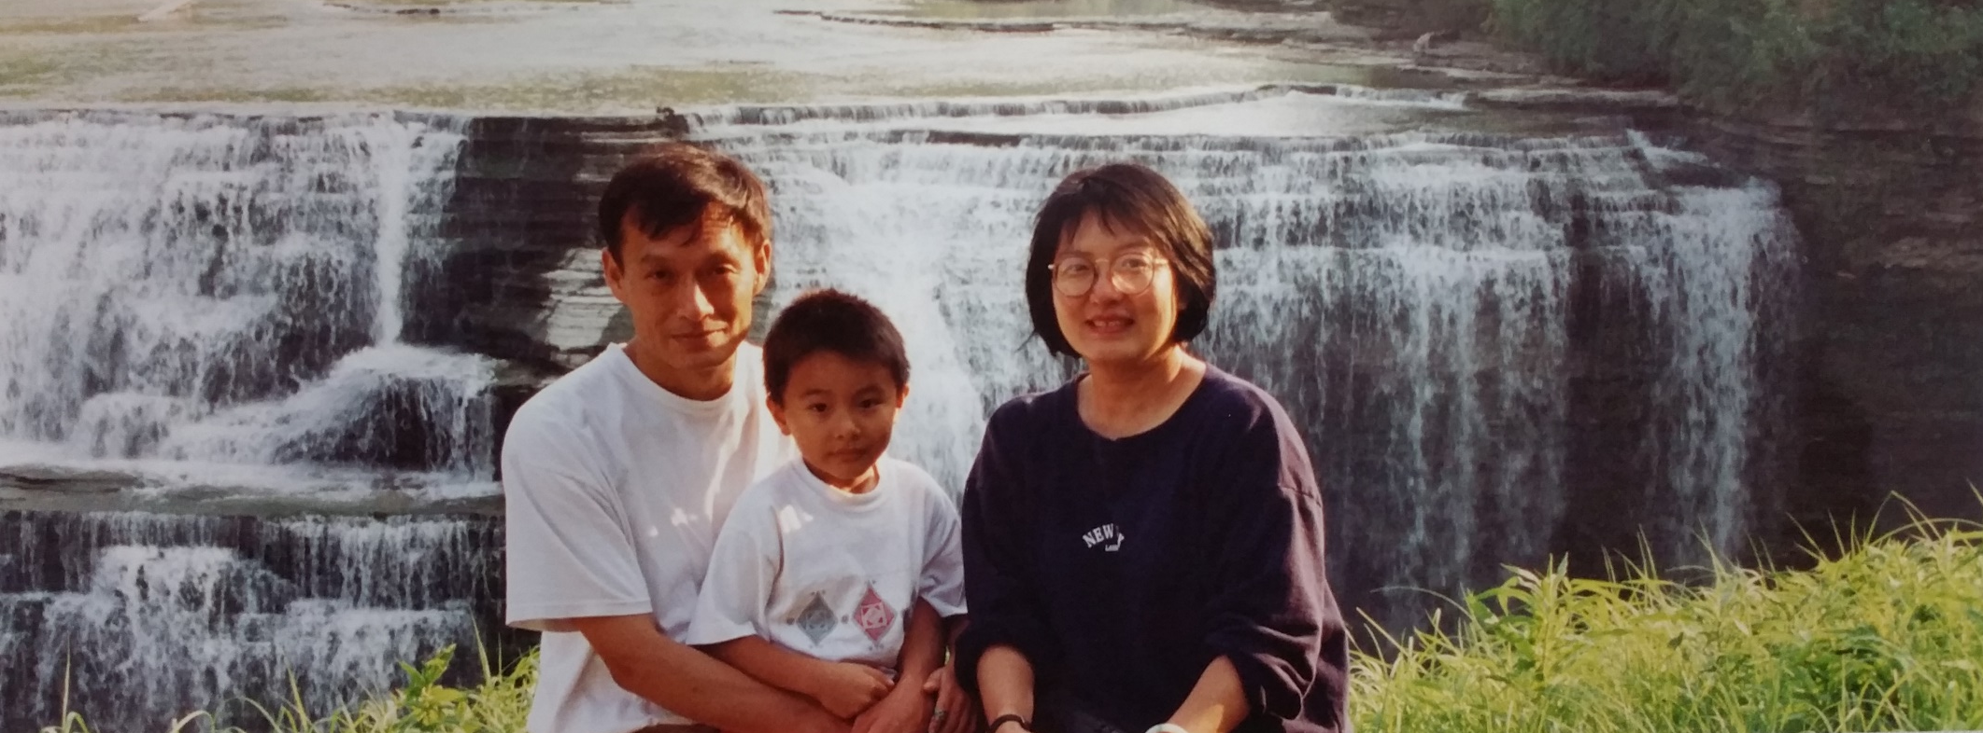
Ithaca, NY, 1996

Slide 13
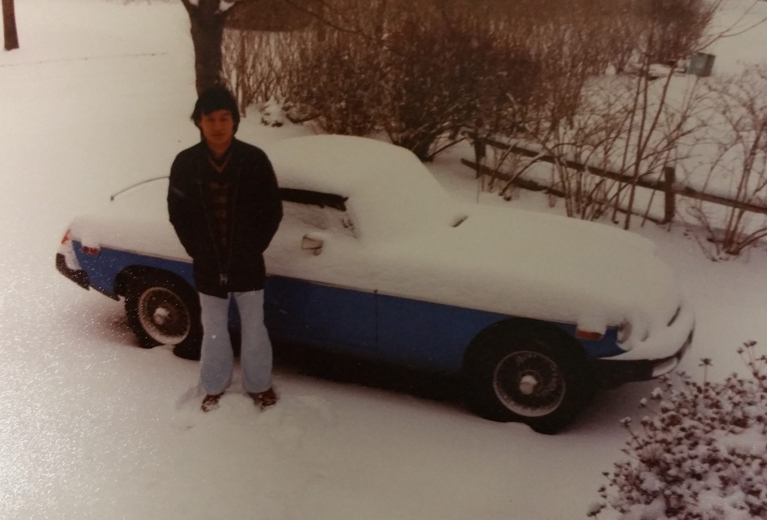
MGB & I in Winter Snow!!!

Slide 14
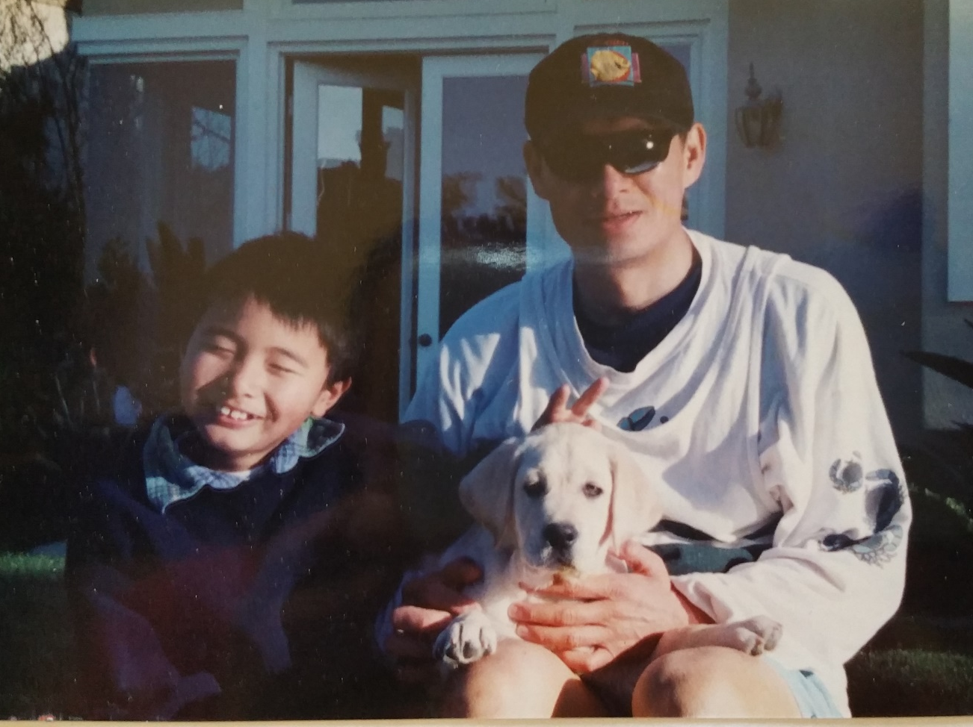
Kelvin in Irvine, 2000-2016

Slide 15
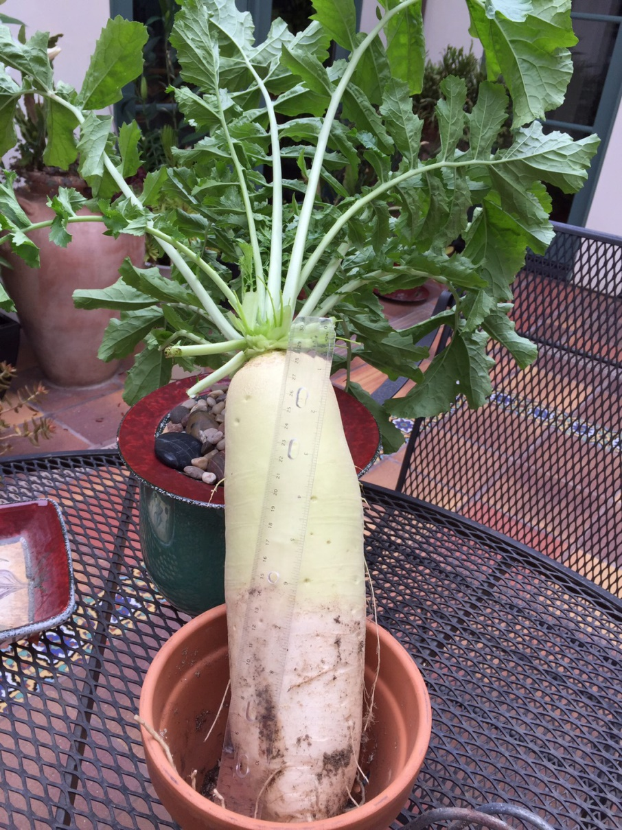
Backyard Farming, Irvine, CA 2015

Slide 16
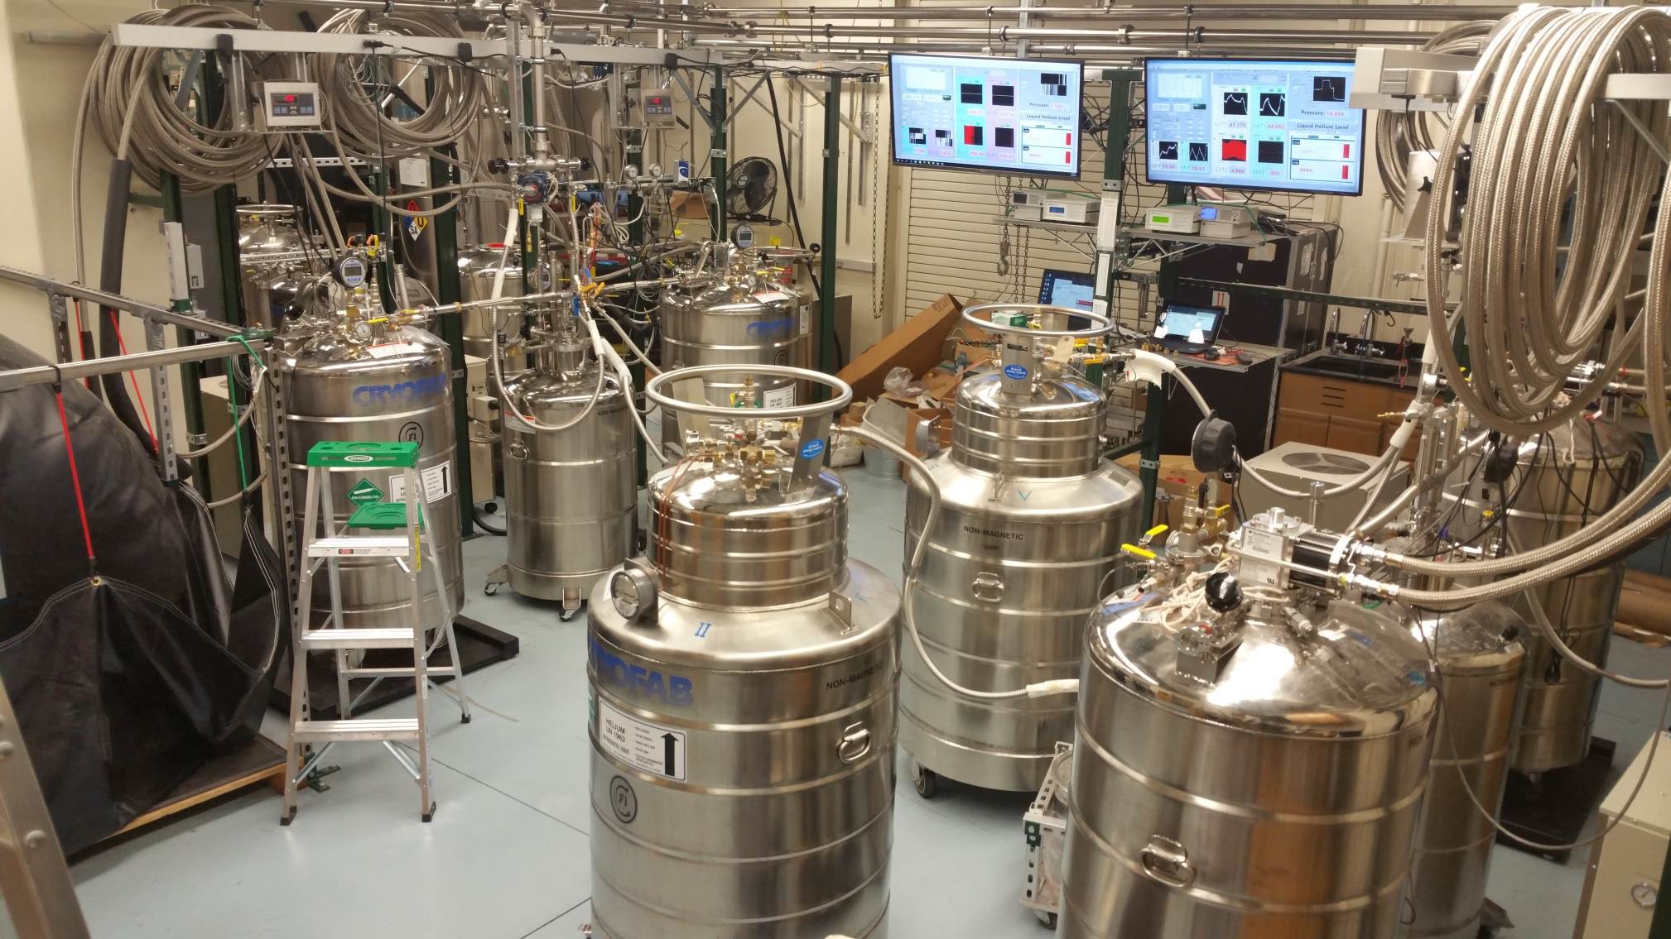
Homebuilt Helium Recycling Facility

Slide 17
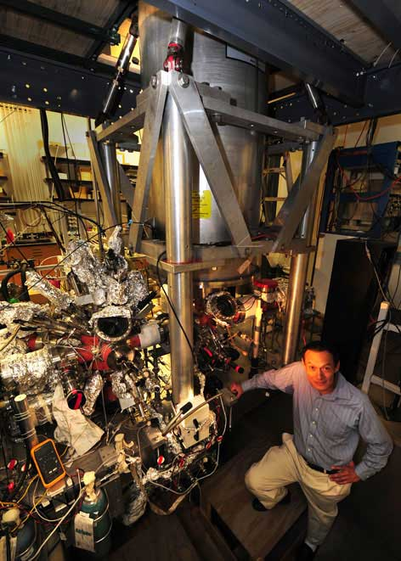
“Two-Story” STM 600 mK, 10⁵ Gauss 10⁻¹¹ mmHg

Slide 18
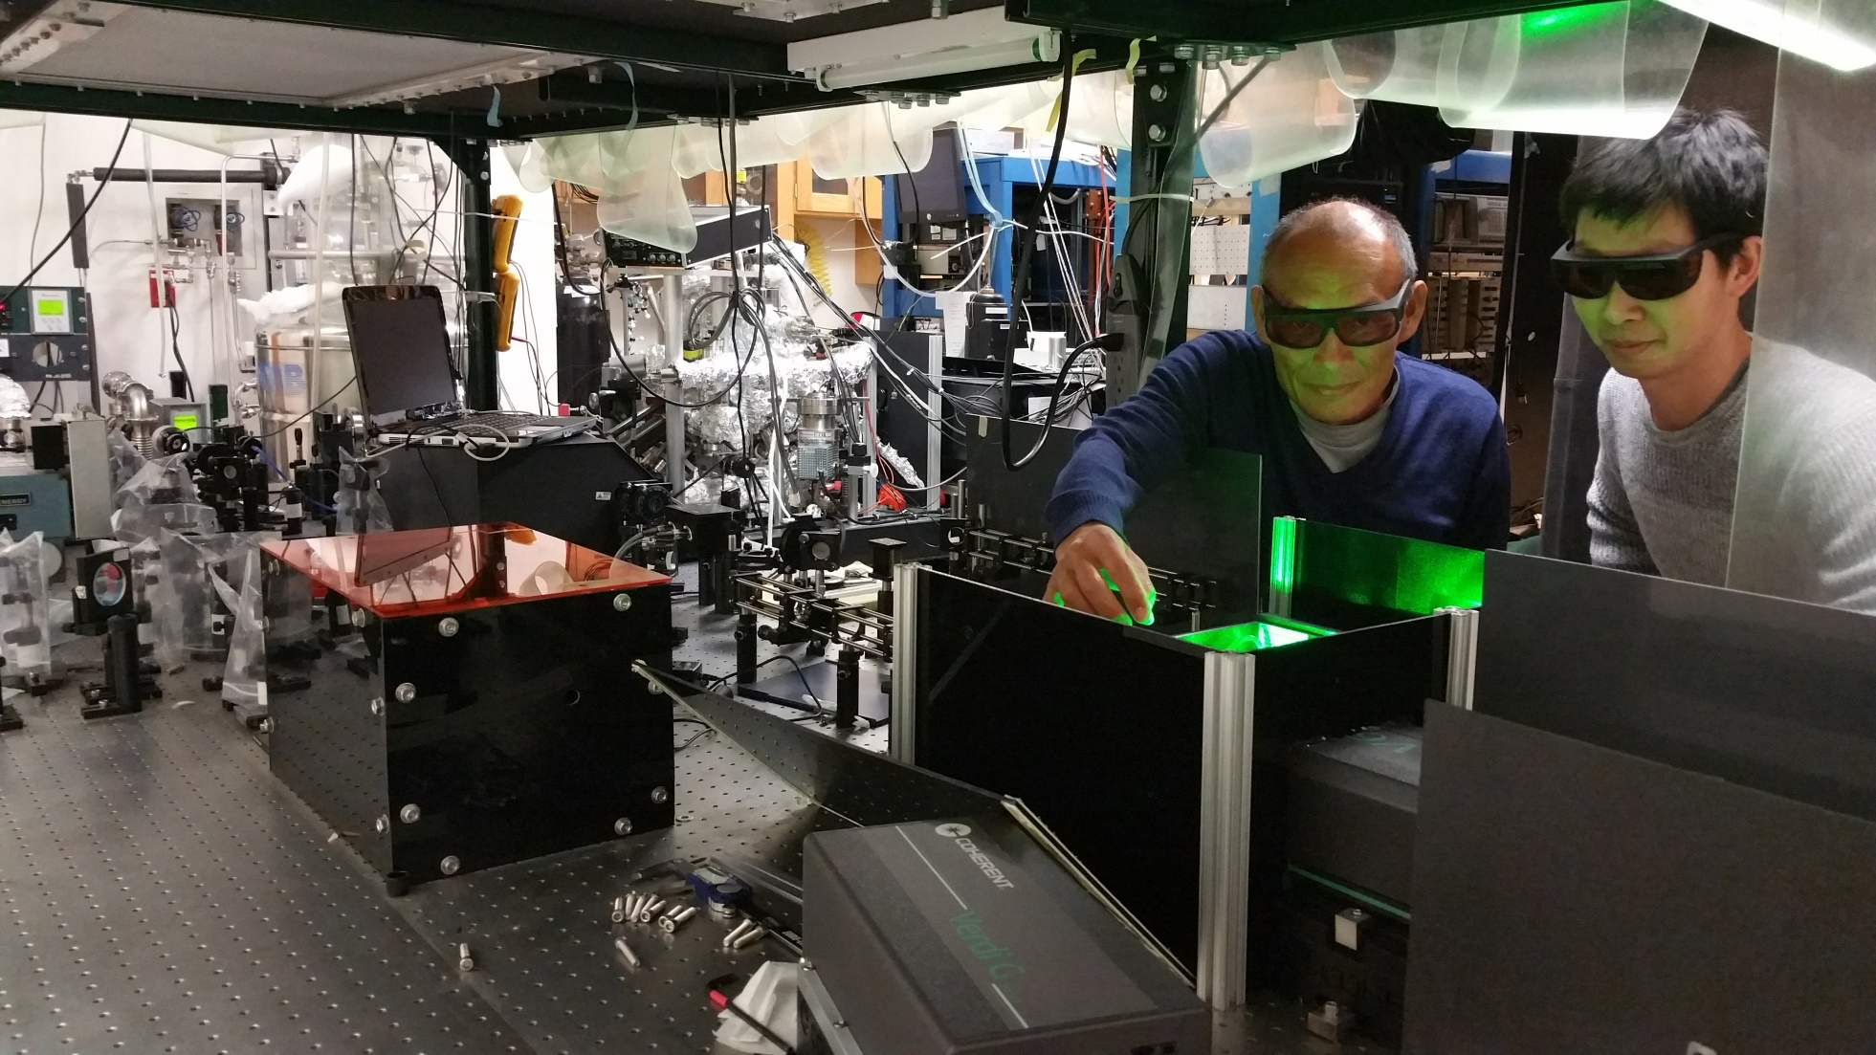
Wilson Ho & Shaowei Li @ UC Irvine, 2017

Slide 19
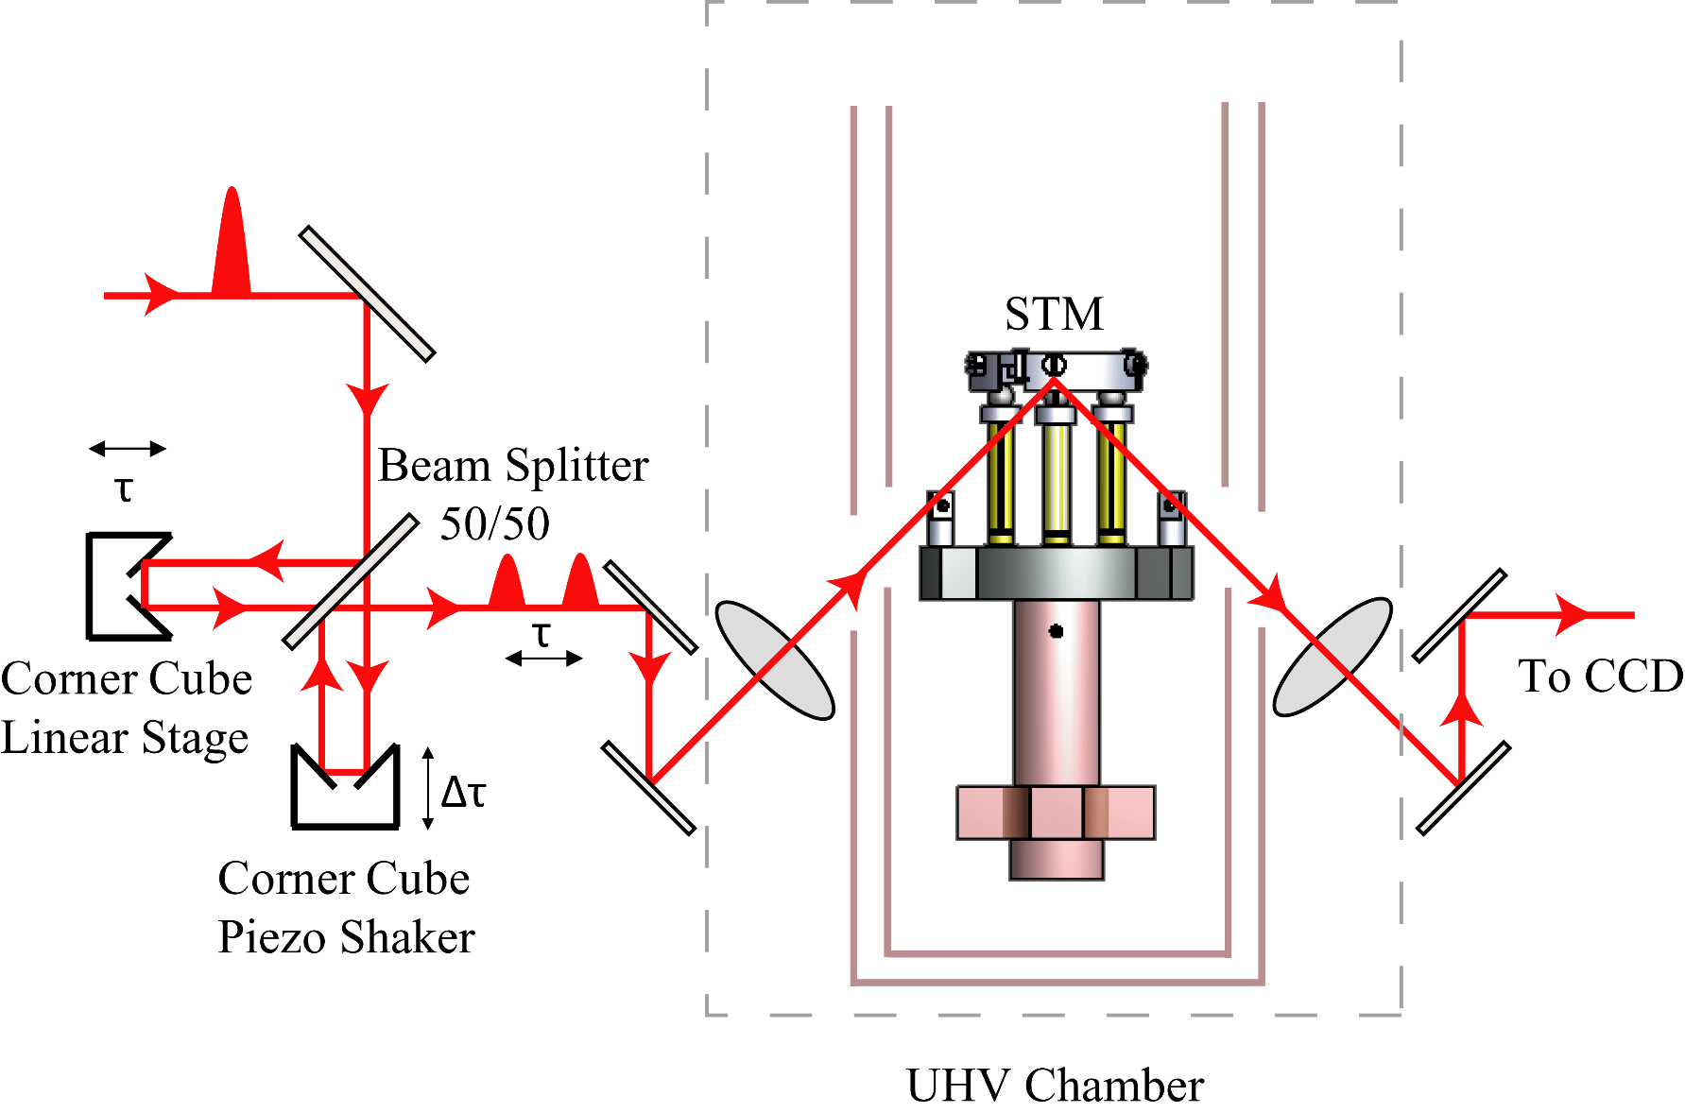
Coupling Femtosecond Laser to STM

Slide 20
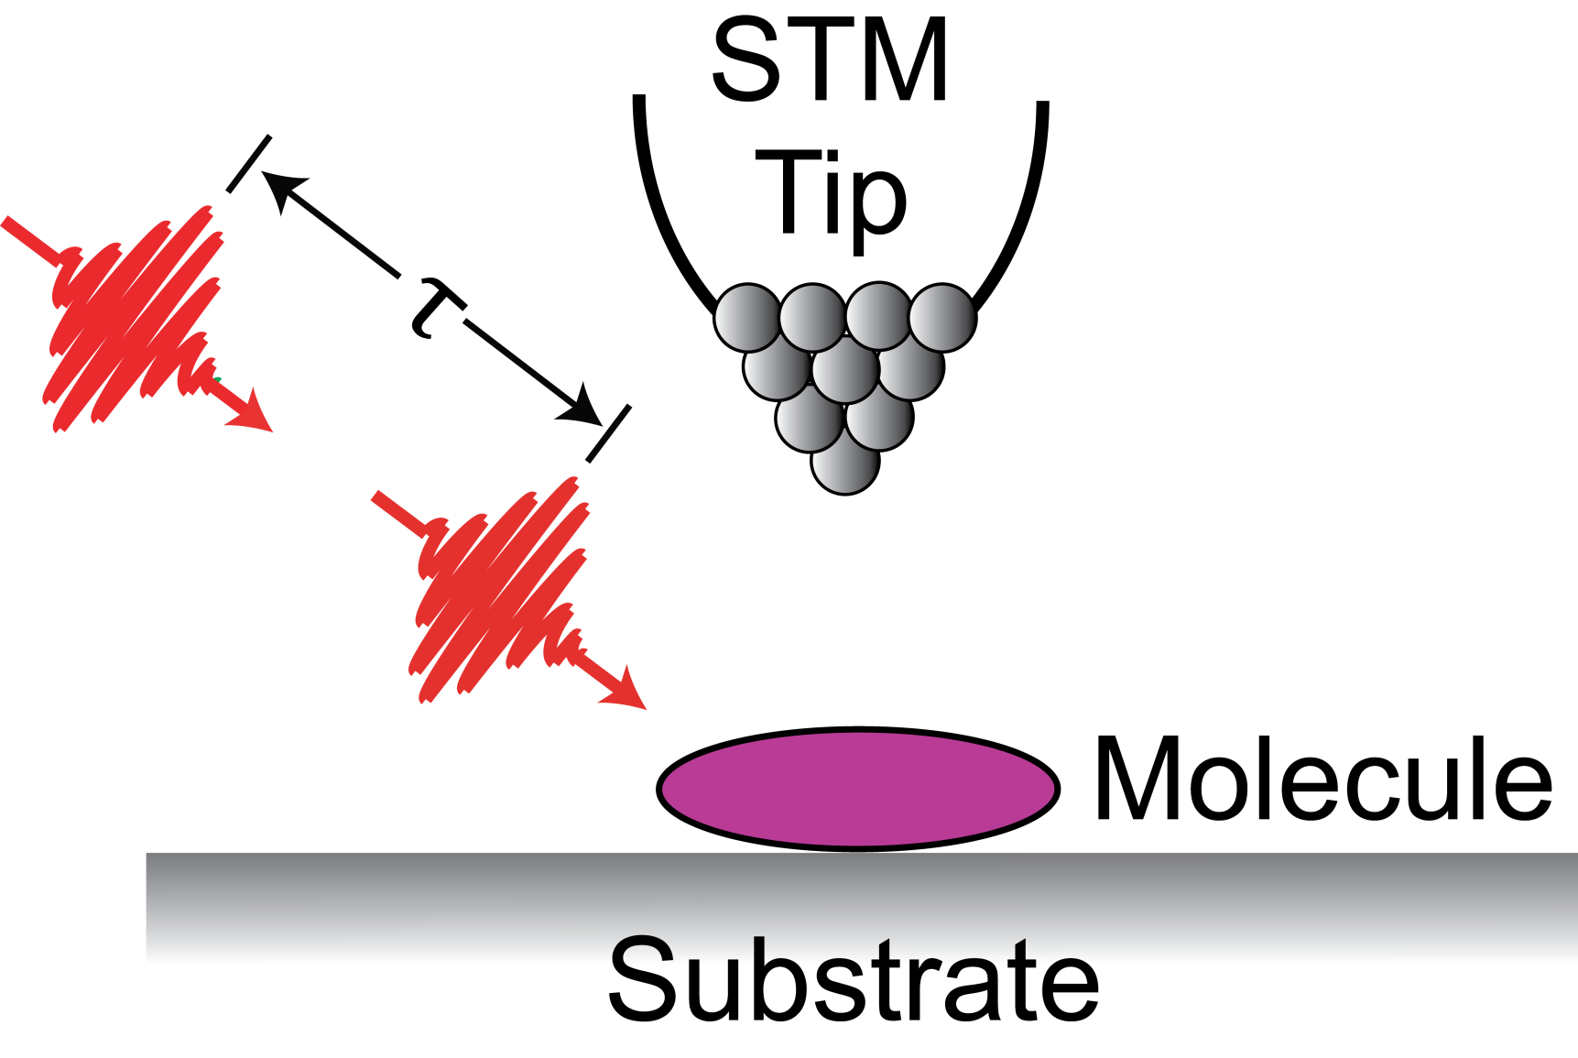
Femtosecond Laser & Scanning Tunneling Microscope

Slide 21
STM Induced Conformation Change
High
Current
Low
Current

Slide 22
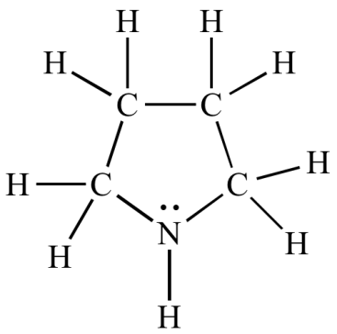
Pyrrolidine Conformational Change
Ag(110)

Slide 23
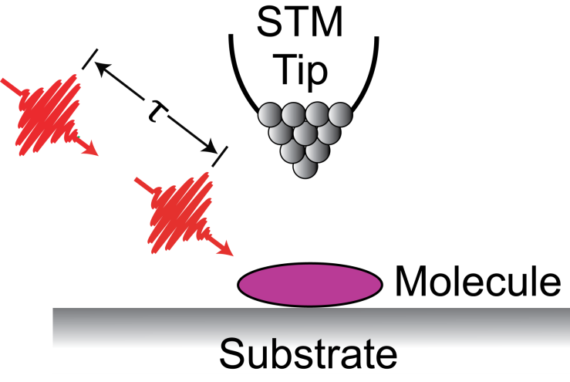
35 fs laser + 0.1 Å STM
Period=146 fs

Slide 24
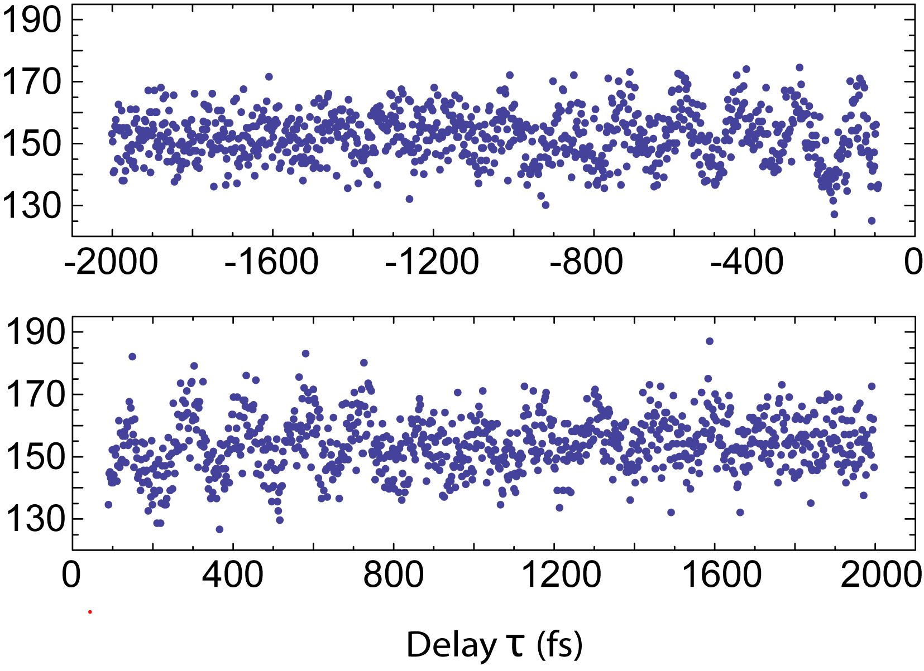

Slide 25
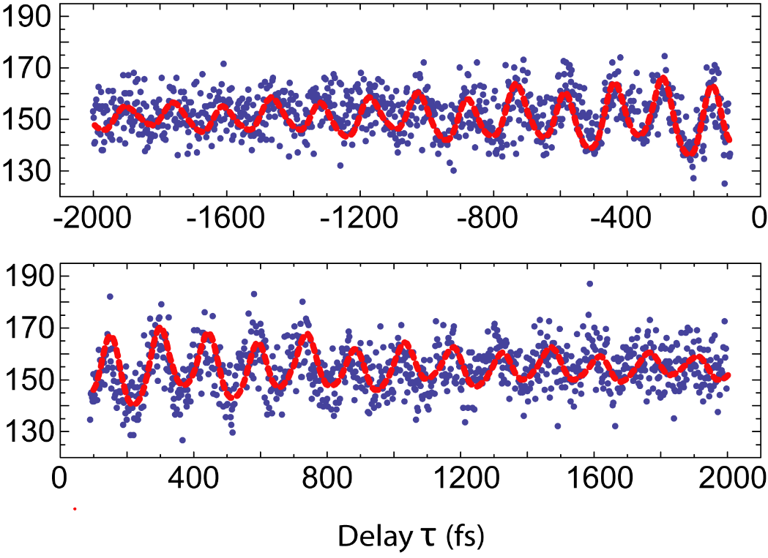

Slide 26
17 Years in Irvine, CA
• Mission Accomplished:
0.1 nm + 30 fs
in 1 molecule!

