Slide 1
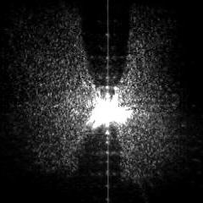
“Small and Fast: femtosecond light-matter interactions at 0.1-nanometer”
Wilson Ho
20th Wu Chien Shiung Science Camp, 2017, Lukang
Tip
image
Real
tip

Slide 2
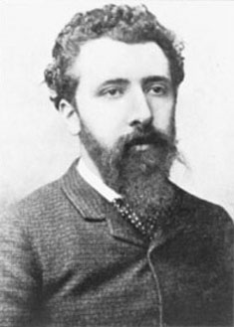
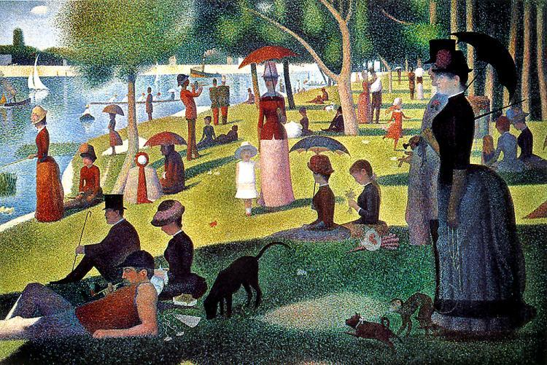

Georges-Pierre Seurat
Pointillism (n)
a theory and technique of applying small strokes or dots of color to a surface so that from a distance, they blend together; also called Neoimpressionism or Divisionism
1859 - 1891
D_{min} ≈ λ / 2

Slide 3
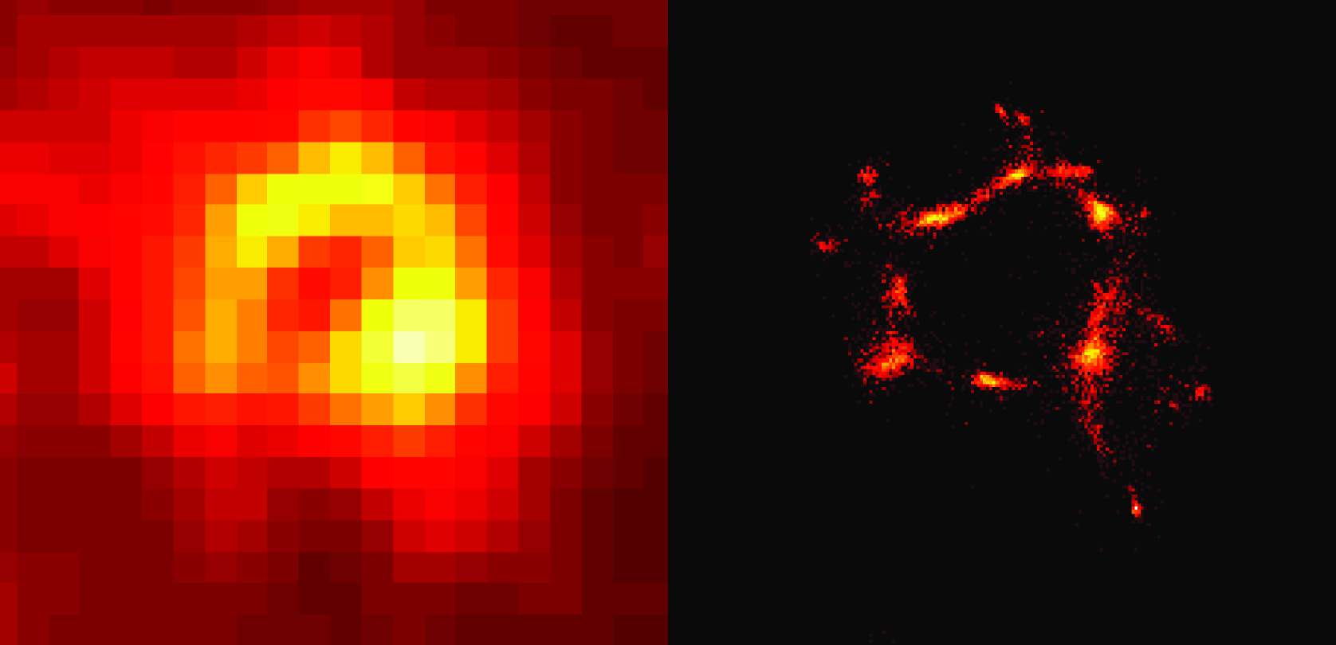
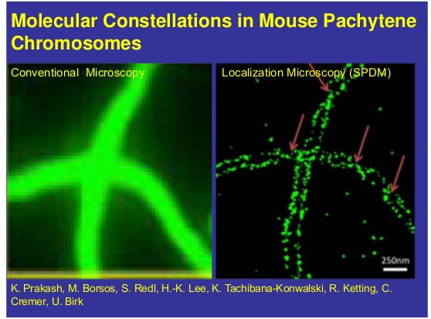
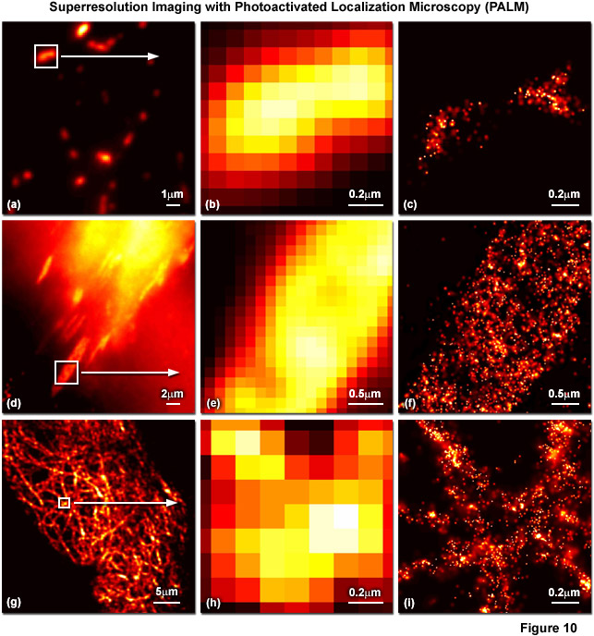
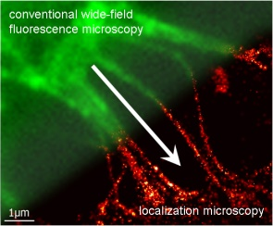
Superresolution Microscopy

Slide 4
What is the limit of spatial resolution in light matter interaction?
How to achieve this limit of spatial resolution?

Slide 5
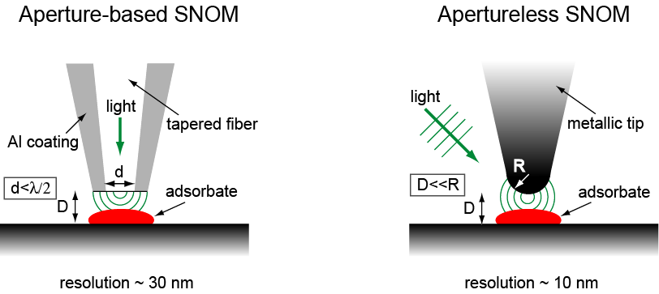
Resolution of Optical Spectroscopy
Field Enhancement
W = (2DR)^{1/2}

Slide 6
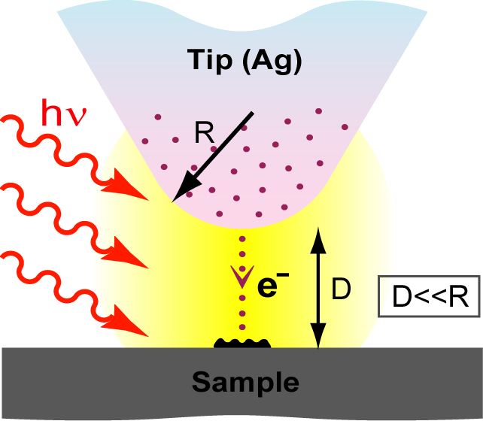
Length Scales in the STM Junction
Diffraction limit:
a few hundred nm
Plasmon localization:
a few nm
Size of single molecules:
a few Å ∼ a few nm
Confinement of tunneling electrons:
< 1 Å

Slide 7
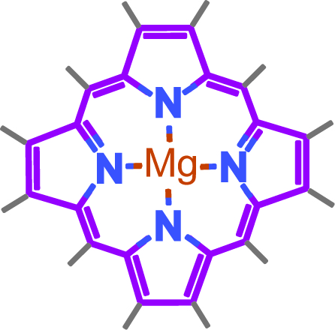
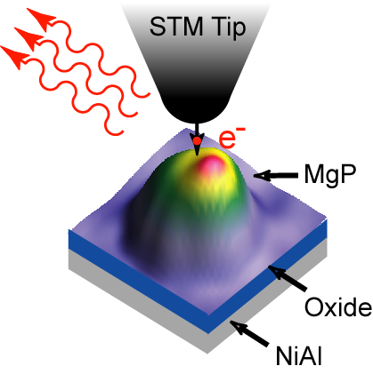
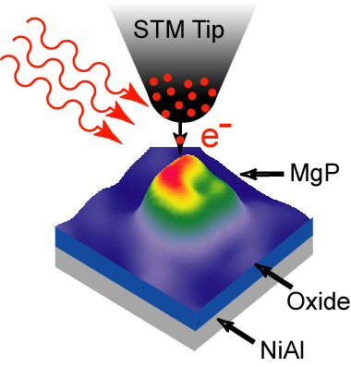
Diffraction Unlimited Resolution
Detecting photon emission from the STM:
e⁻ in, ν out
Coupling lasers into the STM:
ν in, e⁻ out

Slide 8
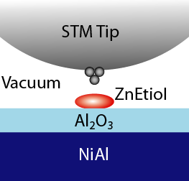
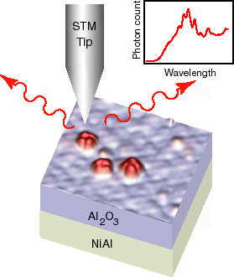
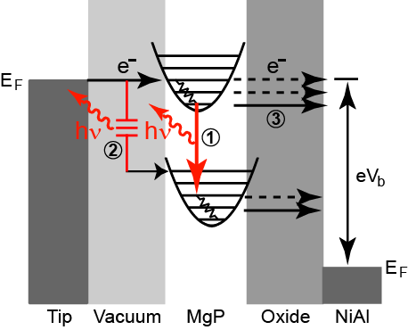
Single Molecule Fluorescence

Slide 9
Tunneling Electron Induced Light Emission
UHV chamber
Collection Efficiency: 1%
Notes:
slide number3

Slide 10
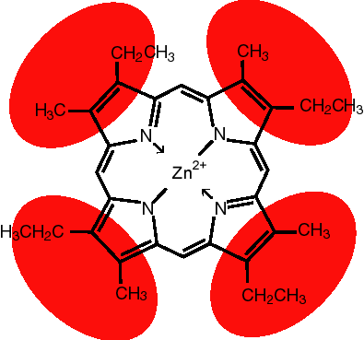
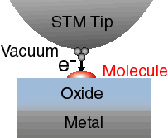
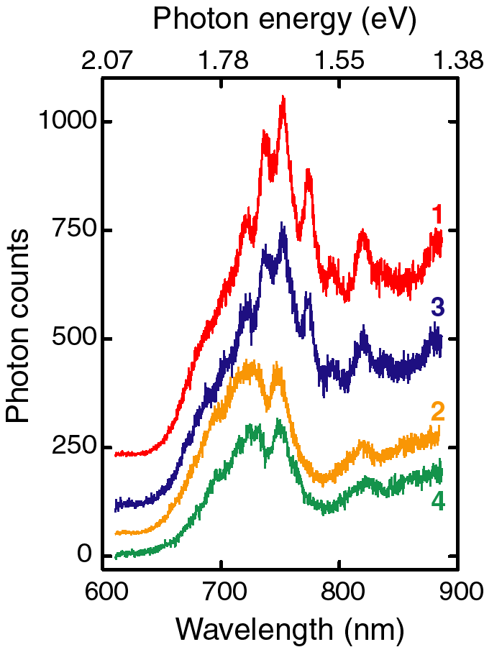
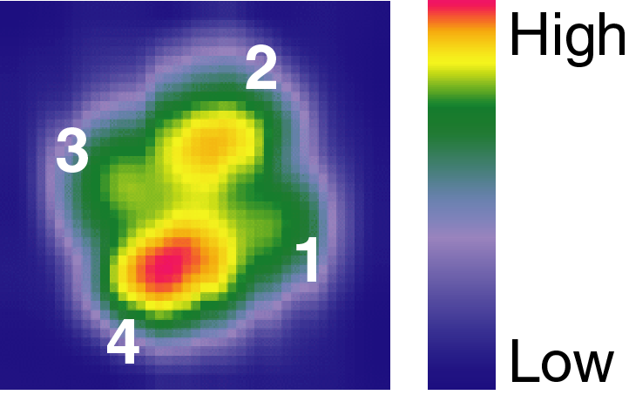
Photon Emission From Molecules on Oxide Films

Slide 11
TIF – Ag vs. W Tips

Slide 12
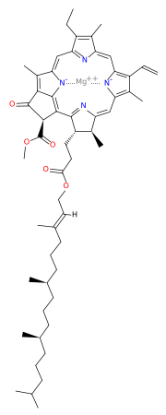
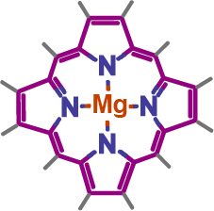
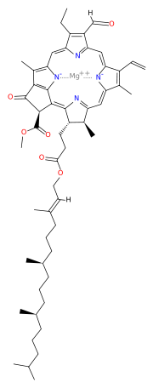
Magnesium Porphine (MgP)
Chlorophyll-a
Chlorophyll-b
The simplest porphyrin.
Center of photosynthesis.
Interesting optical and electrical properties.

Slide 13
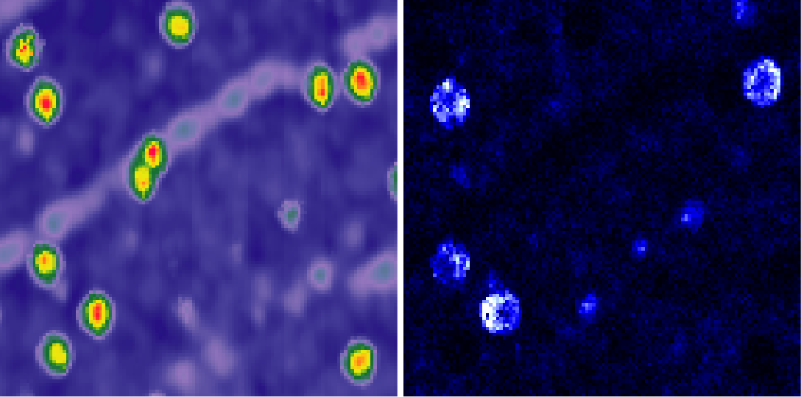
Searching for Emitting MgP
STM topography
Photon image
37 × 37 nm

Slide 14
4/11 MgP Are Emitting
STM topography
Photon image
37 × 37 nm

Slide 15
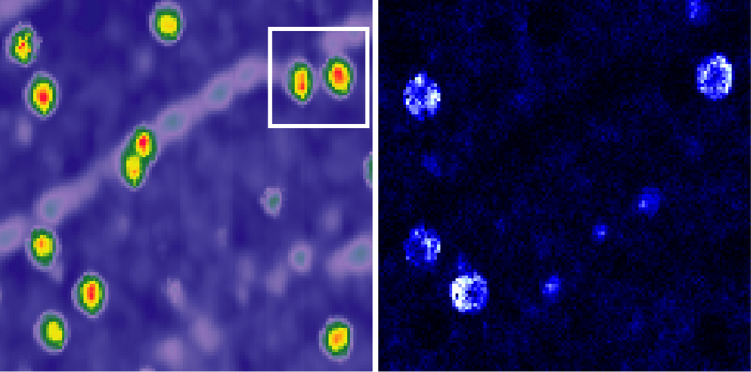
Let’s Zoom in
STM topography
Photon image
37 × 37 nm

Slide 16
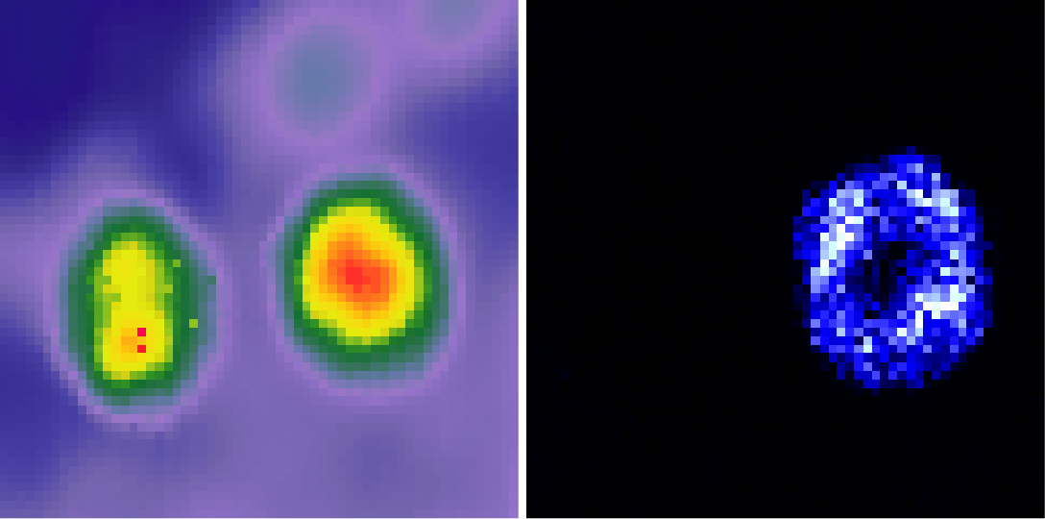
Symmetric Emitting MgP
STM topography
Photon image
6.8 × 6.8 nm

Slide 17
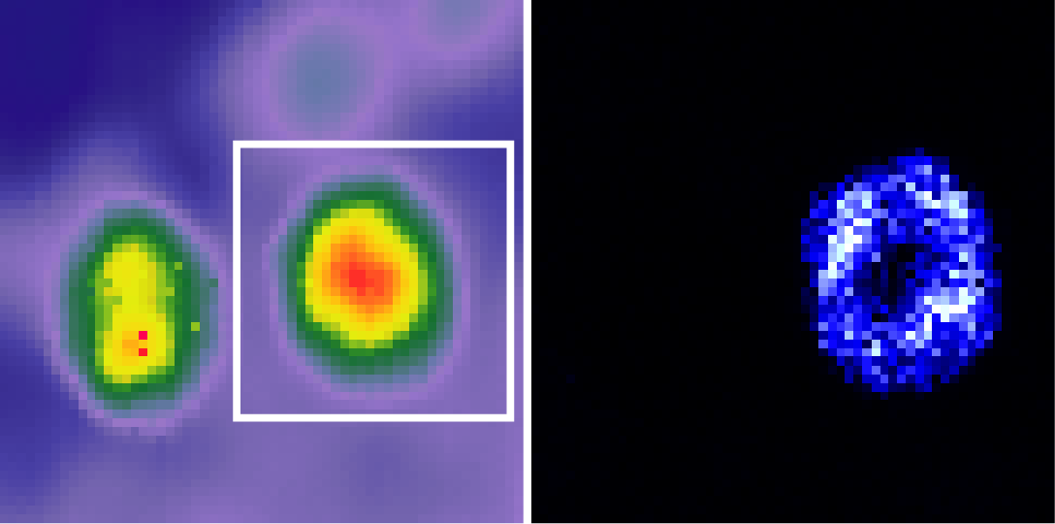
Let’s Zoom in
STM topography
Photon image
6.8 × 6.8 nm

Slide 18
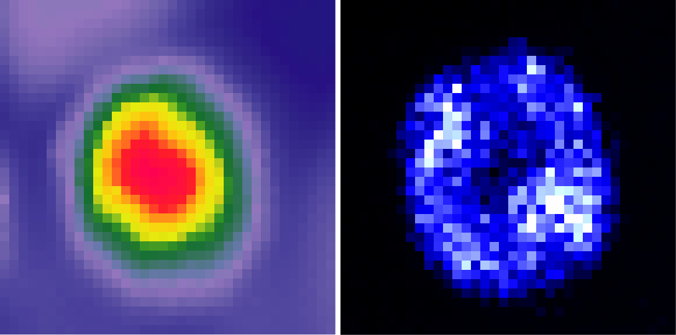
Ring-Like Emission Pattern
Weak emission in the center.
Ring is the chromophore.
3.5 × 3.5 nm

Slide 19
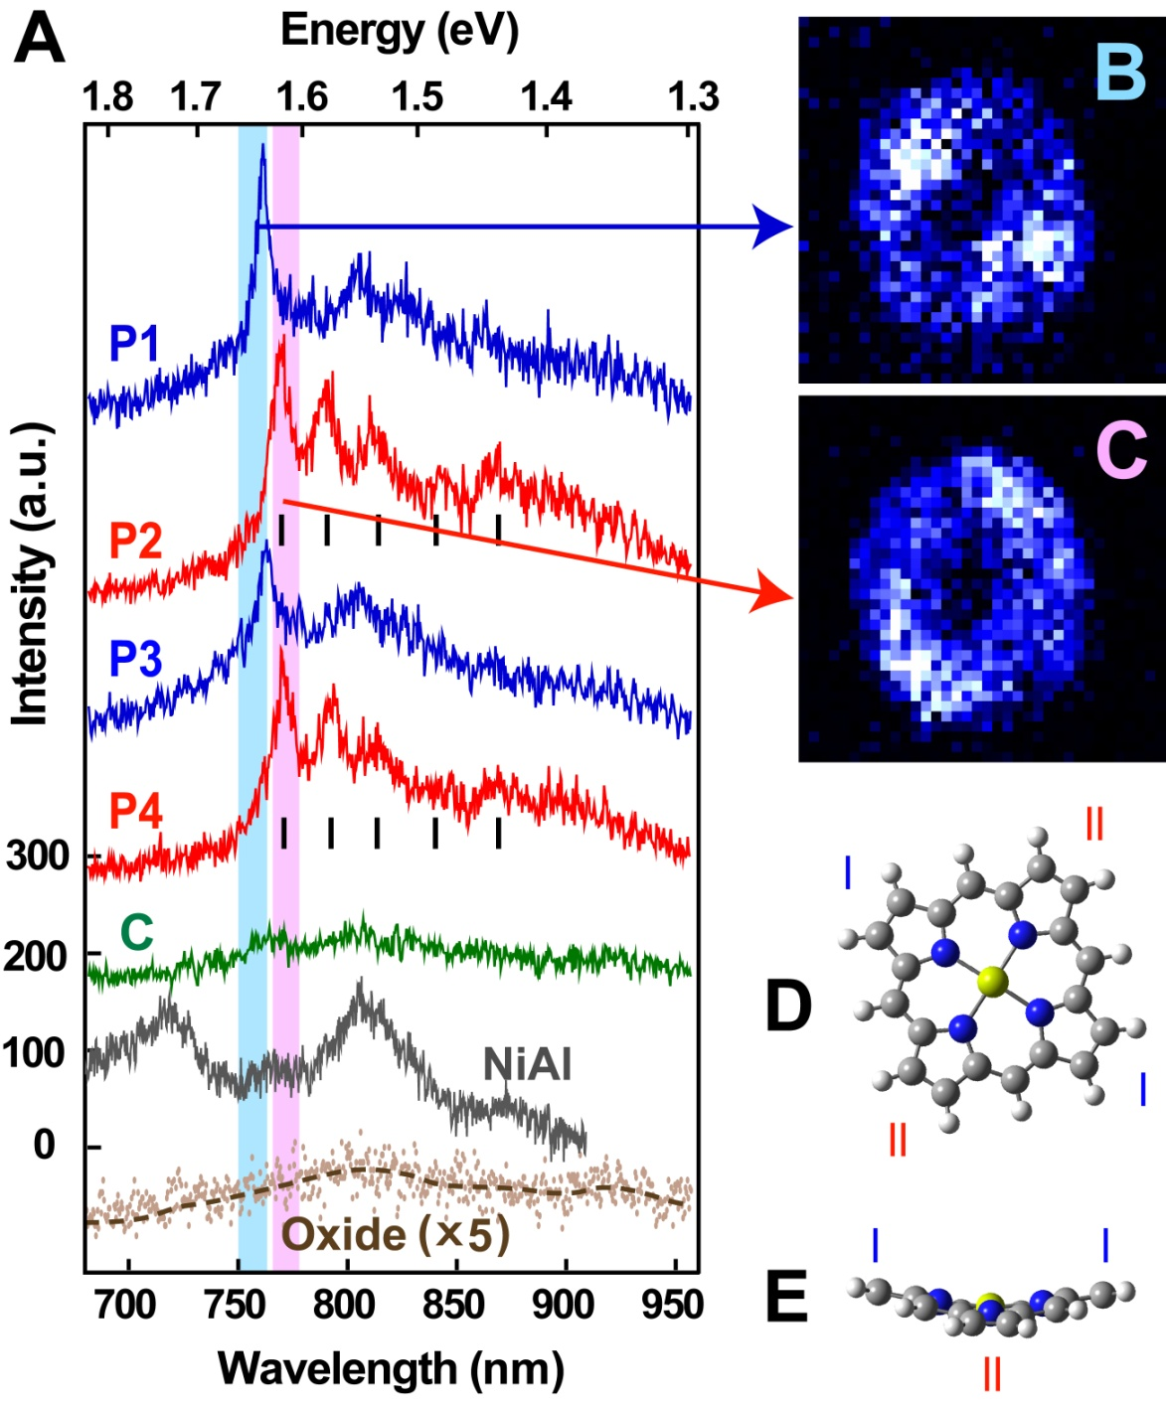
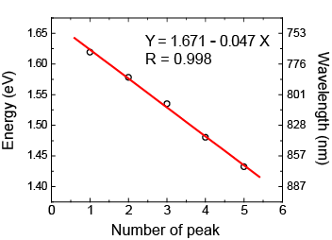
Spatially Resolved Vibronic Fluorescence
Slope = 47 meV (380 cm⁻¹)
Pyrrole ring tilt and rotation mode

Slide 20
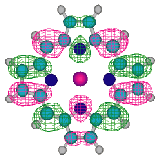
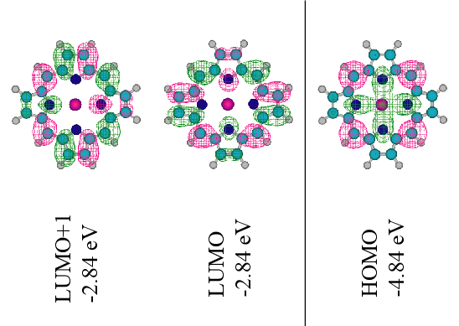
Spatially Resolved Vibronic Fluorescence
↓

