Slide 1
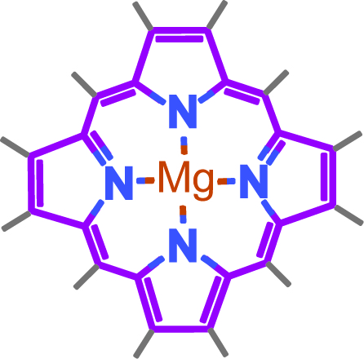
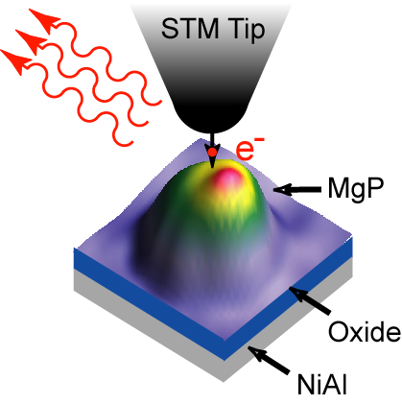
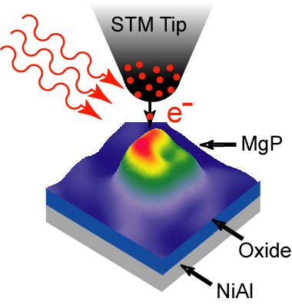
Diffraction Unlimited Resolution
Detecting photon emission from the STM:
e⁻ in, ν out
Coupling lasers into the STM:
ν in, e⁻ out

Slide 2
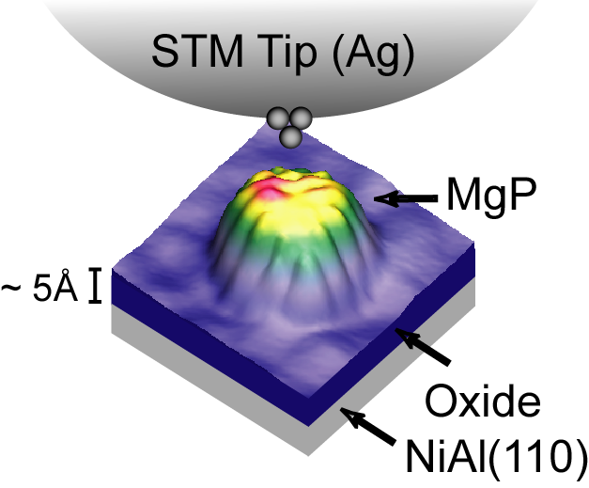
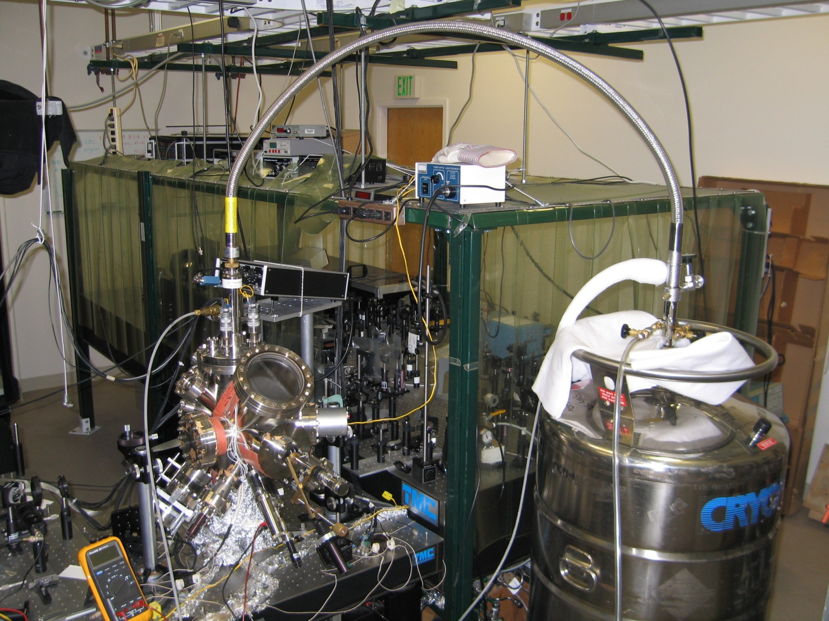
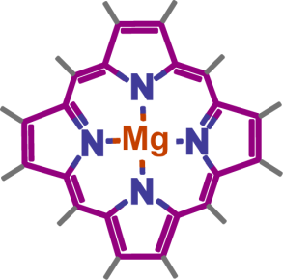
The Experimental Setup
CW:
532 nm (Nd:YAG);
633 nm (HeNe);
800 nm (Ti:Sapphire)
Pulsed:
800 nm, 70 fs duration
Lasers
STM
Magnesium Porphine
LHe
Lens
Lens

Slide 3
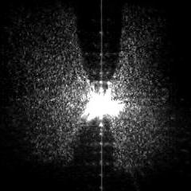
Probing Light-Matter Interactions at the Atomic Scale
Tip
image
Real
tip

Slide 4
Probing Light-Matter Interactions at the Å-Spatial Resolution
Tip
image
Real
tip
S.W. Wu, N. Ogawa, W. Ho, Science 312, 1362 (2006).

Slide 5
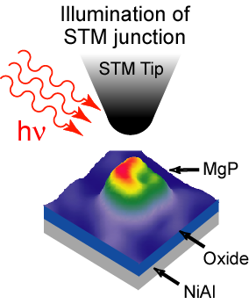
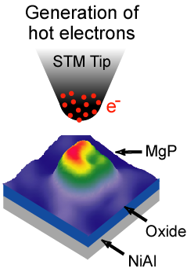

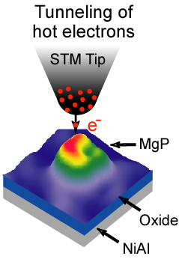
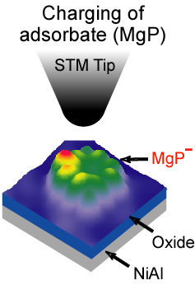
Photo-induced resonant tunneling

Slide 6
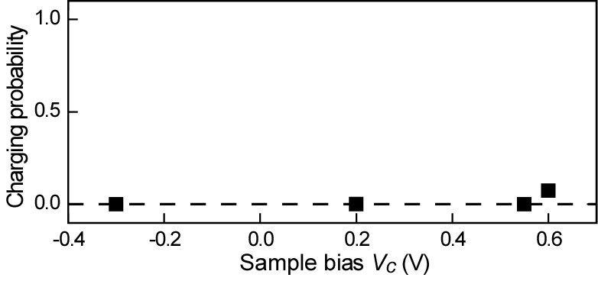
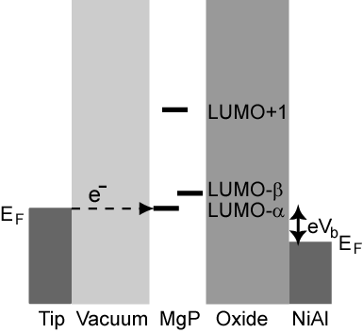
The charging of molecule is initiated by resonantly tunneling into the molecular states.
Onset of LUMO-α
Without illumination

Slide 7
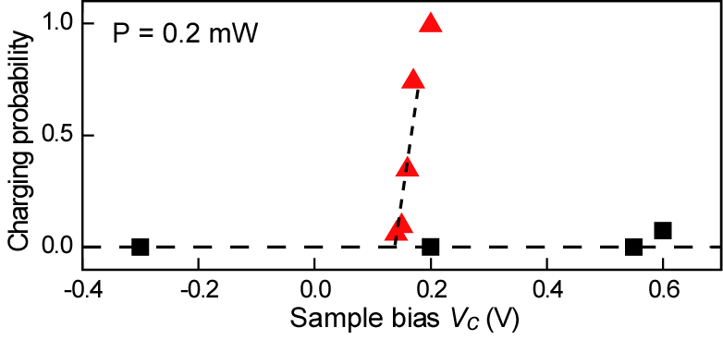
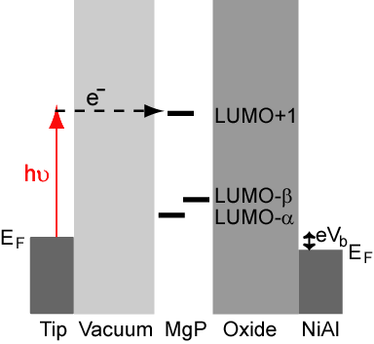
The photo-induced channel reduces the voltage threshold of charging.
633 nm
CW
Without illumination
λ = 633 nm (1.96 eV)

Slide 8
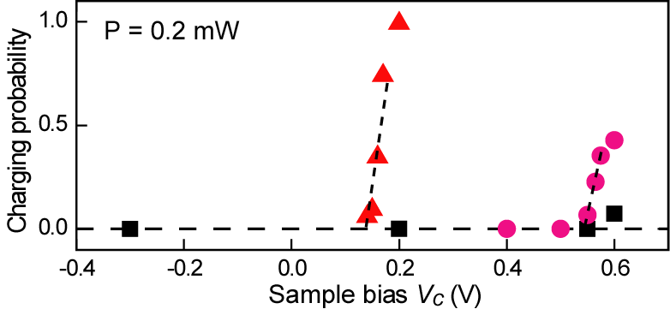
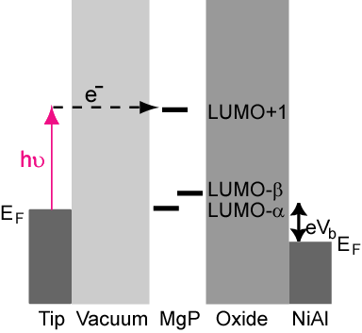
The photo-induced channel reduces the voltage threshold of charging.
800 nm
CW
λ = 633 nm (1.96 eV)
λ = 800 nm (1.55 eV)

Slide 9
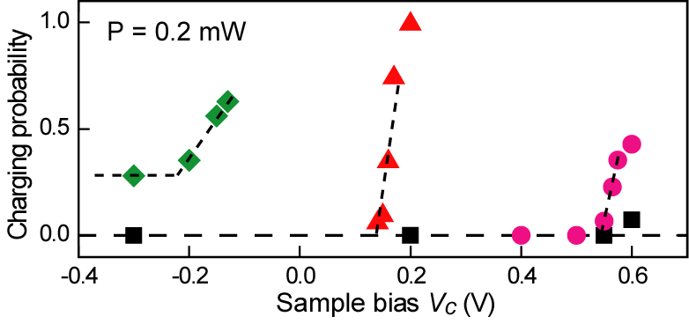
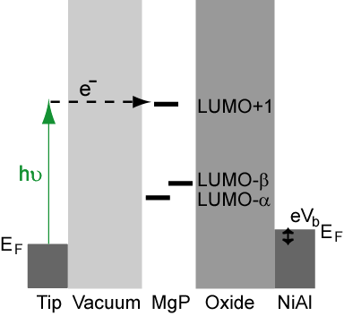
The photo-induced channel reduces the voltage threshold of charging.
532 nm
CW
λ = 532 nm (2.34 eV)
λ = 633 nm (1.96 eV)
λ = 800 nm (1.55 eV)

Slide 10
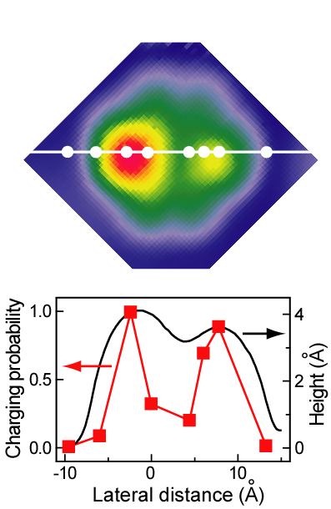
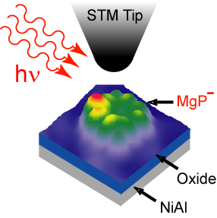
Å-Resolution in Photo-Induced Electron Transfer
Coupling photons to the tunneling process
Ångström Resolution!
S.W. Wu, N. Ogawa, W. Ho, Science 312, 1362 (2006).

Slide 11
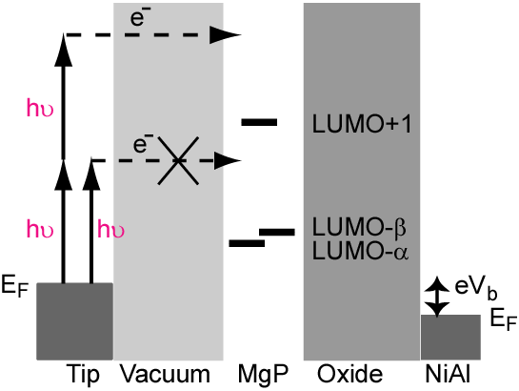
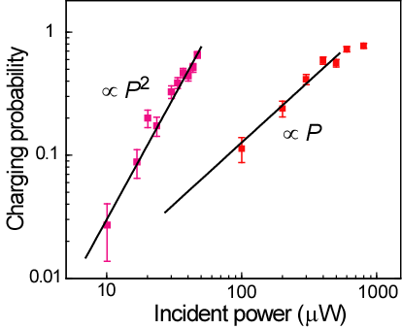
The tunneling of hot electrons is photo-induced, via one-photon or two-photon absorption.
807 nm, ML, 70 fs
Vc = 0.3V
633 nm, CW
Vc = 0.2V

Slide 12
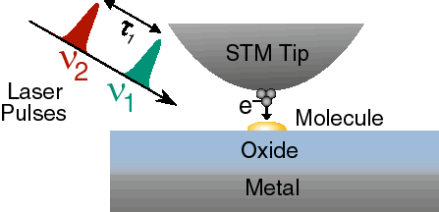
Ultrafast Optical Spectroscopy with Spatial Resolution of the STM

Slide 13
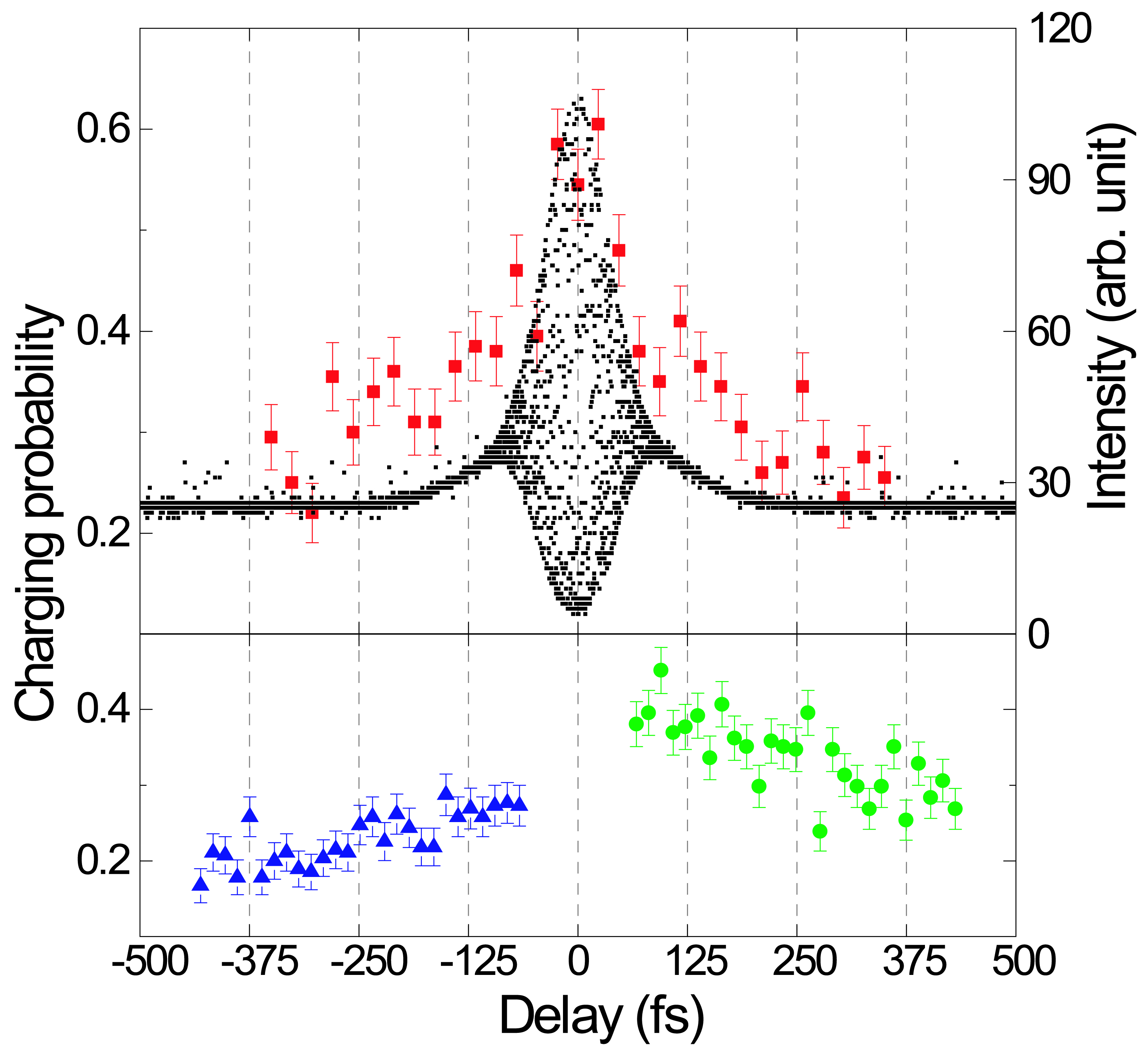
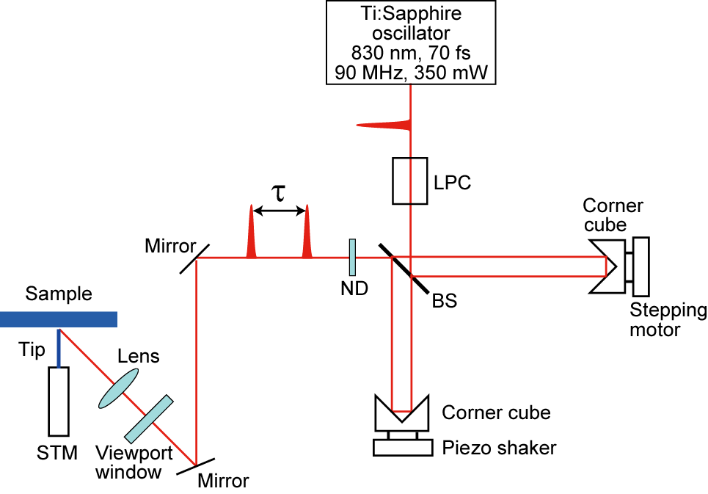
Dynamics of Electron Transfer at the Å-fs Limit
1.8
pJ/pulse
Peaks @
125, 250, 375 fs
8 THz or
33 meV
↓
↓
↓
↓
↓
↓
S.W. Wu, W. Ho, Phys. Rev. B 82, 085444 (2010).

Slide 14
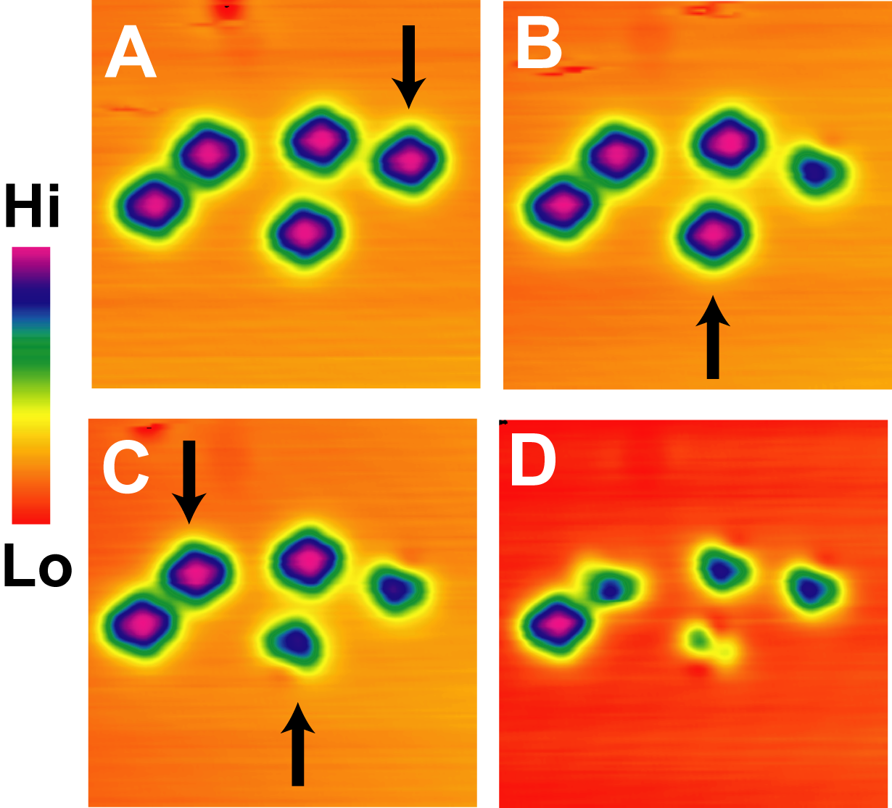
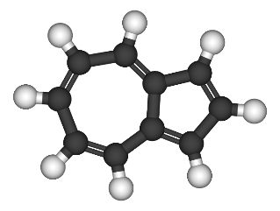
Single-Bond Dissociation
azulene

Slide 15
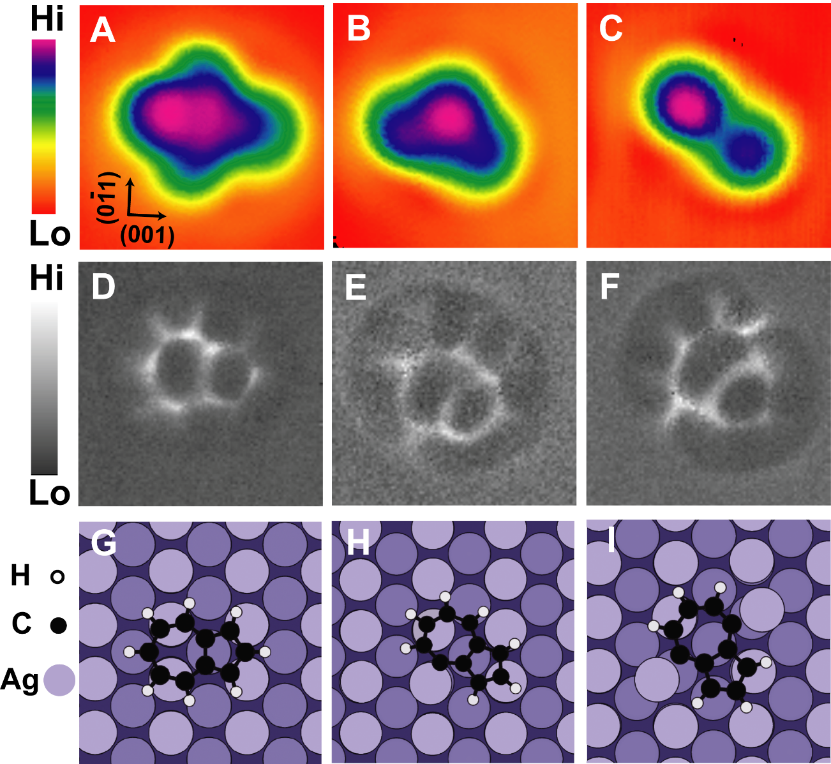

Structural Imaging
azulene

Slide 16
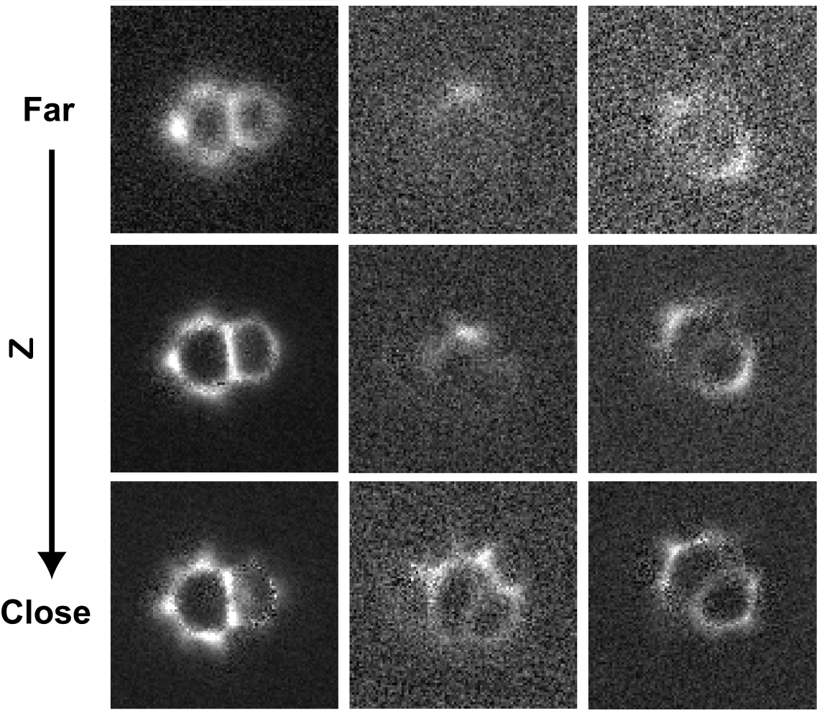


Single-Molecule Tomography

Slide 17
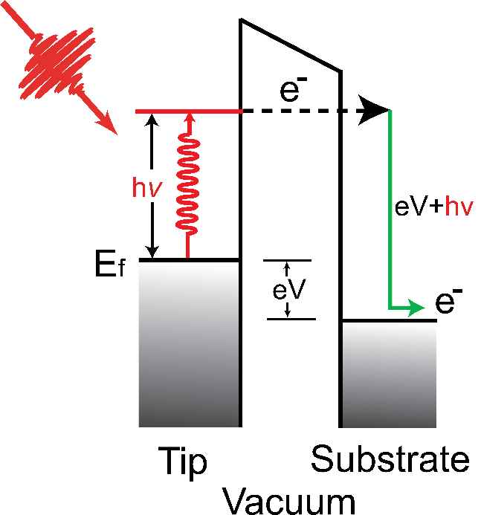
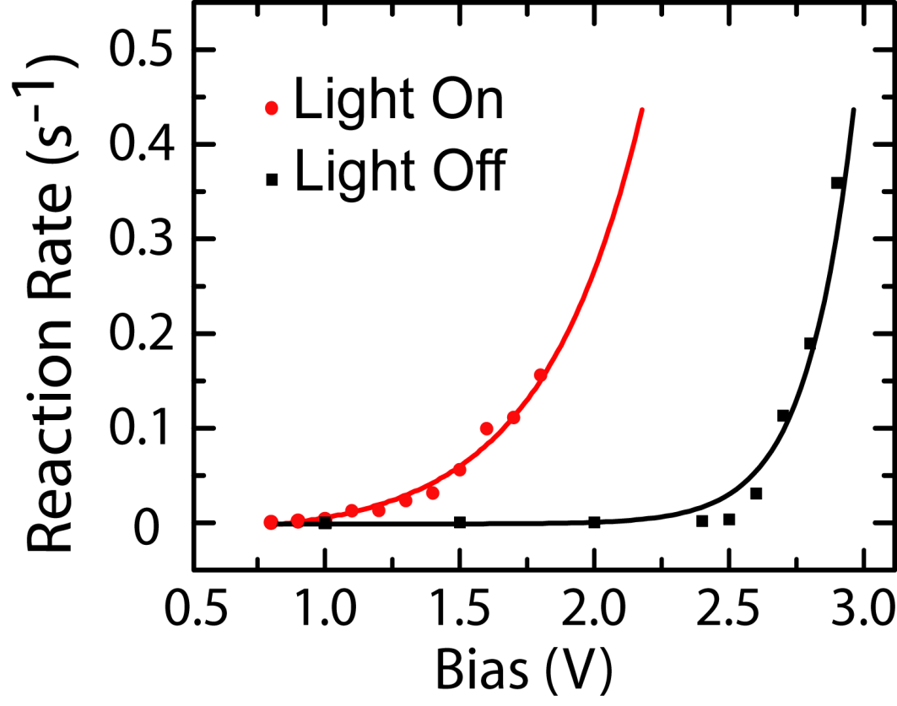
Light Induced Single-Bond Dissociation

Slide 18
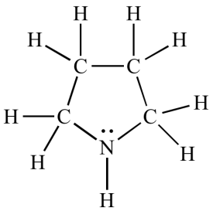
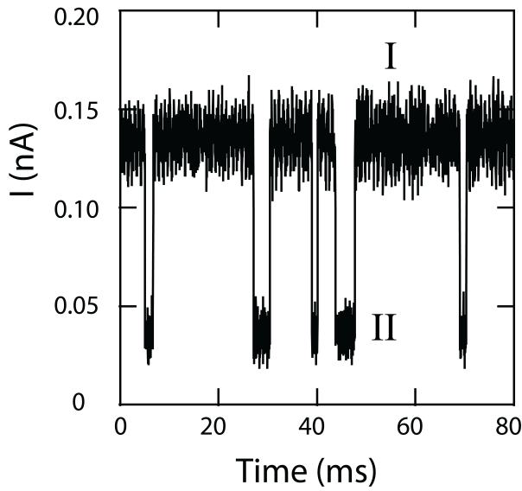
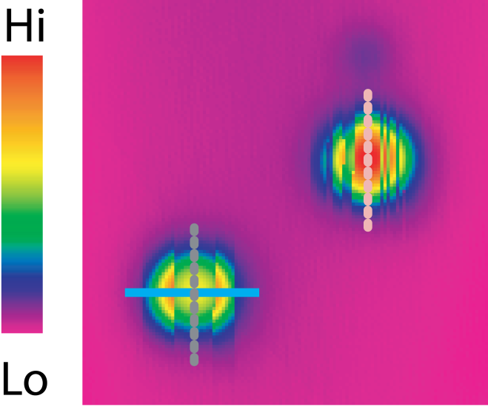
Tunneling Electron Induced Conformation Change
pyrrolidine
Ι
ΙΙ
J. Gaudioso, L.J. Lauhon, W. Ho, Phys. Rev. Lett. 85, 1918 (2000).

Slide 19
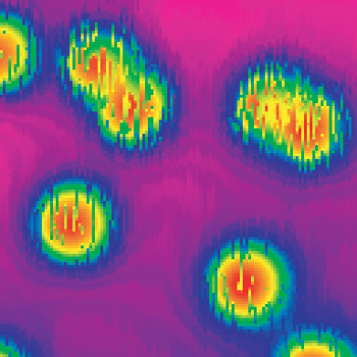
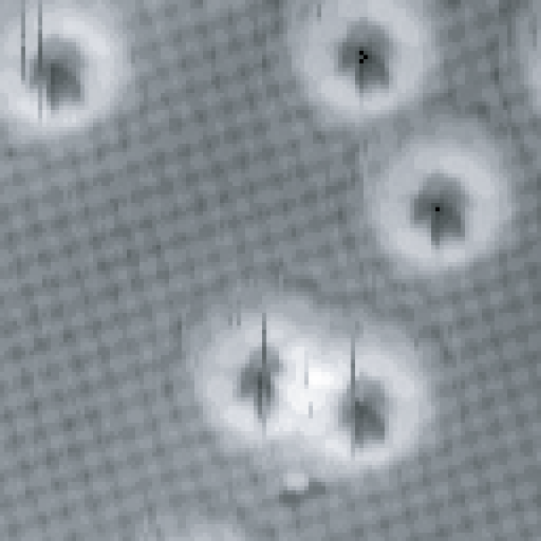
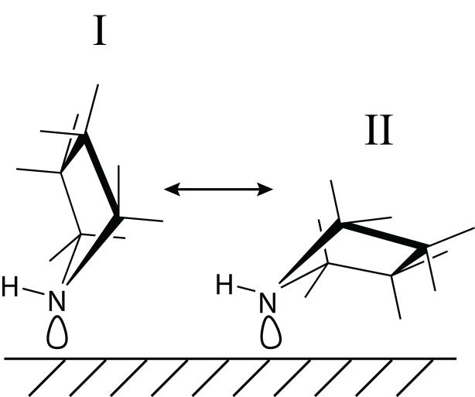
Heterogeneous Landscape: the need for single molecule studies
pyrrolidine
Cu(001)

Slide 20
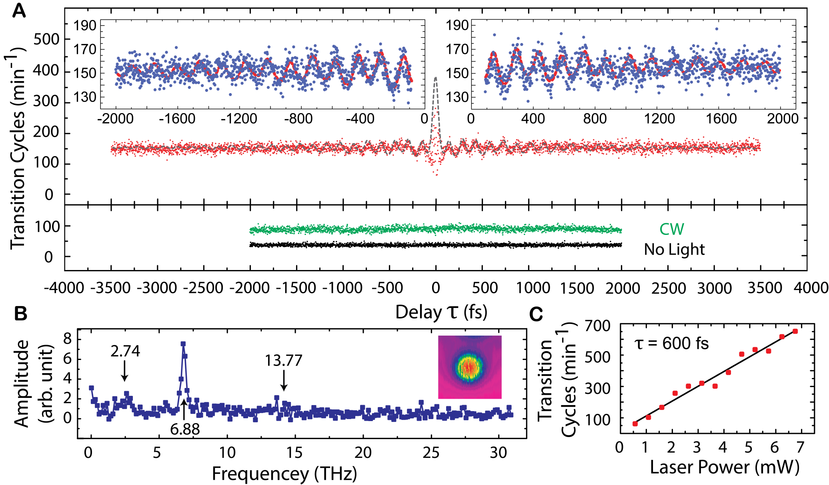
CaSTL: Monomer Dynamics

Slide 21
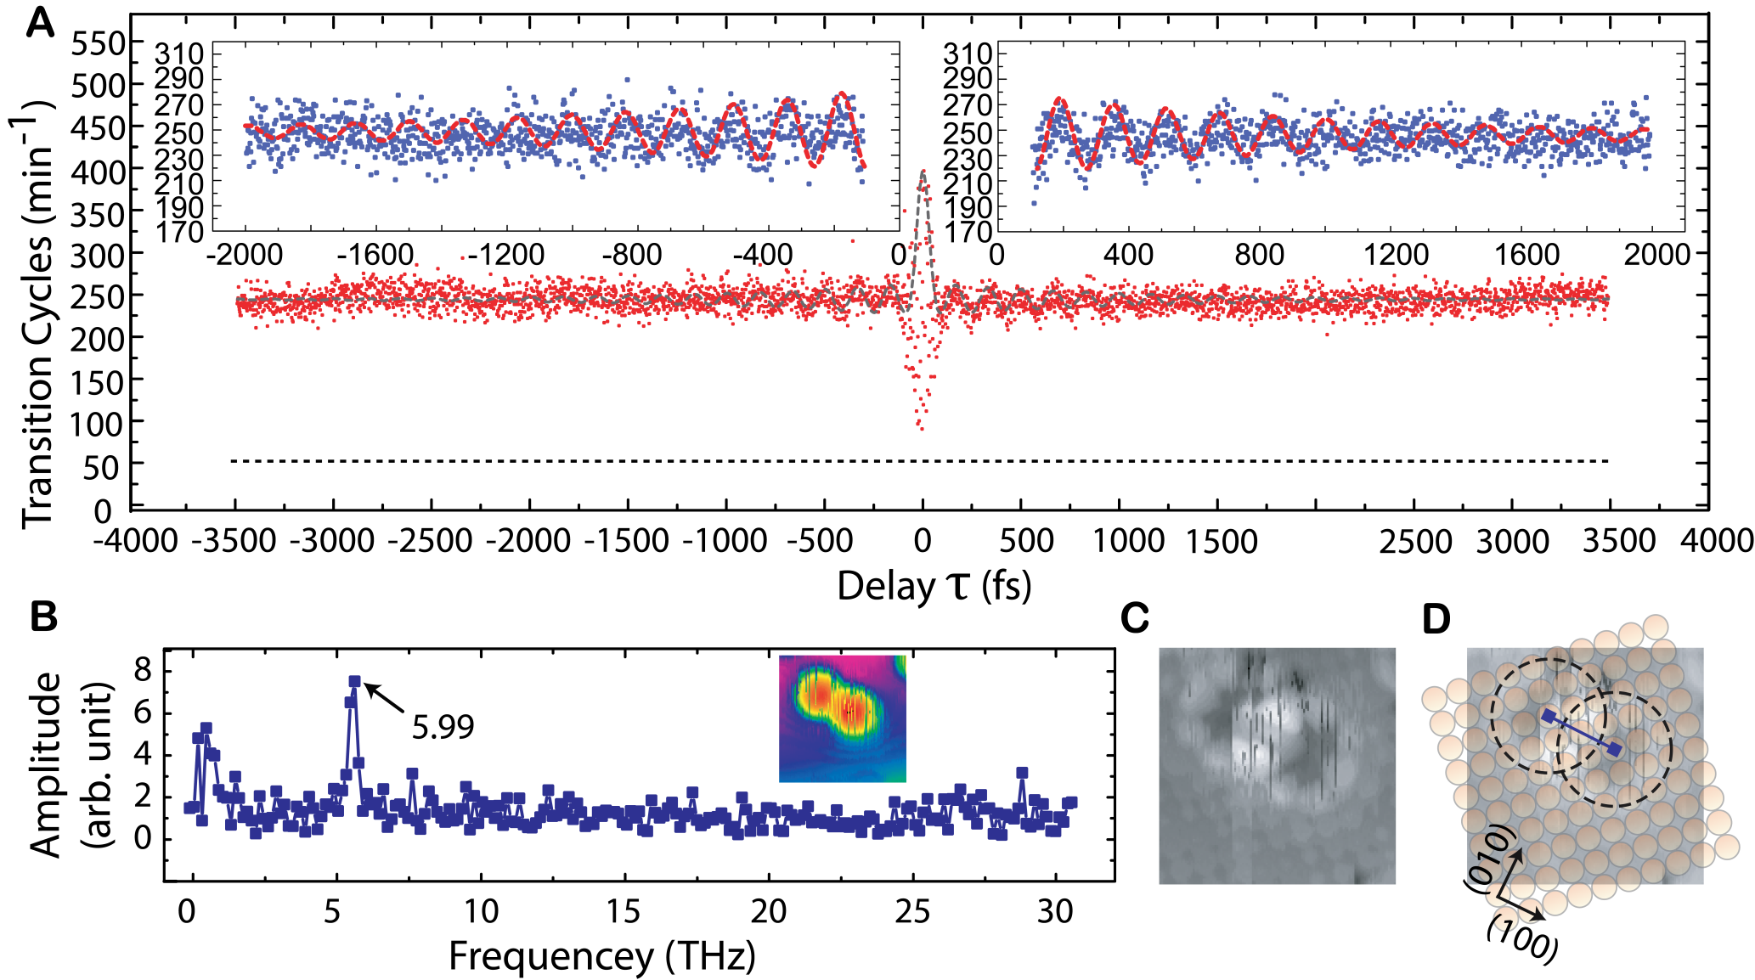
CaSTL: Single Dimer Dynamics

Slide 22
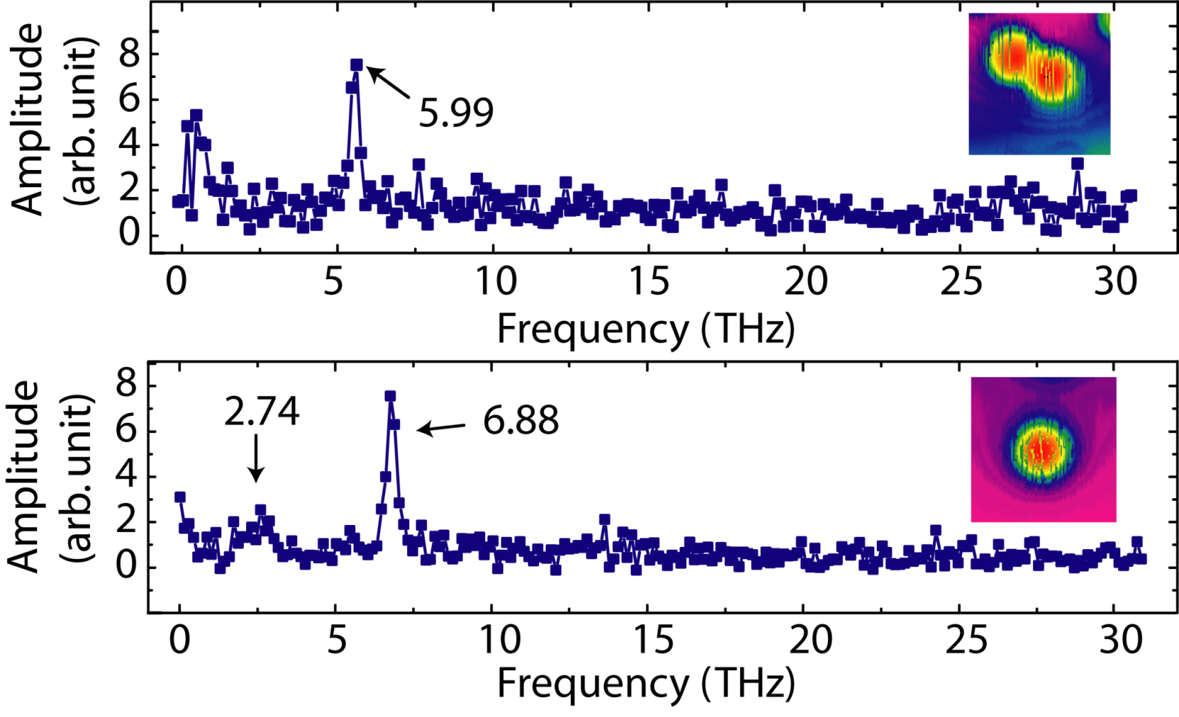
Monomer vs. Dimer
167 fs
6.0 THz
24.8 meV
146 fs
6.9 THz
28.5 meV

Slide 23
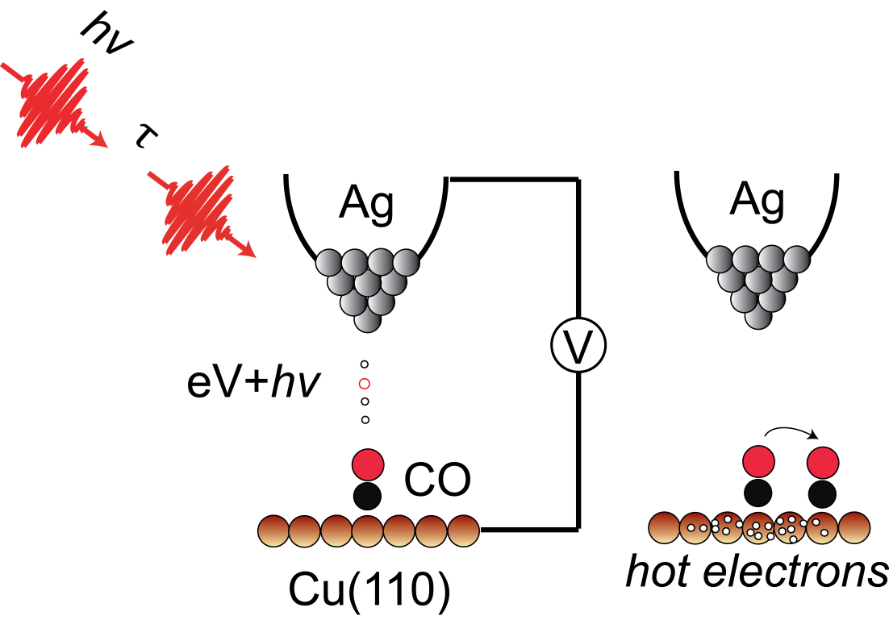
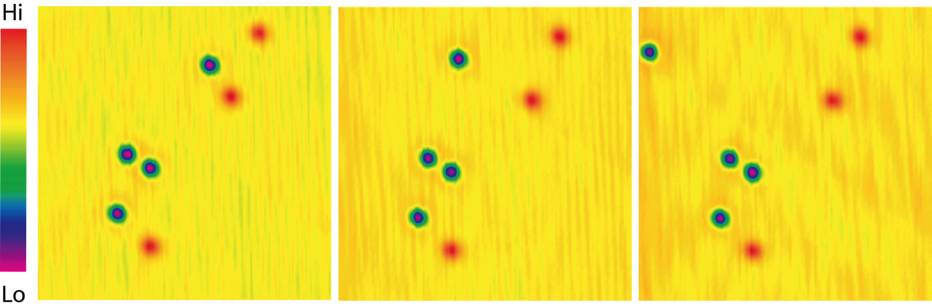
Moving Single CO on Cu(110) with fs Light, watch with STM
Wilson Ho, Ruqian Wu
fs time
resolution
Å spatial
resolution
Notes:
Three still topographic images showing from left to right laser induced hopping of a CO molecule on the Cu(110) surface at 10 K.

Slide 24
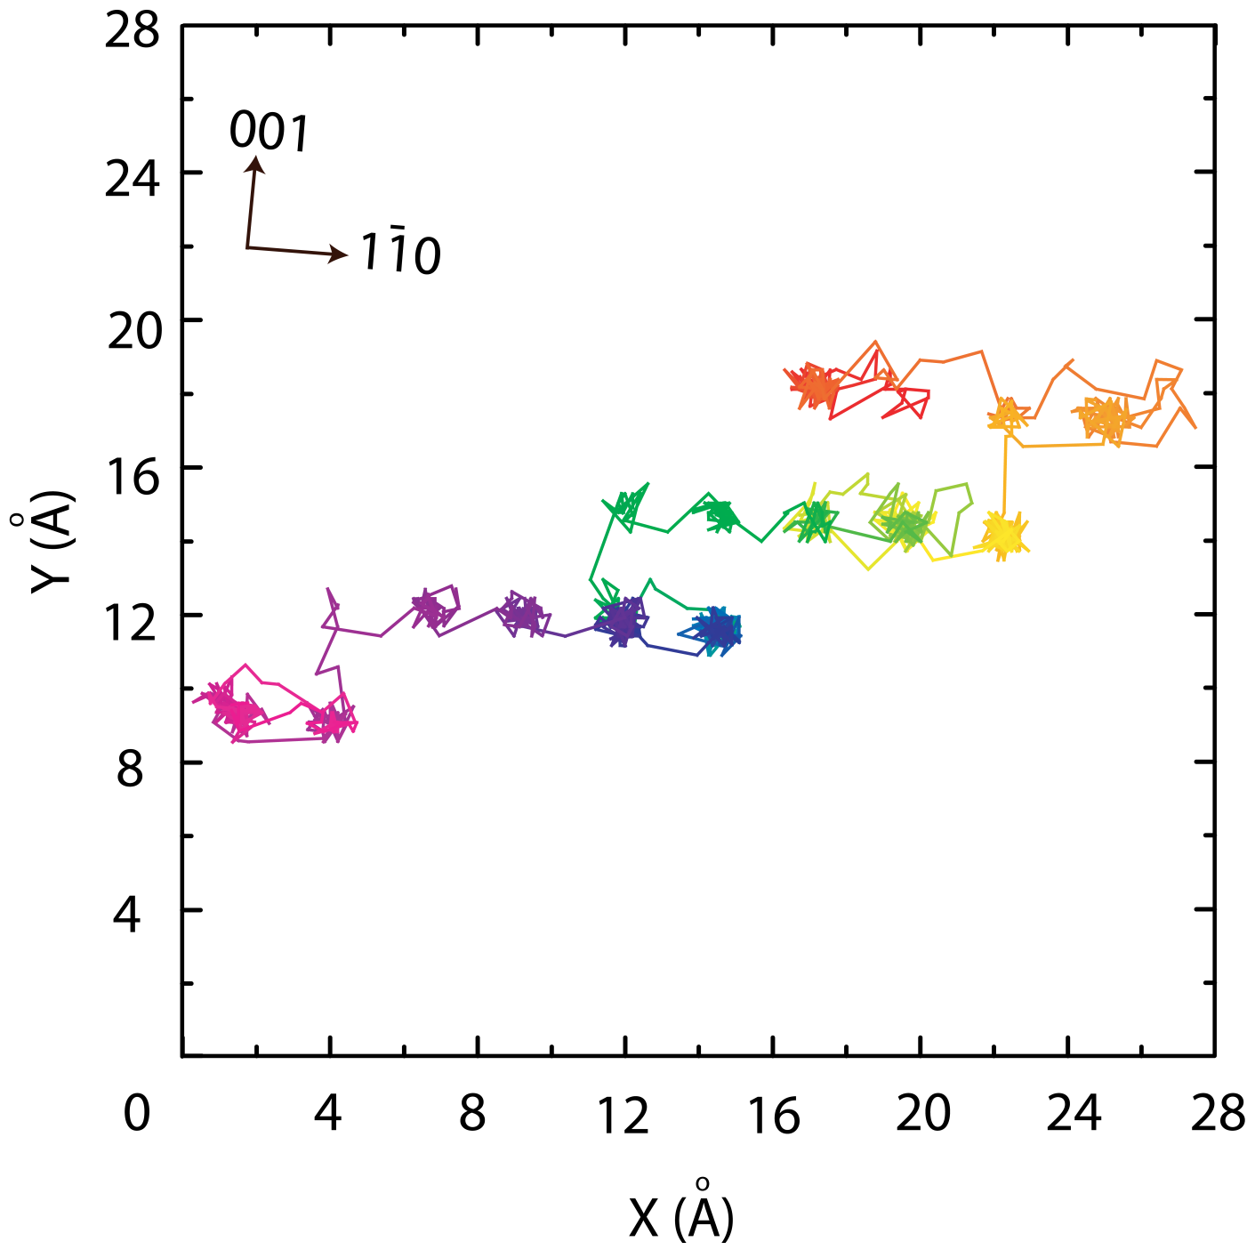
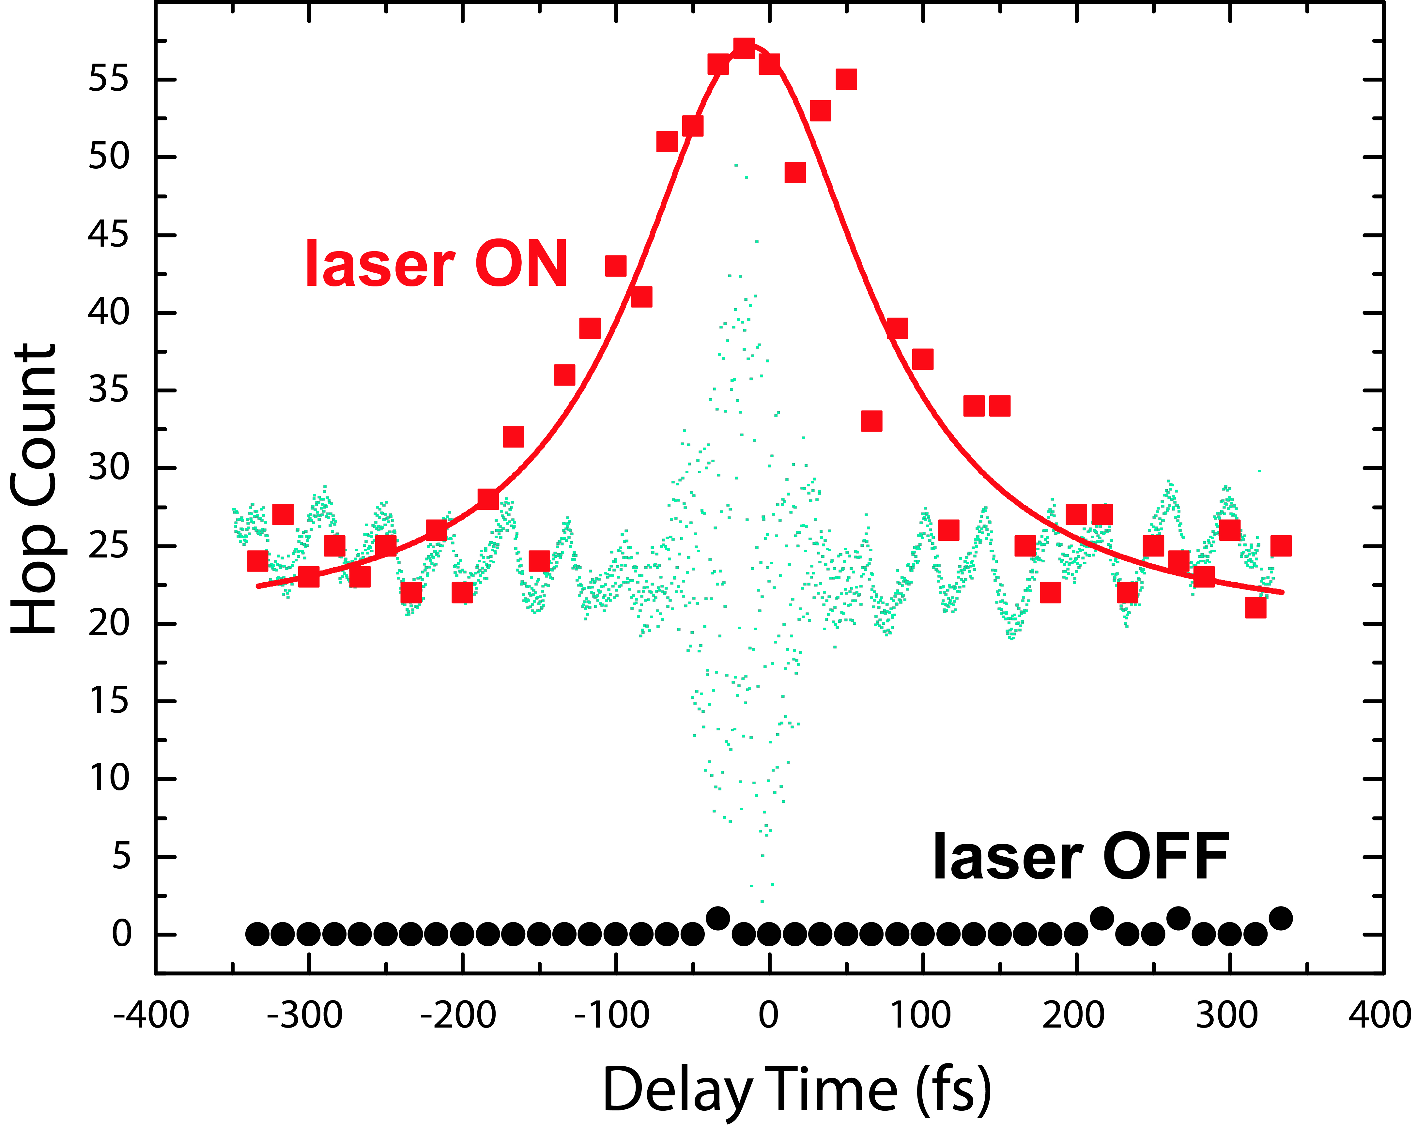
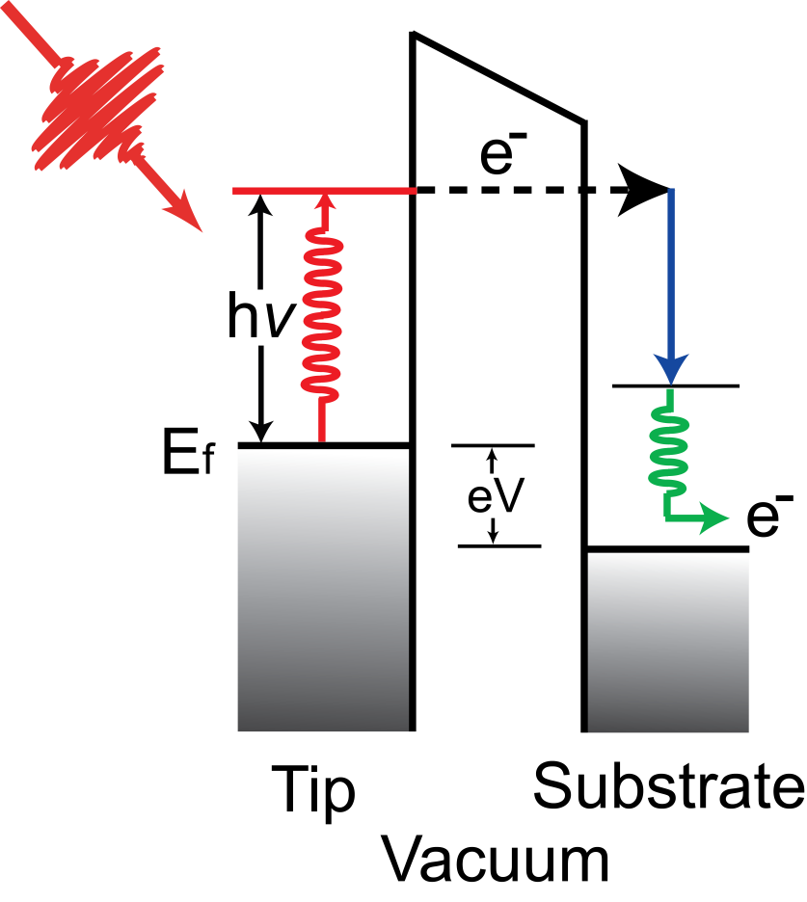
Dynamics of Laser Induced Hopping of Single CO on Cu(110)
Wilson Ho, Ruqian Wu
hot
e⁻
40 fs laser
pulse width
Notes:
Still picture showing the sites occupied by CO during the femtosecond laser induced hopping on a Cu(110) surface at 10 K.

