Slide 1

Designing Chemistry Using Biology
James C. Liao
Academia Sinica, Taipei, Taiwan

Slide 2
Precise,
Predictable
Designable
Non-precise
Unpredictable
Physics
Chemistry
Biology
Precise,
Predictable
Designable
Non-precise
Unpredictable
Physics
Chemistry
Biology

Slide 3
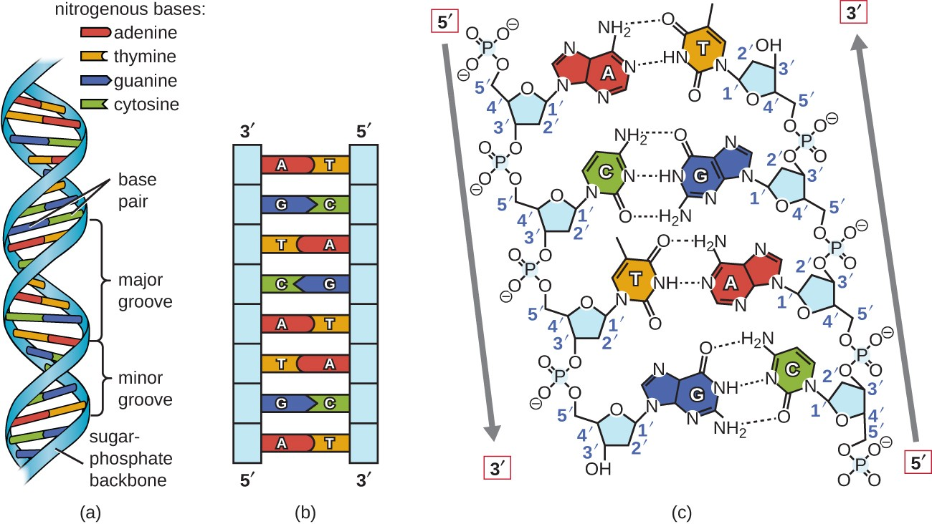

Slide 4
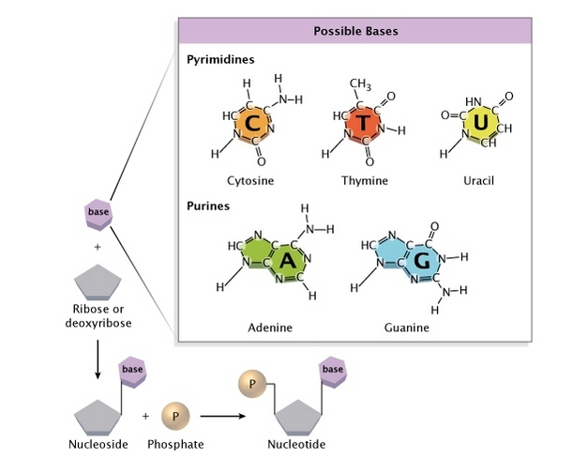


Slide 5
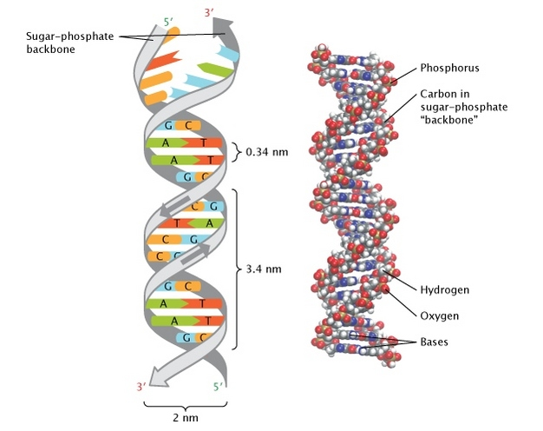

Slide 6
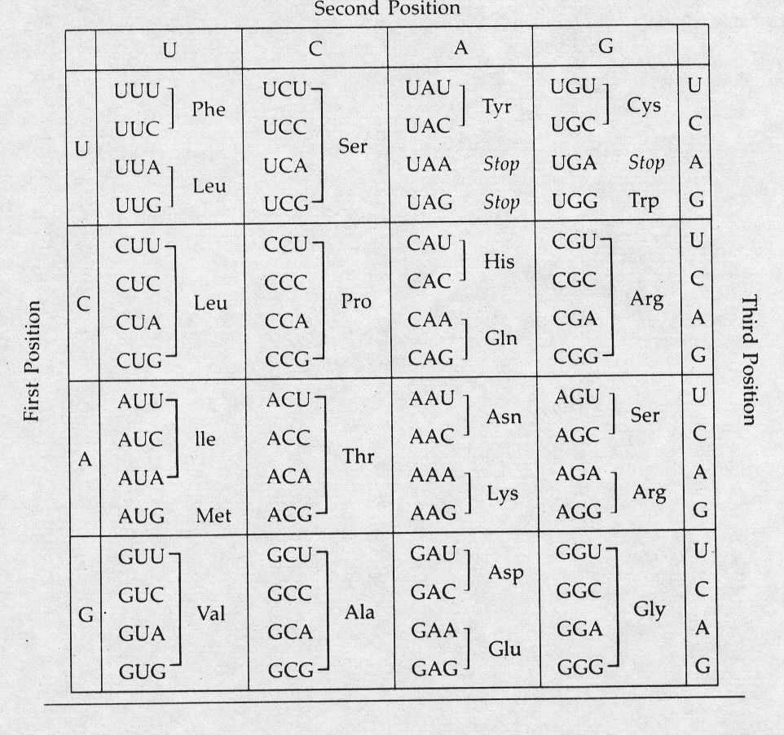

Slide 7
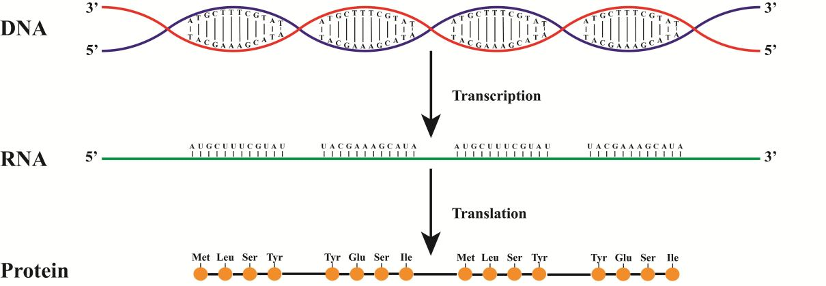
Biology becomes digital (數位化)

Slide 8
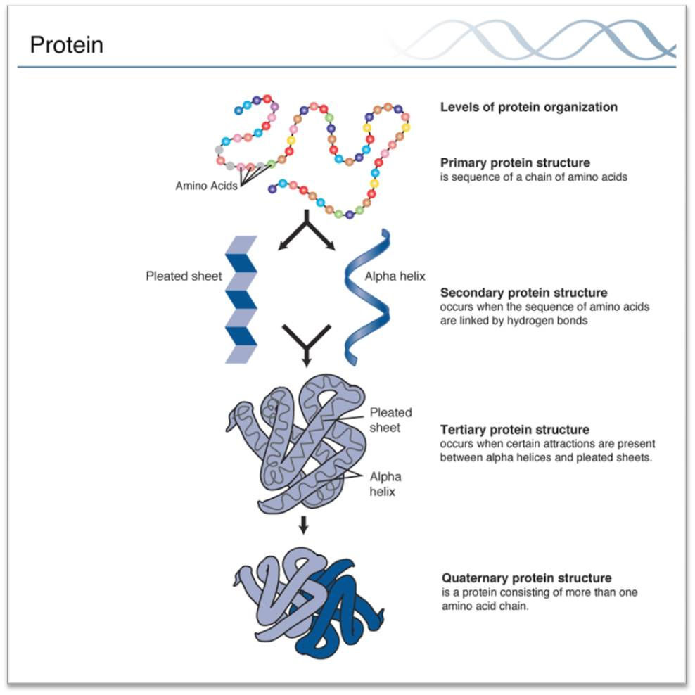
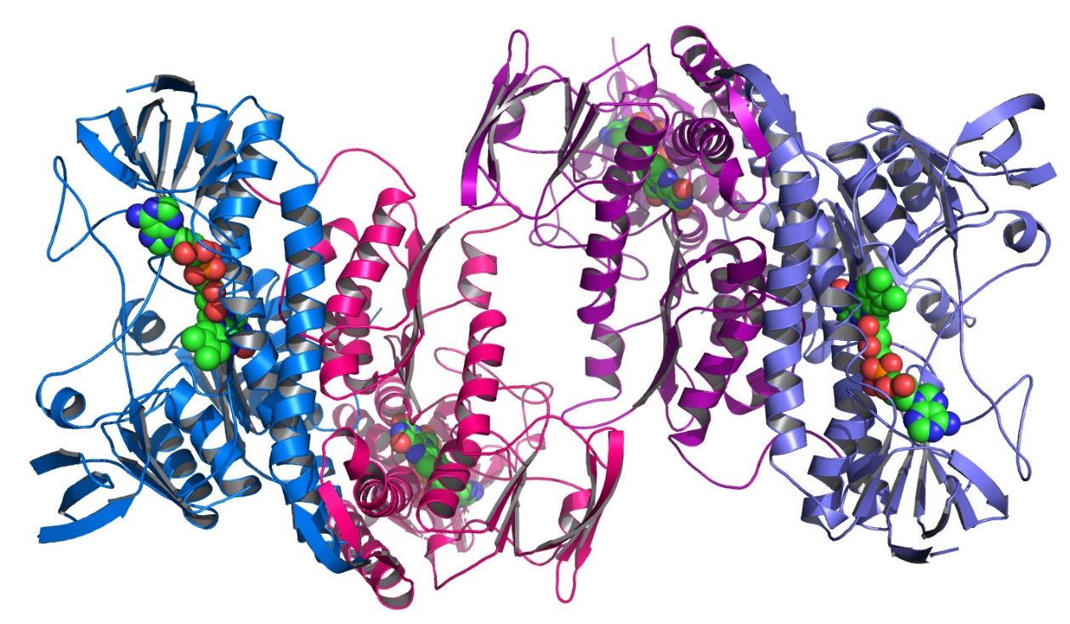

Slide 9
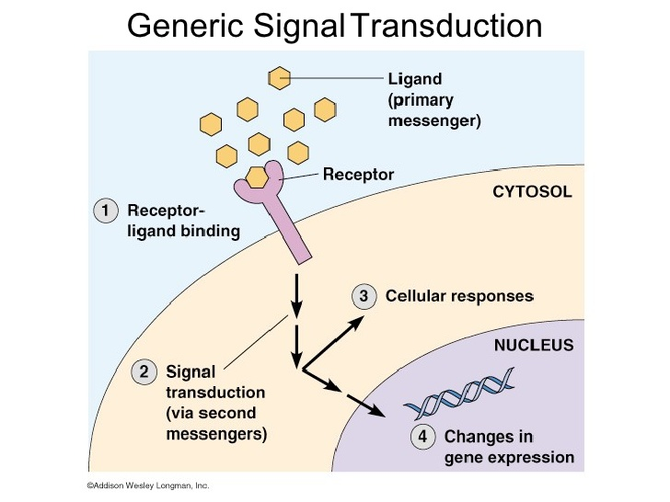
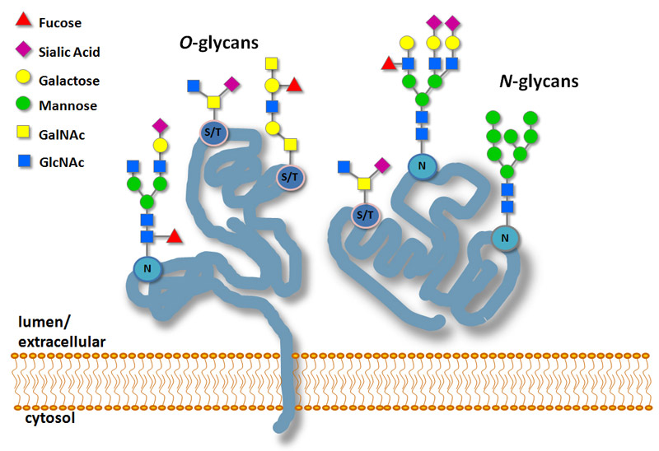

Slide 10
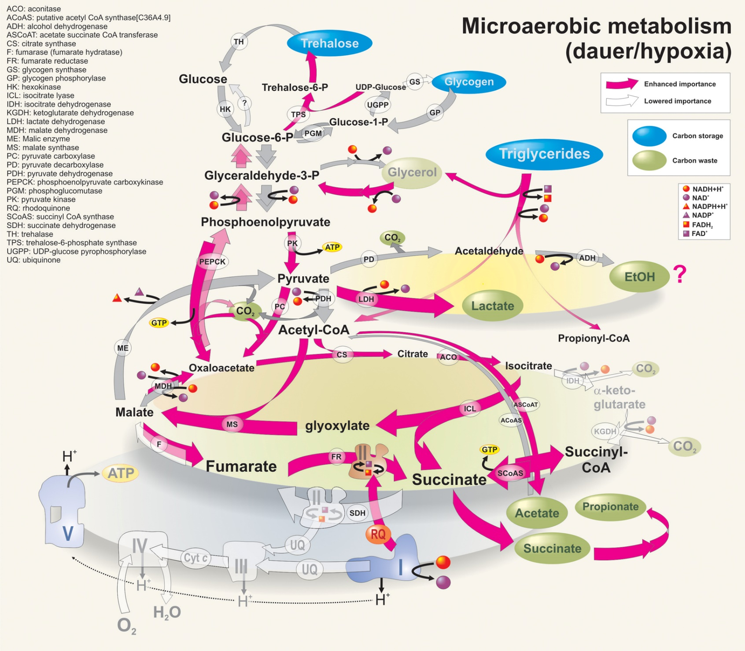

Slide 11
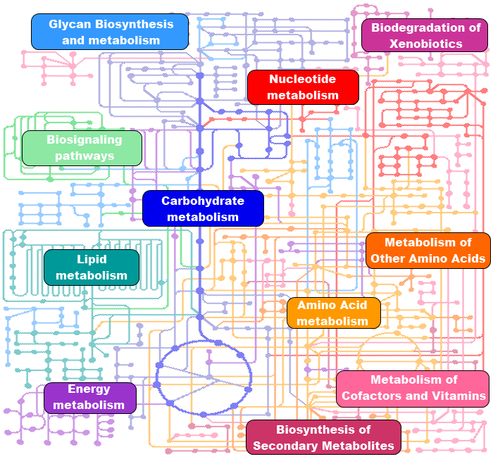

Slide 12
Biology becomes digital (數位化)
數位化
模組化
客製化
1
0
觀念, 意象
類比性
情境依賴性
1
0

Slide 13
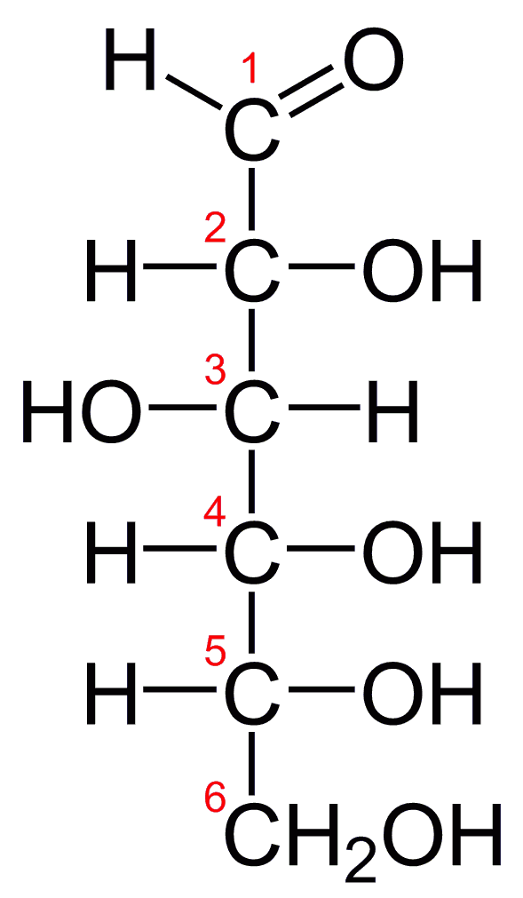
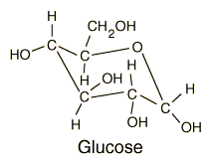
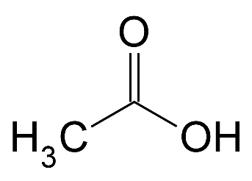
Non-oxidative glycolysis
?
C₆H₁₂O₆
3
C₂H₄O₂

Slide 14
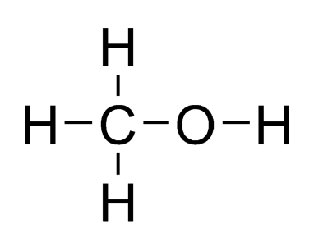
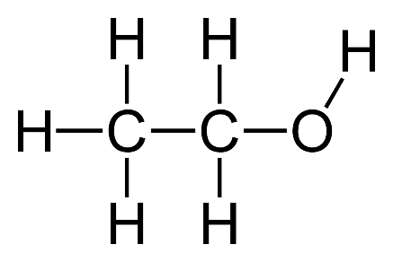
Methanol condensation
?
H₂O
2 CH₃OH C₂H₅OH + H₂O

Slide 15
CO2 reduction
6 “H₂”
2 CO₂
C₂H₅OH
3 H₂O

Slide 16
C₅H₁₀O₅
Methanol/Pentose
Upgrading
CH₃OH
C₆H₁₂O₆
H₂
0.5 CO₂
Methane Upgrading
1.5 CH₄
C₂H₅OH

Slide 17
A
A
B₁
B₁
B
B
B₂
B₂
B₅
B₅
B₆
B₃
B₃
B₄
B₄
C
C

Slide 18
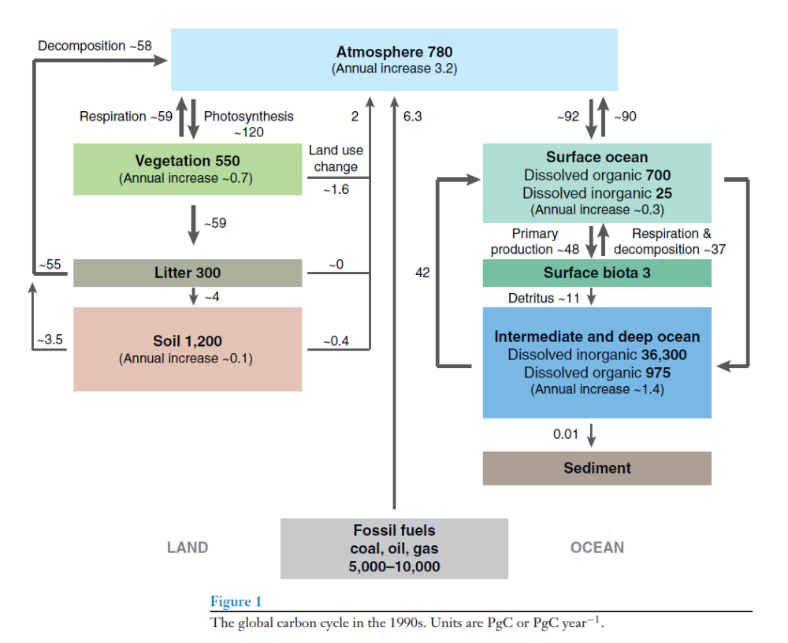
Ideal Biofuel should come from new photosynthesis
Atmosphere 780
(Annual increase 3.2)
2
4.3
Biofuel
Chemicals
Materials
Fossil fuels
Oil, coal, gas
5,000-10,000
Land
Modified from Houghton Annu. Rev. Earth Planet. Sci. 2007
Ocean

Slide 19
Ideal Biofuel should come from new photosynthesis
Atmosphere 780
(Annual increase 3.2)
CH₄
Biofuel
Chemicals
Materials
Fossil fuels
Oil, coal, gas
5,000-10,000
Land
Modified from Houghton Annu. Rev. Earth Planet. Sci. 2007
Ocean

Slide 20
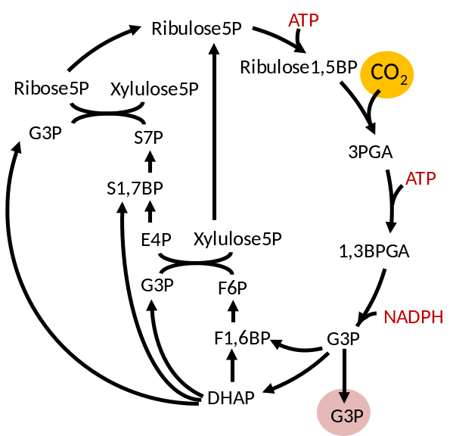
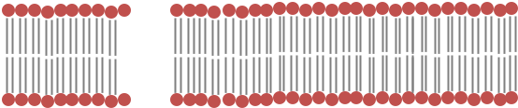
Pathways to Life
Cytoplasm
NADPH
hν
hν
Fd_{ox}
Fd_{red}
PQ
Cytochrome
b₆f complex
PQH₂
ATP
e⁻
Photosystem II
Pc-Cu⁺
Photosystem I
H₂O
O₂
Pc-Cu²⁺
Lumen
Calvin cycle (CBB pathway)
Light reactions
Cellulose
Glucose
Glycolysis (EMP pathway)
ATP
e⁻
TCA Cycle
CO₂
Acetyl-CoA
Pyruvate
CO₂
Fatty acid
Amino acids
Alcohol
Alcohol
Acids
Lipid
Acids
Isoprenoids

Slide 21
Theoretical Energy and Mass Yields
C₆H₁₂O₆ → 2C₂H₆O + 2 CO₂
energy %
mass %
2540 2 x 1235 kJ/mol 97.24% 51%
C₆H₁₂O₆ → C₄H₁₀O + 2 CO₂
2540 2455 kJ/mol 96.6% 41%
2 C₆H₁₂O₆ → C₇H₁₆ + 4CO₂ + CO
2x 2540 4543 kJ/mol 89.4% 27%

Slide 22
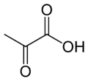
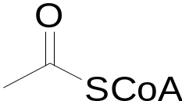
Oxidative Glycolysis
Embden-Meyerhof-Parnas (EMP) pathway
$0.4/Kg
Glucose
F6P
FDP
DHAP
G3P
2e⁻
Partial oxidation
C3
Pyruvate
Carbon yield = 66%
2e⁻
CO₂
Mass yield
= 50%
Acetyl-CoA
C2
$0.8/Kg
Ethanol
Butanol
Lipids
Isoprenoids

Slide 23
Non-oxidative glycolysis
?
C₆H₁₂O₆
3
C₂H₄O₂

Slide 24
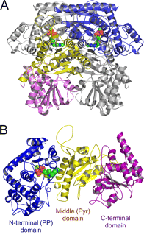
Non-oxidative Glycolysis (NOG)
Glucose
F6P
111
3 F6P
Carbon
Rearrangement
2 F6P
3 AcP
3 E4P
3 AcCoA
Bifidobacterium breve.
Phosphoketolase
Carbon yield = 100%
Ethanol
Butanol
Acetate
F6P →AcP + E4P
X5P → AcP + G3P

Slide 25











Carbon rearrangement: 3 E4P → 2 F6P
E4P
E4P
E4P
F6P
E4P
Tal
G3P
S7P
Tkt
Rpi
Rpe
E4P
X5P
R5P
Ru5P
X5P
E4P
Tkt
Tkt
Tpi
G3P
F6P
F6P
G3P
DHAP
Ald
FBP
F6P
Fbpase
F6P
F6P
Bogorad et al. Nature 2013

Slide 26
Two Modes of Non-Oxidative Glycolysis (NOG)
F6P phosphoketolase
F6P →AcP + E4P
X5P phosphoketolase
X5P →AcP + G3P
F6P
F6P
AcP
E4P
tal
tal
tkt
fpk
E4P
AcP
F6P
F6P
S7P
fpk
X5P
G3P
fbp
S7P
fbp
G3P
G3P
F6P
E4P
tkt
FBP
FBP
AcP
tkt
xpk
tkt
X5P
X5P
fba
G3P
R5P
fba
DHAP
AcP
R5P
AcP
tpi
rpi
G3P
G3P
xpk
rpi
DHAP
fpk
F6P
E4P
Ru5P
xpk
Ru5P
tpi
X5P
G3P
rpe
rpe
X5P
AcP
tkt
Net reaction: F6P → 3 AcP
Bogorad et al. Nature 2013

Slide 27
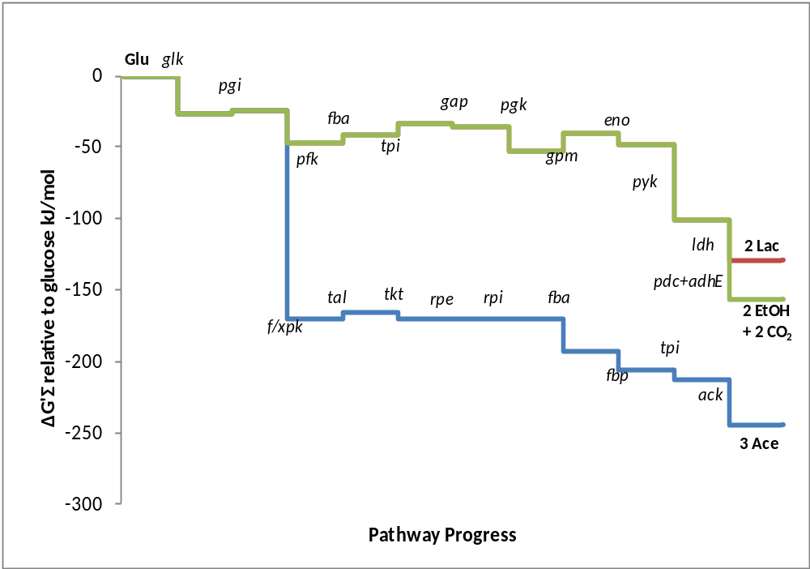
Thermodynamics of oxidative and non-oxidative glycolysis
EMP
NOG

Slide 28
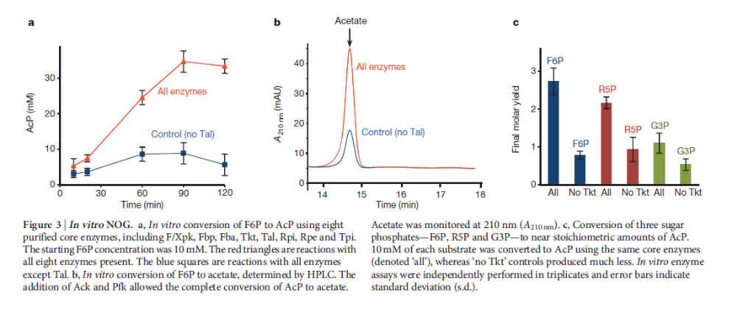
In vitro demonstration of NOG

Slide 29
In vivo demonstration of NOG
FBP
E. coli JCL118 ((ΔldhAΔadhEΔfrdBCΔpflB)
pIB4: Fbp F/Xpk expression
Fbp
F6P
F/Xpk
2 Xylose
AcP
E4P
2 X5P
2 AcP
2 G3P
Theoretical
F6P
NOG
G3P
ΔfrdBC
succinate
3 AcP
Pyr
ΔldhA
lactate
ΔpflB
formate
AcCoA
ΔadhE
ethanol
5 Acetate
Bogorad et al. Nature 2013
control
control

Slide 30
NOG for growth?
EMP
NOG
Glucose (C6)
Glucose (C6)
NOG
AcP (C2)
Pyruvate (C3)
AcCoA (C2)
=== Acetate
CO₂
Acetyl-CoA (C2)
PEP (C3)
OAA (C4)
TCA/GS
Glucose → 2 pyruvate
+ 2 NADH + 2ATP
Pyruvate (C3)
ATP + NADH
Glucose →2 acetyl-CoA + 2 CO₂
+ 4 NADH + 2ATP
Glucose + ATP → 3 acetyl-CoA
Glucose + ATP → 1.5 pyruvate + 1.5 CO₂
+ 3NADH + 3FADH₂

Slide 31
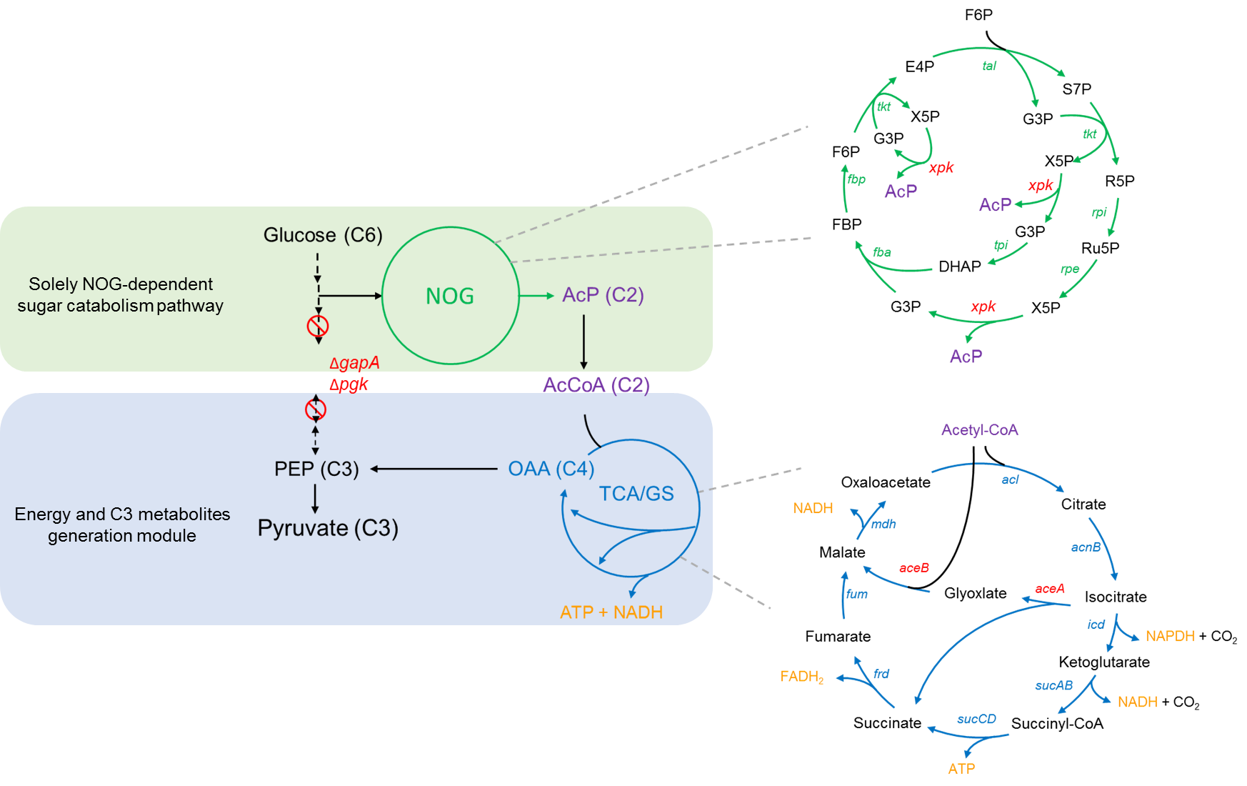
Rewire central metabolism to create a new E. coli

Slide 32
Challenges of rewiring central metabolism
EMP
NOG
Glucose (C6)
Glucose (C6)
NOG
AcP (C2)
Pyruvate (C3)
AcCoA (C2)
CO₂
Acetyl-CoA (C2)
PEP (C3)
OAA (C4)
TCA/GS
Pyruvate (C3)
ATP + NADH
Different sugar catabolism route
Different metabolites concentration (Toxicity?)
Need to re-design cell regulation
  ex. Glucose regulation
  Hard to engineer new E. coli by just overexpressing NOG pathway
  Evolution strategy will be applied

Slide 33
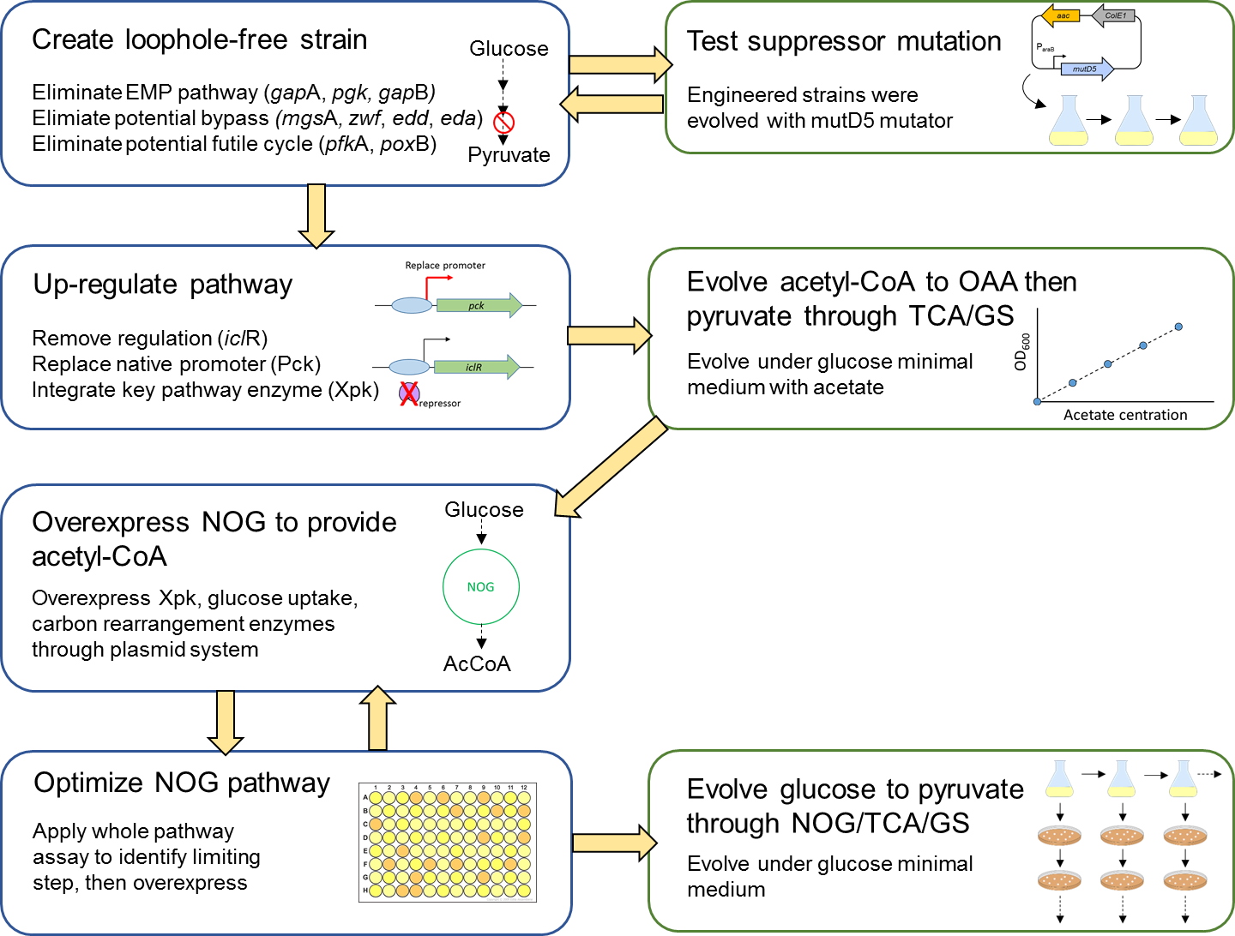
Rewriting central metabolism to construct NOG E. coli

Slide 34
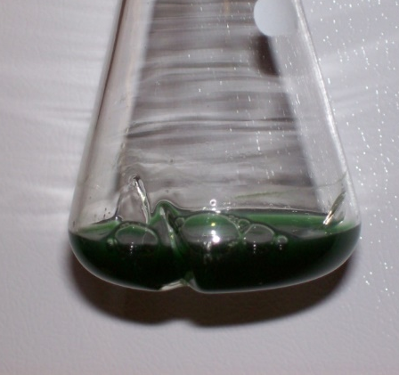
Intrinsic carbon lost by EMP pathway limits the yield
in photosynthetic organisms
CO₂
In photosynthetic organisms, growth and biofuel production are potentially limited by Rubisco, due to:
1. photorespiration
2. the slow turnover rate of Rubisco
Rubisco
RuBP
EMP pathway
CBB cycle
3PG
PYR
pdhc
CO₂
The intrinsic carbon lost by EMP pathway gives
maximum 66.6% of acetyl-coA yield.
Acetyl-coA

Slide 35
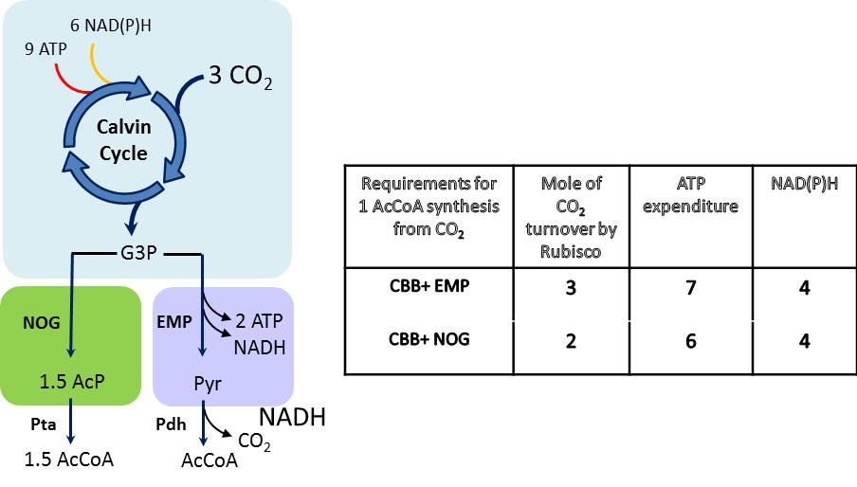
CBB pathway with NOG in phototrophs

Slide 36
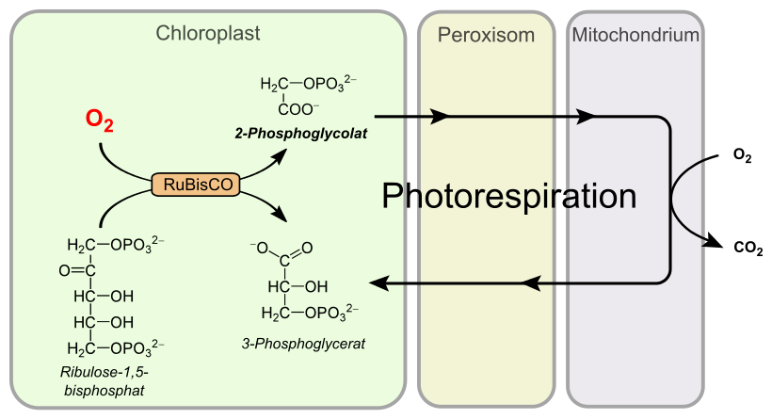
Photorespiration
From Wikipedia

Slide 37

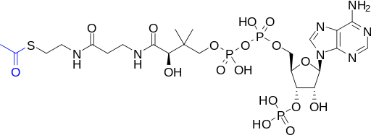
The rGS-Glycerate pathway can convert photorespiration byproduct glycolate into acetyl-CoA without carbon loss.
HCO₃⁻
PEP
Eno
Ppc
2-p-glycerate
Glycolate
oxaloacetate
ATP
NADH
Gk
Mdh
Chloroplast
glycerate
malate
ATP
Tsr
Mtk/Mcl
NADH
tartronate
semialdehyde
Acetyl-CoA
(2) glyoxylate
Gcl
CoA
Acetyl CoA
NADH
Gox
Glycolate
CO₂
Glycolate +NADH + 2ATP Ac-CoA

Slide 38
Demonstration of rGS-Glycerate in E. coli
∆aceB ∆glcB ∆frdB ∆ldhA ∆ptsG.
pyruvate
lactate
∆ldhA
(2) HCO₃⁻
(2) PEP
∆ptsG
(2)2-p-glycerate
½ Glucose
(2) oxaloacetate
ATP
(2) NADH
rGS-Glycerate
glycerate
succinate
fumarate
(2) malate
∆frdB
(2) ATP
∆glcB
∆aceB
NADH
(2) NADH
tartronate
semialdehyde
Ethanol
(2) acetyl-CoA
(2) glyoxylate
ATP
CO₂
Acetate

Slide 39
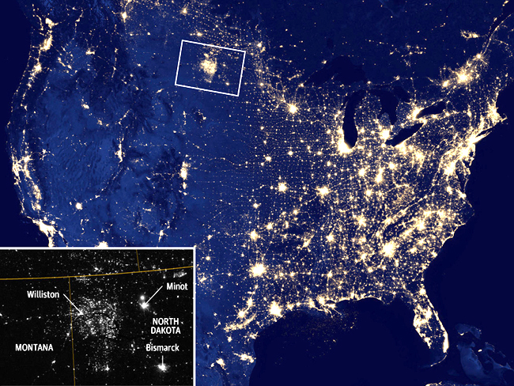

Slide 40
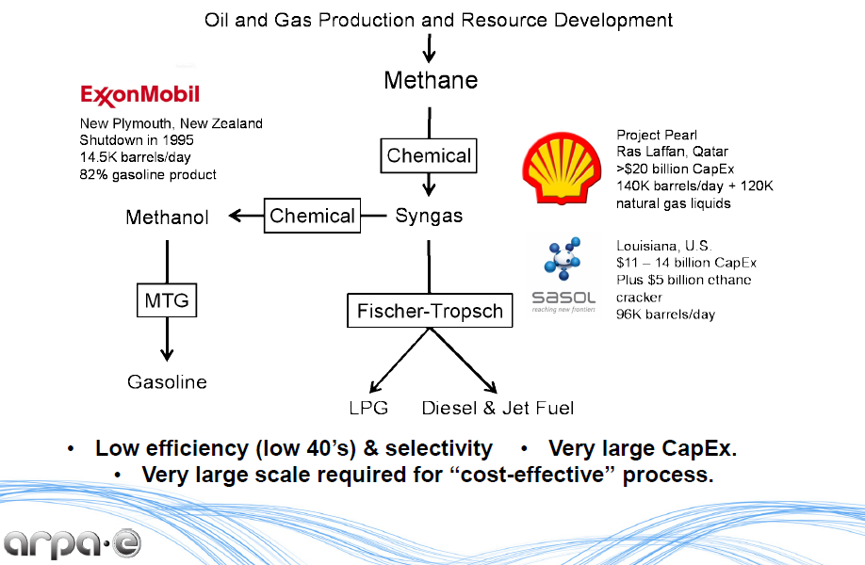
Gas-to-liquid processes requires large scale operations

Slide 41
Problem: Methanol condensation
2 CH₃OH C₂H₅OH + H₂O
ΔG°′ = −68 kJ/mol
ΔG°′ = −182 kJ/mol
4 CH₃OH C₄H₉OH + 3 H₂O
Guerbet reaction
CH₃OH + C₃H₇OH C₄H₉OH + H₂O
Methanol to gasoline (high temp, high pressure)
N CH₃OH [-CH2-]_{n} + H2O

Slide 42
Non-Oxidative Glycolysis (NOG)
MmO
CO₂
(CH₂O)_{n}
CH₃OH
CH₄
[O]
NADPH
RuMP
CBB
F6P
111
2 G3P
3 F6P
4 e⁻
3 AcP
Carbon
Rearrangement
2 F6P
3 E4P
2 Pyruvate
4 e⁻
2 CO₂
3 AcCoA
Ethanol, Butanol, Fatty acids…
2 AcCoA
e⁻
Bogorad Nature 2013

Slide 43

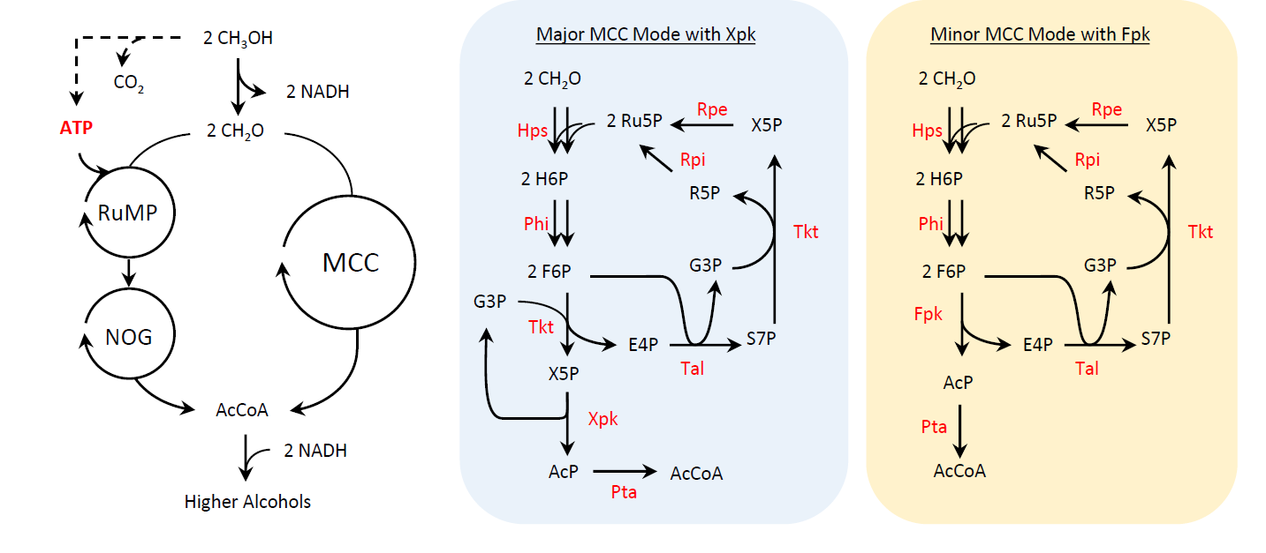
Methanol Condensation Cycle (MCC)
2 CH₃OH C₂H₅OH + 3 H₂O
2 CH₃OH
2 CH₃OH
Ethanol
Ethanol
Synthetic MCC conserves carbon
Bogorad PNAS 2014

Slide 44
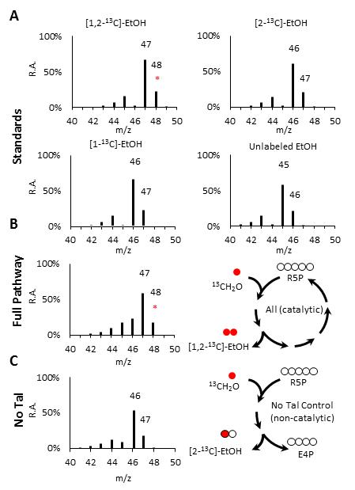
Experimental validation of catalytic cycle
Full Cycle
Half Cycle

Slide 45
A)
B)
C)
D)
Carbon Yield: 80±20%
Carbon Yield: 50±30 %
EtOH
BuOH
No Tal control
No Tal control

Slide 46
Learning from the nature
Natural Methylotrophy
CH₃OH
CH₃OH
CH₂O
CH₂O
Mdh
Ru5P
A
Hps
Rpi
Rpe
R5P
H6P
X5P
Phi
Tkt
B
G3P
F6P
G3P
S7P
Growth
Tkt
Tal
Glycolysis
E4P
Cell
Growth
X
X
Notes:
Unbold the text
Make meoh to ch2o on same line
Make more clear for rpiAB

Slide 47
Learning from the nature
Natural Methylotrophy
Synthetic Methanol Auxotrophy
CH₃OH
CH₂O
CH₃OH
CH₂O
A
A*
A
B
B
Growth
Growth
C₁ dependent growth of E. coli
Using methanol for substrate upgrading
A platform for engineering methanol assimilation
Notes:
Unbold the text
Make meoh to ch2o on same line
Make more clear for rpiAB

Slide 48
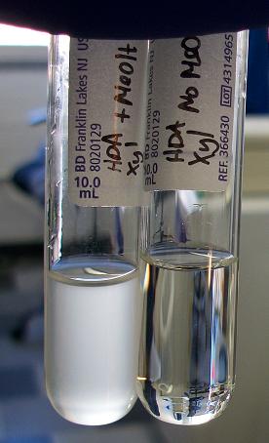
An E. coli strain that requires methanol to grow
Xylose+MeOH
Xylose Only
Xylose
MeOH
Xylose

Slide 49
Designing Chemistry using Biology
A
B₁
B
B₂
D
B₅
B₆
B₃
B₄
C

Slide 50
Evolving Chemistry using Biology
Growth
P
C
P’
D
Directed evolution

Slide 51
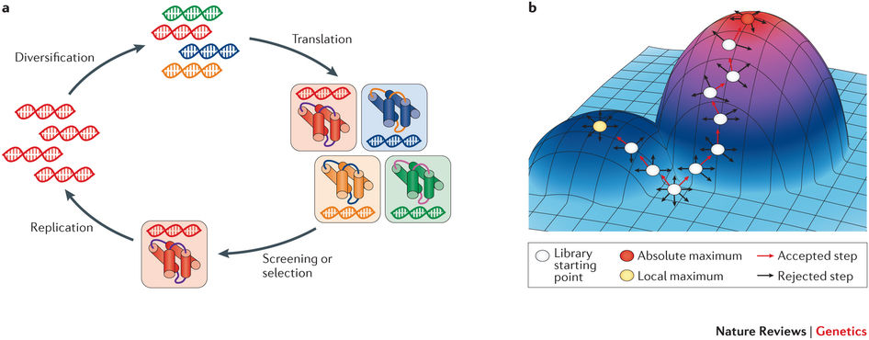

Slide 52
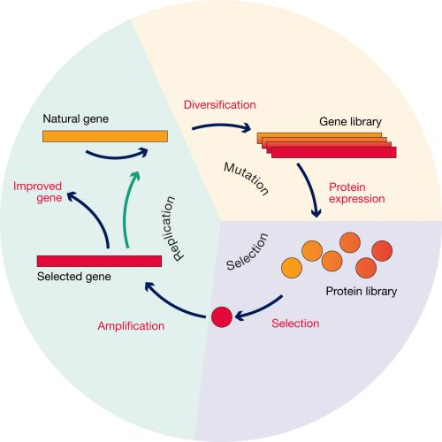
Directed Evolution

Slide 53
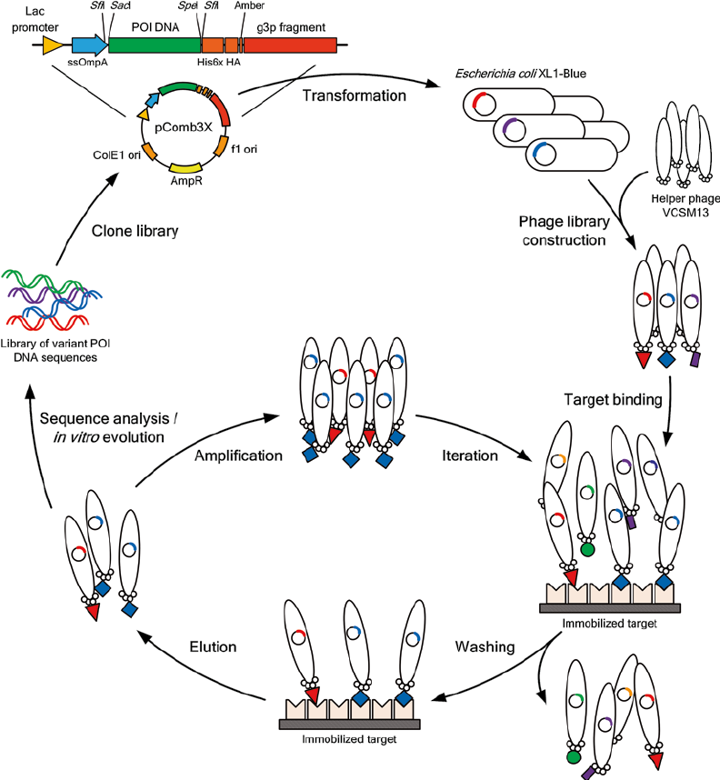
Phage Display

Slide 54
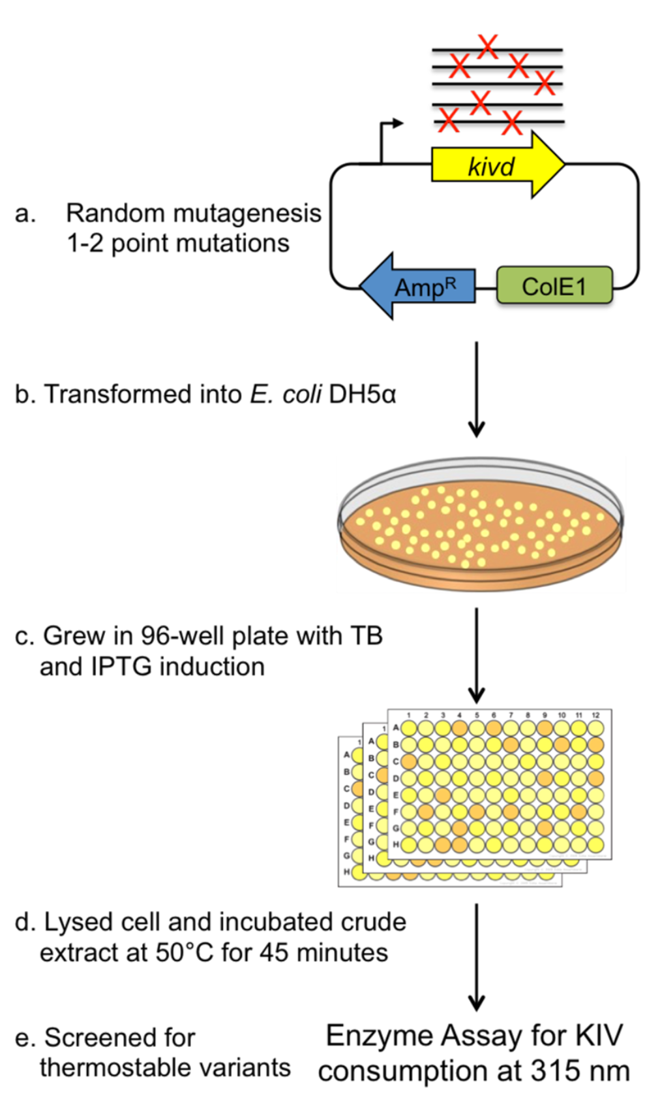
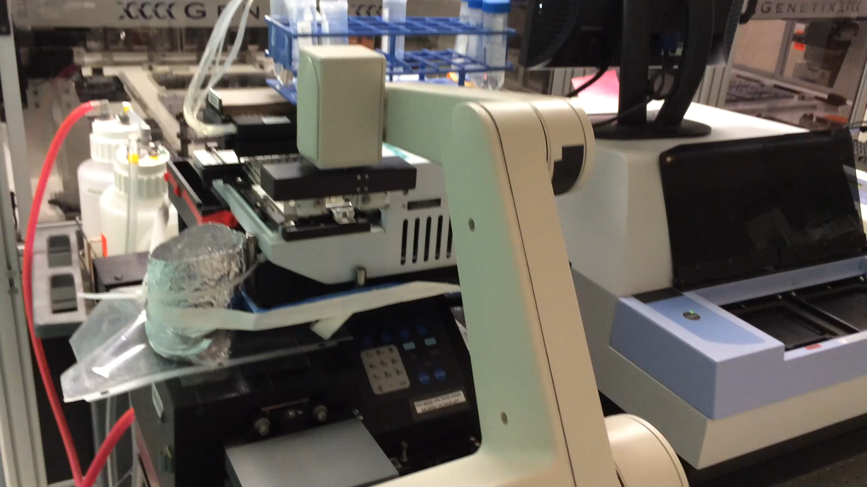
Simple & fast test is required
Decrease of substrate ketoisovalerate (KIV) measured via absorbance at 315nm

Slide 55
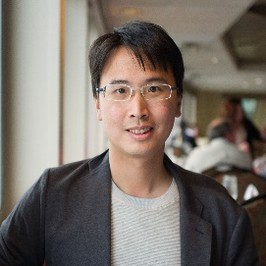
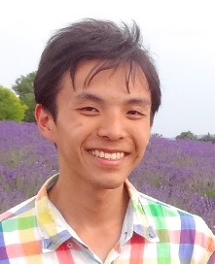
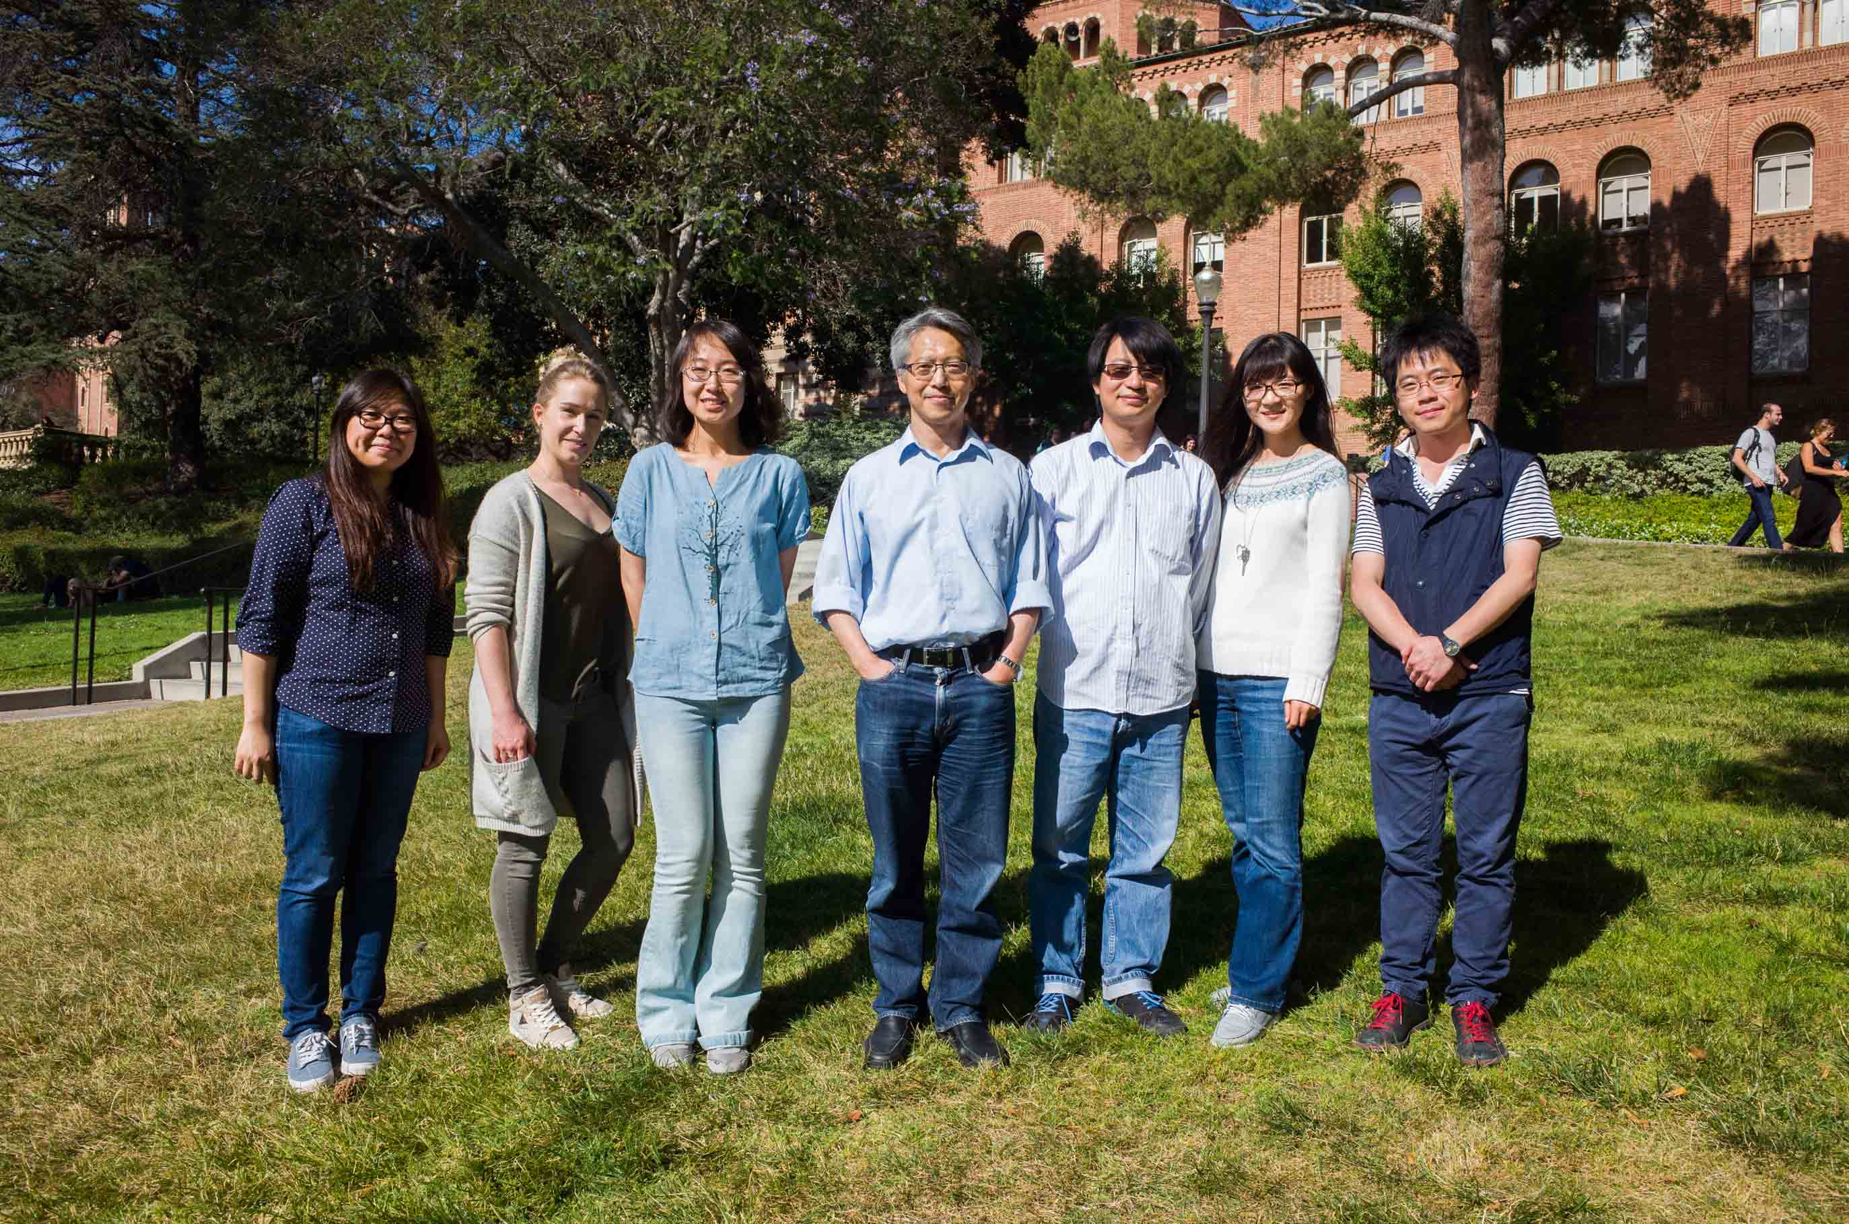
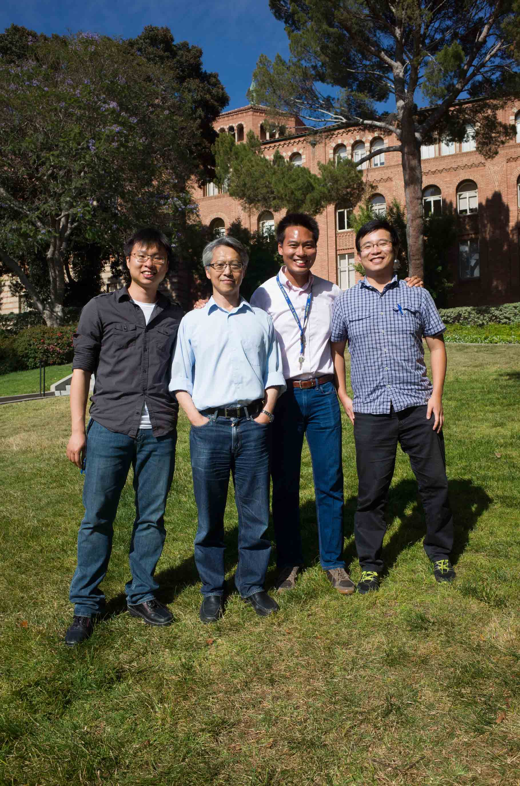
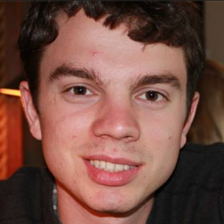
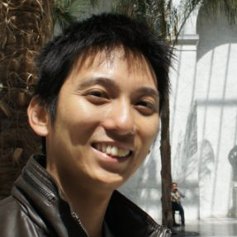


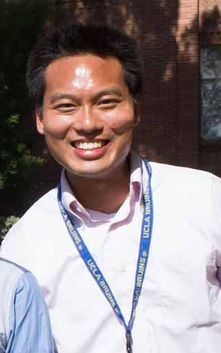
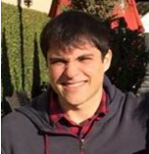
Acknowledgement
Po-Wei Chen
Freddy Chen
Hong Yu
Derrick Chuang
ShanShan Luo
Paul Lin
Igor Bogarad
Tony Wu
Charlie Chen
Alec Yaeger
Sammy Pontrelli
Luo Mi
Lemuel Soh

