Slide 1
Sixty Years of Spiral Density Wave Theory
(Remembering C. C. Lin)
Frank H. Shu
University Professor Emeritus
University of California
1 August 2017
Wu Chien Shiung Science Camp

Slide 2
Outline of Talk
Importance of choosing a mentor for a career in research
Based on 2016 ARAA review article
Mostly pictures
  2 equations
  WKBJ theory (close relationship with Hilbert-Huang Transforms)
Five sections
  Background and motivation
  Linear and non-linear theory
  SDWs in external disk galaxies
  SDWs in planetary rings
  Spiral structure as growing normal modes in disk galaxies
SDWs in protoplanetary disks (brief comment)

Slide 3
Background and Motivation

Slide 4
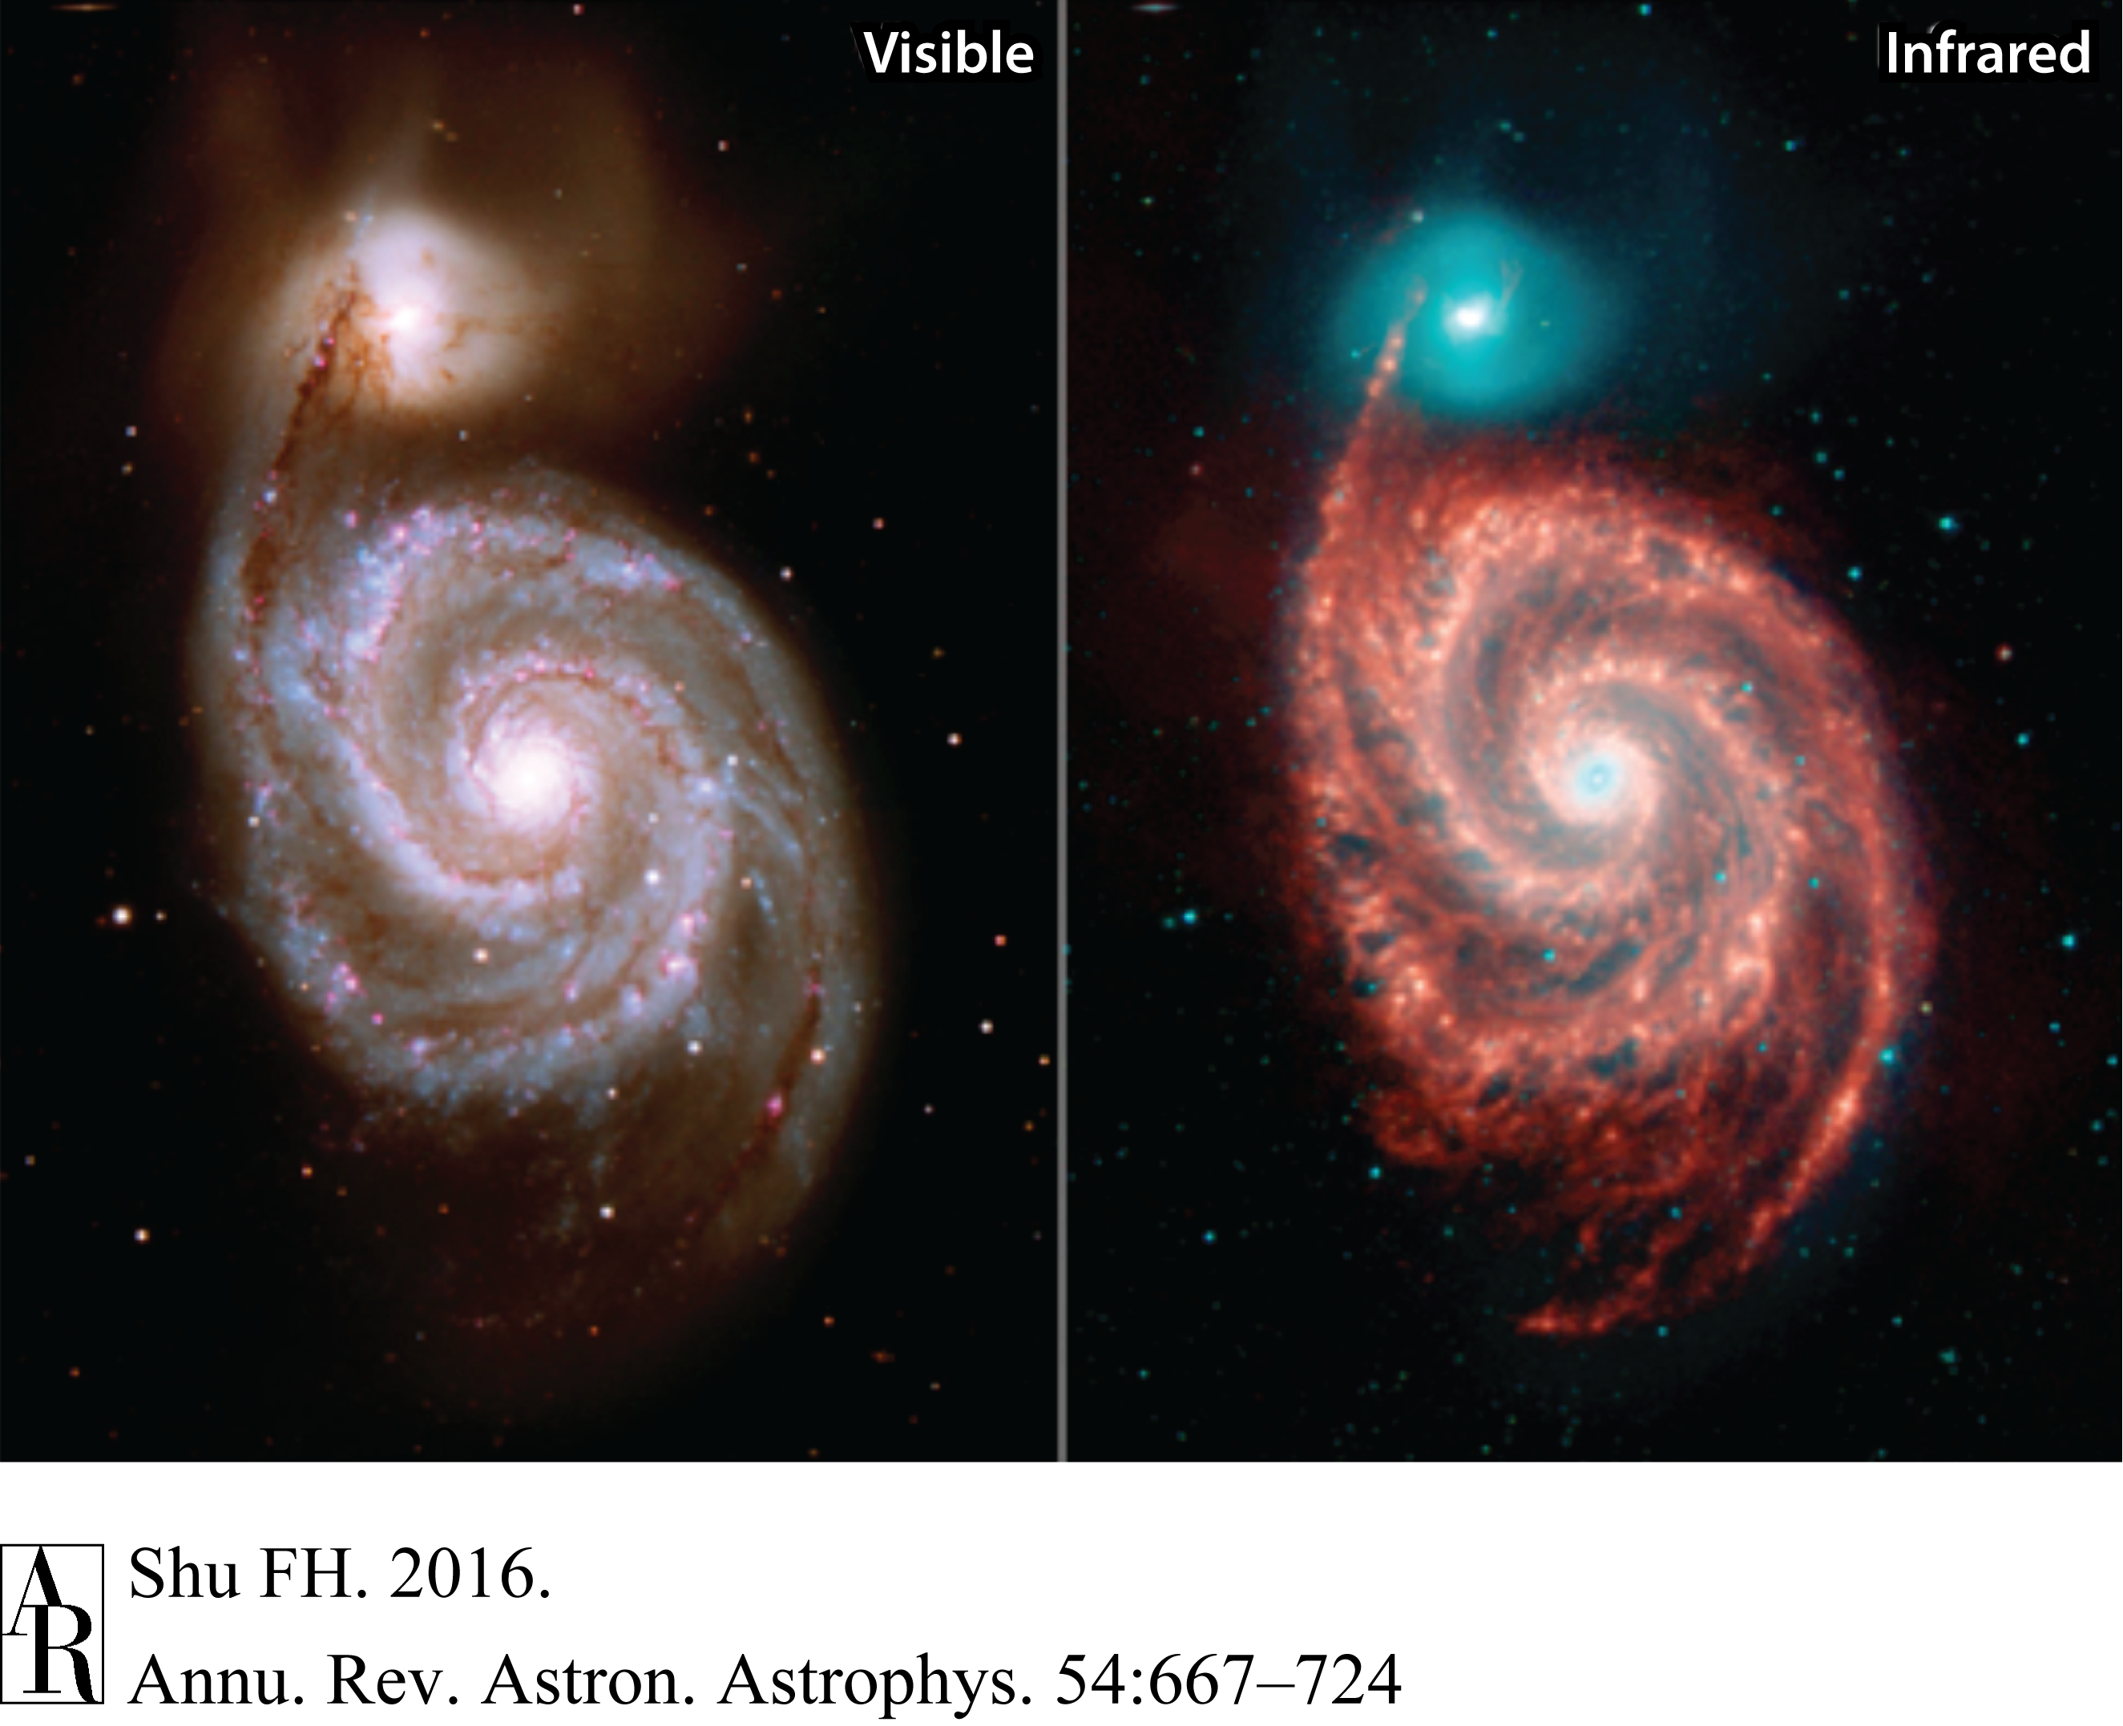
Optical & IR Images of M51
Winding Dilemma: B. Lindblad (1948), P. O. Lindblad (1960),
C. C. Lin (1964 w Shu) SDW
NASA HST/Spitzer

Slide 5
Linear and Nonlinear Theory

Slide 6
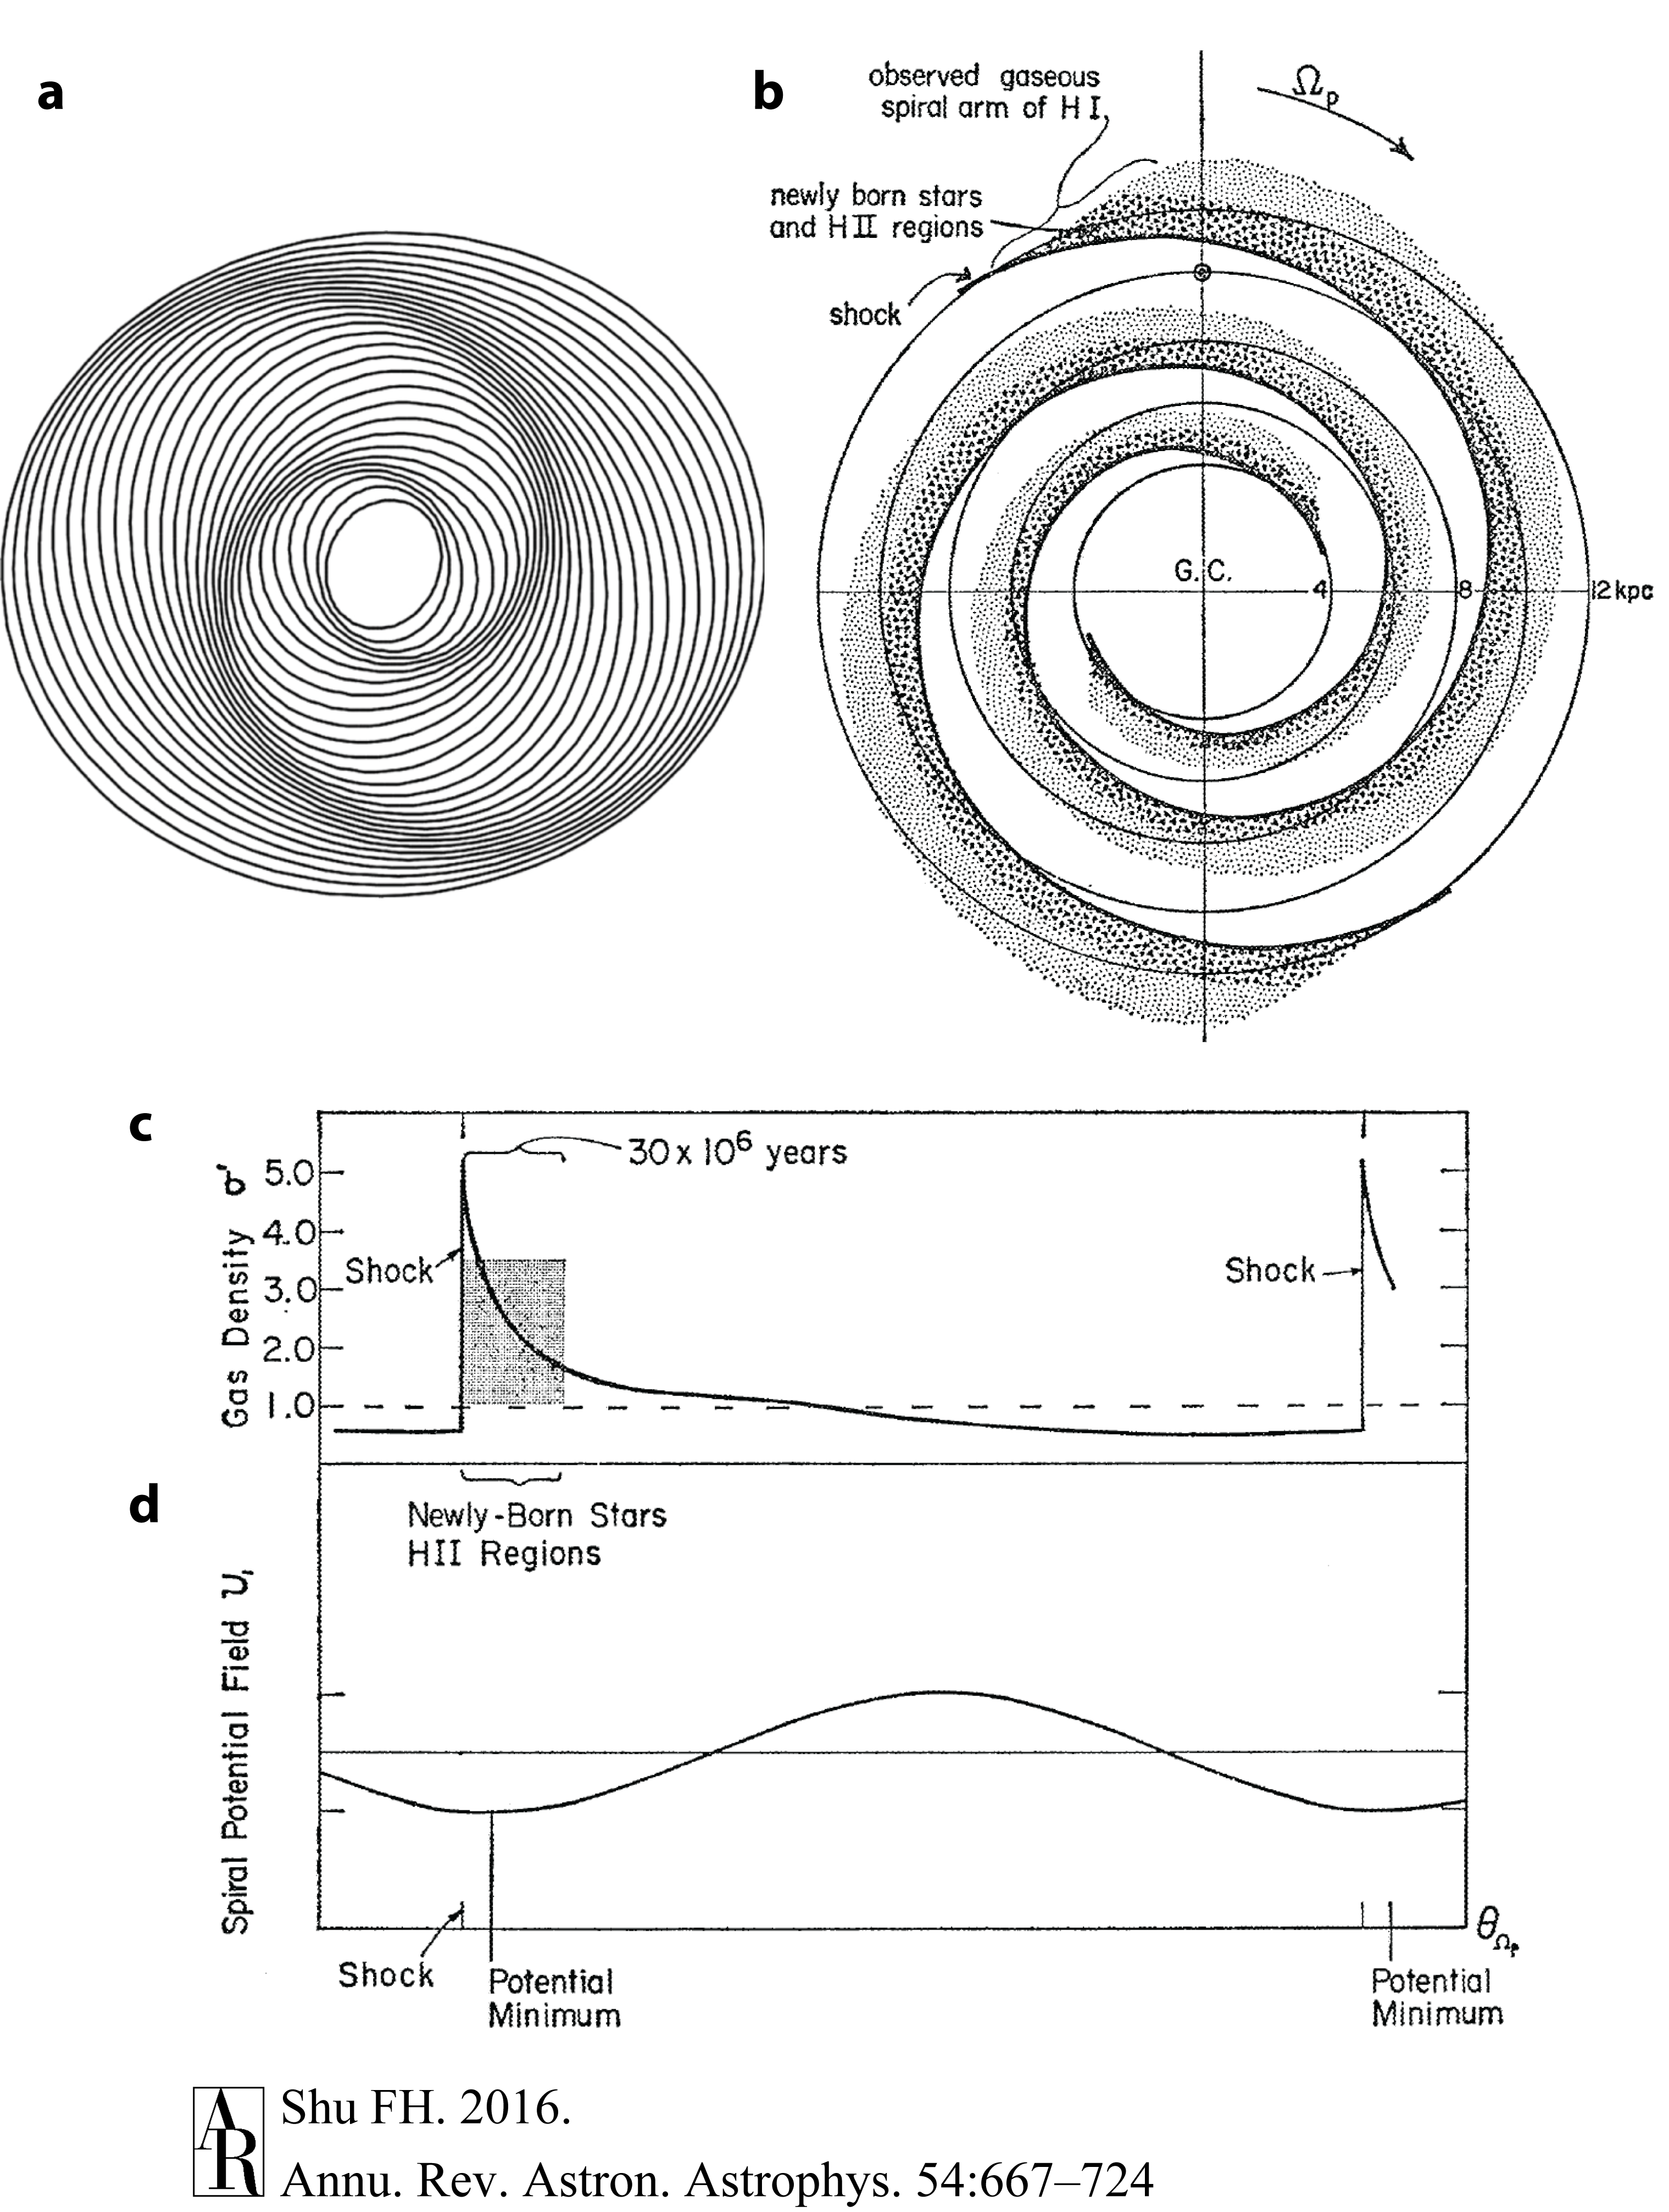
Kinematic SDWs
(Kalnajs 1973)
Two-Armed
Spiral Shockwave
(TASS) Pattern
(Roberts 1969)
TASS Surface Density Response to Grav Potential (5% Field)

Slide 7
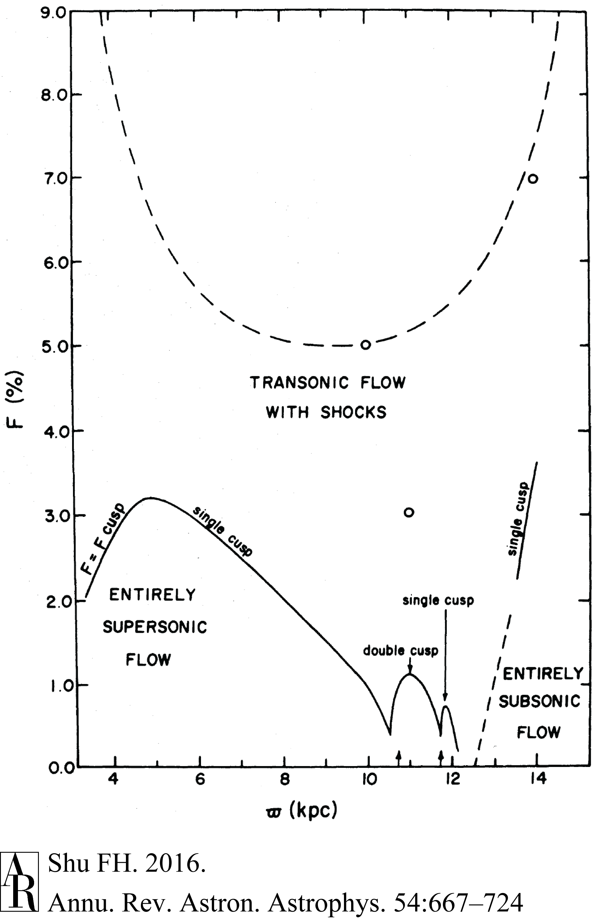
Ultraharmonic
Resonances Reduce Grav Field Strengths Required for Shock Waves, and Lead to Branching of Spiral Arms, & Non-stationary Behavior if
Resonances Overlap
(Shu, Milione, Roberts 1973)

Slide 8
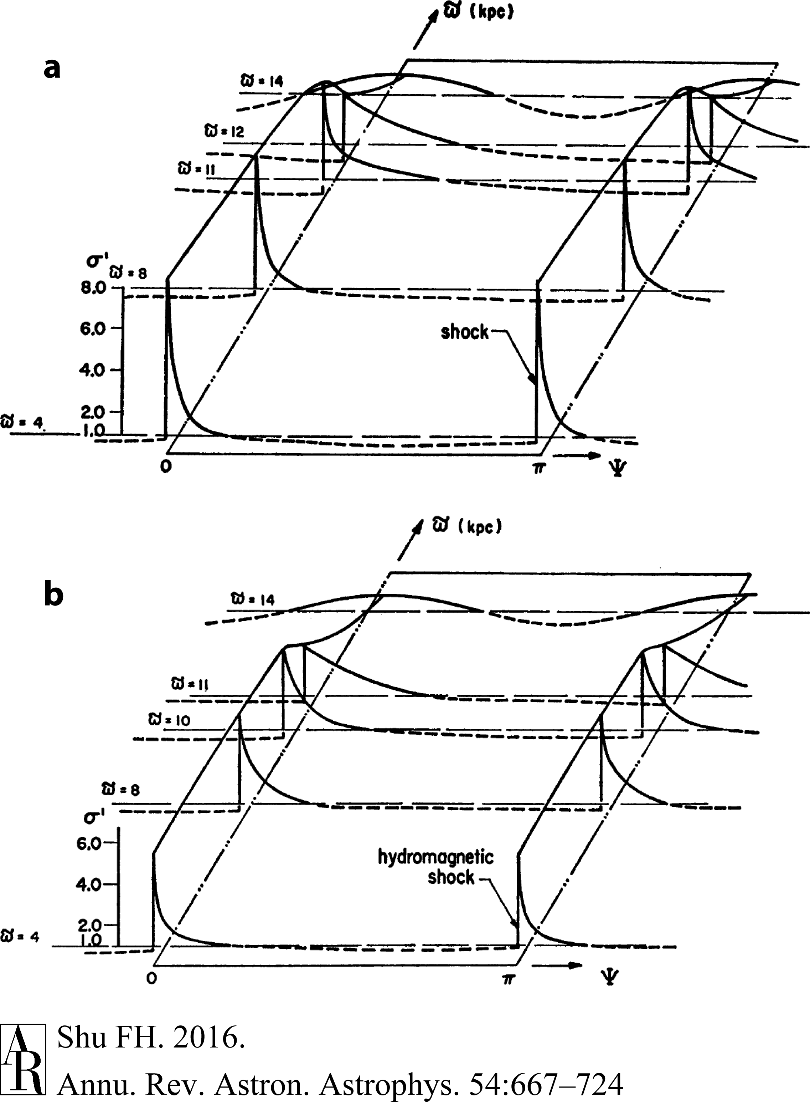
TASS Surface Density Response to Spiral Gravitational Potential w/o & w Toroidal Magnetic Field (2 μG)
(Roberts & Yuan 1970)

Slide 9
SDWs in External Disk Galaxies

Slide 10
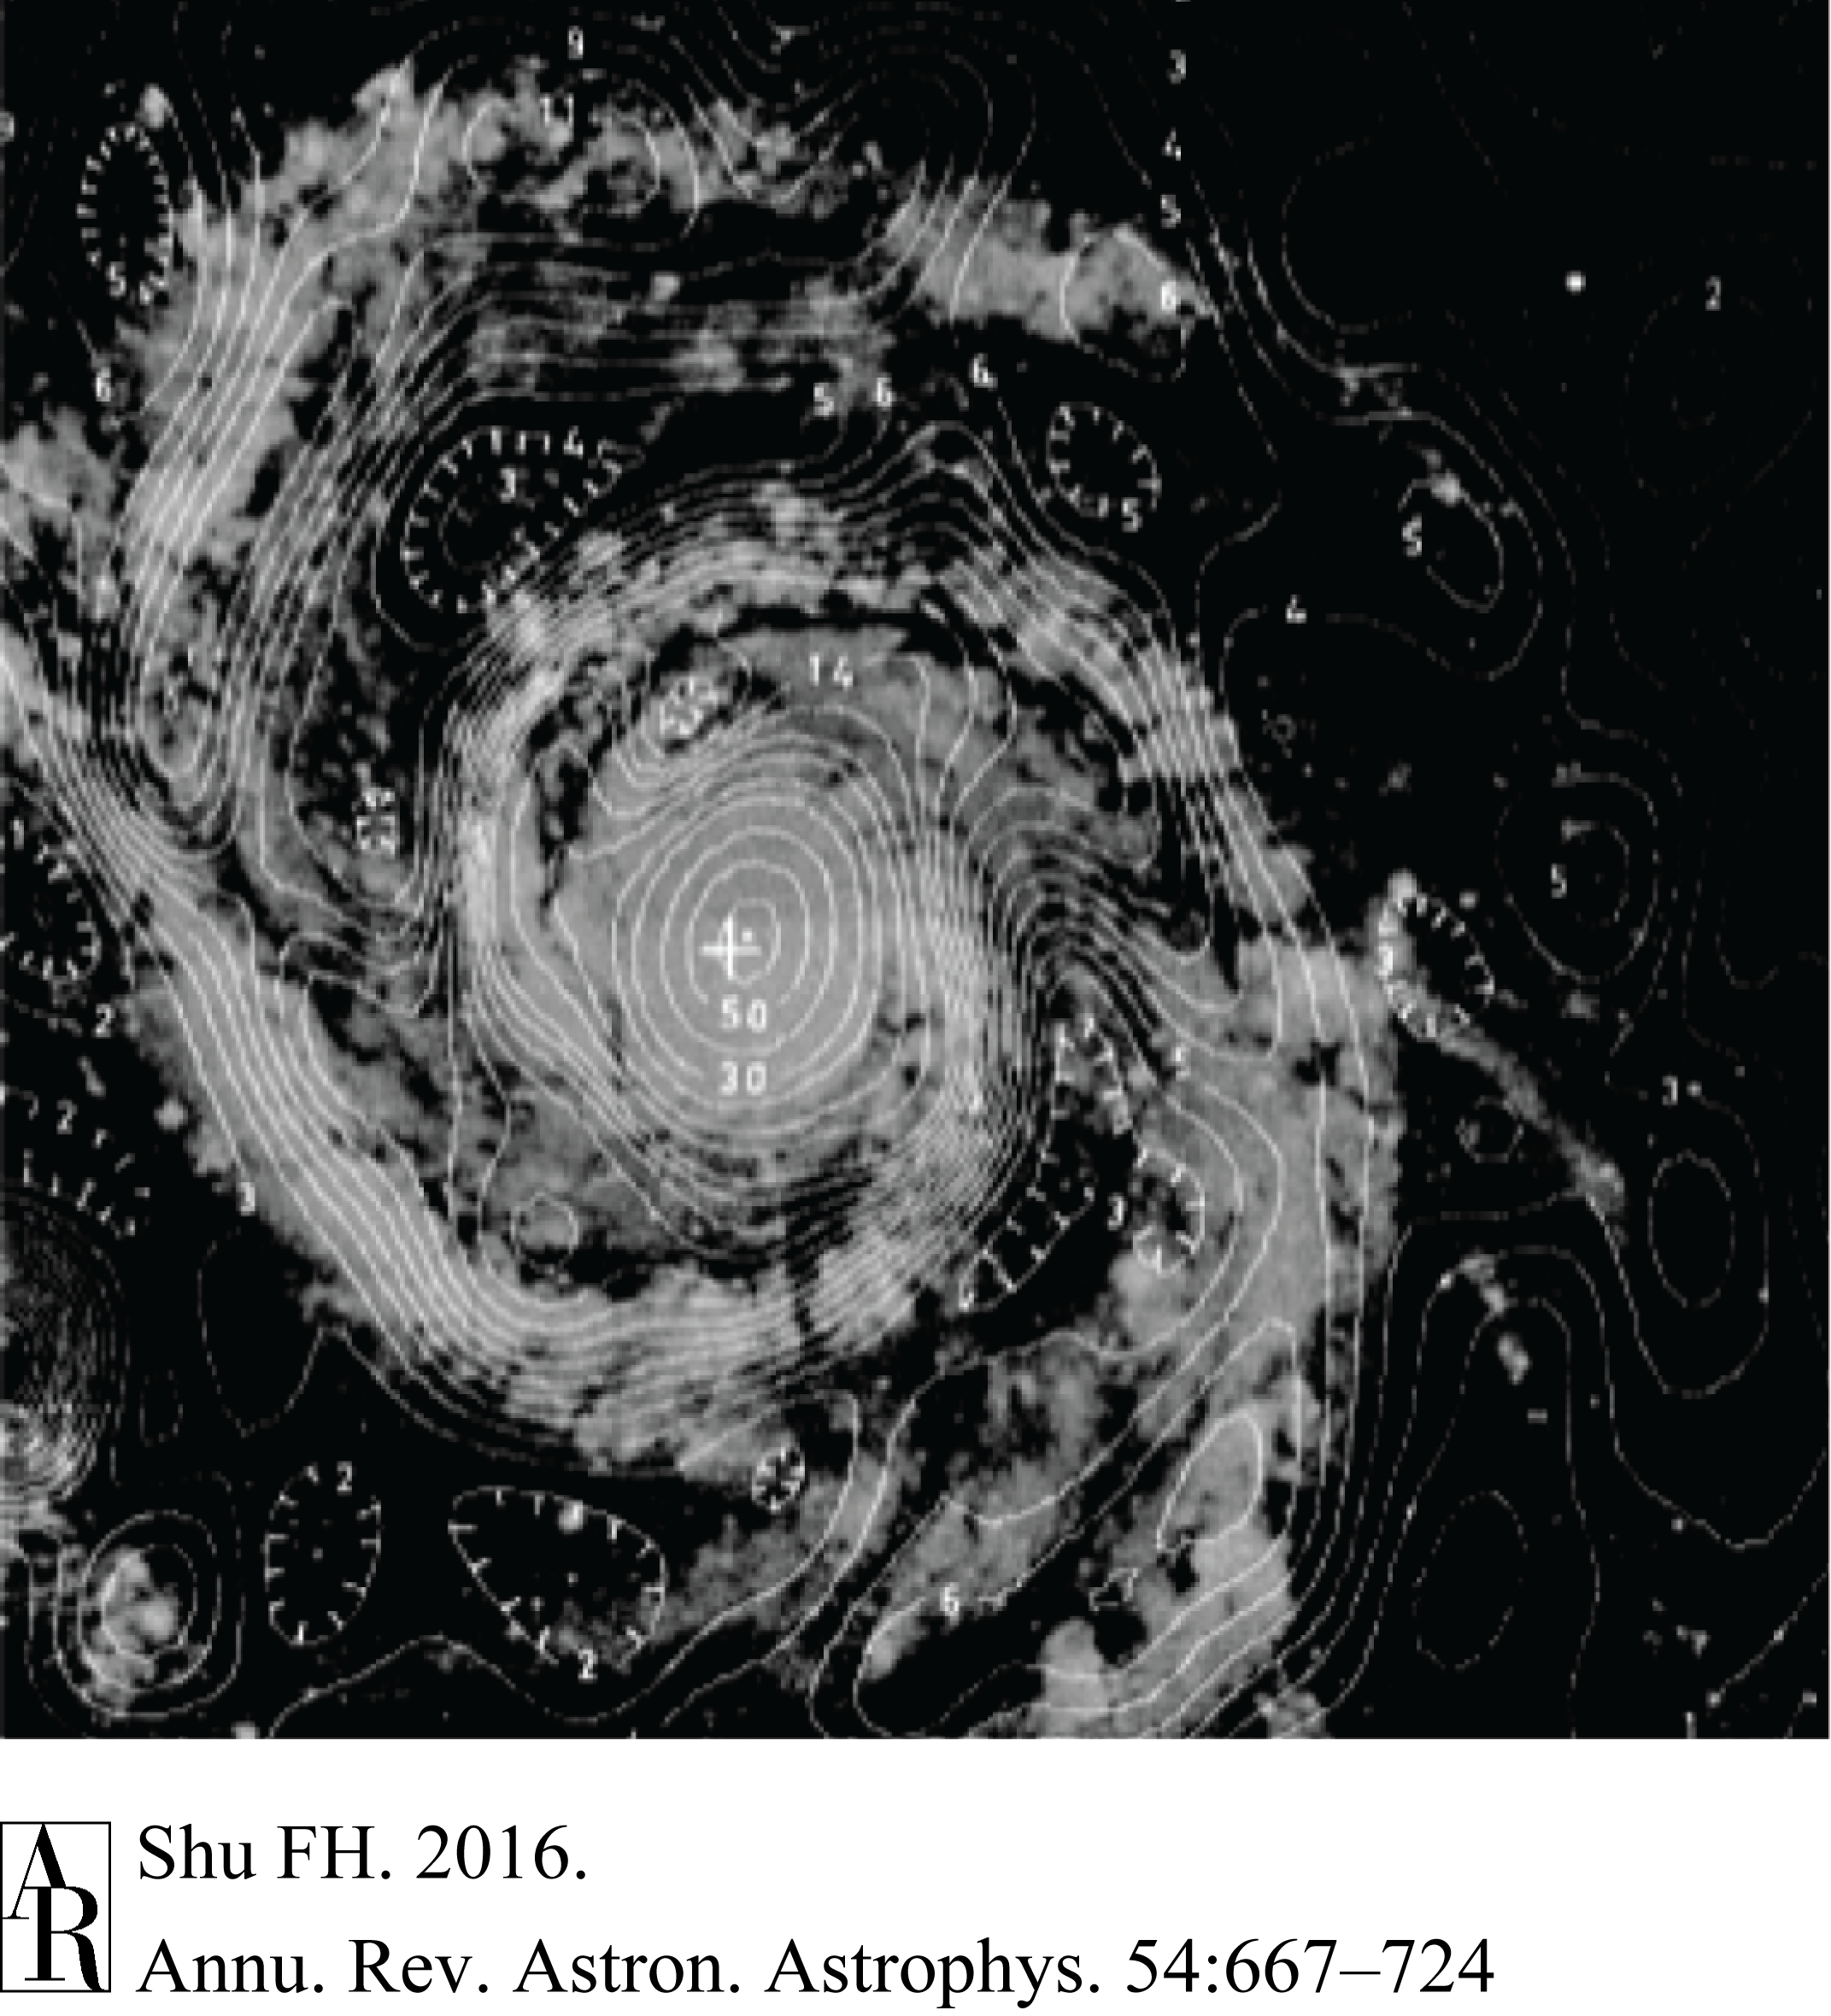
WRST Radio Sychrotron Image of M51
(Mathewson, van der Kruit, Brouw 1972)

Slide 11
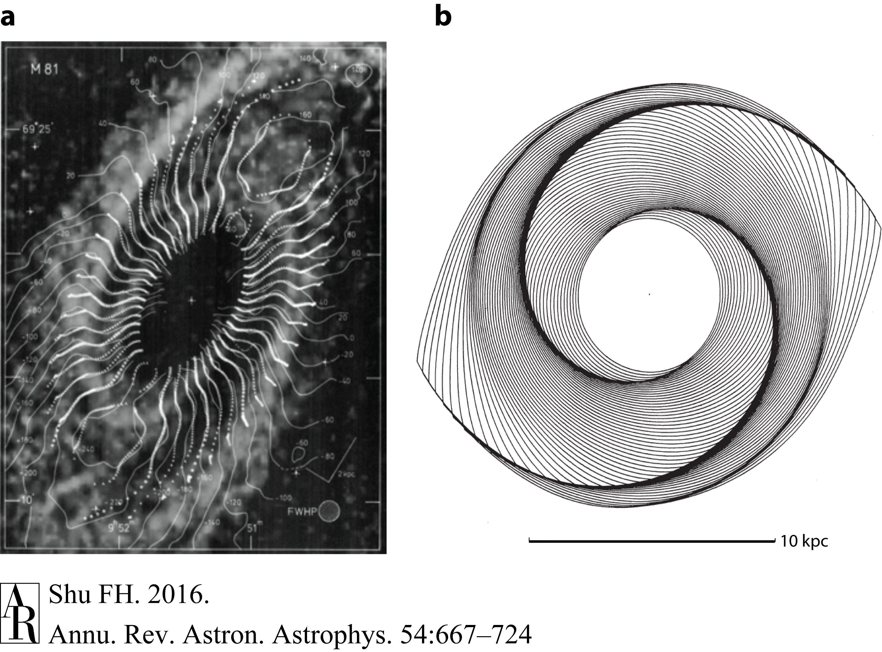
H I Spiral of M81 in Response to Background 2-Armed SDW in Stars
(Visser 1980)

Slide 12
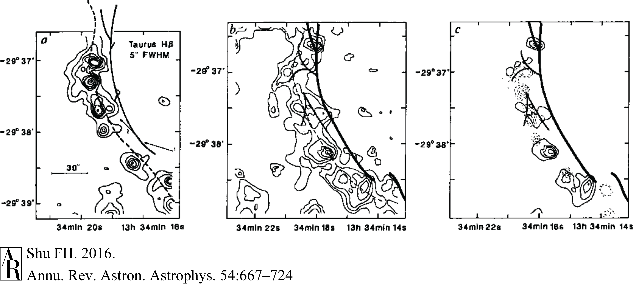
Distribution of Dust, H I, Hα, Hβ
in Eastern Arm of M83
(Allen, Atherton, Tilanus 1986)
In spiral galaxies today, H I may be more a photodissociation product of H₂, rather than H₂ an association product (on dust) of H I.
Notes:
Conclusion: In spiral galaxies today, H I may be more a photodissociation product of H2, rather than H2 an association product (on dust) of H I.

Slide 13
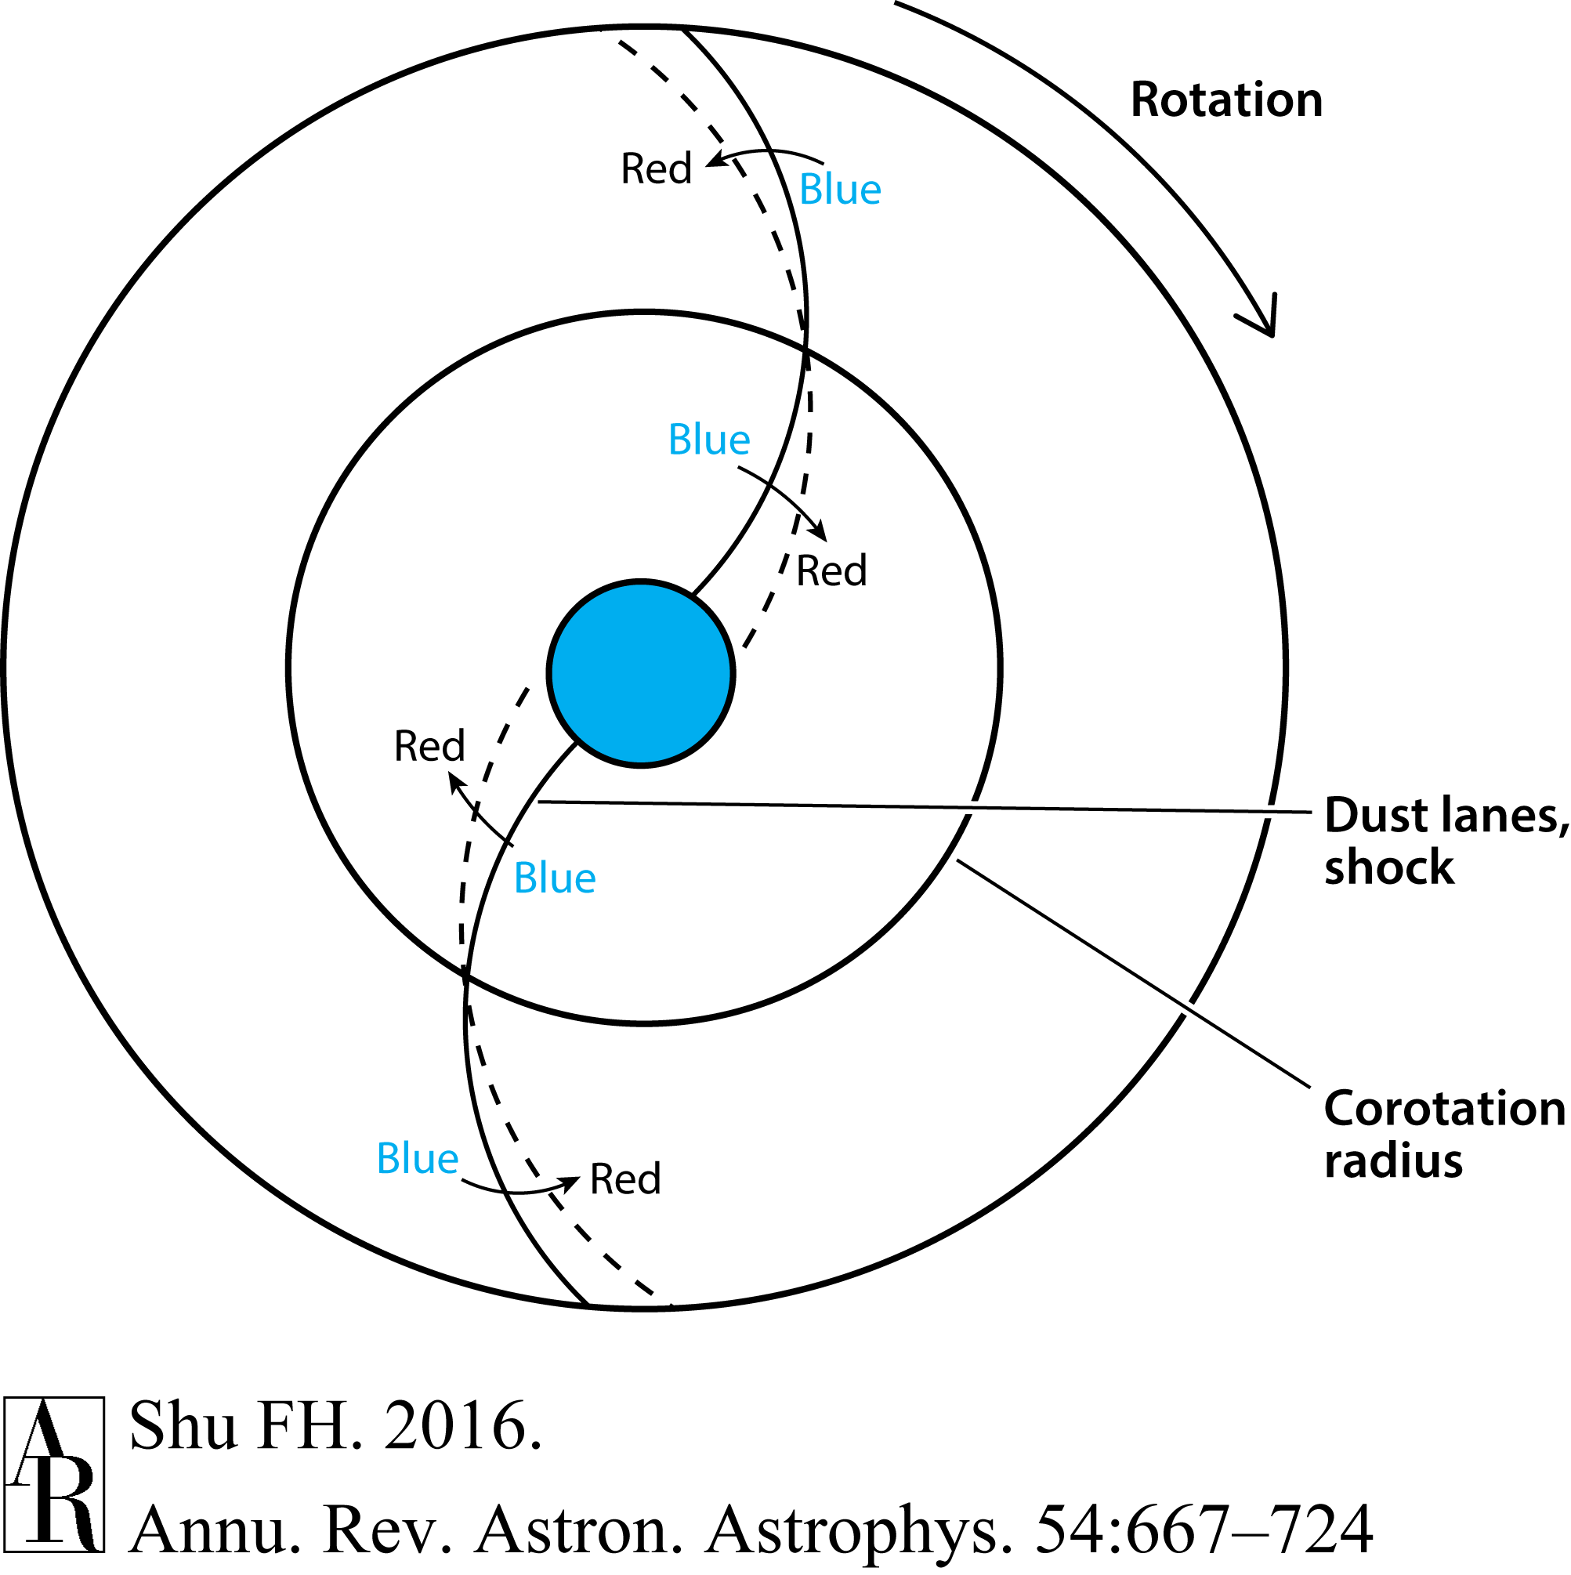
Expected Color Gradients Across Spiral Arms by Triggering of OB Star Formation
(Martinez-Garcia, Gonzalez-Lopezlira, Bruzual-A 2009)

Slide 14
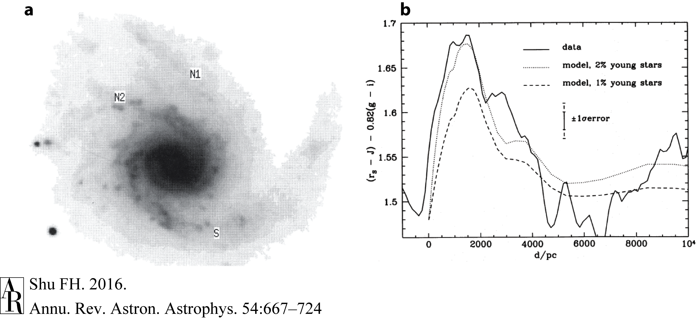
Detected Color Gradients Across in M99
(Gonzalez & Graham 1996)
Martinez-Garcia, Gonzalez-Lopezlira, Bruzual-A (2009): 13 SA and SB galaxies; color gradients in 10 cases, w reversal of sign when cross CR

Slide 15
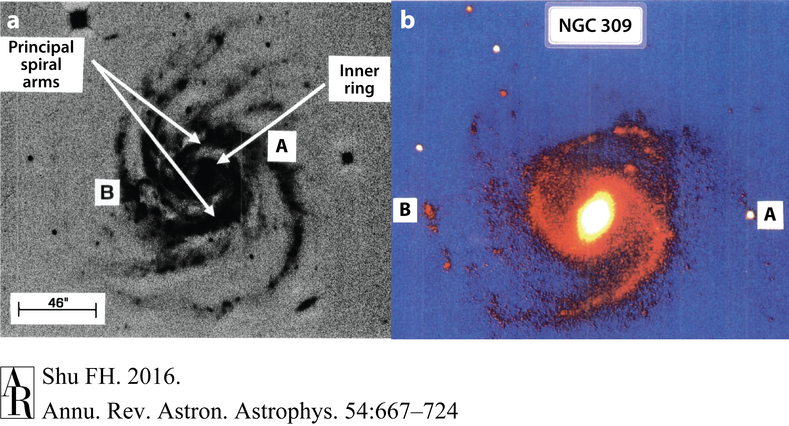
Grand-Design Spirals in Old Disk Stars Can Have Flocculent Response in Pop I Objects
(Block et al. 1994)
()

Slide 16
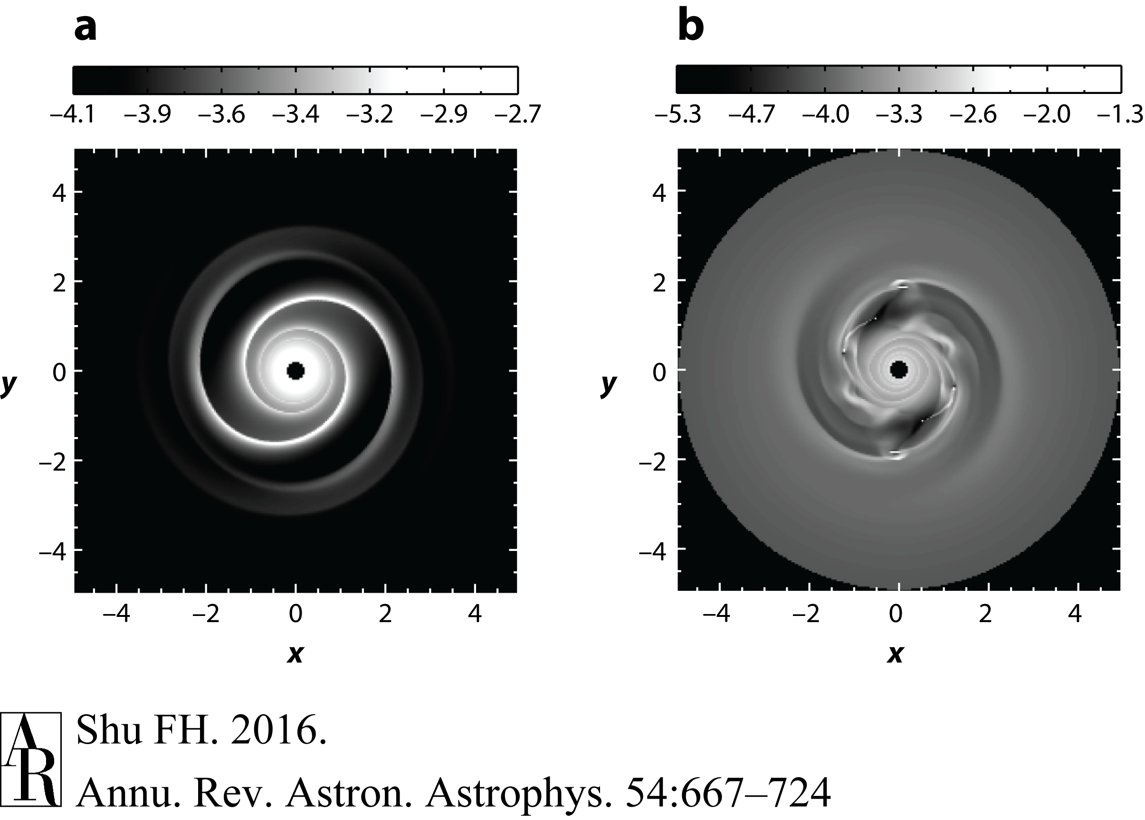
Nonlinear Response of ISM to Regular Forcing Can Be Chaotic b/c of Overlapping Subharmonics
(Chakrabarti, Laughlin, Shu 2003)

Slide 17
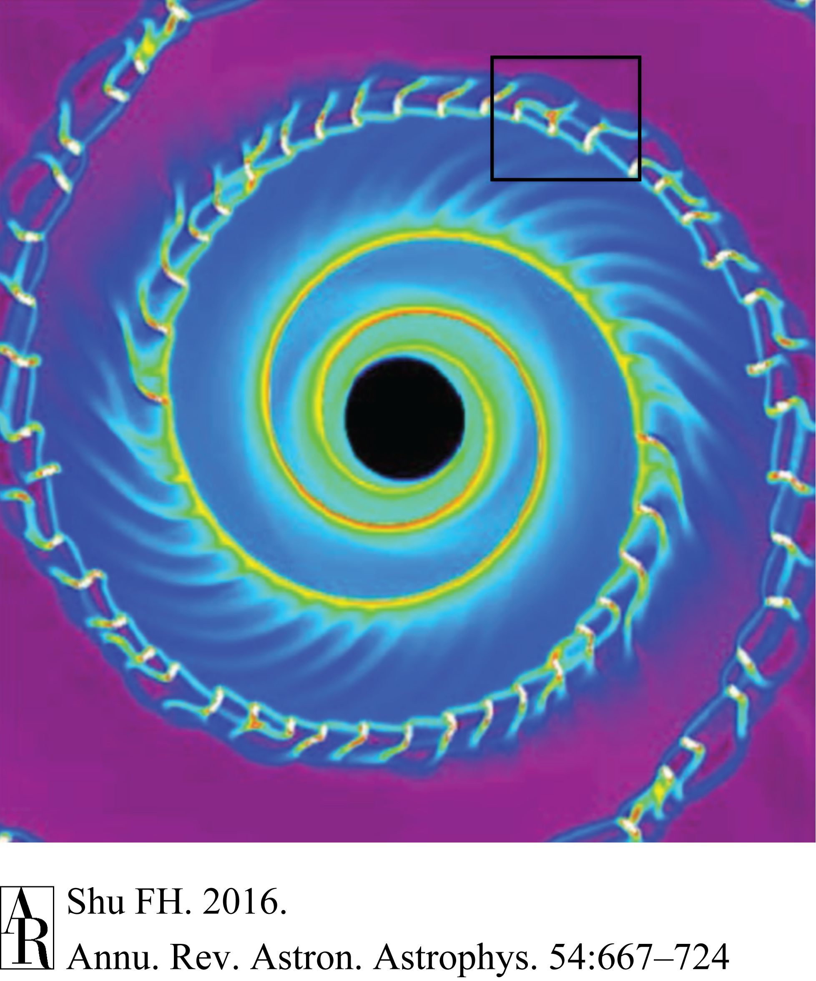
Formation of Spurs and Feathers by Parasitic Magneto-Jeans Instability
(Shetty & Ostriker 2006)

Slide 18
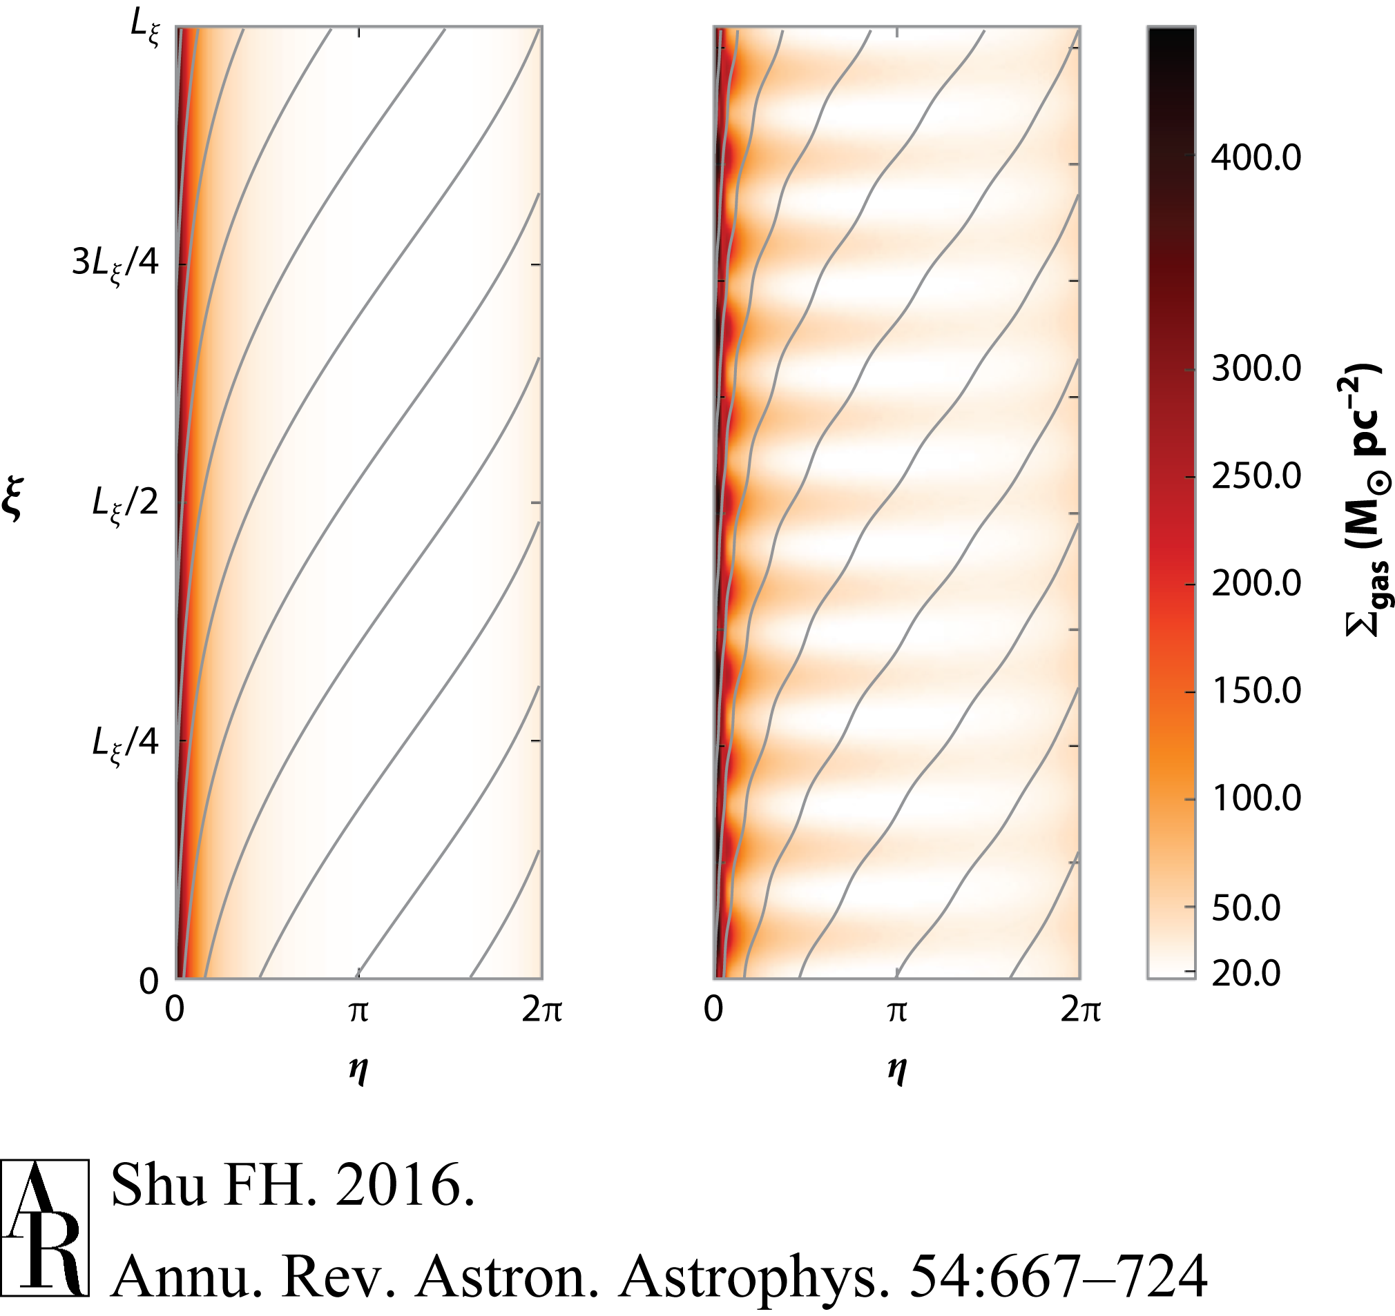
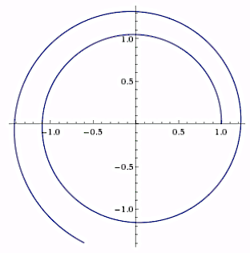
Simulations Pick Up Fastest Growing
Self-Grav Instability in TASS Pattern
(Lee & Shu 2012, Lee 2014)
Discrete Spectrum from
Double Periodicity
of Alllowable Disturbances
Seven irreducible dimensionless parameters:
κ/Ω, Ω_{p}/Ω, a/ϖΩ, v_{A}/ϖΩ,
tan i, F, 2πGσ_{g}/ϖΩ²

Slide 19
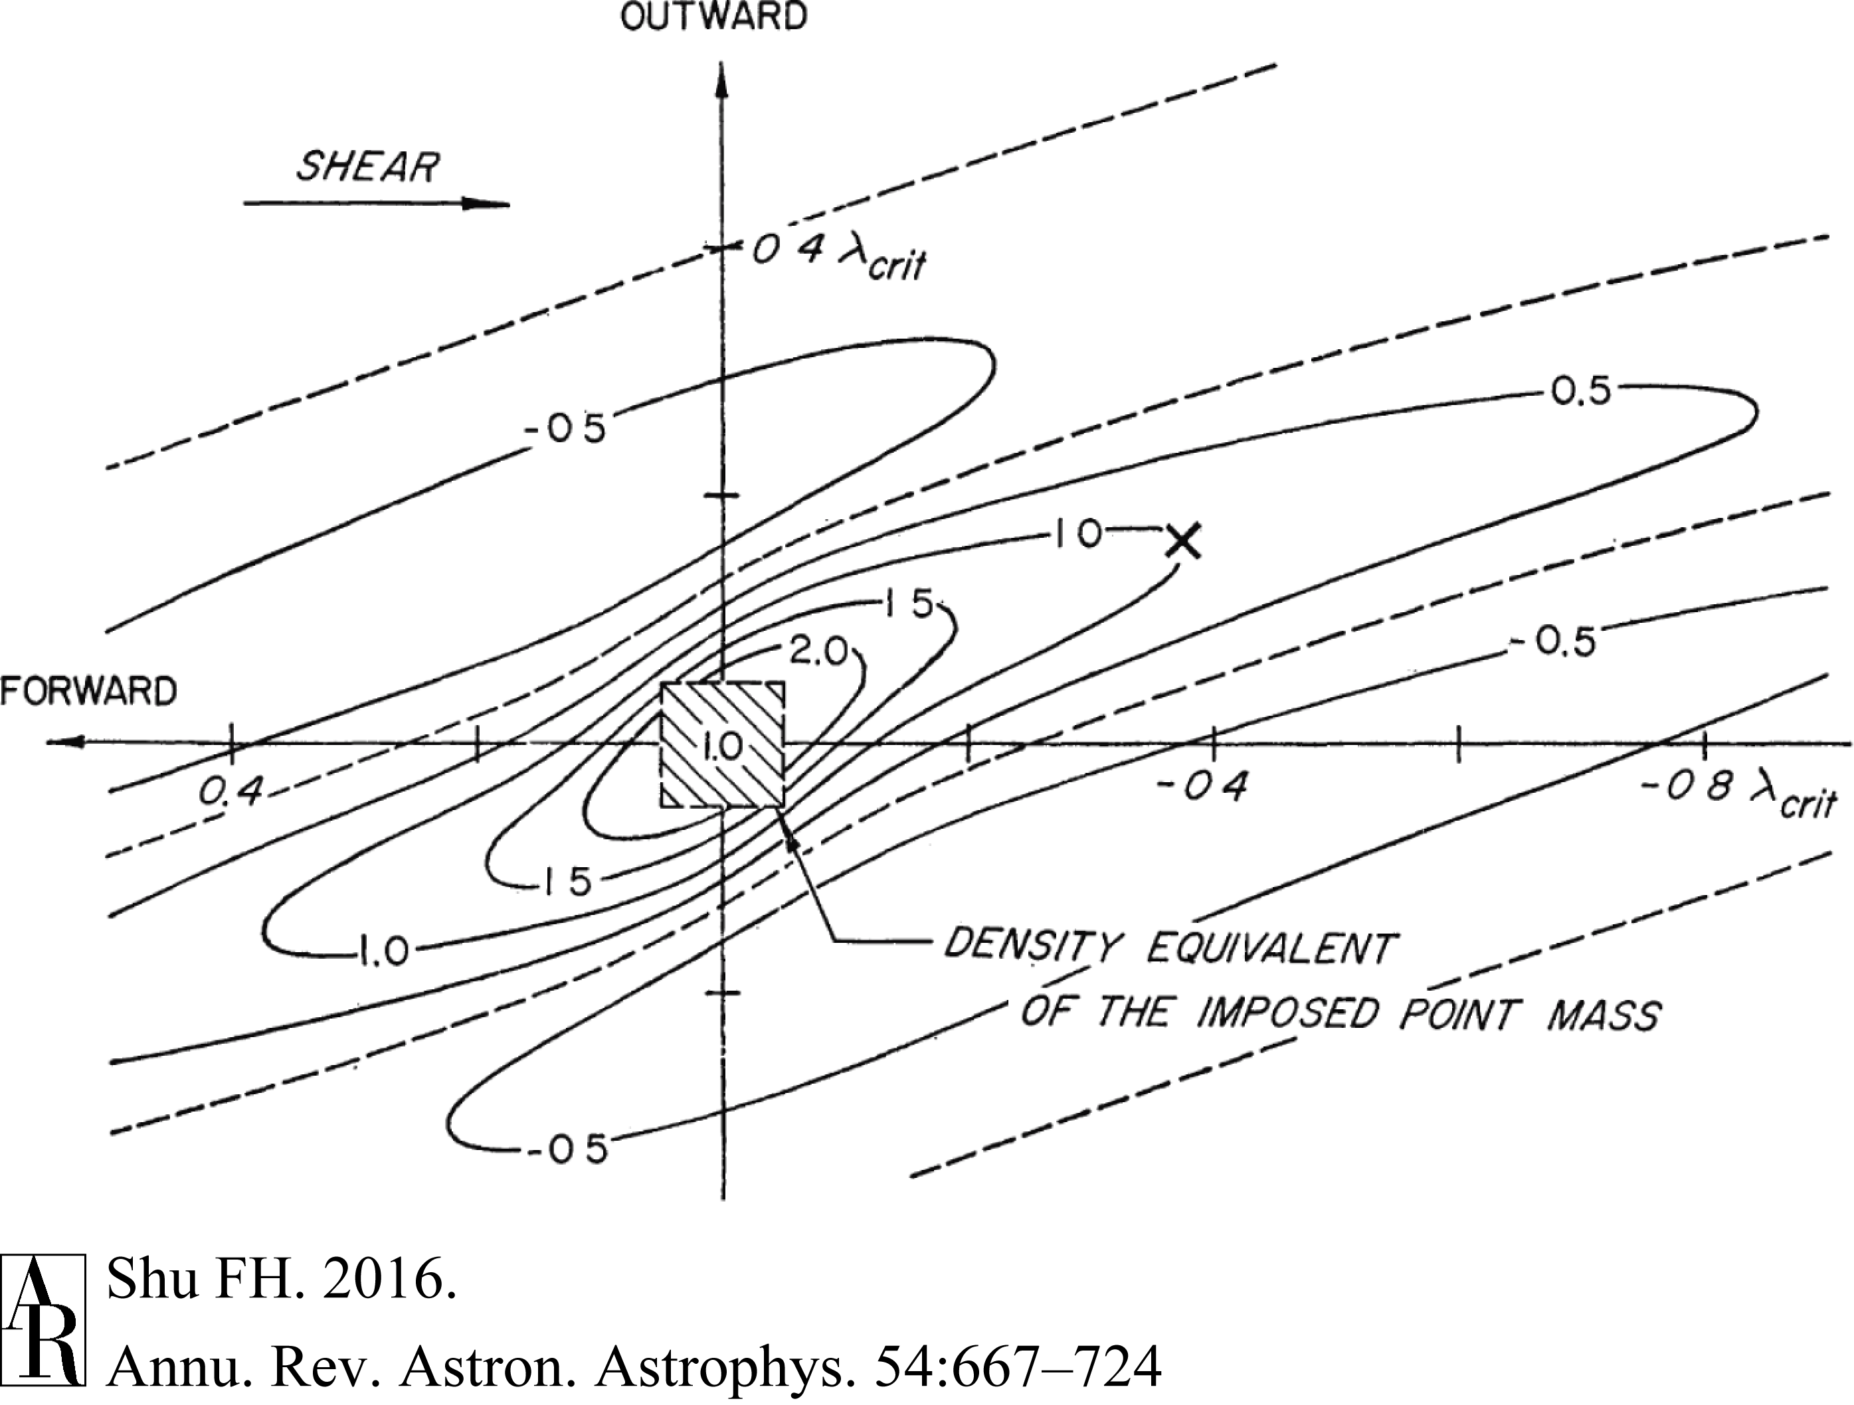
Orbiting Mass Point Produces Density Wakes in Stellar Disk
(Julian & Toomre 1966)

Slide 20
SDWs in Planetary Rings

Slide 21
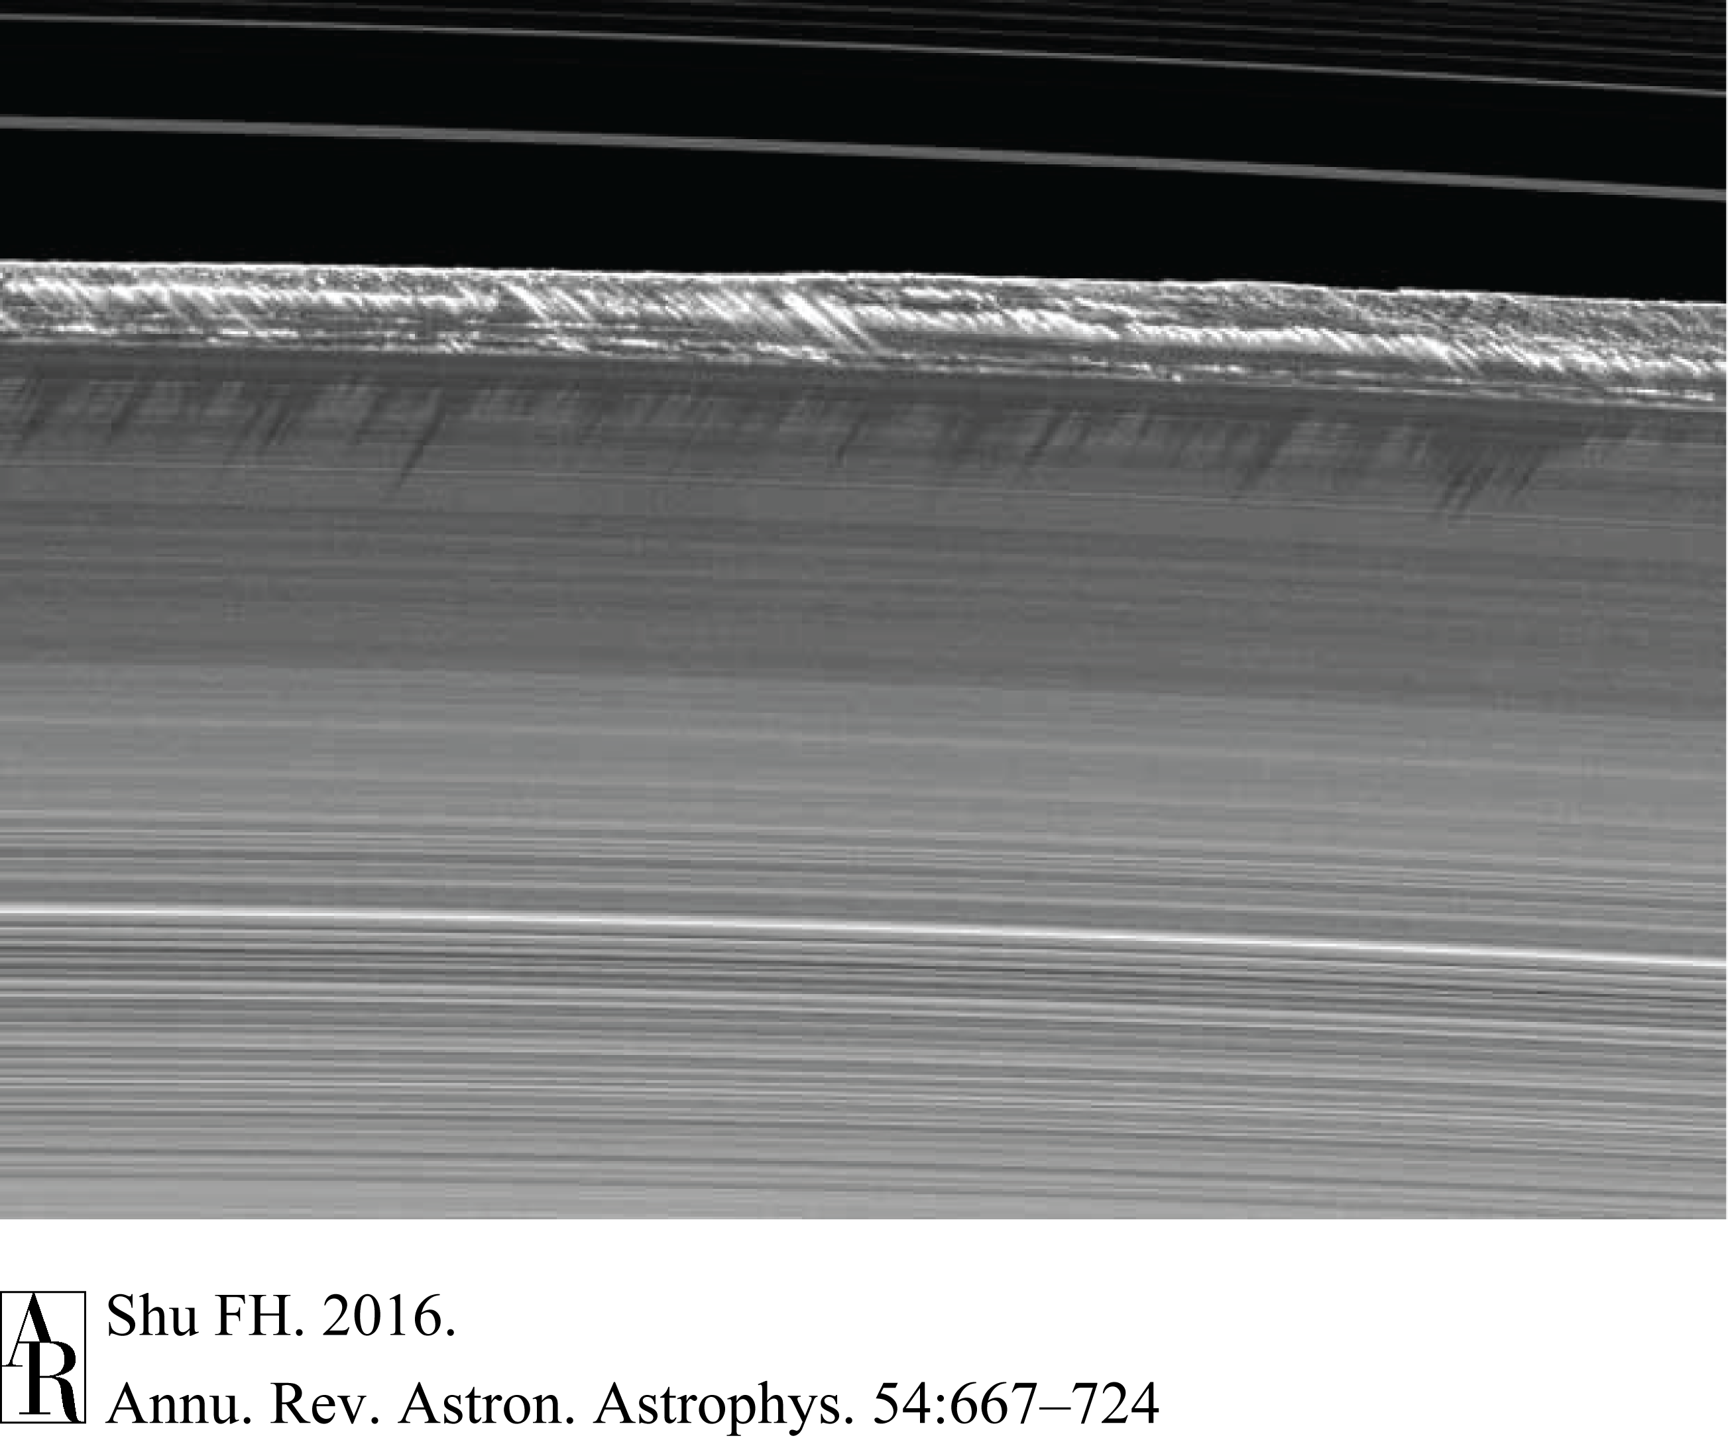
Clearing of Cassini Division by 2:1 ILR
of Mimas (ν = -1 for m = 2 w Ω_{p} = Ω_{M})
(Goldreich & Tremaine 1978, Borderies, Goldrich, Tremaine 1985)
Spitale & Porco (2010), Nicholson et al. (2014)
NASA/JPL/Cassini

Slide 22
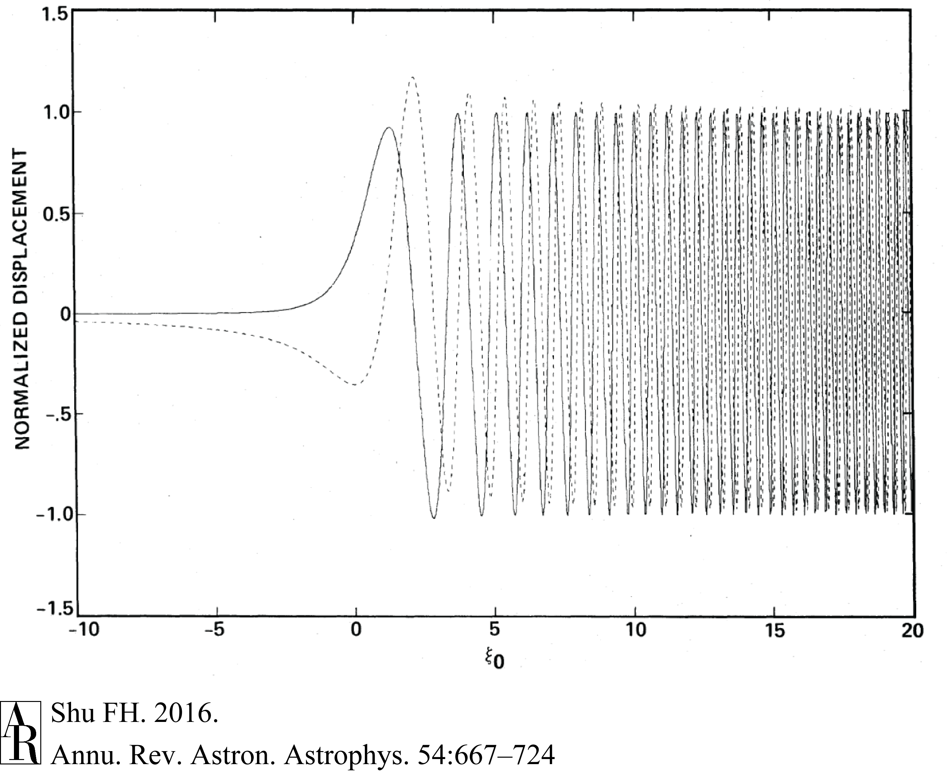
Forcing at ILRs (or OLRs) by Mass Point Launches Long Trailing SDWs
(Shu, Yuan, Lissauer 1985)

Slide 23
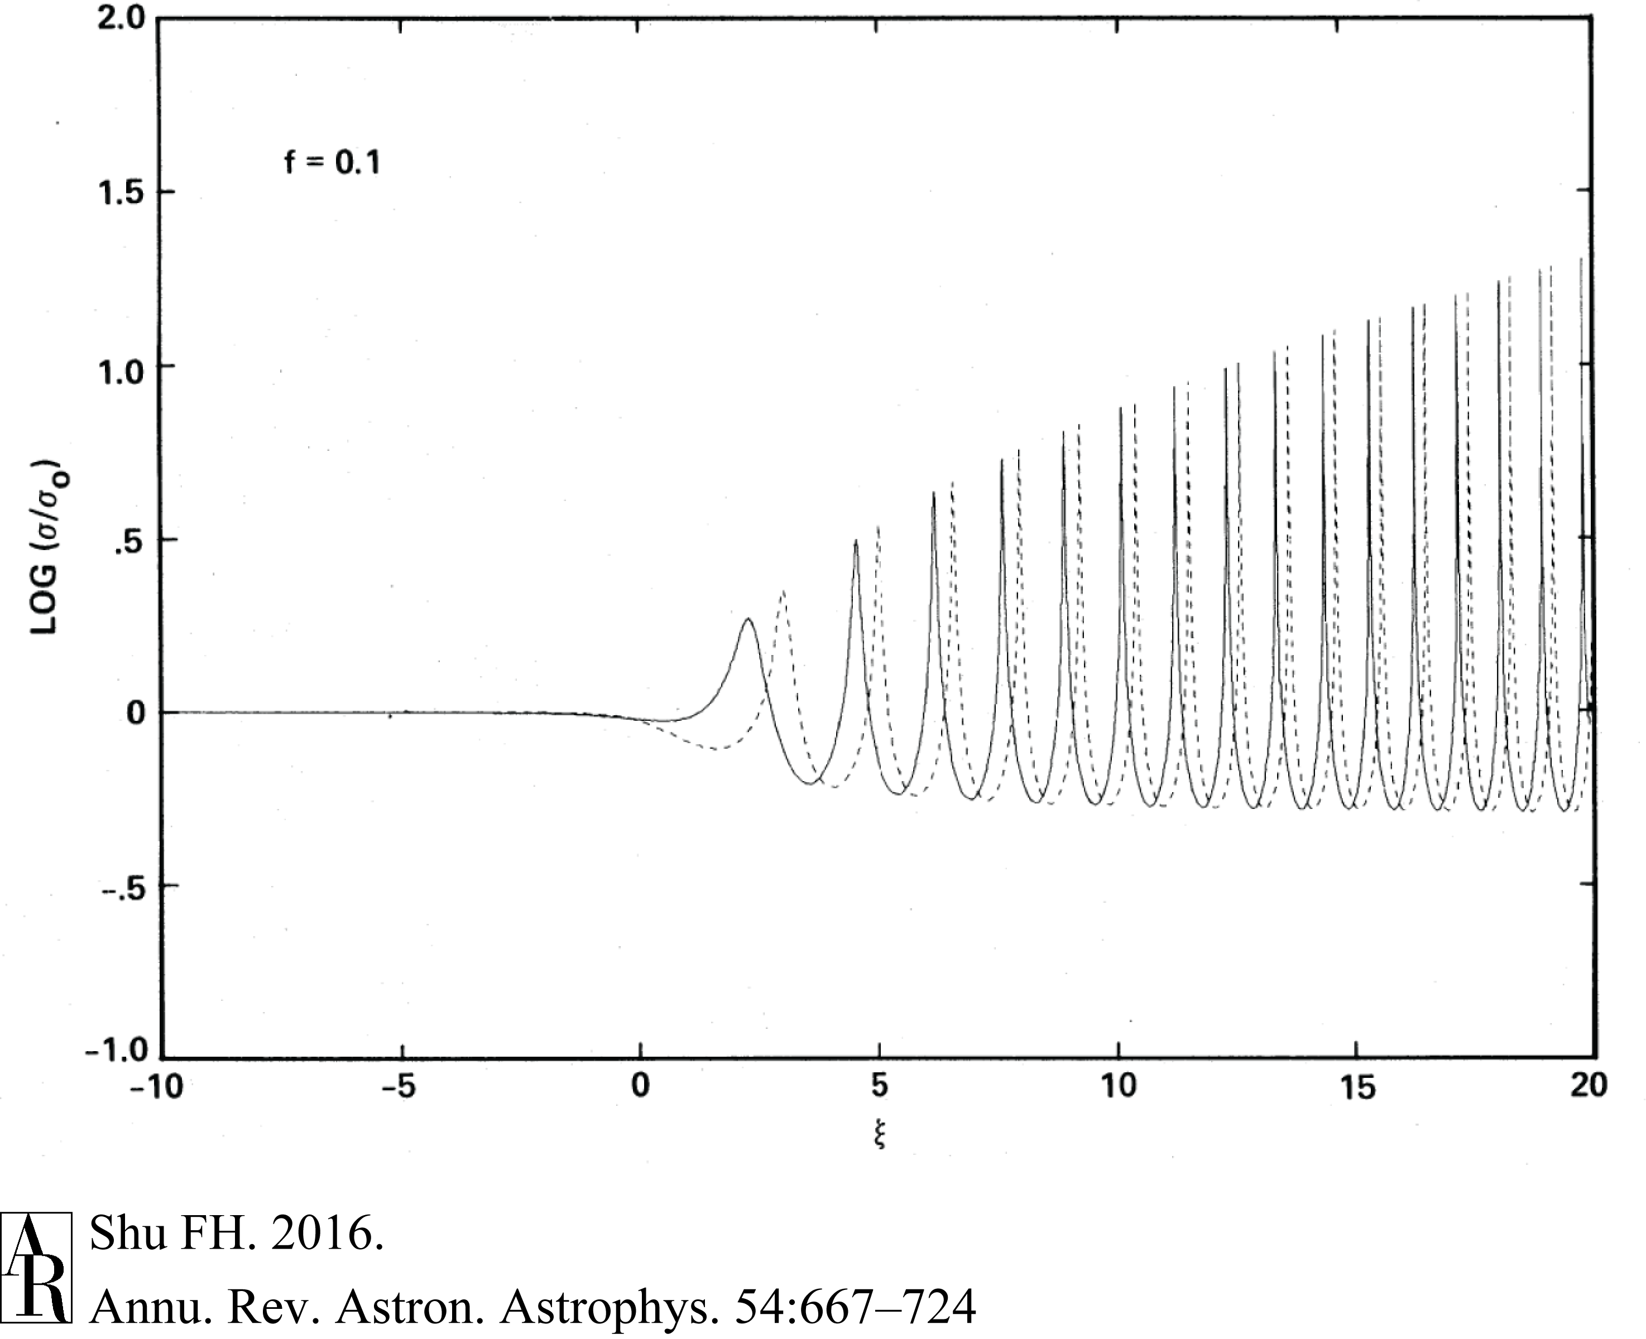
With Modest Forcing, Launched SDWs
Quickly Reach Nonlinear Amplitudes
(Shu, Yuan, Lissauer 1985a; inviscid calculation)

Slide 24
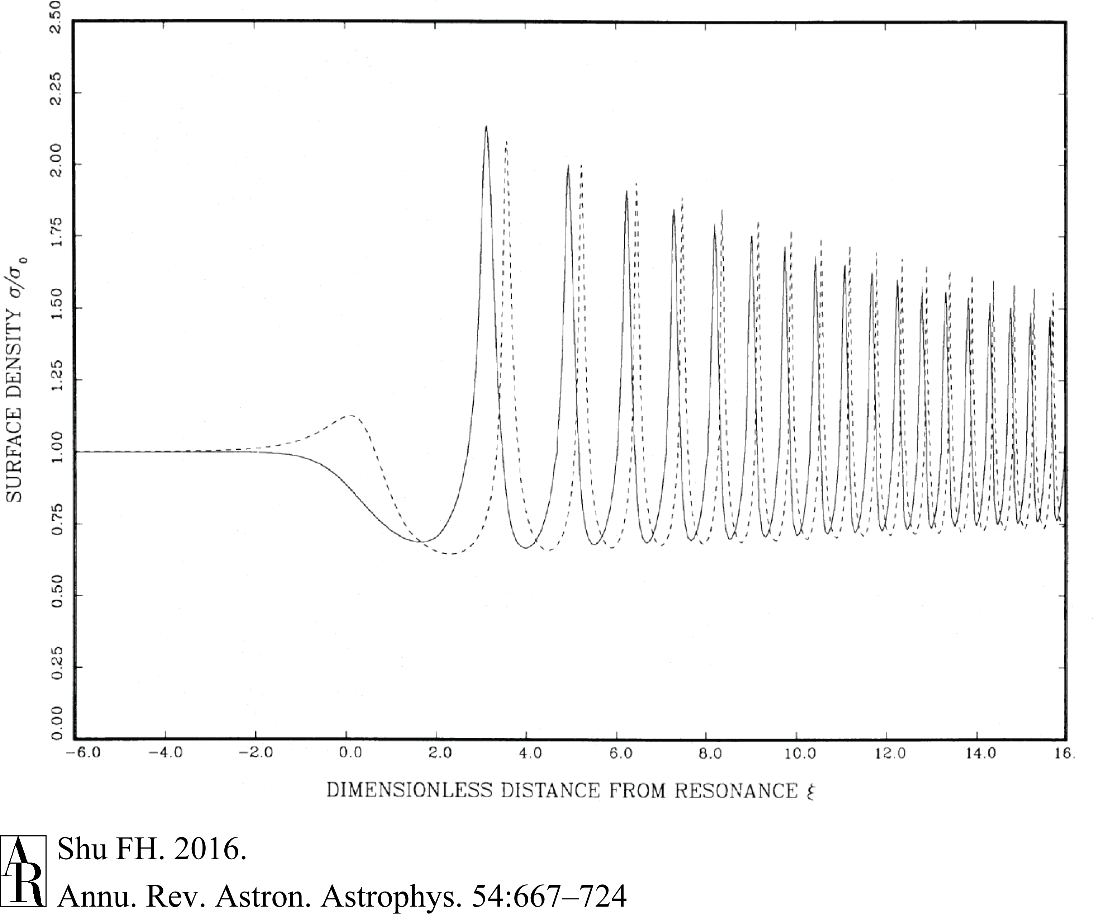
Collisional Damping w Measured Coeff of Restitution by Bridges, Hatzes, Lin (1984)
(Shu, Yuan, Lissauer 1985)

Slide 25
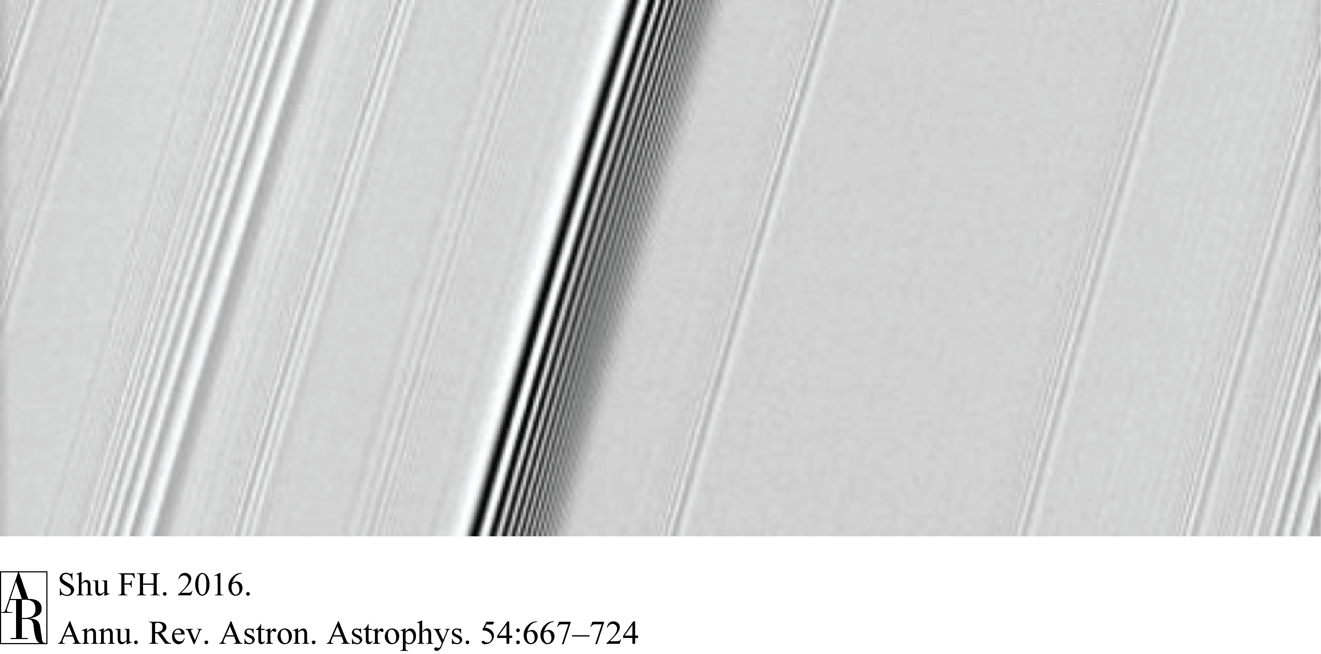
Voyager 2 Observed SDWs and SBWs
Launched at 5:3 Resonance w Mimas
(Shu, Yuan, Lissauer 1985)
NASA/JPL?Cassini

Slide 26
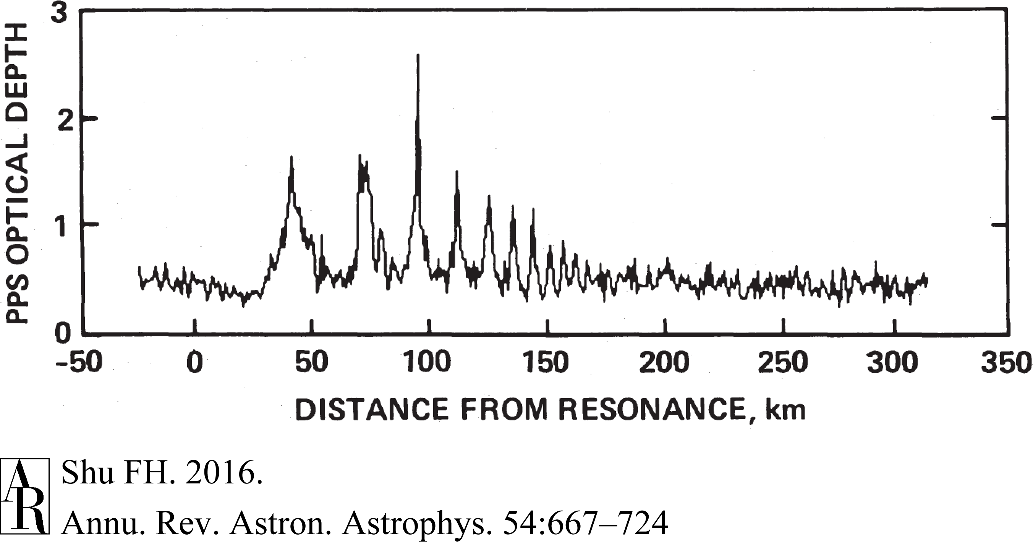
Damped SDW at Mimas 5:3 Resonance
Observed by Stellar Extinction
(Shu, Dones, Lissauer, et al. 1985b)

Slide 27
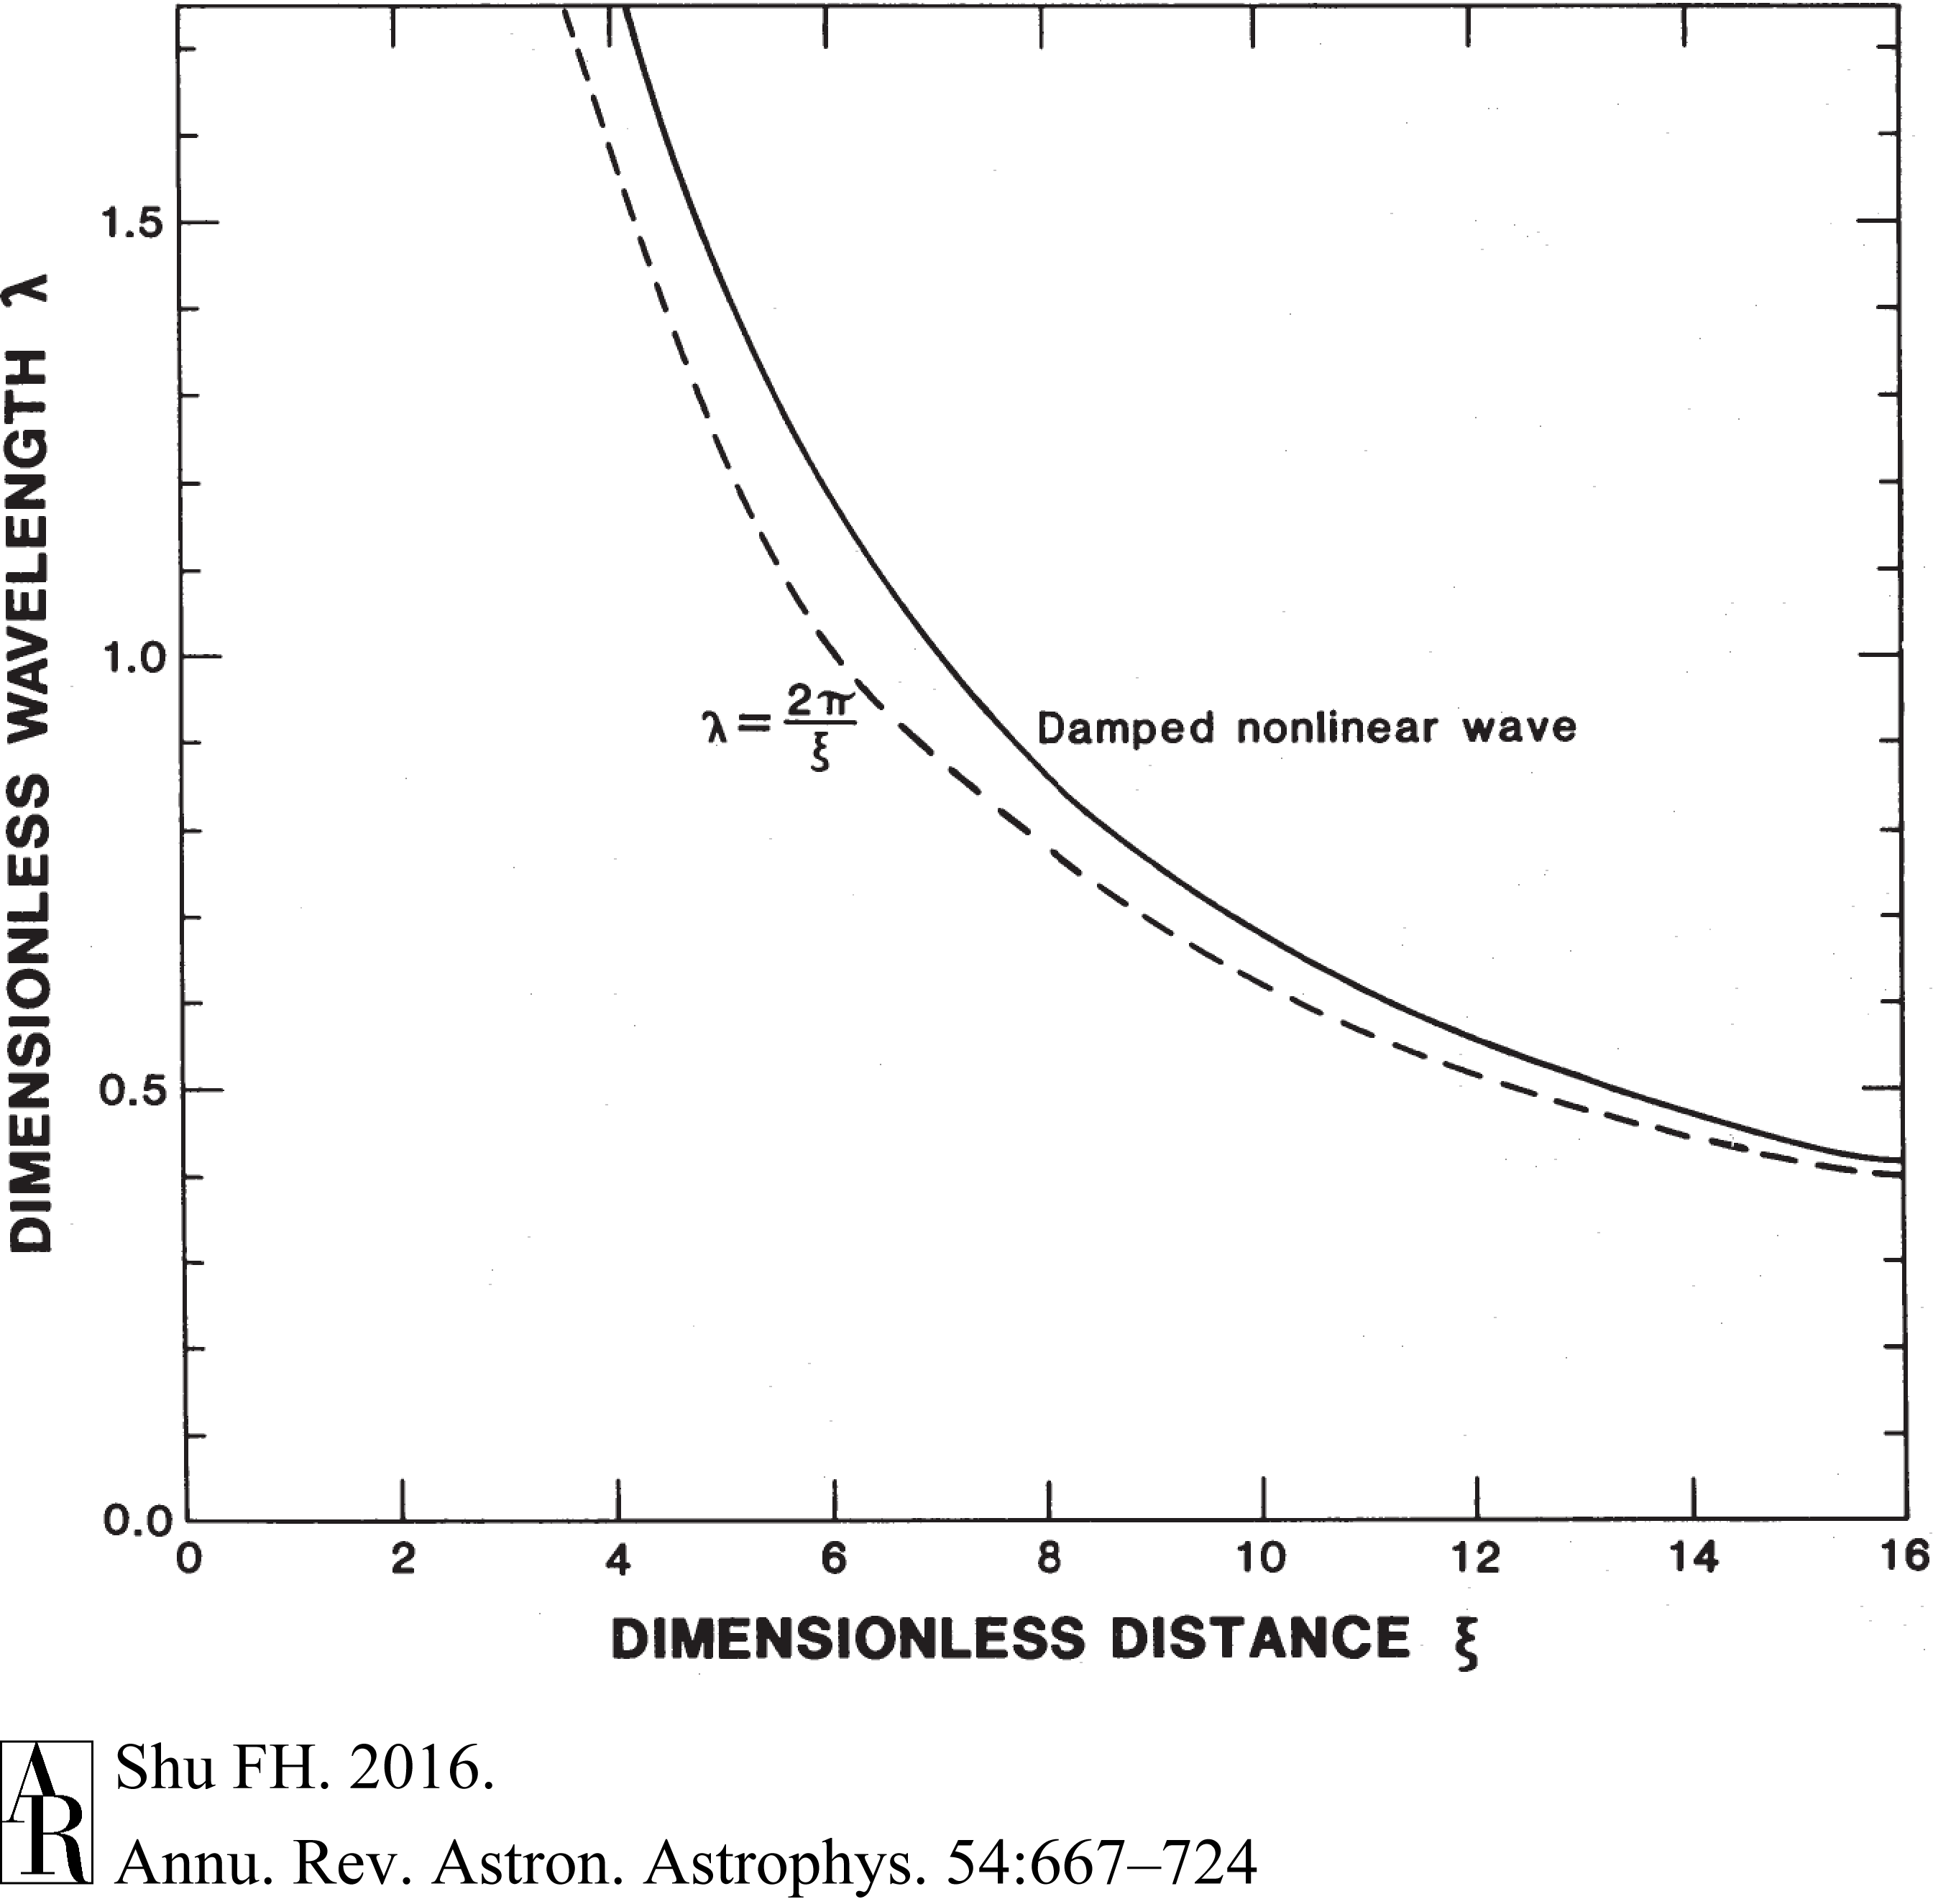
With Nonlinearity Offset by Damping
λ ~ surface density/dist from resonance
(Shu, Dones, Lissauer et al. 1985b)

Slide 28
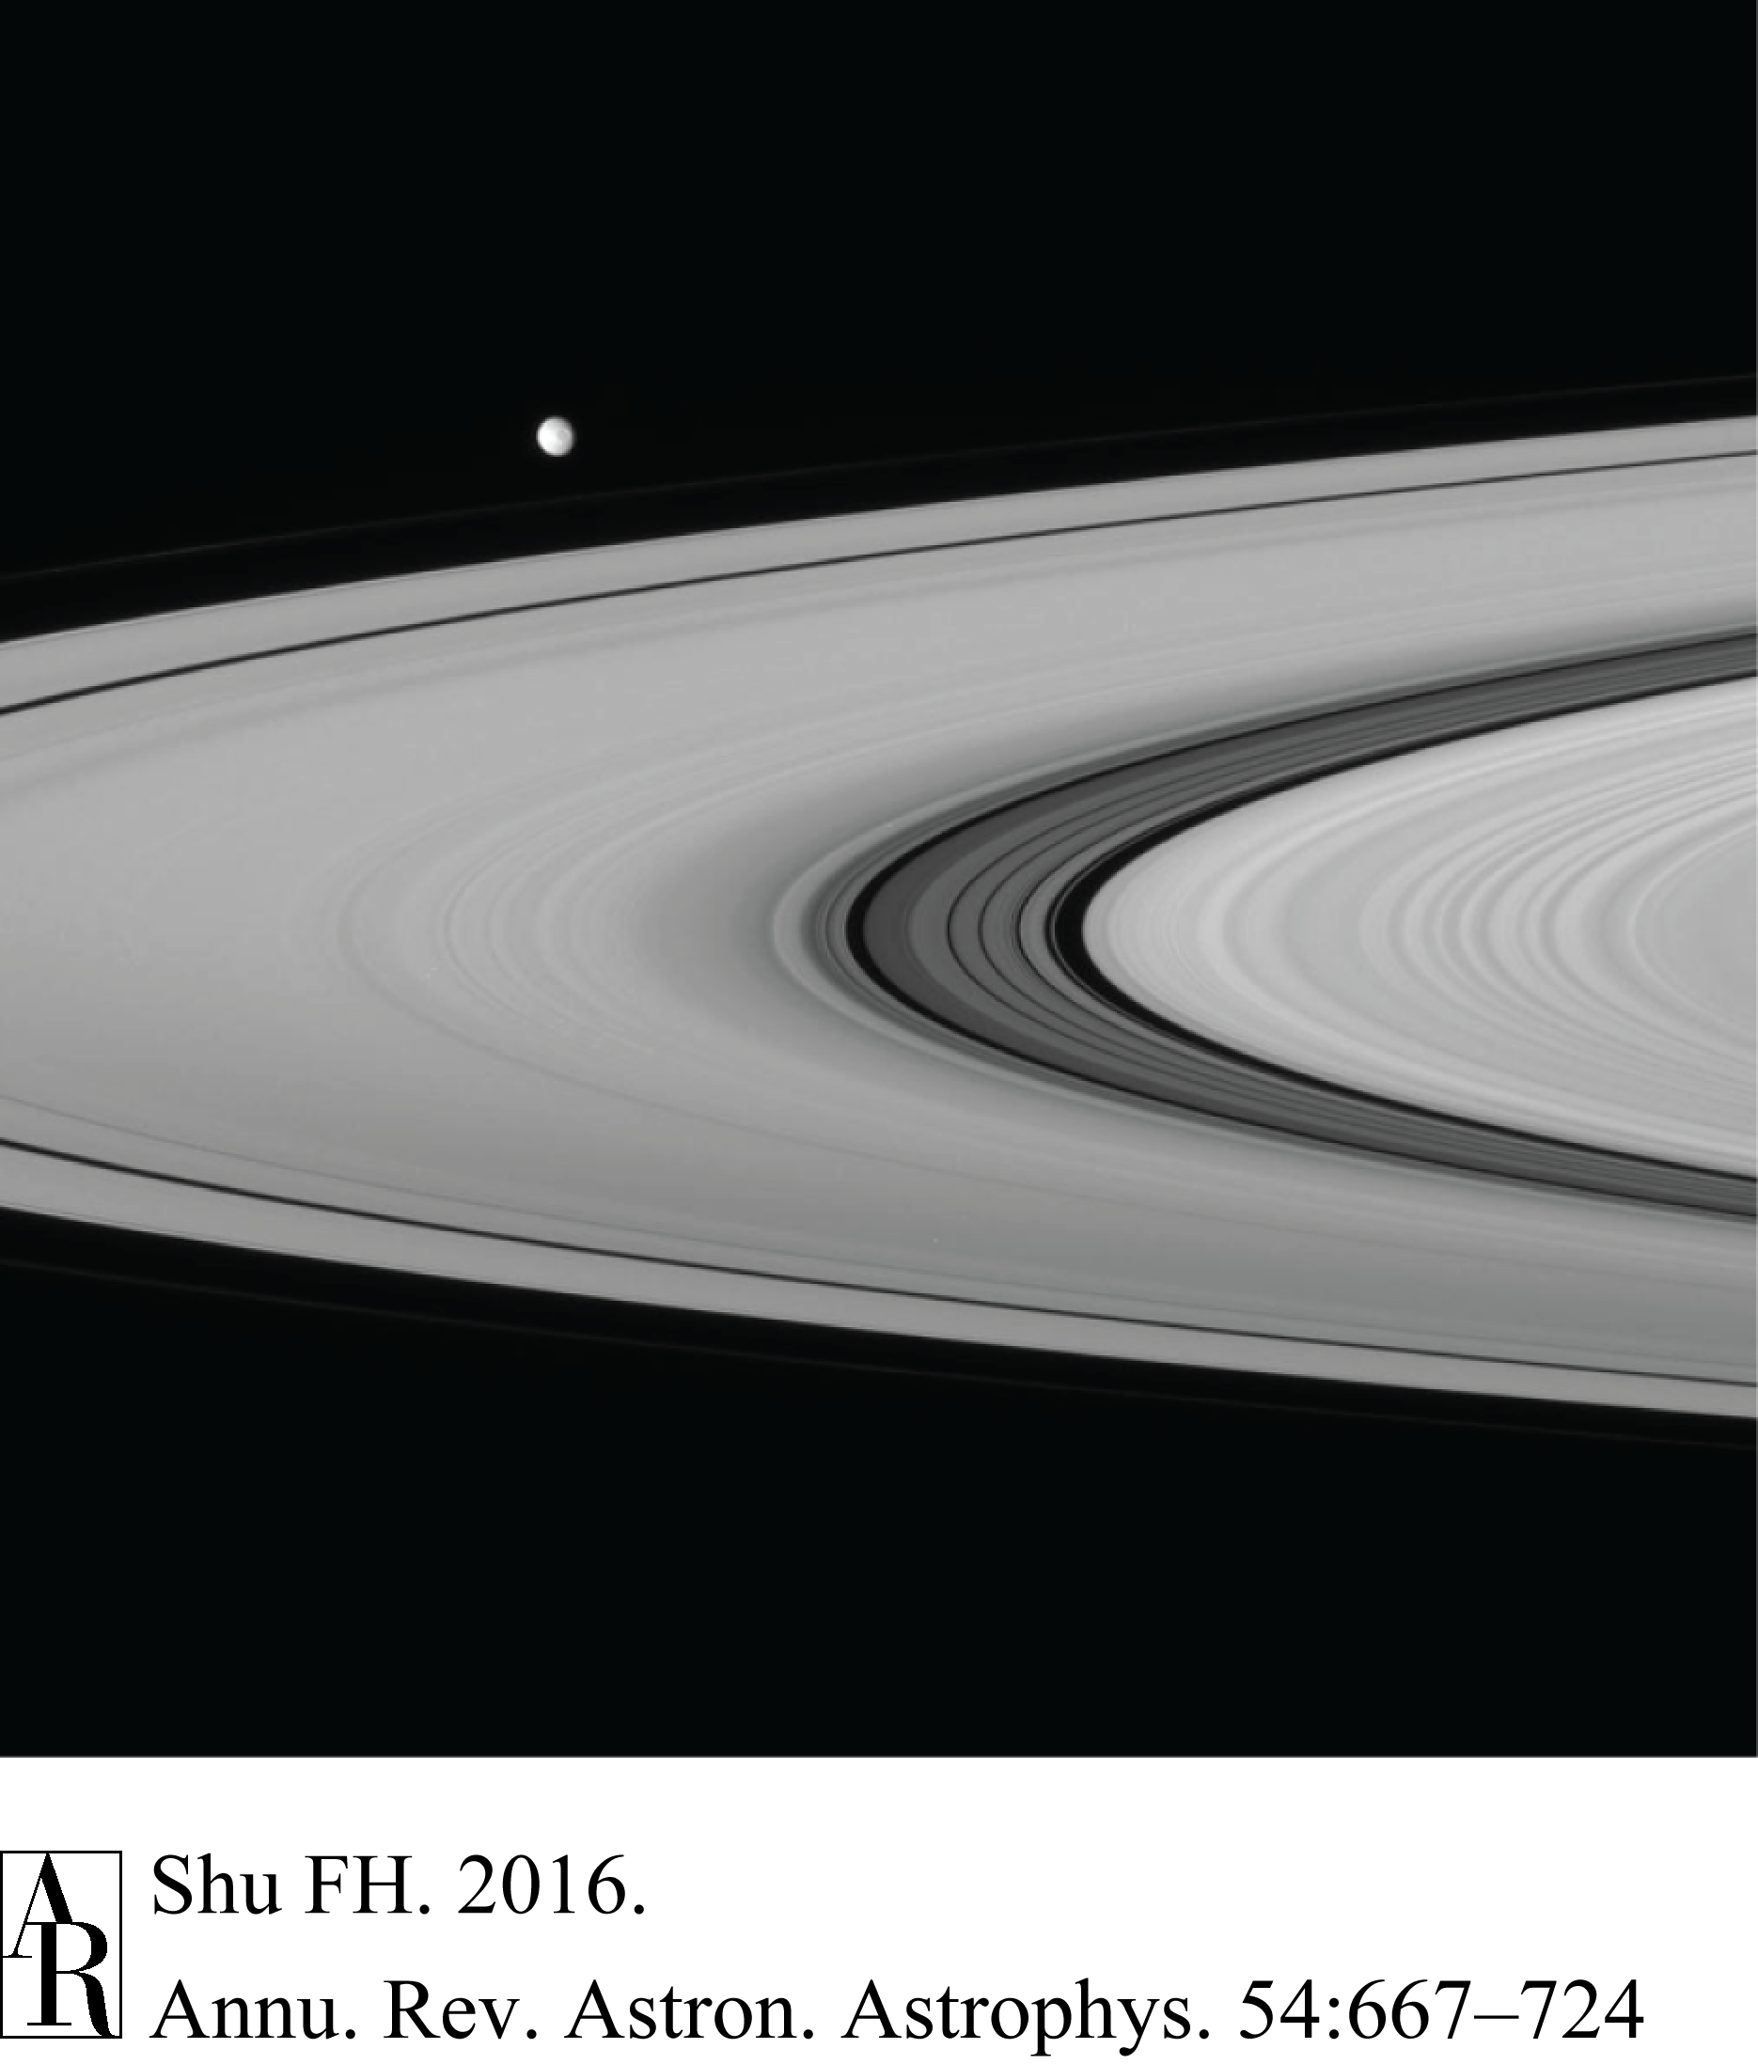
NASA Question: Can Voyager 1 or 2 Fly Safely Through Cassini Division?
Voyager 1: Cassini Division has
alt debris lanes & clear lanes
Shepherding moonlets
ang mom transport repulsive
back reaction: migration of moonlets
Speculations before 51 Peg:
spitting out small moons beyond A ring
migration of planets in protoplanetary disks
could early migration of Jupiter have affected structure of solar system?
NASA/JPL/Cassini

Slide 29
Spiral Structure as Growing
Normal Modes in Disk Galaxies
(Shu 1970; Kalnajs 1971, 1974, 1976)

Slide 30
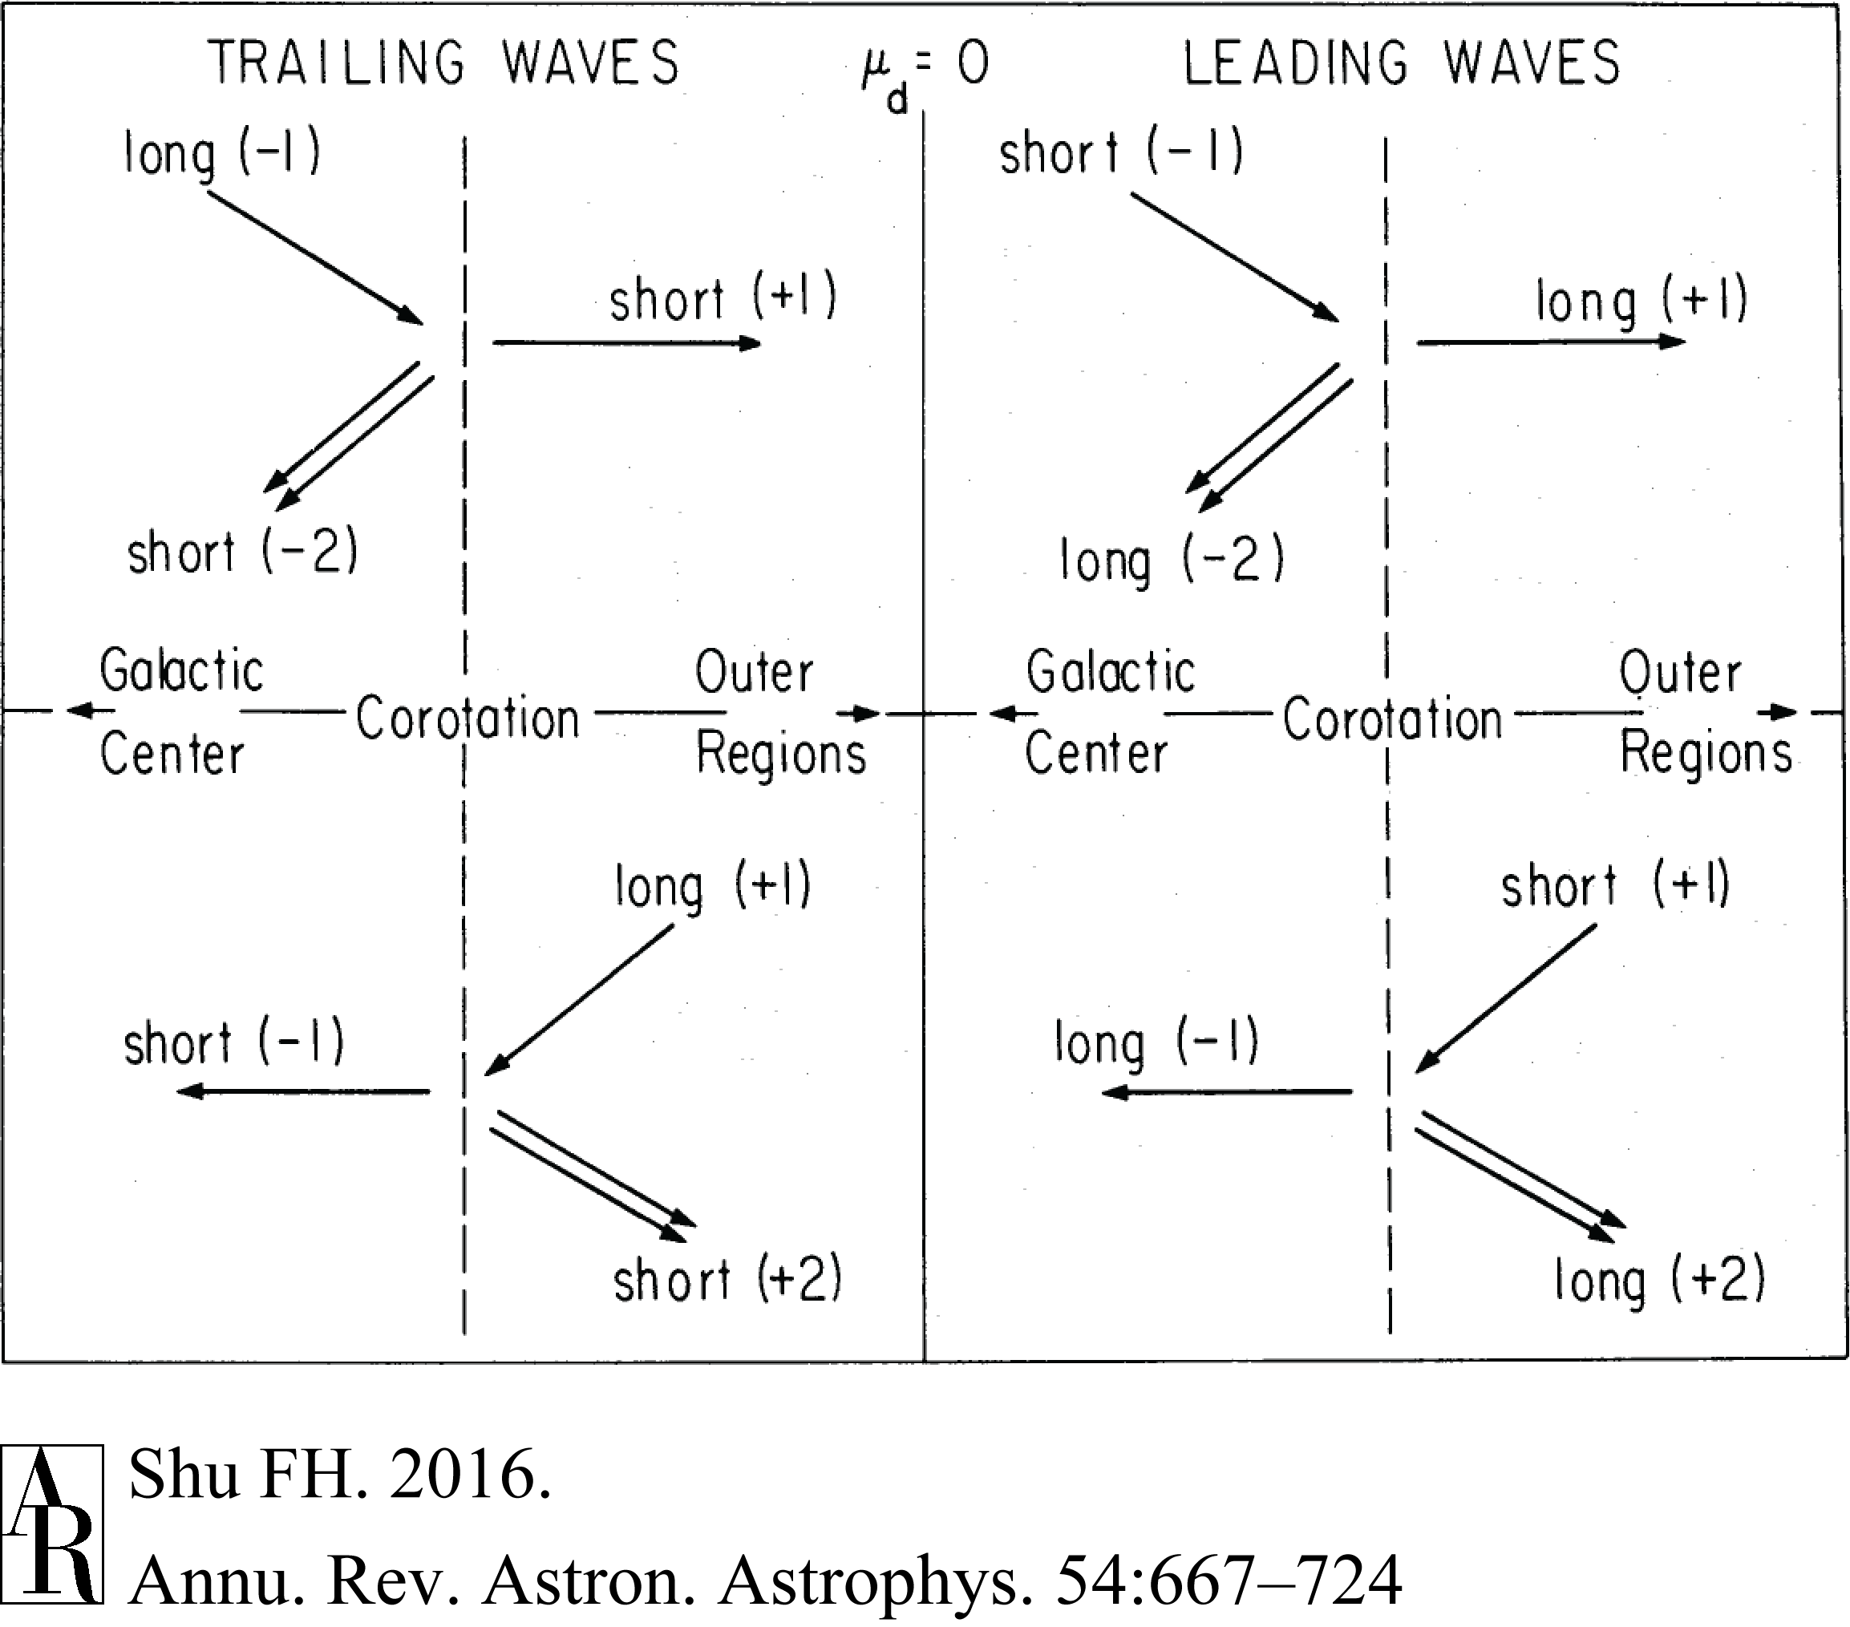
Wave Amplification by Stimulated Emission of Radiation across CR
(Mark 1976)

Slide 31
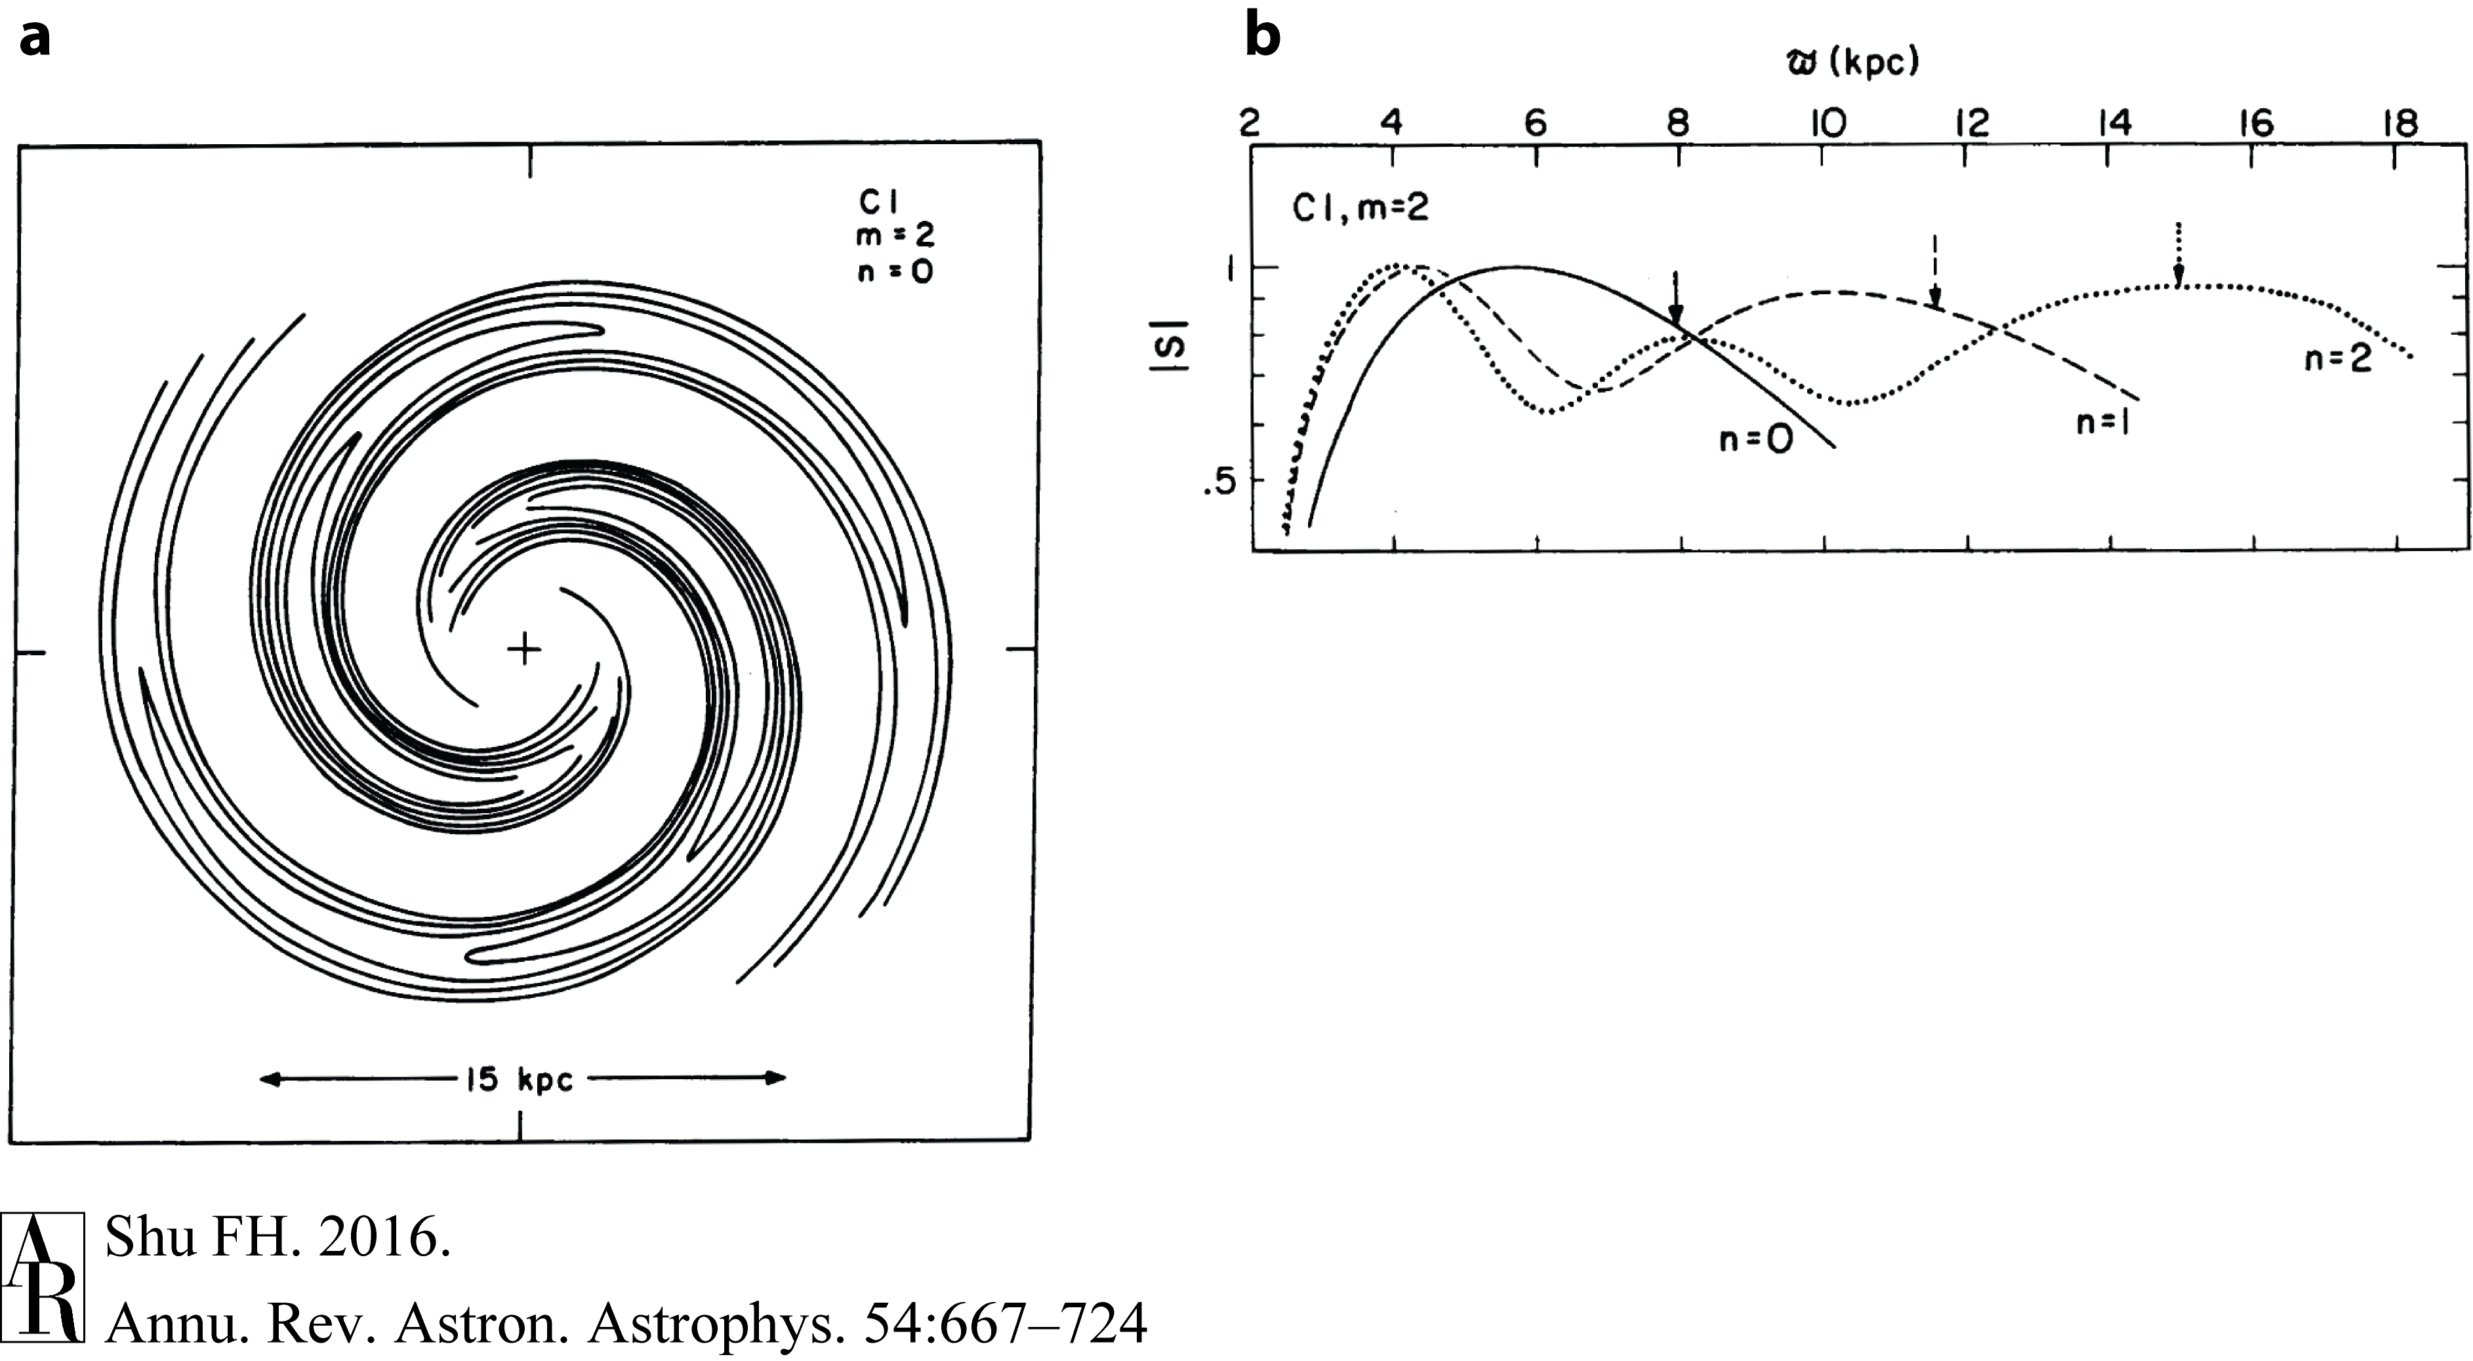
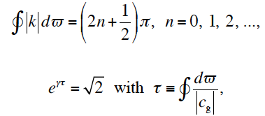
Feedback and Coherence
(Bertin, Lau, Lin et al. 1977)

Slide 32
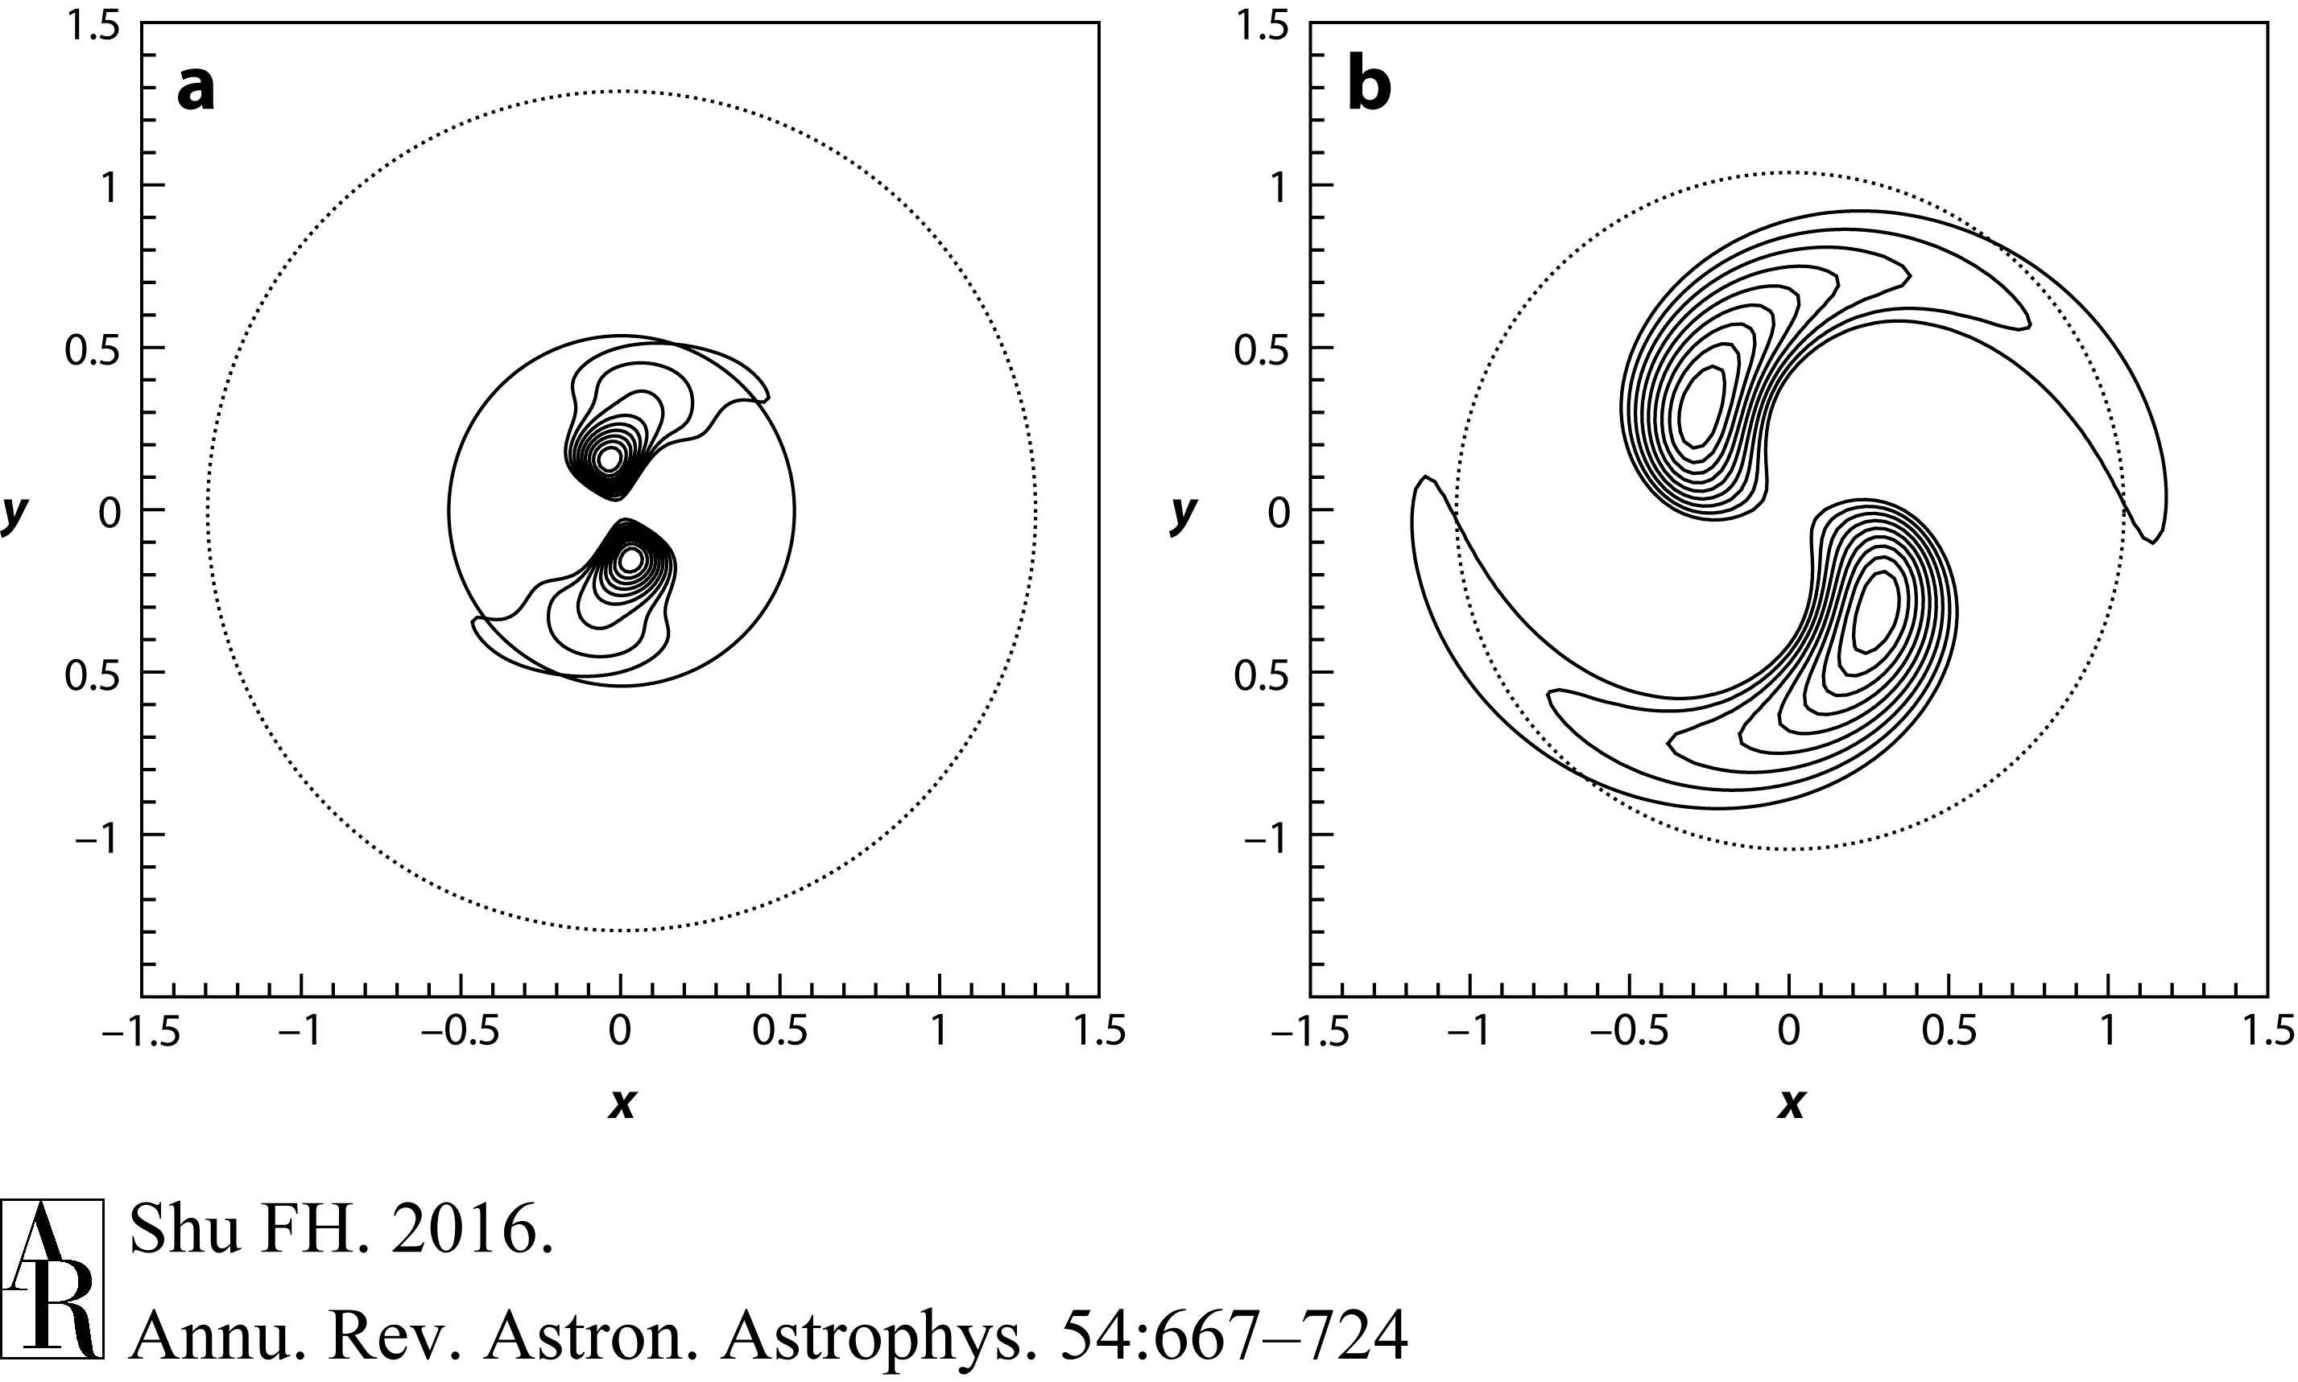
Generic Form of Most Unstable Modes
In Stellar Dynamical Disks
(Jalali & Hunter 2005)
m = 2, n =0
m = 2, n =0

Slide 33
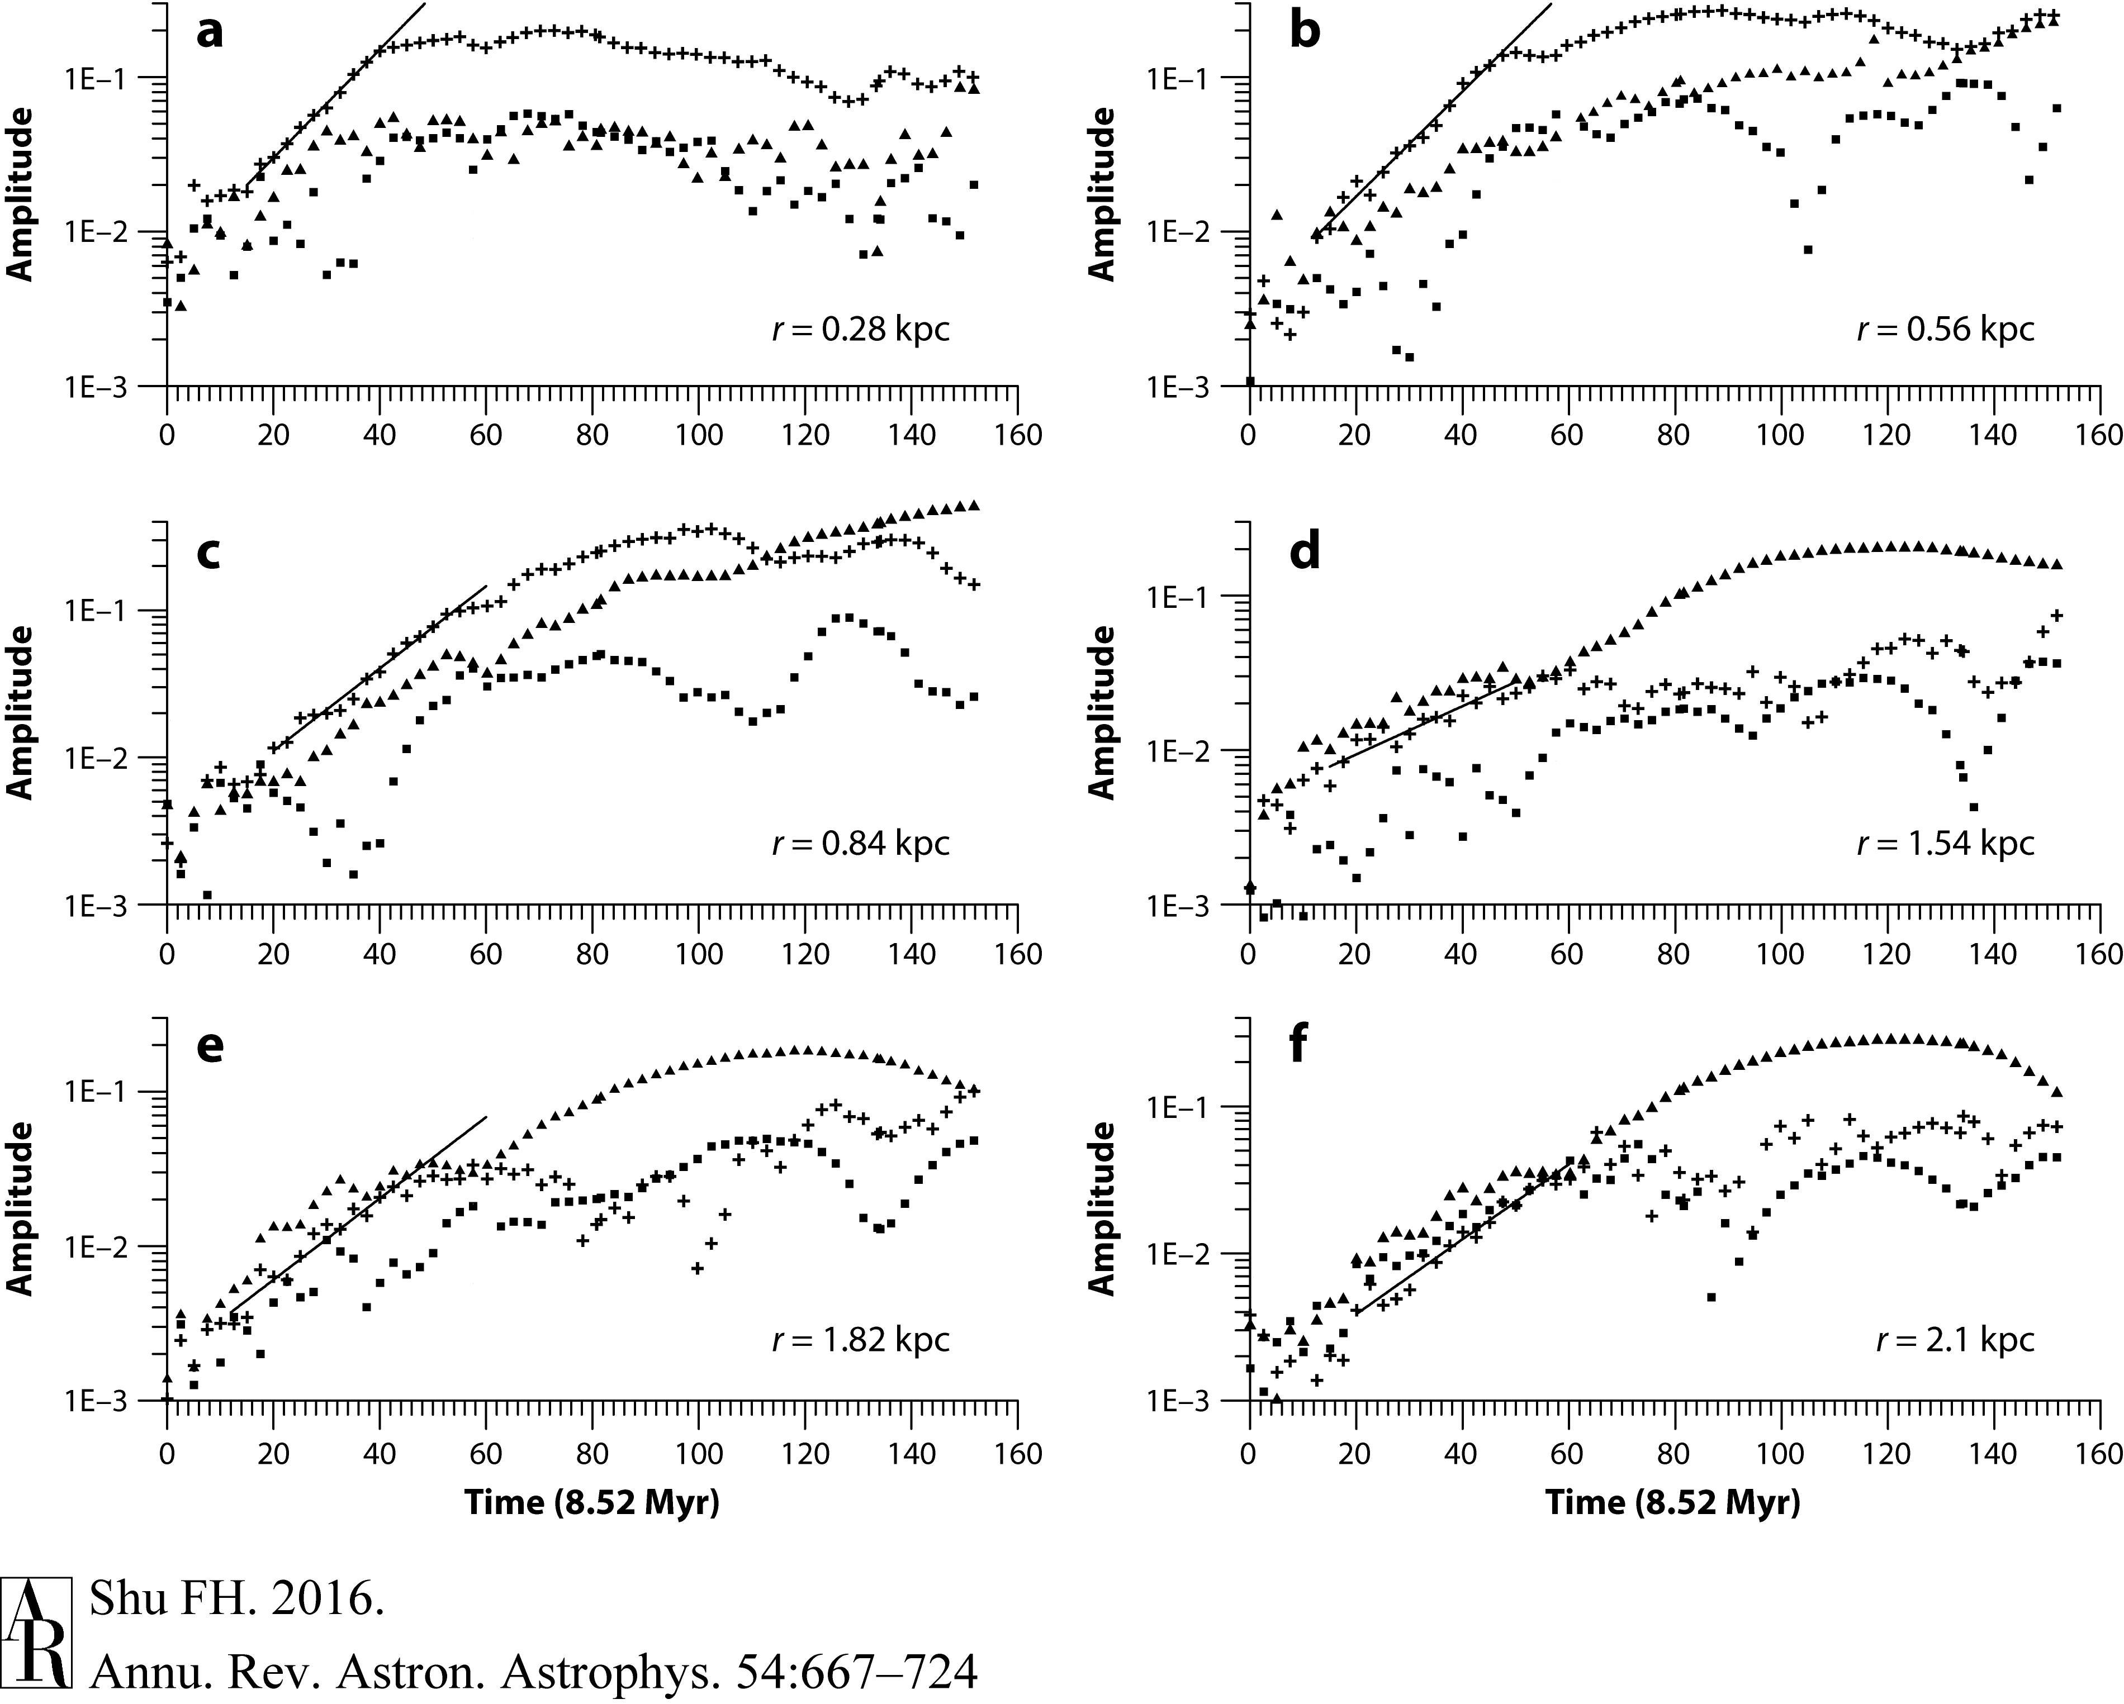
Numerical Simulations of J&H Modes
(Khoperskov et al. 2007)

Slide 34
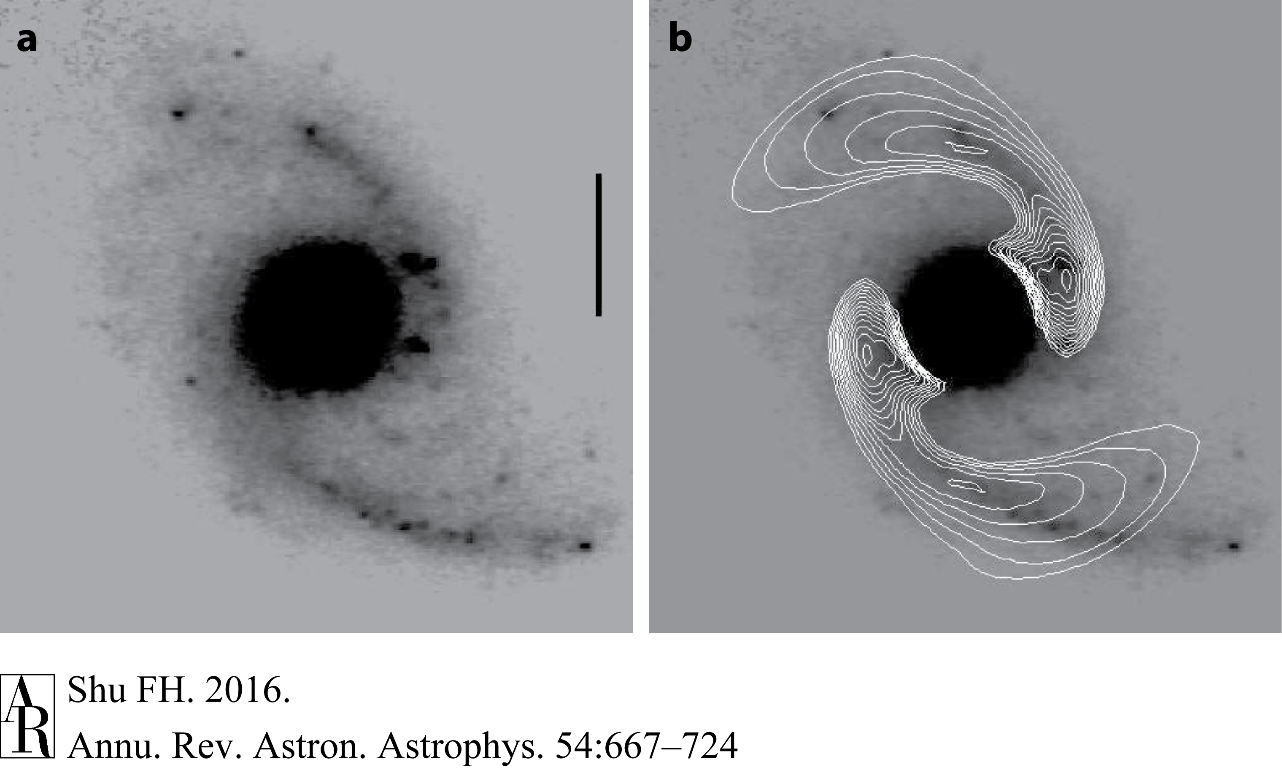
Modal Amplitude Modulation in K Band Image of Stellar Dynamical Disk
(Puerari et al. 2000: NGC 5248 – GD in IR, GD in Optical)
m = 2, n =1

Slide 35
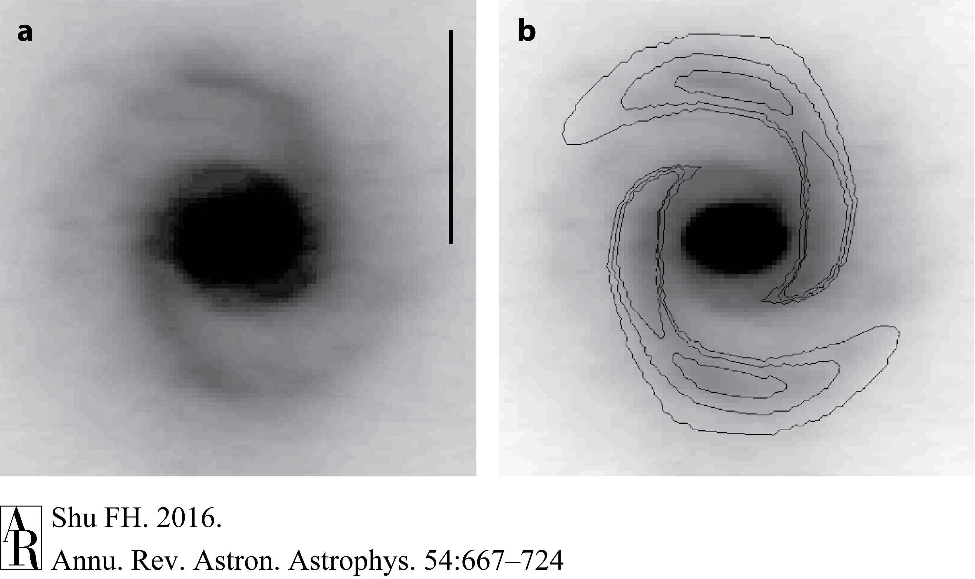
Modal Amplitude Modulation in K Band Image of Stellar Dynamical Disk
(Puerari et al. 2000: M 4062 – GD in IR, Flocculent in Optical)
m = 2, n = 1

Slide 36
SDWs in Protoplanetary Disks

Slide 37
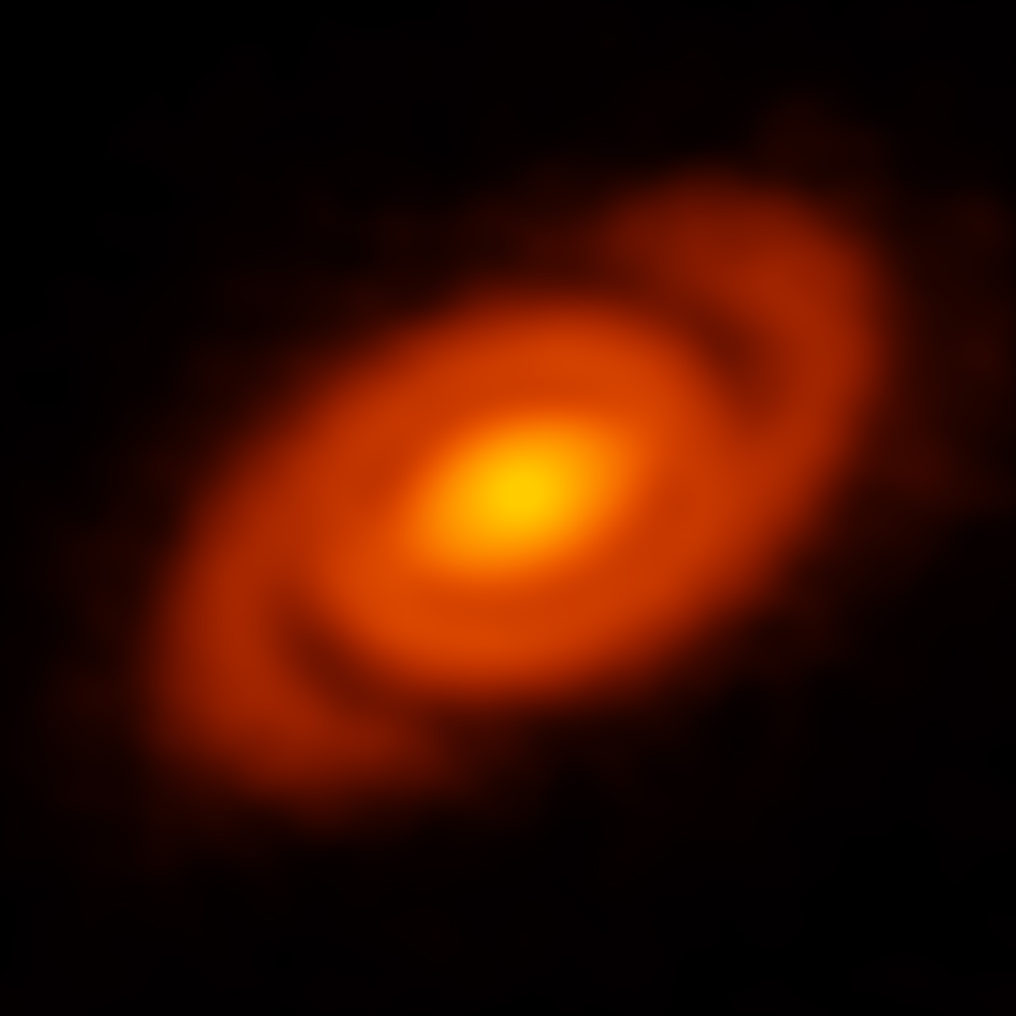
ALMA Image of Spiral Structure in Protopanetary Disk of YSO: Elias 2-27
(Perez et al. 2016)
()

Slide 38
Importance of Mentorship in Research
The most innovative research occurs in unexplored territory where one may not know what are even the right questions to ask, much less how to answer them.
For such problems, the best guides are experienced researchers who have been through it before in other (related) fields. Learn from such masters.
Do not be discouraged by disparaging remarks from others. Nature is the final arbiter of what is right in science.
Be scrupulously honest about what you know and what you do not know. Be prepared for surprises. Practice humility.
Welcome difficulties. If the problem is easy, it’s probably not that important, or it would have been solved before.
Be open to how progress in your field might impact other fields, and vice-versa. Disciplinary boundaries are the constructs of humans, not of nature.

