Slide 1
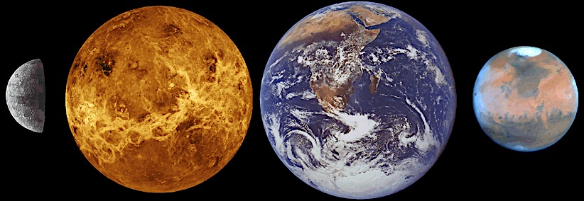
Two Planets: Challenges of Living on Earth & Mars
Frank H. Shu¹ & HX Team (formed 2009)²
¹ASTRON Solutions Corporation
2 August 2017
Wu Chien Shiung Science Camp
²ASIAA: P. Ho, R. Krasnopolsky, R. E. Taam, T. S. Wei, S. J. Zheng; IoC; F. T. Luo, H. F. Tseng;
NTHU: N. H. Tai, P. F. Cheng, D. S. H. Wong; ITRI: S. K. Wu; CityU: C. T. Liu; UMich, R.T. Yang; S. CA: F. S. Model, S. Chien
Notes:
¹M. J. Cai, F. T. Luo, P. T. P. Ho, R. E. Taam, Y. D. Huang. T. S. Wei, K. H. Chien, S. K. Wu, S. Chien, N. H. Dai, S. J. Zheng

Slide 2
Outline of Talk
Motivations for colonizing Mars
Challenges to survival on Earth
Challenges to survival on Mars
Getting to Mars (& back)
Hohmann transfer orbit
Chemical and nuclear rocket propulsion
Living and working on Mars
Water, oxygen, and thorium
Making methane fuel
Building a high-tech carbon-based economy
Transforming Martian soil from sterile/toxic to fertile
Lessons for Earth from thinking about Mars (and vice-versa)
Using biochar to reverse climate change
Making nuclear energy Safe, Sustainable, Secure, $uperior* (may skip)
ESA
Notes:
A climate scientist and a climate skeptic walk into a bar. The skeptic says to the bartender, “What’s your strongest drink?” The bar tender brings out a bottle and says: “This one is 97% alcohol but it’ll cost you more.” The skeptic slams his fist on the bar, yells, “I’m not paying,” and storms out. The scientist turns to the bartender and says: "That's the trouble with these guys; you show them the proof, and they still don't buy it.”

Slide 3
Challenges to survival on Earth
Notes:
A climate scientist and a climate skeptic walk into a bar. The skeptic says to the bartender, “What’s your strongest drink?” The bar tender brings out a bottle and says: “This one is 97% alcohol but it’ll cost you more.” The skeptic slams his fist on the bar, yells, “I’m not paying,” and storms out. The scientist turns to the bartender and says: "That's the trouble with these guys; you show them the proof, and they still don't buy it.”

Slide 4
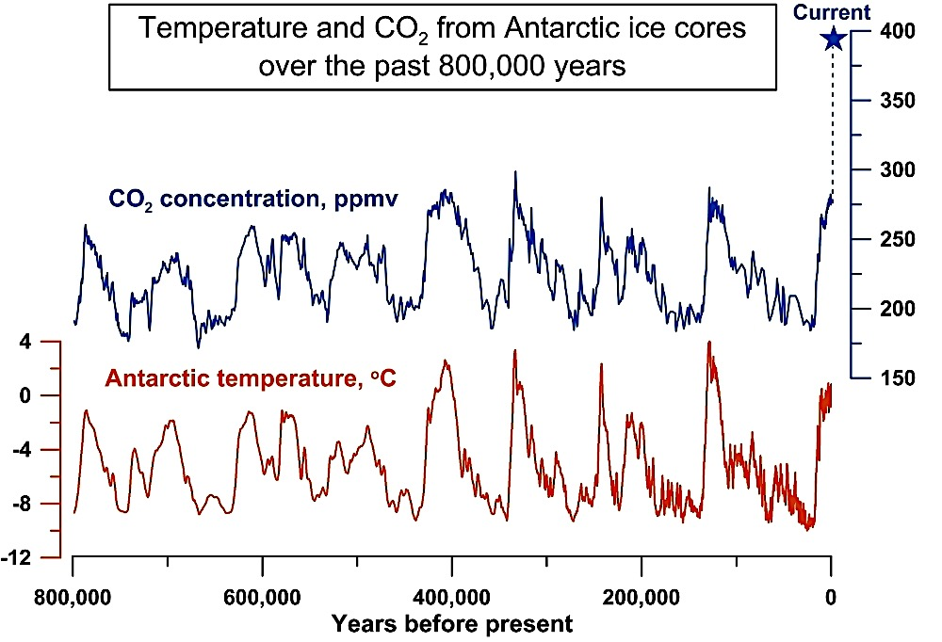
Antarctica Ice Core Data Milankovic cycle, amplification, & positive feedback
In its present configuration, Earth is on the brink of instability, with small forcings leading to large amplification & feedback that produce climate “phase change.”

Slide 5
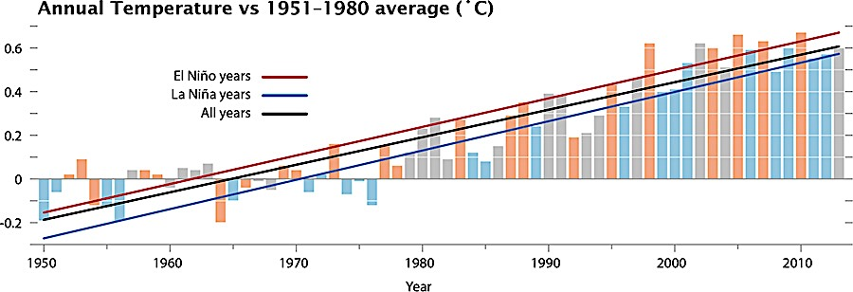
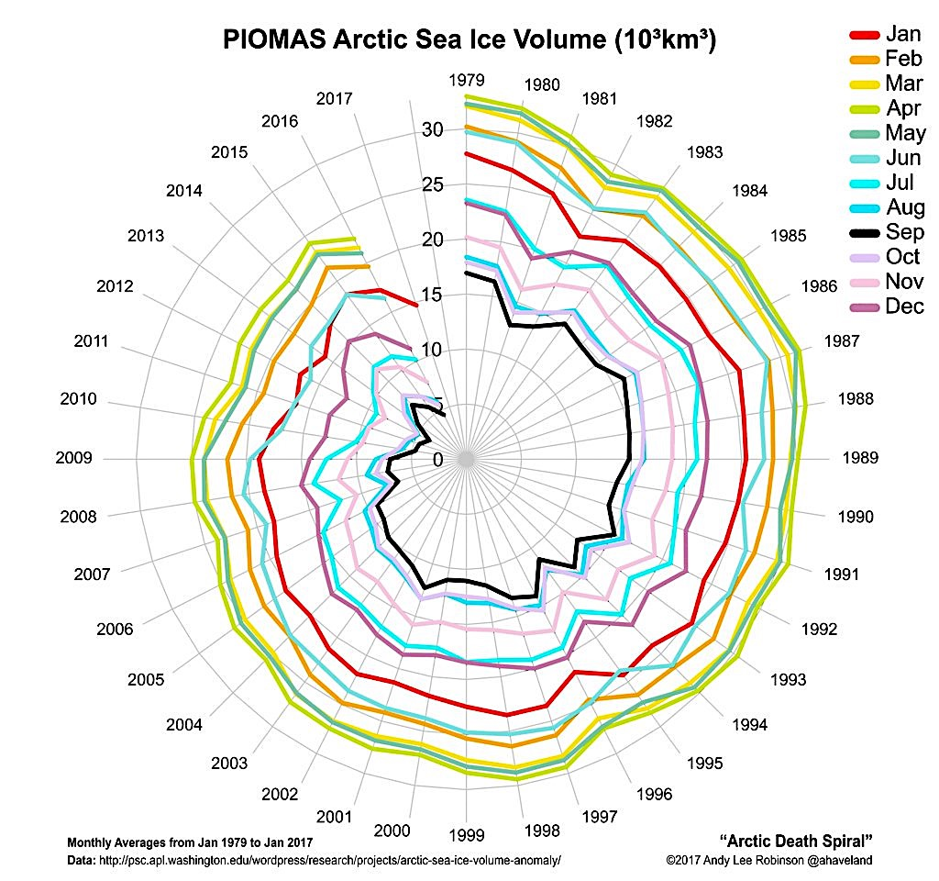
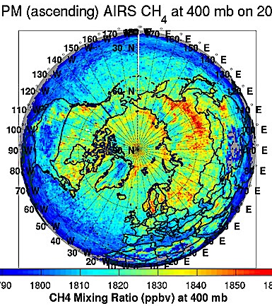
Mean Temp Rise & Arctic Death Spiral
Since industrial revolution, mean surface temp ⬆ 1.2 ºC
Polar regions most sensitive;
glacial ice on a death spiral.
Switching from coal to nat
gas not a solution:
Only 50% better if no leaks
If leaks, CH₄ 85x worse for 20 yr, 25x for 100 yr
Fracking for nat gas & drilling
for off-shore methane hydrate
(“combustibe ice”): potentially
disastrous for leakage of CH₄
Reliance on nat gas to back up solar/wind: an unrealisic “solution” to a dire problem.
Time to move to Mars?
NASA GISS
CH₄ Nov 2002
CH₄ Jan 2014

Slide 6
Challenges to Survival on Mars (Useful exercise to appreciate Earth)
Low surface temperature and pressure
Solution: pressurized & heated habitats
Low surface gravity
Solution: wear weighted suits
No magnetic field to shield against galactic cosmic rays
Solution: live inside – underground shielding (> 4 m rock)
Travel or work outside – superconducting magnetic shields
High per capita needs for energy/materials
Solution: thorium molten-salt breeder-reactor

Slide 7
Lower Martian Gravity Twin paradox: Earth twin cannot dunk, Mars twin can

Slide 8
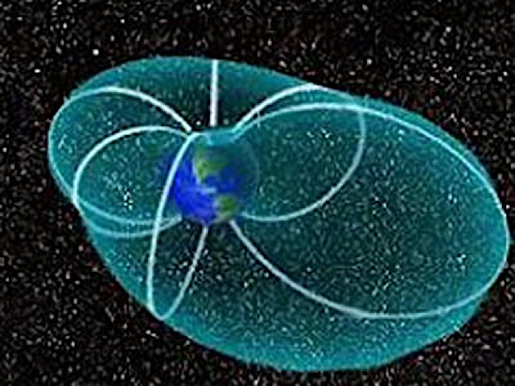
Exposure to Galactic Cosmic Rays Leads to Brain Damage Compression of Earth magnetosphere by solar storm in 2016 (Mars has no magnetic field today – planetary dynamo has died)
If Earth with a field with a
strength of 65 microtesla
at a pole can provide enough
protection for a surface with
radius R_{E}, what is the zone
of protection afforded by a
supercoducting magnet of
the Large Hadron Collider
with a field strength of 8.33
Tesla at a pole? (mass of
equipment = 35 tonne)
Answer: about 10 m.
In an equatorial belt betw
7 m and 10 m, the field
strength is similar to a
“closed” MRI machine.
11 R_{E} → 4 R_{E}
Tata Institute of Fundamental Research Cosmic Ray Laboratory

Slide 9
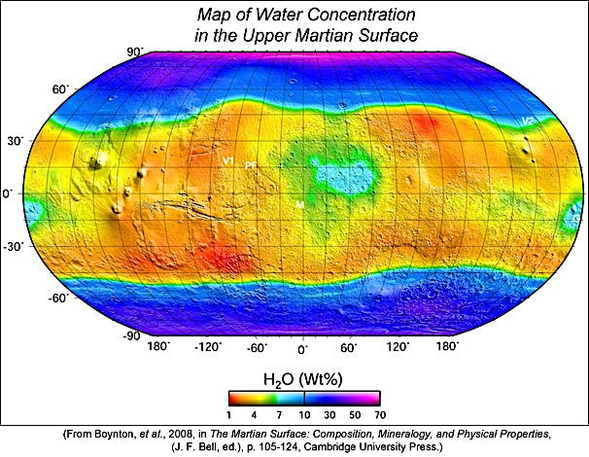
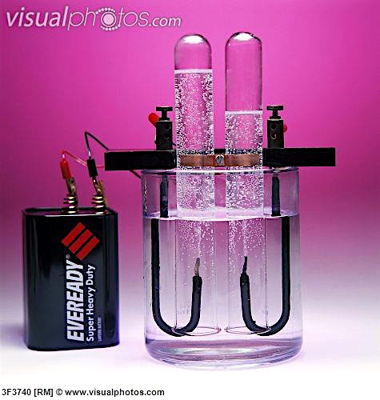
Ice and Dry Ice on Mars Water & Dense Carbon Dioxide Available to Melt, Clean, & Transform
Ordinary or advanced
electrolysis to split water:
H₂O + elec →H₂ + ½ O₂
Sabatier reaction to make
methane exothermically:
4H₂+CO₂ → CH₄ + 2H₂O
+ heat
Net reaction,
CO₂+2H₂O→CH₄+2O₂,
requires energy input

Slide 10
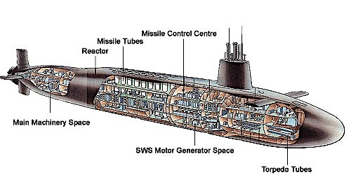
Sustaining Life for Months w/o Fresh Water & Air
Problem faced by submarine crews (~ 140)
Solution: nuclear reactor w P ≈4x3 MWt*
Enriched U fuel (US & UK > 90% U-235)
Water cooled & moderated (PWR)
Fresh water by distilling seawater
Oxygen by dissociating H₂O (torpedo away H₂); CO₂ captured & disposed
* F_{d}u = (½C_{d}ρu²A)u = 0.001(1000 kg m⁻³)(12.5 m/s)³π(12.5 m)² ≈ 1 MW
With professionally trained operators, completely safe
Automatic shutdown: if lose coolant, also lose moderator
Decay heat? (0 hr: 6.5% P; 1 hr: 0.6%); not a problem at low P
US exported LWR technology (⬆ PWR & BWR) to rest of world, except for mavericks who wanted fuel that can be natural U (0.7% U-235, 99.3% U-238)
Canada: heavy water (CANDU) reactors (D₂O not H₂O, which absorbs n)
USSR: graphite moderated, water cooled; only accident to have runaway chain reaction (Chernobyl)
Defence Industry Daily

Slide 11
Energy is the Driver of Matter Transformation and Defines the Limits of a Developed Society Deep Meaning of E = mc²

Slide 12
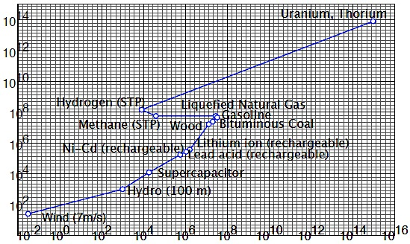
The S-Diagram of Energy
Sun and wind stronger on Earth than Mars. Earth headed for climate catastrophe w/o new nuclear (Caldeira, Emmanuel, Hansen, Wigley (2016)
Duration of use
Coal loses to wind/gas b/c of
renewable mandates, need
to scrub noxious emissions,
& inefficient steam turbines
J/kg
J/L
Compactness of equipment
Notes:
Cheapest way to produce H₂ is via coal gasification:
2C (s) + O₂ (g) → 2CO (g),
CO (g) + H₂O (g) → H₂ (g) + CO₂ (g);
Then combine H2 (g) with C (s) to make liquid hydrocarbons.

Slide 13
Breaking the Paradigm of Turbine Electricity Generation
GE Supercritical CO₂ (sCO₂) Turbine: Sunrotor 10 MWe
In normal gas turbine, CO₂ in combusted fuel is a gas. In sCO₂ turbine, CO₂ is at T > 400 ºC & P > 100 bar high enough to lose distinction betw gases & liquids. I.e., sCO₂ can expand like a gas to create flowing fluid with almost density of a liquid. (Imagine augmented power of turbine on jet plane expelling exhaust 100x denser than air.) Compact coupling of molten salt heat & sCO₂ turbine. Polar caps of Mars contain frozen CO₂ (dry ice, the ideal dense starting state for sCO₂).

Slide 14
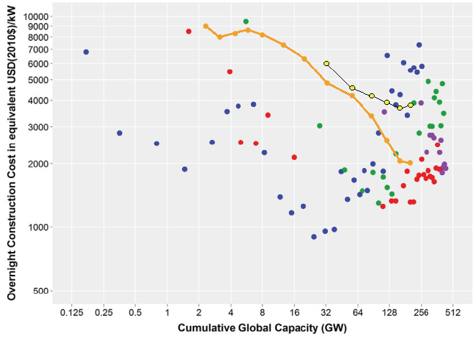
Myth: Nuclear Power Is Expensive w Negative Learning Curve Lovering, Yip, Nordhaus (2016)
Solar PV (res)
To avoid “cost-escalation,”
must achieve safety by
physics, not by engineered “defense in depth”
Large-scale release of
radioactivity to environment
& theft of weapons-grade
nuclear materials should be
essentially physically
Impossible.
Burning U-235 is
unsustainable and not
suitable for Mars in the
long run.
On all these points, thorium
Is a better choice
France
Japan
Solar PV (utl)
USA
Korea
Straight-line on log-log plot → power law

Slide 15
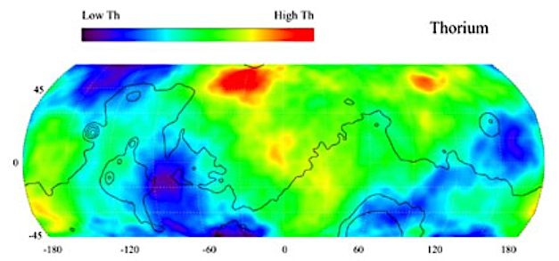
Thorium on Mars Th-232 → Pb-208 by 4 beta & 6 alpha, then a gamma: t_{1/2}= 14 Gyr
www.mars.jpl.nasa.gov/odyssey
Nat Th is pure Th-232, 4x more abundant than U, no enrichment needed

Slide 16
Basics of Nuclear Energy
Fission vs Fusion: n vs charged particles

Slide 17
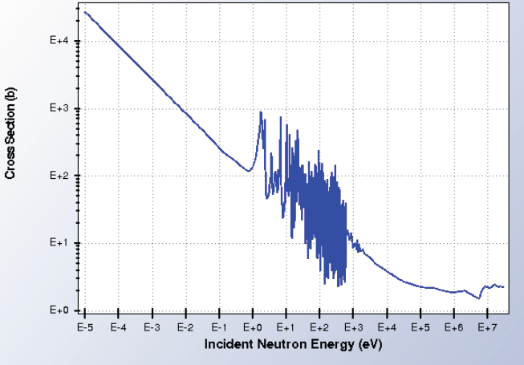
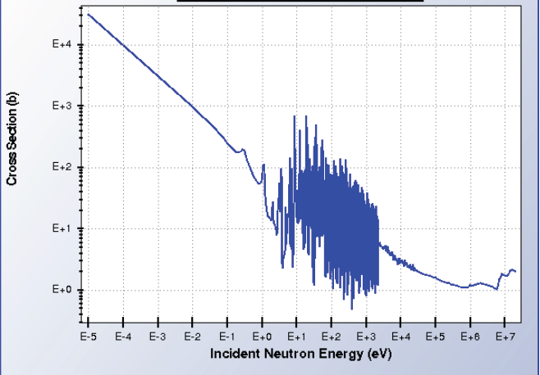
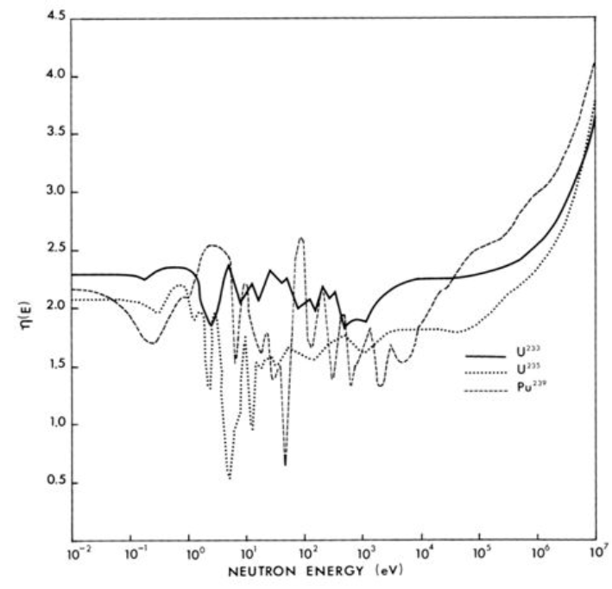
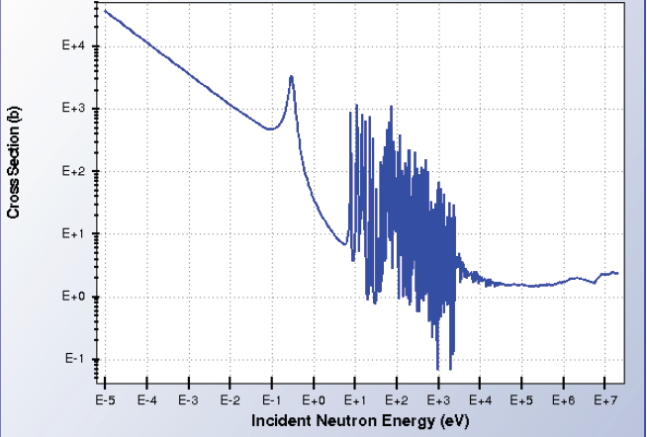
Nuclear Fission
Fissile, even p, odd n: n + + 2 or 3 n (1 for chain reaction)
U-235 (0.7% of natural U)
Pu-239 breed by adding excess n to fertile U-238 (99.3% U)
U-233 breed by adding excess n to fertile Th-232 (100% Th)
FPs
²³³U(n,FP)FP
²³⁵U(n,FP)FP
4.0
Pu-239
1E3
1E3
σ (barn)
σ (barn)
3.0
1E0
U-233
1E0
1E-3
1E0
1E3
1E6
1E-3
1E0
1E3
1E6
# n per fission event
n energy (eV)
n energy (eV)
2.0
U-235
Pre-WW2 discoveries:
Fermi: bombard U w n,
results depend on bench
Hahn: discover Ba (Z=56)
Meitner & Frish: U fission
Bohr: U-235 = fissile
Szilard & Fermi: crit mass
Research classified
1E3
1.0
σ (barn)
1E0
²³⁹Pu(n,FP)FP
1E0
1E3
1E6
1E-3
1E0
1E3
1E6
n energy (eV)
n energy (eV)

Slide 18
U-238/Pu-239 Breeder Fuel Cycle
Number of neutrons N
Number of protons Z
Capture of n w gamma emission increases N (red arrows)
Beta decay turns n into p (blue arrows)
Beta decay violates parity conservation (post-war YCN, LTD, & WCS)
Alpha decay drops N by 2 and Z by 2 (black arrows)
U-235: t_{1/2} = 0.7 Gyr, 0.7% of UO₂, UO₃ water soluble, UF₄ s or l, UF₆ g
U-238: t_{1/2} = 4.5 Gyr, 99.3% of UO₂, centrifuge UF₆ to 3-20% U-235 for LWRs
Pu-239: t_{1/2} = 24 kyr, large fission σ, but 40% → Pu-240, only fast breeder possible
Pu-240: spontaneous fission, deterrent to weapons proliferation

Slide 19
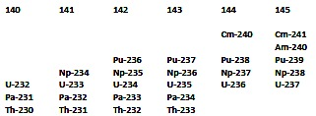
Th-232/U-233 Breeder Fuel Cycle
Number of neutrons N
Number of protons Z
?
Fermi-Wigner debate
(n,2n)
Th-232: t_{1/2} = 14 Gyr, 100% nat Th, 4x abundance of U in crust
U-233: large fission σ, 8% branching → U-234, thermal breeding OK
n-caps → U-235 w large fission σ; n-caps dead-end U-236 or Pu-238
Weapons deterrent: ²³²Th(n,2n)²³¹Th(β⁻)²³¹Pa(n,γ)²³²Pa(β⁻)²³²U, fast n

Slide 20
Getting to Mars
Reusable chemical rockets to low earth orbit (LEO)
Fission fragment shuttle from LEO to Mars Orbit
Difficult descent from Mars orbit to surface
Thorium molten-salt breeder reactors for use on surface

Slide 21
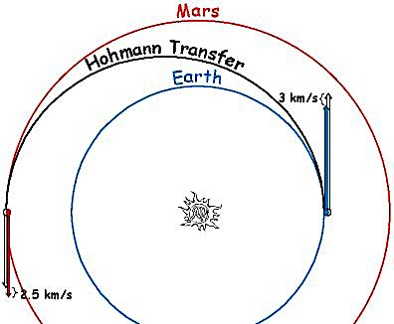
Getting to Mars (and Back) Conventional Approach: Hohmann Transfer Orbit
orbits Sun 24 km/s
Approximate Earth and Mars
to have circular orbits about Sun
Boost spaceship from LEO into
circular orbit of Earth around Sun
Add 3 km/s to the circular orbit
to put spaceship into elliptical
Hohmann transfer orbit
After 259 days, spaceship at
aphelion & Mars circle; time
launch so that Mars will be there
Add 2.5 km/s to the Hohmann
transfer orbit to put spaceship
into Mars’s circular orbit
Have 459 days to explore surface
of Mars before begin 259 d trip
back to Earth & reentry by drag
Earth orbits Sun 30 km/s
1.52 AU
1 AU
clowder.net
SpaceX (Blue Origin, Virgin Galactic) innovation:
reuseable rockets

Slide 22
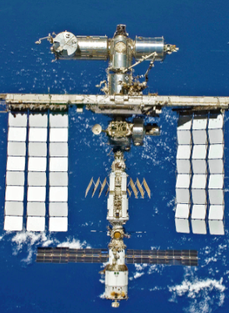
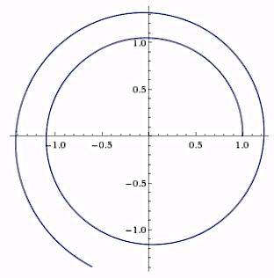
Unconventional Approach
Rocket science: d(Mv) = -(dM)(Δv-v) → added v = Δv ln(M_{i}/M_{f})
Δv for fission fragments 13,000 km/s ~ 3000x chemical propellents
Recycle organic waste & water, only ejecta FPs: v ≈ Δv(M_{FP}/M_{f})
Not Hohmann: v accumulated gradually rather than impulsively
Small payloads: potentially possible to get to Mars in 2 weeks (!) people
Large paylods: tangential thrust w ½ FPs (33.2 N) → 2.24 yr for trip from Earth to Mars, & each tonne paylod to Mars needs 1 MWt from 2F-MSR
Payload/fuel ratio ≈ 1000
On Mars arrival, parachute (?) 2F-MSR (CFRC pipes) & ²³³UF₄ onto surface
Task is easy; most of weight is in fluoride salts, which cannot be damaged
Example: ISS (420 t) needs 420 MWt 2F-MSR on-board w sterile
blanket salt (not breeder) to give excess neutrons for Ni-on-
Glass guide-tube ion-propulsion

Slide 23
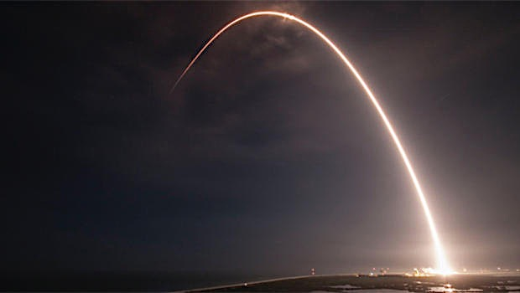
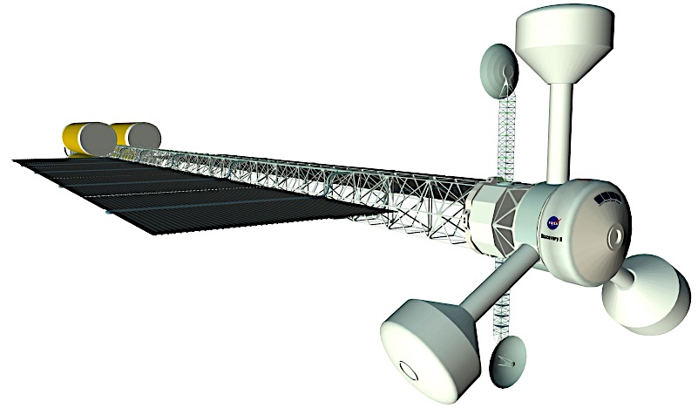
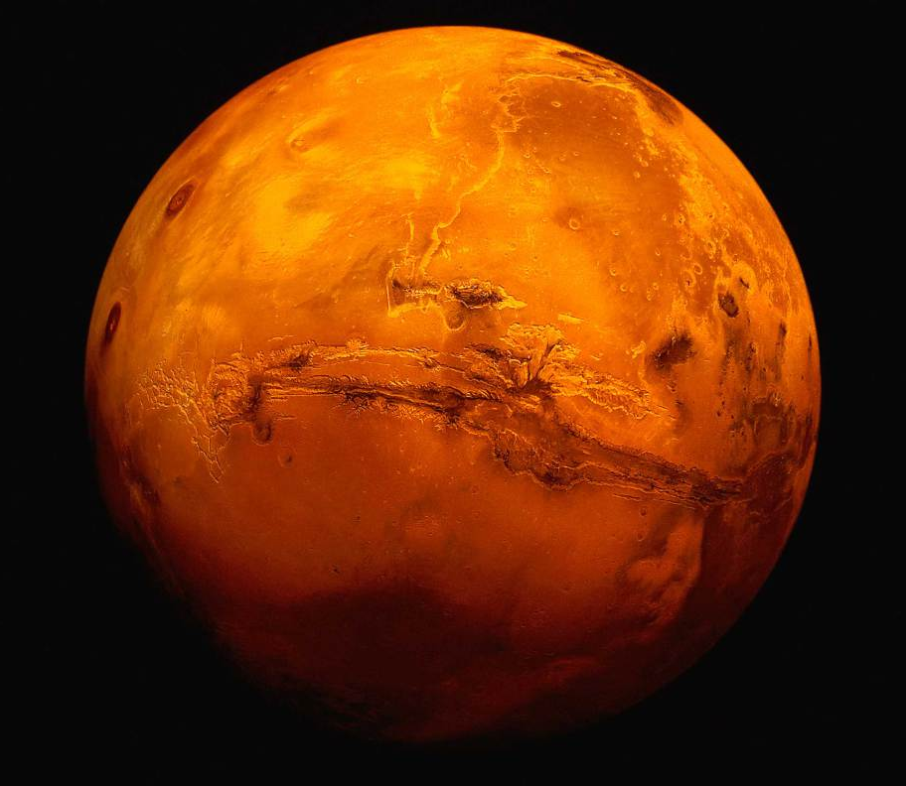
More Detailed Design
Earth to Mars travel time = 2.24 yr (after LEO → Lunar L1 → L2)
Mean acceleration = 8 μg; artificial gravity (~ 2 min rot period)
Mass budget = 420 t = 113 t carbon composite structure + 60 t H₂O (shielding against γ)+ 105 t magnetic shielding (against GCR) + 111 t MSR & FFRE•+ 0.72 kg U-233 fuel to propel spaceship w 0.23 t left for 10 yr use on Mars at 60 MWt of power + 28 t food + 2.28 t crew*
MSR radiator 100 m x 37 m x 0.01 m (74 t including blanket salt at 1000K)
FFRE radiator (37 t including blanket salt at 1000 K)
*US DOE has 1 tonne ²³³U; downblending b/c nuclear proliferation concerns
NASA/TM-2005-213559
except fission not fusion
SpaceX launches comsat
www.cbsnews.com

Slide 24
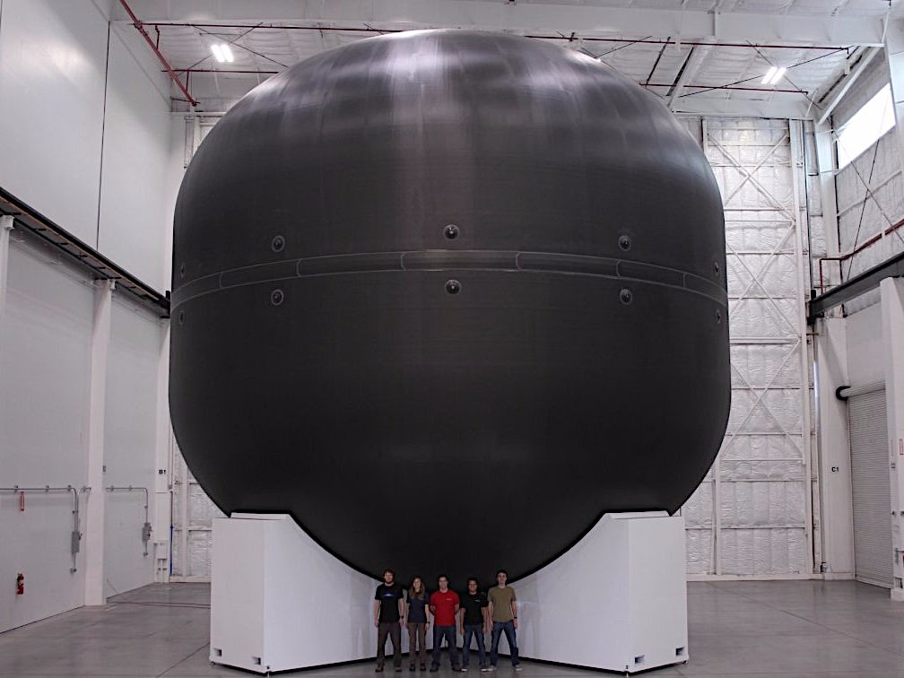
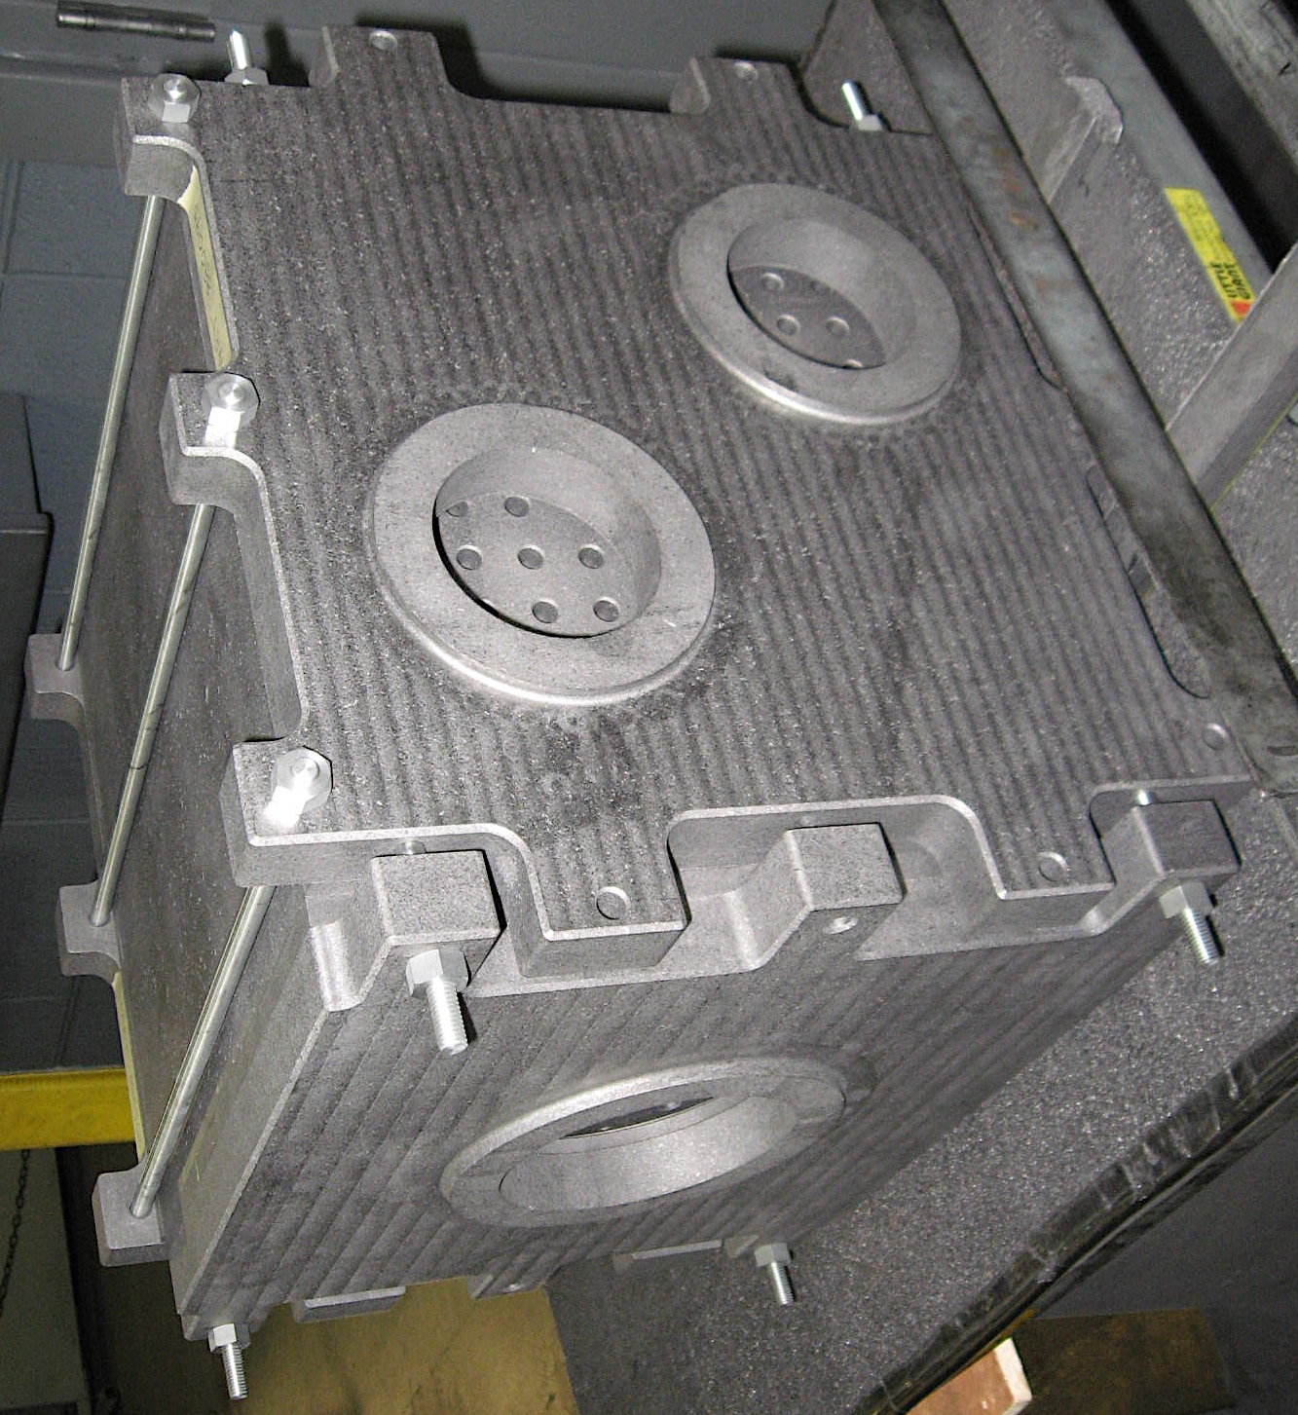
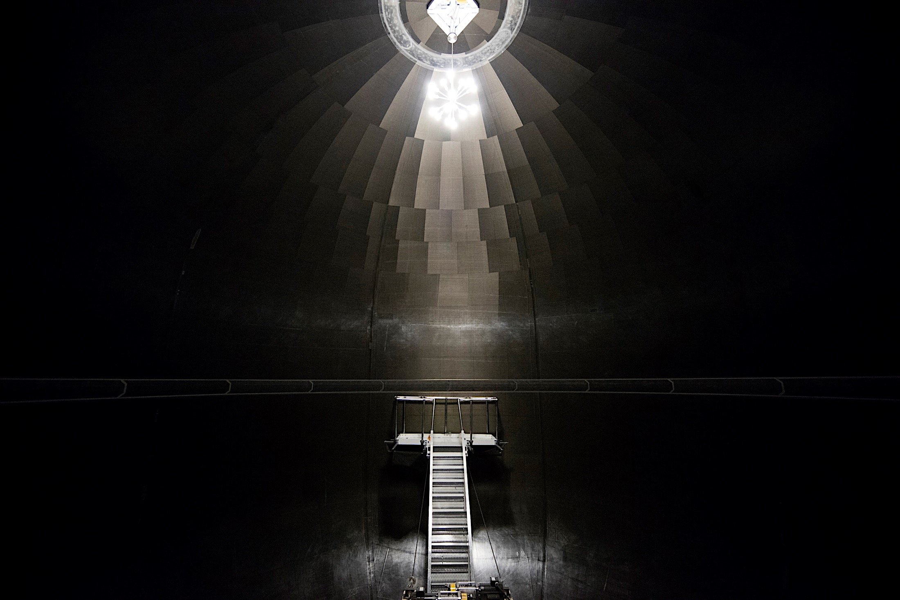
Carbon Fiber Fuel Tanks & Reactor Core Elon Musk, Making Humans a Multi-Planetary Species (SpaceX, 2016) Frank H. Shu, Two-Fluid Molten Salt Reactor (US Patent 20120051481) A1)
Nuclear-grade graphite
immersed in 900 ºC
molten fluoride salt
SpaceX
HX
HX
SpaceX
Idea of using carbon fiber as strong lightweight
construction material not new, e.g., tennis racquets,
bicycles, SMA, Boeing 787, Lamborghini SE, ALMA
However, carbon fibers weaved Into a cloth are porous
Must seal to hold liquids, e.g., rocket fuel or molten salt
Such graphitic materials have virtue of being
strong at high temperatures
not corroded by molten fluoride or chloride salts
High-T use in space/Mars does not need Al₂O₃ cladding

Slide 25
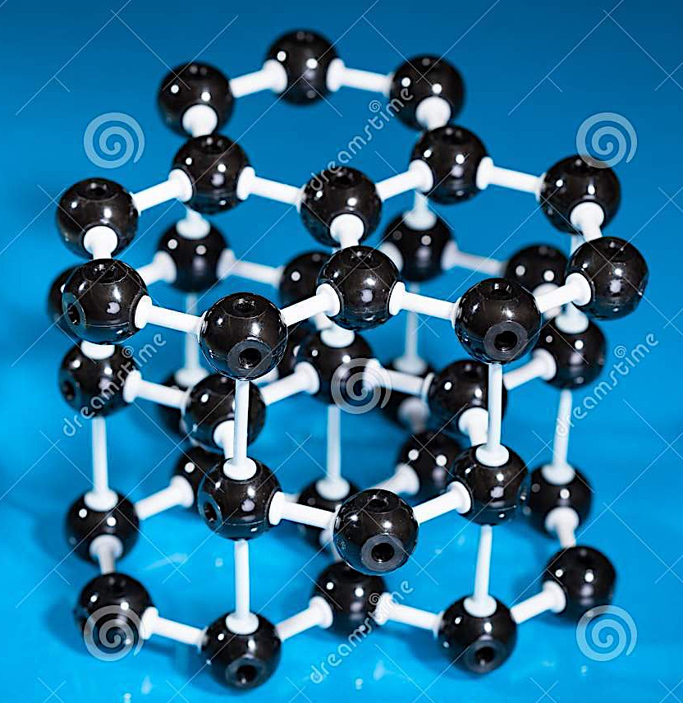
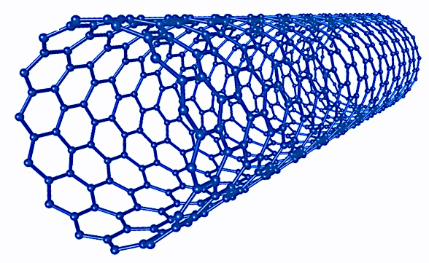
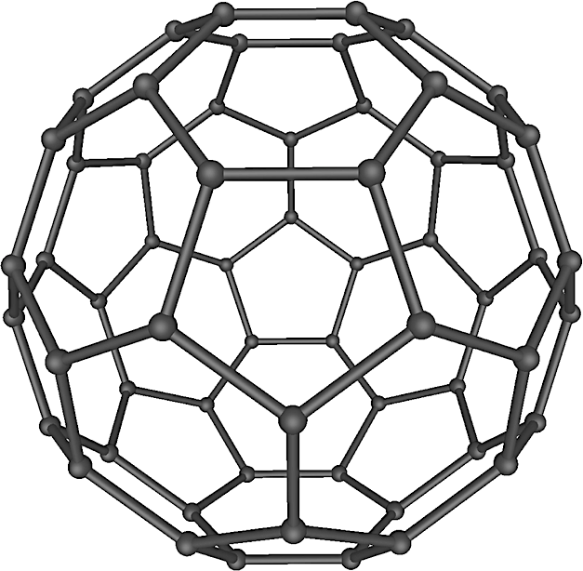
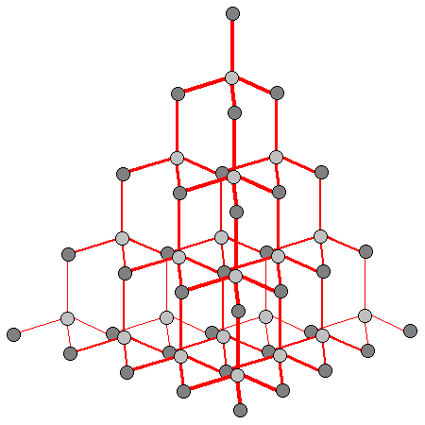
Carbon is the Future in Construction & Electronics
Each carbon atom in graphite double (sigma) bonded in planar
direction to 3 other carbons. Sigma covalent bonds:
very strong
not broken by any reactant other than oxygen (at edges)
In an oxygen-free environment (e.g., immersed under anoxic
molten salt), reactor-grade graphite resistant to attack by any
other element in the periodic table (e.g., fission products)
Since C has 4 valence electrons, sigma-bonding to 3 other C’s
uses up only 3 valence electrons; 4th electron free to
form out-of-plane bond to other atoms (e.g., H), or
roam through lattice (conductor or semi-conductor,
depending on impurities occurring naturally or doped)
Binding across planes in graphite is weak (van der Waal forces);
can peel one plane from others using scotch tape (2010 Nobel)
Graphene = single sheet of graphite (2016 cost: US$100/g)
Graphene rolled up into a cylinder = C-nanotube
C-nanotubes strong & light, good for construction & electronics
C-nanontube rolled up in 3rd dimension = buckyball or fullerene
Diamond w each C double-bonded w 4C = strongest 3-D structure
Lacking free O₂, Mars may be better for making double-bonded C

Slide 26
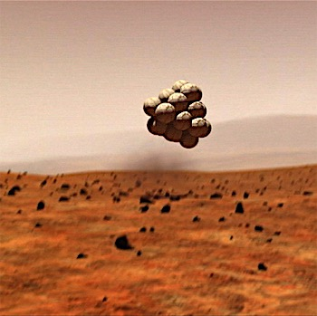
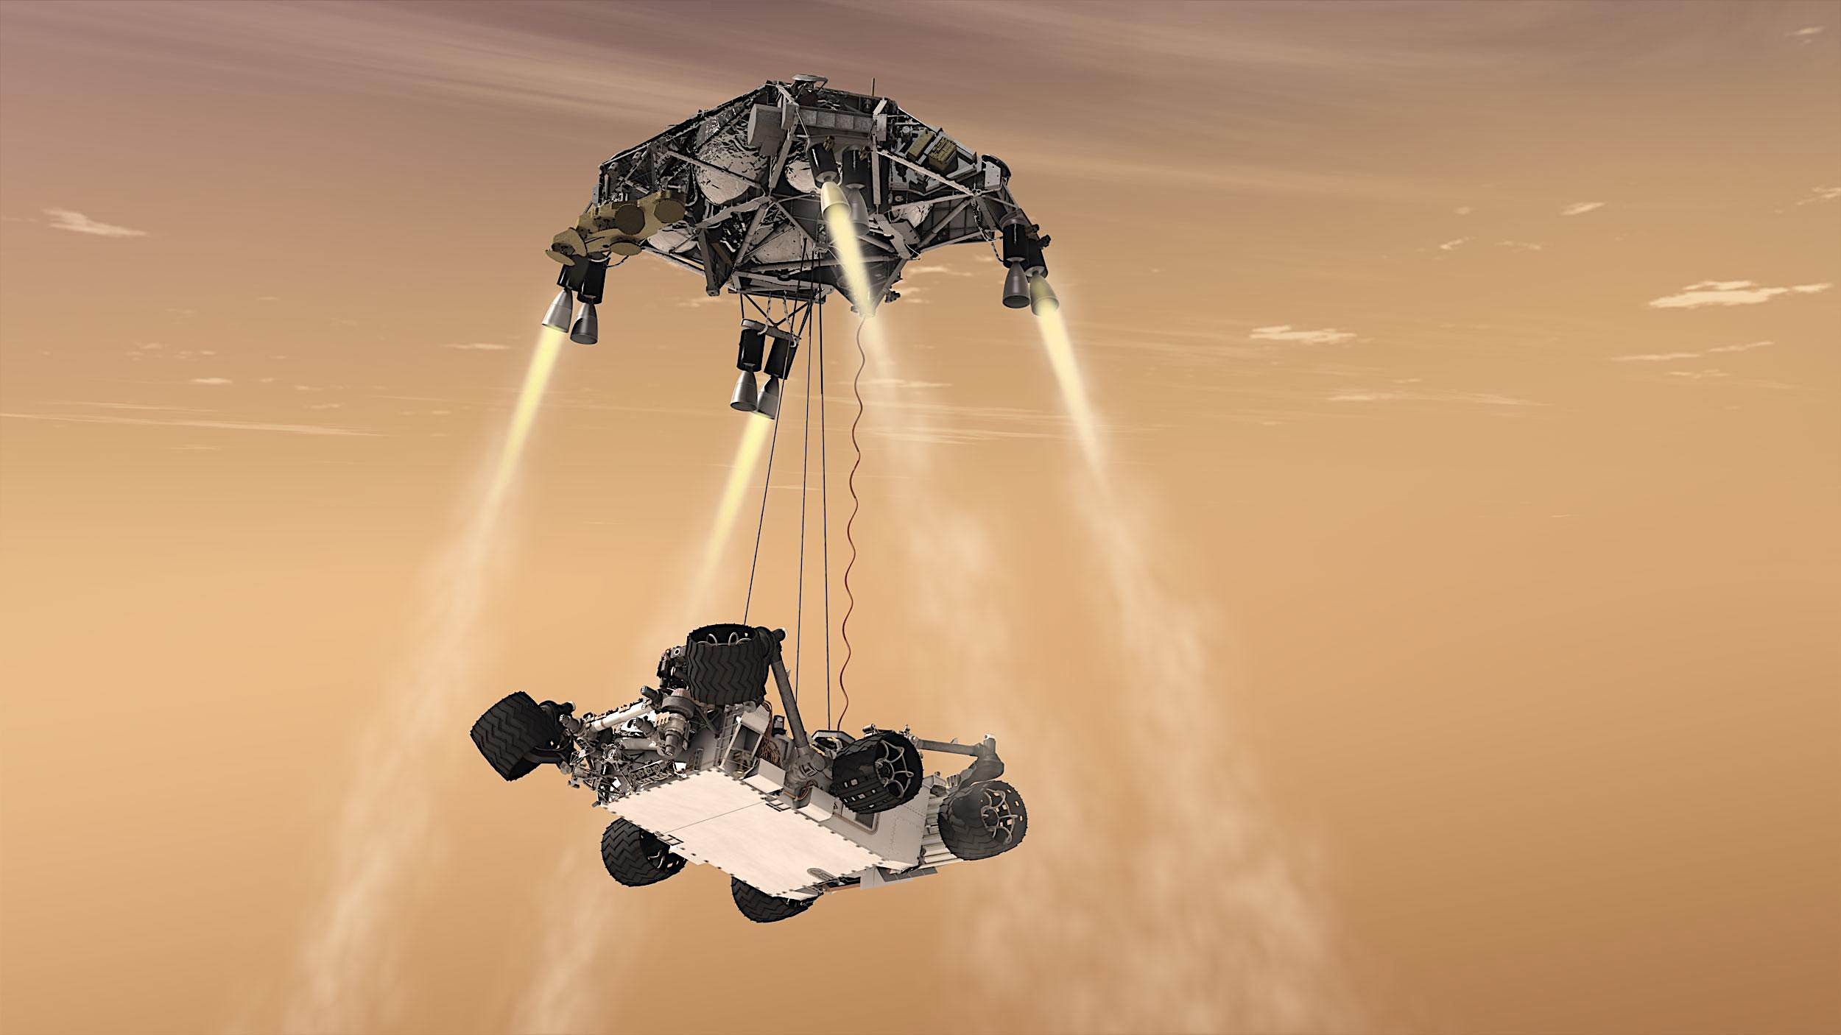
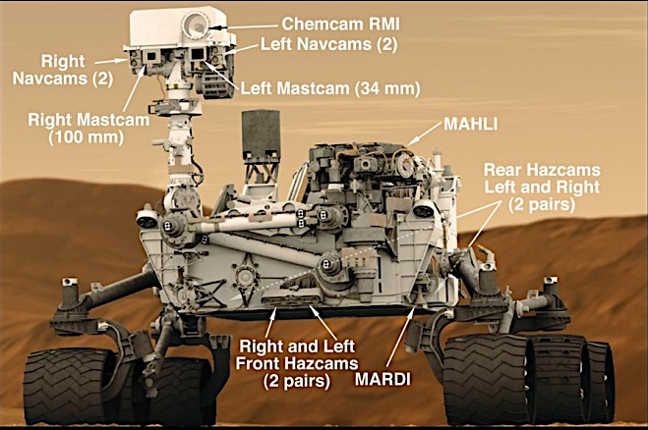
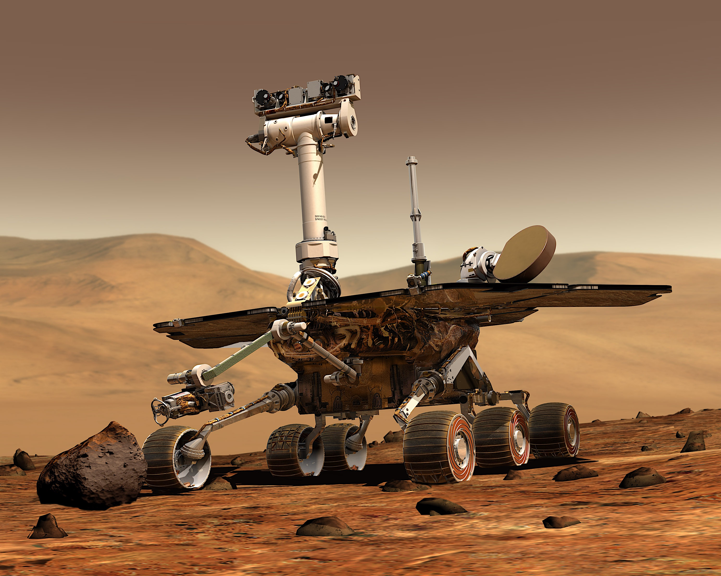
Descent of Rovers to Martian Surface
Curiousity rover: nuclear powered (RTG)
Spirit & Opportunity rovers
solar powered
NASA
NASA
Taiwan to participate in building next-generation rover

Slide 27
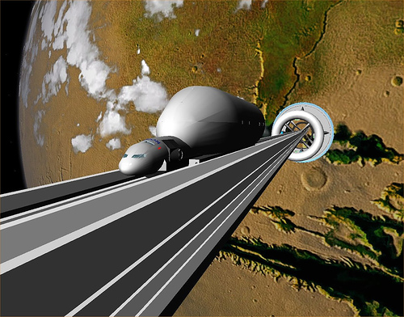
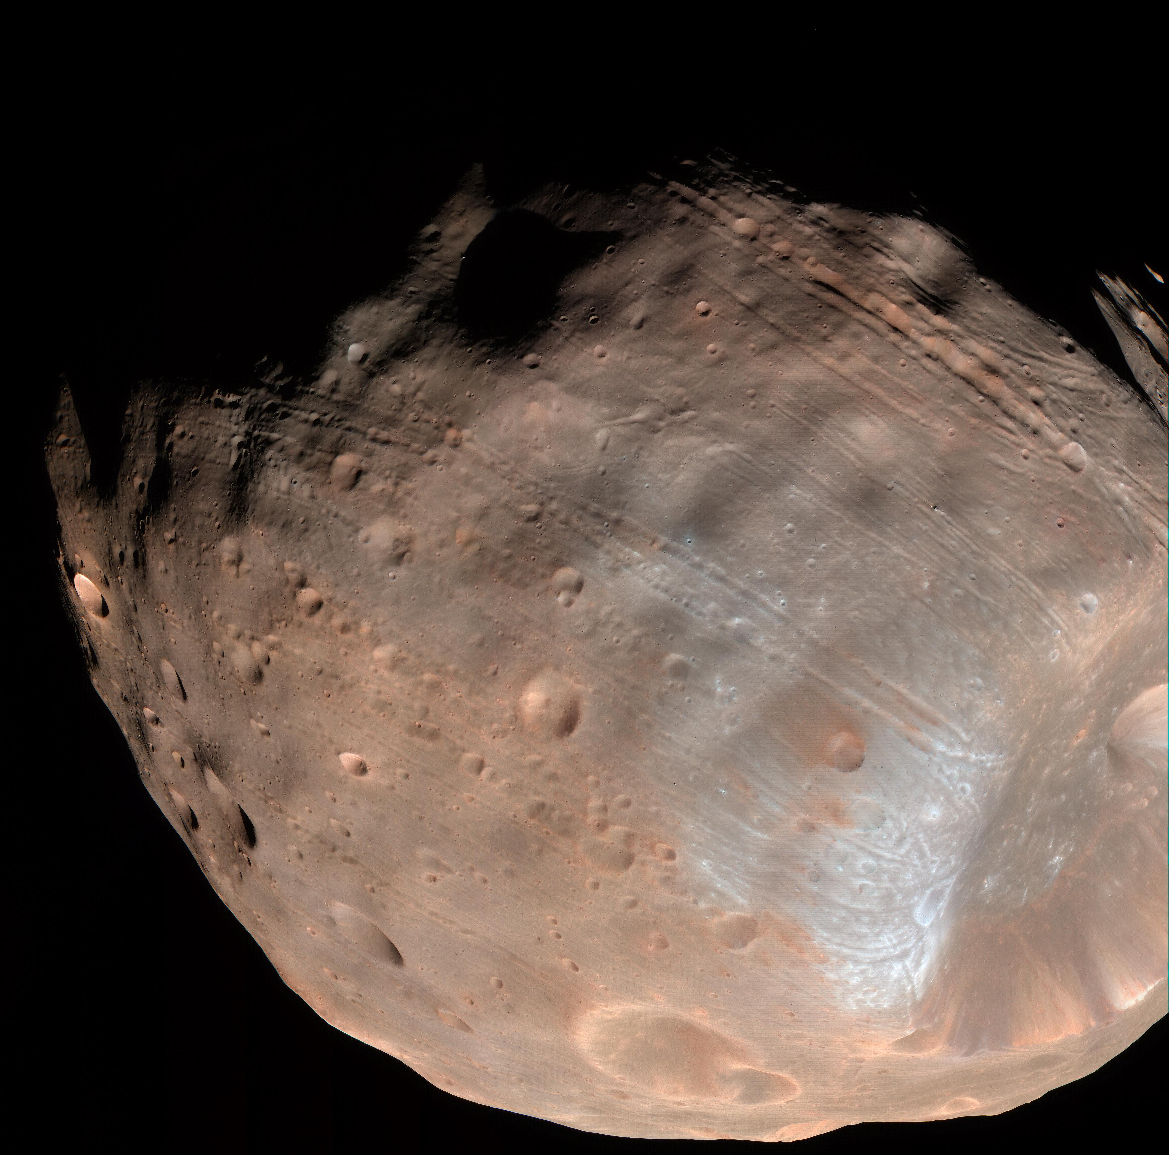
Tsiolkovksy & Artsutanov’s (1959) Dream - Space Elevator Cable of C-nanotubes tethered at Mars synchronous orbit (24.62 hr) Cf. Phobos orbit = 7.66 hr , Deimos orbit = 30.35 hr (all sidereal)
Think of tall bamboo w superstrong fibers
Mars synchronous orbit at GM/r_{s}³ = ω² where ω =2π/24.62 hr at r_{s}=x_{s}r₀ w x_{s}=6.025 & r₀=3390 km
Equatorial eff grav field: g_{eff} = -GM/r² + ω²r = g₀(-x⁻²+x_{s}⁻³x) w g₀ = GM/r₀² = 0.38 g & x = r/r_{0.}
Descent/ascent time: maybe day or two
Cable tension balances grav: d(σA) + g_{eff}ρAdr = 0
If σ = const, ln(A/A₀)=(g₀ρr₀/σ)[1-x⁻¹+(x_{s}⁻³/2)(1-x²)]
At x = x_{s}: ln(A_{s}/A₀) = 0.7533(g₀ρr₀/σ)
fat @ r_{s}, skinny @ r₀; inverted Taipei 101
Phobos
from
Mars
Surveyor
Art credit: Caltech
Example: If σ = g₀ρr₀ = 20 GPa (1 atm = 0.1 Mpa) & ρ = 1600 kg/m³ (C-nanotube), then ln(A_{s}/A₀) = 0.7533 or A_{s}/A₀ = 2.124. C-nanotube theoretical breaking strength σ ≈ 300 Gpa.✓ However, C-nanotube may unzip w single defect (Ding et al. 2016). Cable mass (r₀ to r_{s}) = 9.399ρA₀r₀ = 1.6x10⁹ kg if A₀ = π(0.1m)². Cost per kg?
 Elevator = tuning-fork w tines 200 km N & S of equator?
.

Slide 28
Living & Working on Mars
Take technological advantage of the lower gravity & extreme
cold to create a sustainable space-faring society where:
Free oxygen to corrode metals does not exist, relaxing an important constraint on the production of high-T_{h} alloys
Low ambient T_{a} and high T_{h} yields greater eff for heat engines based on sCO₂ turbines; ideally, eff = (T_{h} – T_{a})/T_{a}
No free oxygen implies no free burning of chemical fuels
A thorium economy can provide abundant clean energy
Natural existence of CO₂ & H₂O at solid densities & no free O₂ imply easier manufacture of CH₄ & O₂ (rocket fuel)
Favorable environment for development of high-tech carbon industry can justify colonization investment
Biochar (low-end C) can make dead planet bloom with life

Slide 29
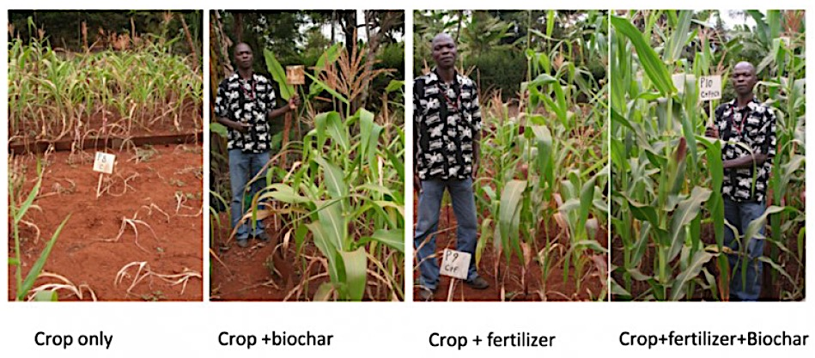
Herbert’s Dream in “Dune”:
Transforming a Desert Planet
Heat biomass in absence of O₂ to produces charcoal = biochar
Add biochar to carbon-depleted soils to enhance crop productivity
Hood-Nowatny (2016): 75% increase in soil productivity in tropical & temperate zones
Circular economy: biomass→biochar→more arable land for growing biomass, …

Slide 30
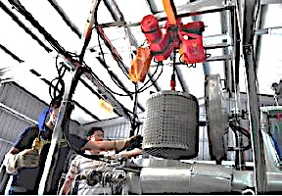
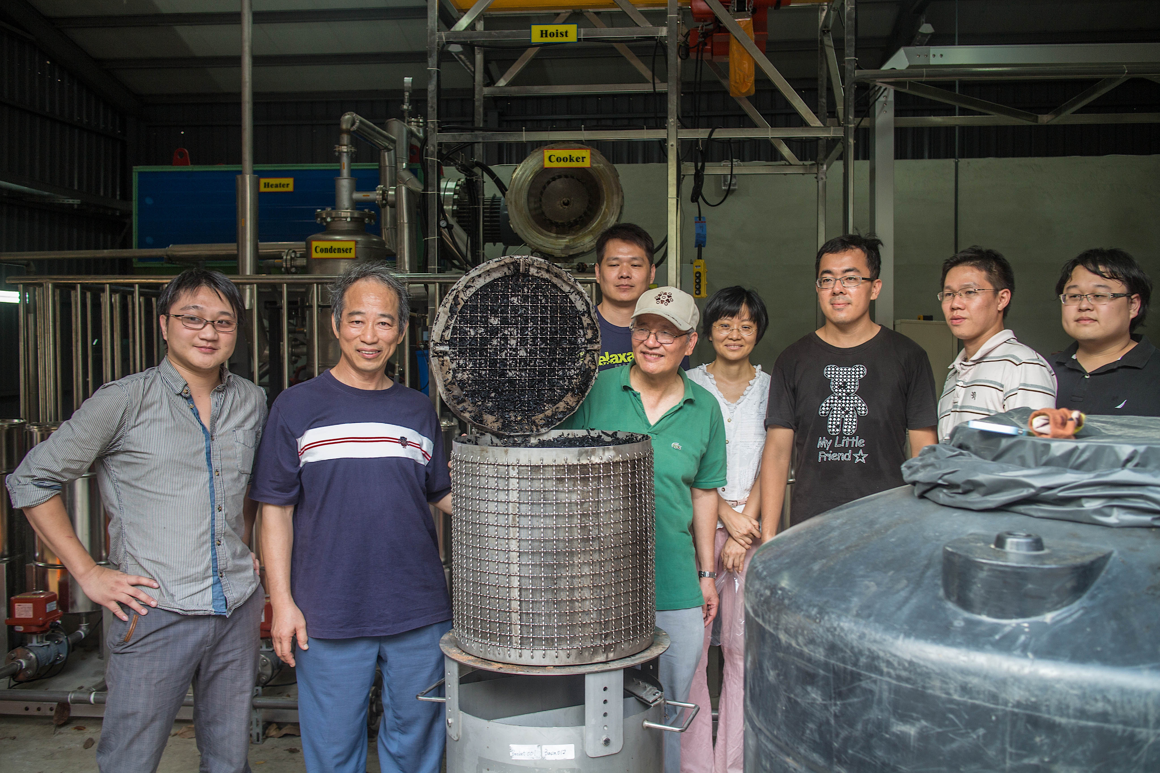
What is Biochar? Carbonized Biomass. How can it be cleanly & quickly manufactured? Supertorrefaction Submerge biomass under molten salt at 300 to 550 ºC for 10 to 1 min Reaction rate at constant P & T proportional to exp(-ΔG/RT) w |ΔG| ~ R(10⁴ K)
STR Patents: TW, CN, USA, RUS, CAN, UK, FR, DE, JP, IN, BR, AU
YouTube video

Slide 31
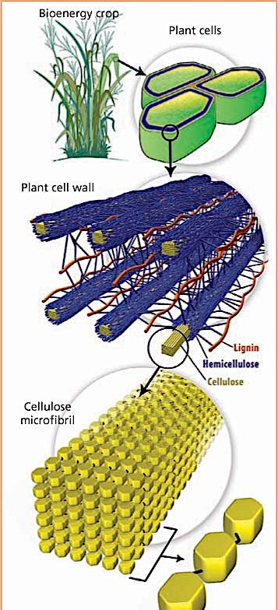
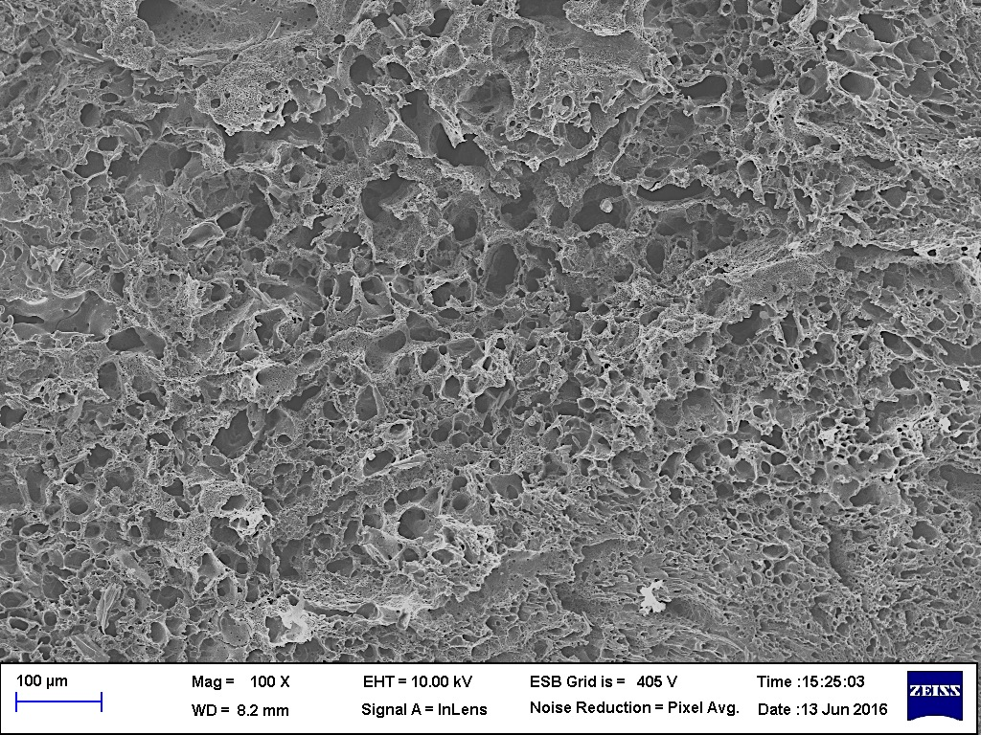
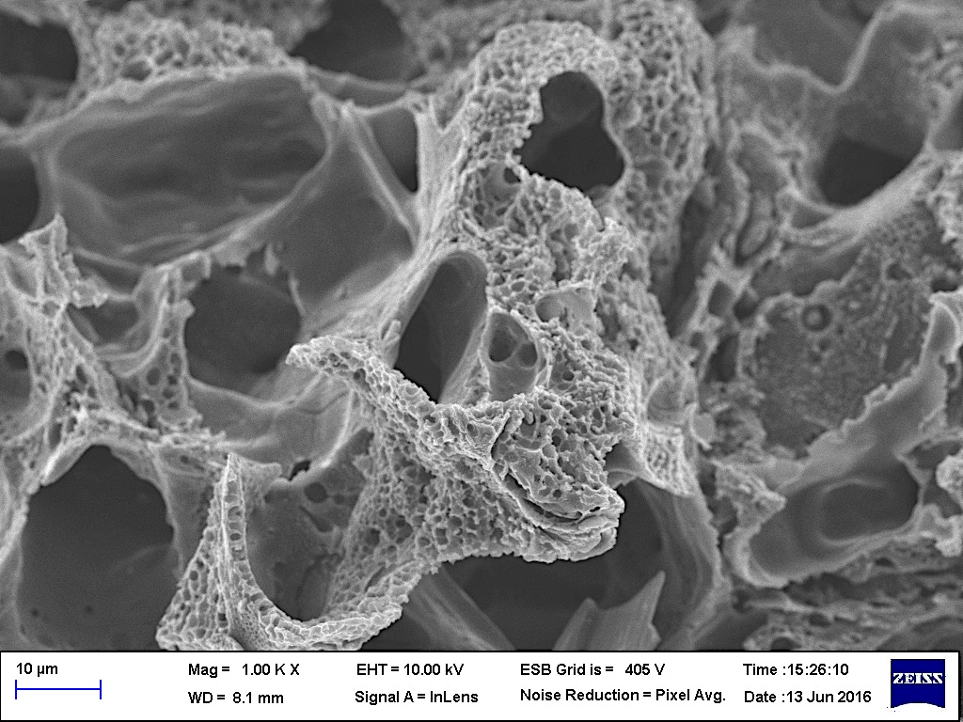
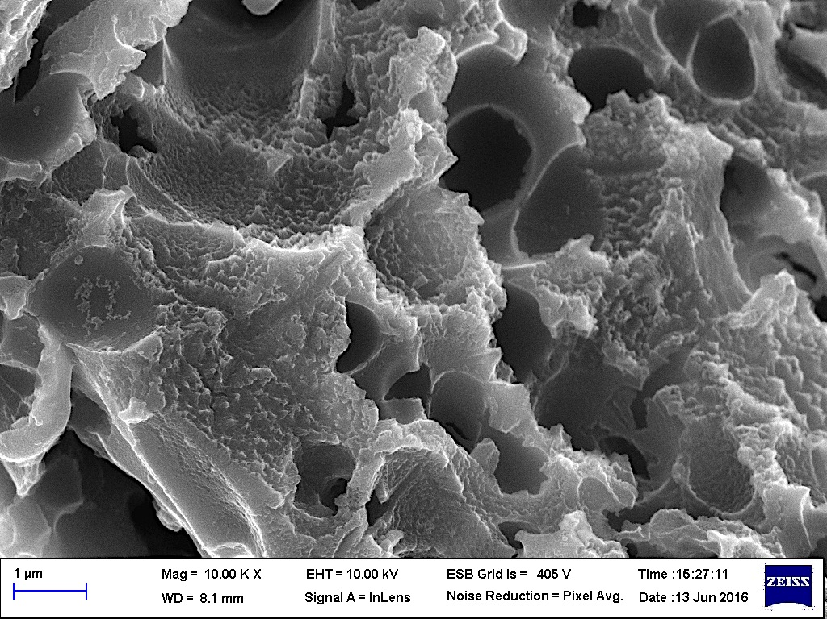
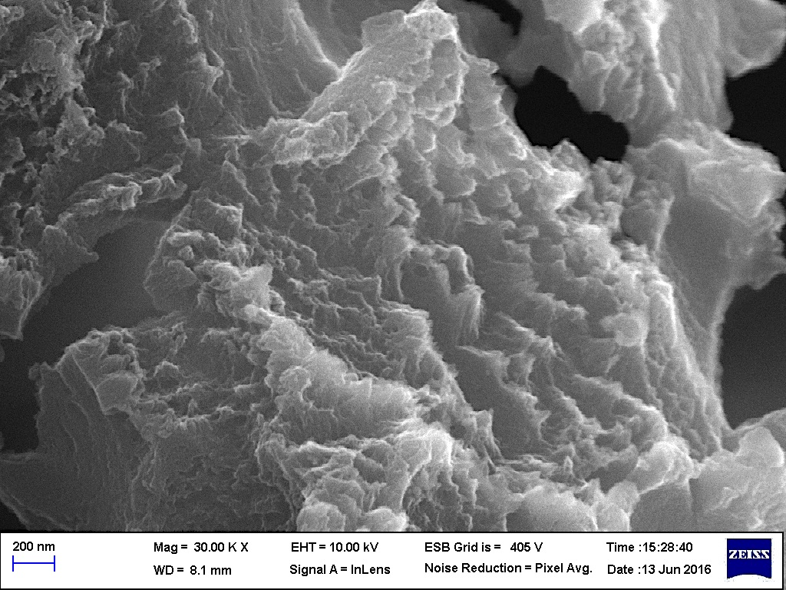
0602-550550 C for 1 min followed by washing with 2N nitric acid and water
Biochar & Activated C from Leucaena at 550 ºC in 1 min BET CO₂ = 414 m²/g (cf. Graphene 2600 m²/g)
Cells
Microfibrils

Slide 32
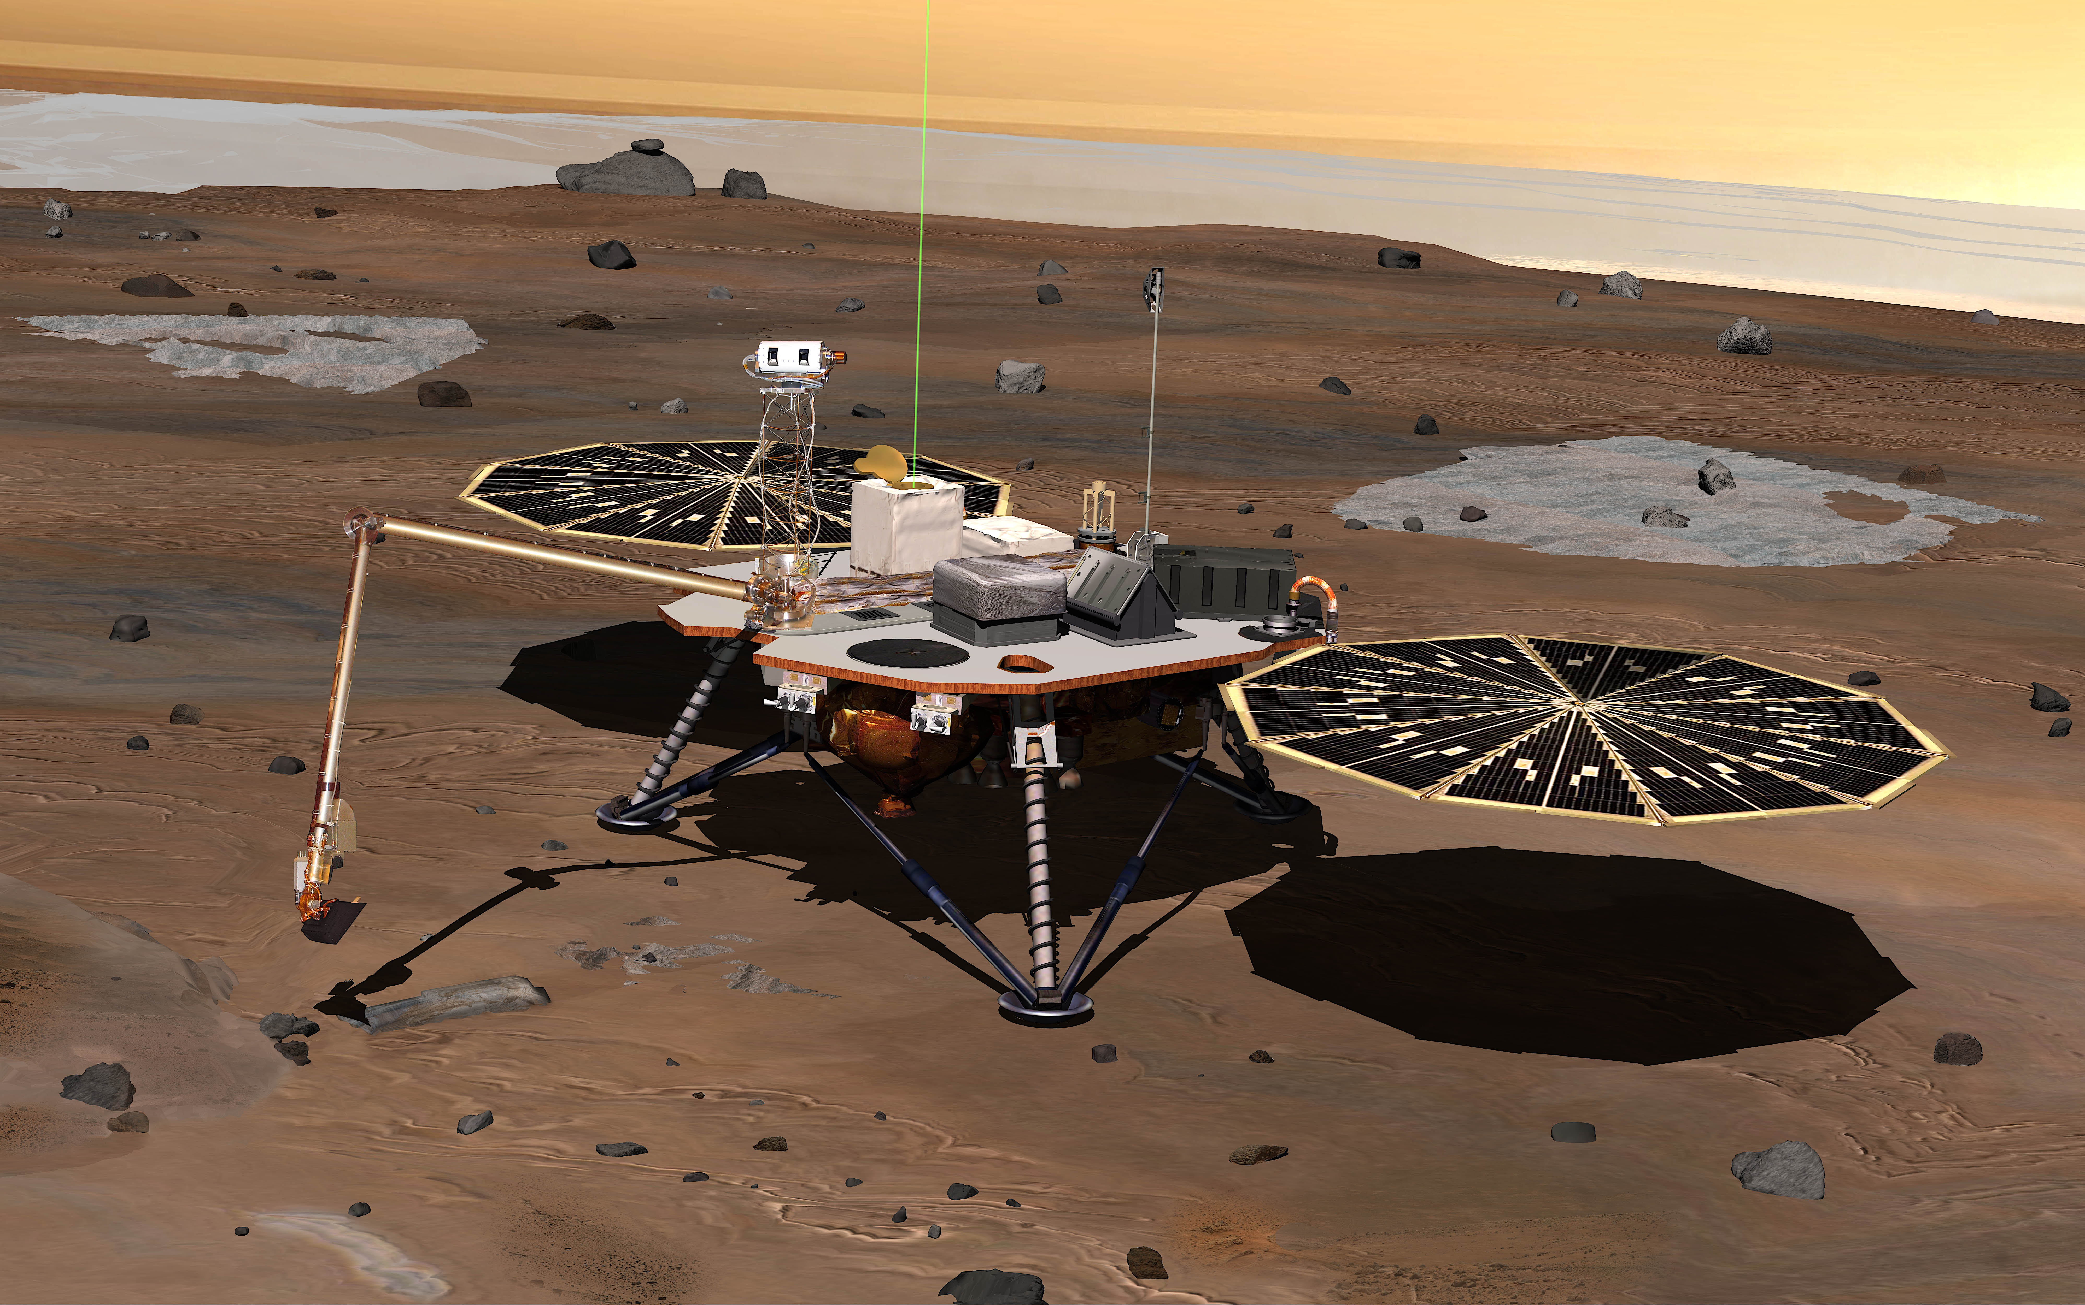
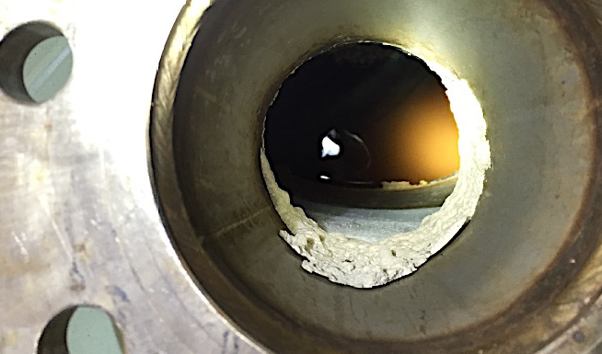
0602-550550 C for 1 min followed by washing with 2N nitric acid and water
Perchlorates in Martian Soil
Phoenix Mars polar lander found Martian soil
to contain by weight 0.6% perchlorate salt in
proportions Ca(ClO₄)₂:Mg(ClO₄)₂ = 60:40
Perchlorate salt, a powerful oxidant, is toxic to
beneficial soil bacteria and to humans
Fortunately, Ca(ClO₄)₂ & Mg(ClO₄)₂ are highly soluble in water:
Can filter them w activated-C/biochar
Molten salt 300 ºC < T < 400 ºC melt &
decompose perchlorates:
Melt: Ca(ClO₄)₂ + heat → Ca⁺⁺ + 2ClO₄⁻
Decompose: 2ClO₄⁻ + heat → 2Cl⁻ + 4O₂
Wet CaCl₂ and MgCl₂ can keep down dust;
but release of O₂ needs regulation on Mars
(Oxygen now in rust or rocks or H₂O or CO₂)
NASA JPL/Caltech-UAriz
HX

Slide 33
Lessons for Earth from Thinking about Mars (and vice-versa)

Slide 34
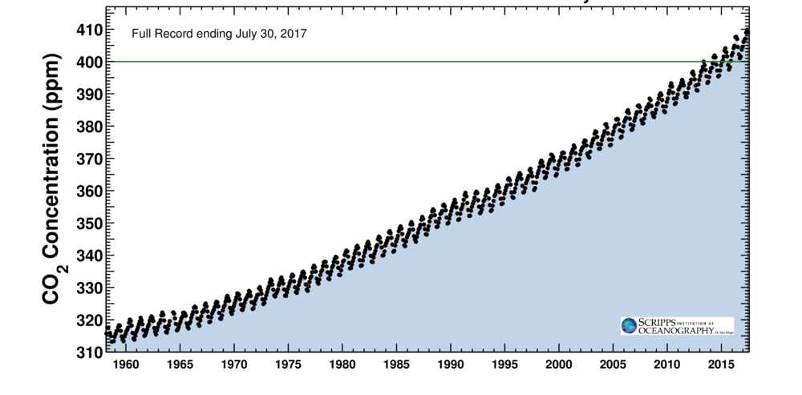
Reversing Climate Change on Earth
Flatten curve to 450 ppm by 2050
With New Nuclear Energy + Renewables (STR, biofuel, hydro, wind, solar, geo)
Keeling Curve for CO₂ Concentration at Mauna Loa
*
*
*
*
*
*
Pledged INDCs
*
*
*
*
*
*
*
*
*
Beyond 2050, reduce CO₂ by 2 ppm per year w biochar to recover desertified lands. Circular/sustainable economy: waste → resource by leveraging nuclear energy = 2x10⁶ chemical
*
Full record ending 30 July 2017
CO₂ Concentration (ppm)
Safe
Business as usual:
Before end of century: ⬆3-4 ºC
Asia-Pacific: 6 ºC
1000-yr timescale: 60 m sea rise
1960 1970 1980 1990 2000 2010 2020 2030 2040 2050
Notes:
IEA: T$84.5 (all sectors) by 2040

Slide 35
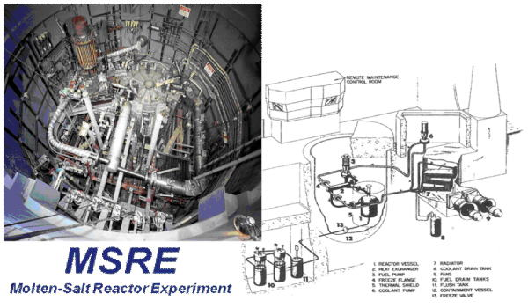
Making Nuclear Energy
Safe, Sustainable, Secure, & $uperior
ORNL
YouTube Videos
Patented Improvement: 2F-MSBR FHS Patents: USA, CN, RUS, JP, FR, GB, DE, SE
Novel Features
Carbon Composite Materials to Resist MS Corrosion
Large Pool to Prevent Weaponization of Bred U-233

Slide 36
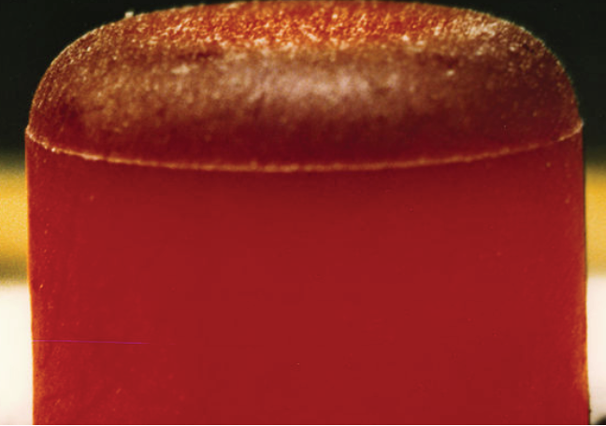
Two-Fluid (fuel & coolant) MSBR (ORNL) = LFTR (Sorensen) Solves problems of disposing LWR waste & sustainability of nuc option
²³²Th(n,γ)
²³³Th(β⁻)
²³³Pa(β⁻)
²³³U
On Earth:
Pu/An in core converts Th-232 into U-233
LWR used fuel Th-232 Blanket ThF₄
U-238, U-235
Pu/actinides
Fission prod’s
Th-232
Carrier:
⁷LiF/BeF₂ or NaF/BeF₂
Graphite
Core
FPs
On Mars:
U-233 in core gives breeder 2F-MSBR
UF₄ (pool) _{FV} UF₄ (core)
²³³U & ²³²U from (n,γ) & (n,2n)
IFR or LFR
or TWR
300 yr
Ground
Regulated
Use (Wiki)
nuc medicine, nuc batteries (Pu-238, Sr-90)

Slide 37
Modified Design - *Differences from ORNL Assembly of CFRC Pipes* Carrying Fuel Salt in Large Pool* of Blanket Salt w Floating Graphite Balls* that Define a Spherical Core
Core + pool = Tube & shell HX: most efficient ΔQ_{f}→ΔQ_{b}
T_{f} and T_{b} controlled
by how hard one
pumps 2 fluids
Decay heat flows
to pool to run pumps (4 fuel salt,
4 blanket salt)
Station blackout:
keep running at
least 1 + 1 pumps
to cool fuel salt
Loss of coolant
accident:
Lose absorber ThF₄
& moderator as
G balls drop to
floor of pool
Freeze plugs open,
drain fuel salt into
passively cooled
dump tanks
Dump tanks dilute
fuel with enough
sterile salt so
mixture freezes if
spilled from tank
FPs never escape
into environment

Slide 38
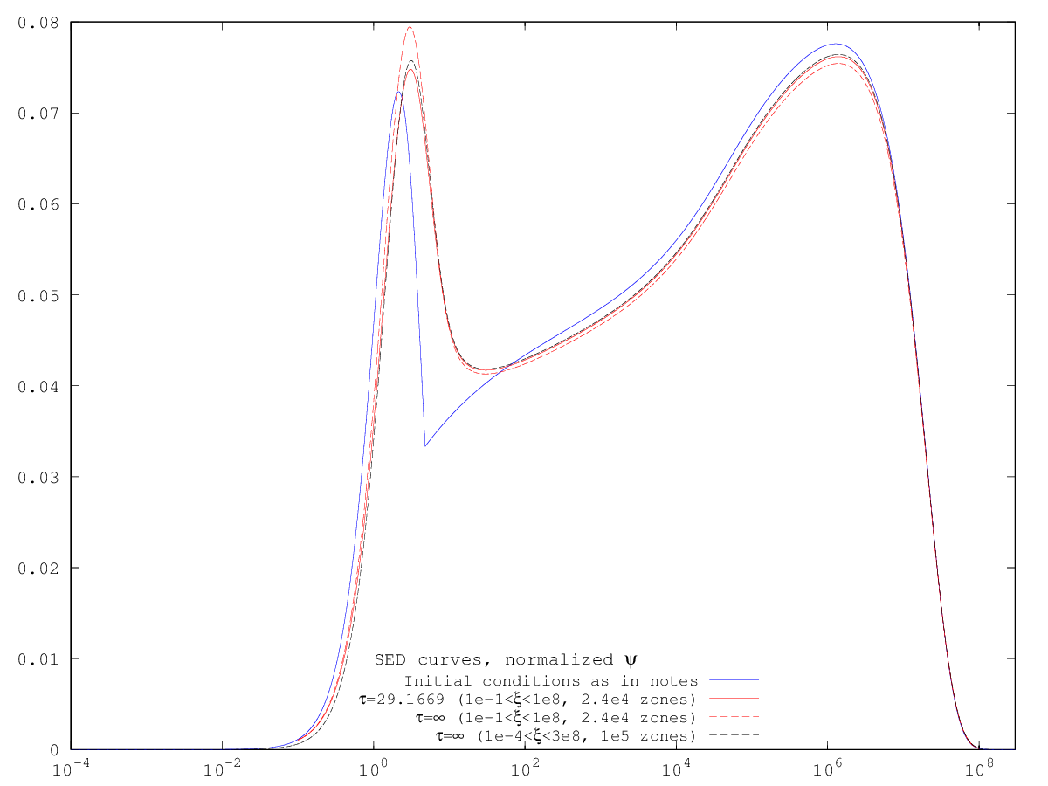
Neutronics
Scattering of n off nuclei 9x, 12x, 19x, 23x heavier than itself
<Δv> & <ΔvΔv> << v & vv ➔Fokker-Planck in speed space (like globular-
cluster dynamics, cosmic-ray acceleration, Black-Scholes stock pricing)
Alternative to MCNT: Forsberg & Greenspan (2003), Mathieu et al. (2005)
SED of Grape reactor (D = 2.4 m) very different from SED of LWRs
Critical mass for U-233 = 104 kg
Breeding ratio depends on how
clean salt is of FP
Critical mass for Pu-239 = 30 kg
Conversion ratio > 0.6 (0.8-0.9?)
Not yet enough LWR “waste”
to build required fleet of 2F-MSBRs
to halt & reverse climate change
Initiation
of most ➔
of fission
reactions
Responsible
for generating
weapons
deterrent ➔
ξ^{3/2}ϕ(ξ)
1
10⁻²
10⁰
10²
10⁴
10⁶
10⁸
ξ = ε/kT (kT = 0.1 eV)
Notes:
1

Slide 39
Shippingport Reactor Vessel (236 MWt) HEU LWR: U-233 seed, Th-232 blanket, Breeding ratio = 1.01 2F-MSBR w cleaner, safer, more compact system should do better

Slide 40
Thorium Breeder Reactors for Earth
Sustainable: Proven Th reserves enough to supply 100% of world energy needs for > 400 yr, long enough to develop fusion
No “waste” except FPs that decay to background levels in 300 yr
Industrial processing: Fluoride volatility, vacuum distillation (easy on Moon or Mars)
Safe: Runs without operator decisions except for advance scram
Secure: Always U-232 mixed w U-233 in 2-fluid MSBR; optional Pu-239→Pu-240 (esp. MSBRs w more thermal spectrum)
$uperior: sCO₂ turbine rather than steam
Excellent coupling to molten salt
Very compact equipment
High thermal efficiency (> 50%)
Development paid by solar thermal
Notes:
v = Δvln(M_{i}/M_{f})

Slide 41
The Path Forward on Earth & Mars
Path forward driven by international interest to colonize Mars
Transparency to open up understanding of 2-fluid MSBRs vs. alt’s
Lack of transparency is what led to arms race & illogical fear of nuclear energy w resultant threat to the survival of civilization
CN, RUS, JP, EU intend to establish lunar base; USA contribution: nuclear reactor? (Kirk Sorensen before 2001 for Moon)
RTG experience: Voyager/Galileo/Cassini/Pluto (Pu-238 decay)
Class 104(c) research reactor where < 50% of power/products are sold may fast-track NRC regulation (Rod Adams)
Spin-off applications for Th-2F-MSBR: scaled-up version to save civilization on Earth from climate change
Notes:
v = Δvln(M_{i}/M_{f})

Slide 42
Thank You Everyone!
Astron

Slide 43
Energy Mix Since Scientific Enlightenment Bill Gates: “We need an energy miracle” (Atlantic 2015)
New Renew
Nuc
Hydro
Nat Gas
Biomass
Oil
Coal
Use of coal started industrial revolution in mid-18th century
End of slavery in mid-19th century (England 1830 & America 1864)
In 20th century, wars (colonial, WW1, WW2) fought over nat resources in africa, middle east, far east, & europe, but MAD prevented WW3
In 21st century, burning of FFs → global warming & related conflicts

Slide 44
Policy of Cheap Oil Allows Economic Globalization; Lack of Social Cohesion Drives Income Inequality
Map of GINI index: 0 = complete equality; 1 = complete inequality
Uneven effects of climate change on rich & poor
Can the threats of climate change catalyze a new social compact?
Or should we start over on Mars?
Answer to both may be synergistic

